Slide 1
ALIEN INTROGRESSION IN COTTON
Dharminder Pathak, Ph.D.
Plant Breeder (Associate Professor)
Dept. of Plant Breeding and Genetics
Punjab Agricultural University , Ludhiana
India
Email: dharminderpathak@pau.edu

Slide 2
Some facts about cotton
Cotton was one of the first few crops where Mendelian principles of inheritance were applied.
Compact family block design was developed in cotton.
Cotton defies Vavilovian principles.
Major cause of Industrial revolution in Europe and civil war in the States.
Lint-the major economic product of cotton survived during evolution without any selective advantage to the plant.
It is the first crop where IPM strategies were developed in India.
Cotton is the first crop in the country where transgenics have been commercialized.

Slide 3
Some facts about cotton
Cotton was one of the first few crops where Mendelian principles of inheritance were applied.
Compact family block design was developed in cotton.
Cotton defies Vavilovian principles.
Major cause of Industrial revolution in Europe and civil war in the States.
Lint-the major economic product of cotton survived during evolution without any selective advantage to the plant.
It is the first crop where IPM strategies were developed in India.
Cotton is the first crop in the country where transgenics have been commercialized.

Slide 4
Some facts about cotton
Cotton was one of the first few crops where Mendelian principles of inheritance were applied.
Compact family block design was developed in cotton.
Cotton defies Vavilovian principles.
Major cause of Industrial revolution in Europe and civil war in the States.
Lint-the major economic product of cotton survived during evolution without any selective advantage to the plant.
It is the first crop where IPM strategies were developed in India.
Cotton is the first crop in the country where transgenics have been commercialized.

Slide 5
Some facts about cotton
Cotton was one of the first few crops where Mendelian principles of inheritance were applied.
Compact family block design was developed in cotton.
Cotton defies Vavilovian principles.
Major cause of Industrial revolution in Europe and civil war in the States.
Lint-the major economic product of cotton survived during evolution without any selective advantage to the plant.
It is the first crop where IPM strategies were developed in India.
Cotton is the first crop in the country where transgenics have been commercialized.

Slide 6
Some facts about cotton
Cotton was one of the first few crops where Mendelian principles of inheritance were applied.
Compact family block design was developed in cotton.
Cotton defies Vavilovian principles.
Major cause of Industrial revolution in Europe and civil war in the States.
Lint-the major economic product of cotton survived during evolution without any selective advantage to the plant.
It is the first crop where IPM strategies were developed in India.
Cotton is the first crop in the country where transgenics have been commercialized.

Slide 7
Some facts about cotton
Cotton was one of the first few crops where Mendelian principles of inheritance were applied.
Compact family block design was developed in cotton.
Cotton defies Vavilovian principles.
Major cause of Industrial revolution in Europe and civil war in the States.
Lint-the major economic product of cotton survived during evolution without any selective advantage to the plant.
It is the first crop where IPM strategies were developed in India.
Cotton is the first crop in the country where transgenics have been commercialized.

Slide 8
Some facts about cotton
Cotton was one of the first few crops where Mendelian principles of inheritance were applied.
Compact family block design was developed in cotton.
Cotton defies Vavilovian principles.
Major cause of Industrial revolution in Europe and civil war in the States.
Lint-the major economic product of cotton survived during evolution without any selective advantage to the plant.
It is the first crop where IPM strategies were developed in India.
Cotton is the first crop in the country where transgenics have been commercialized.

Slide 9
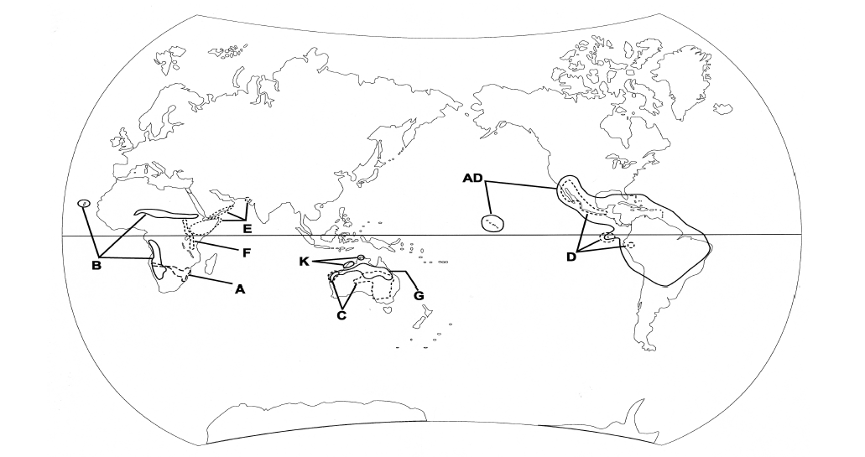
Wendel et. al. (2010)

Slide 10
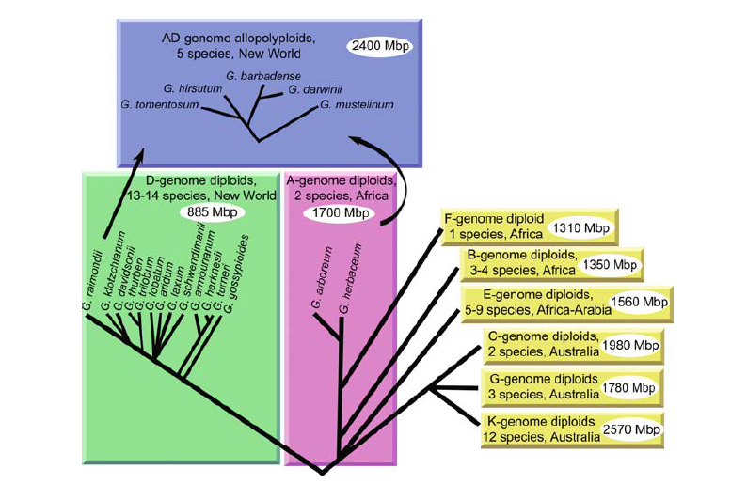
Wendel et. al. (2009)

Slide 11
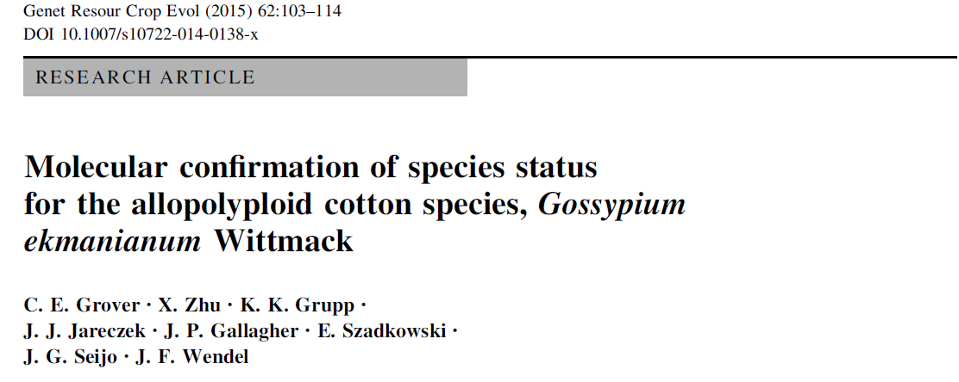

Slide 12
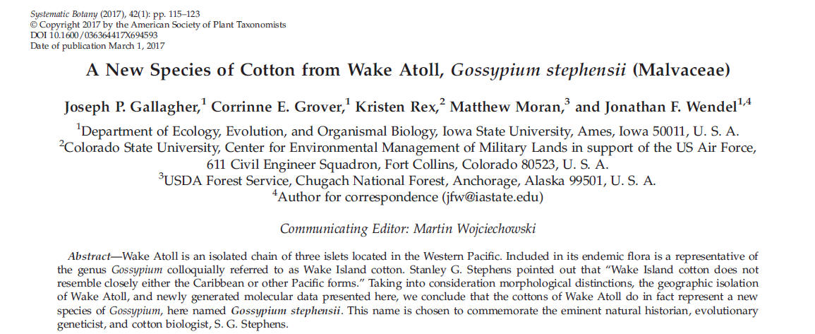

Slide 13
Gossypium gene pools
Primary gene pool:
G. hirsutum
G. barbadense
G. darwinii
G. tomentosum
G. mustelinum
G. ekmanianum
G. stephensii
Secondary gene pool:
A, D, B, and F genome species
Tertiary gene pool:
C, E, G, and K genome species

Slide 14
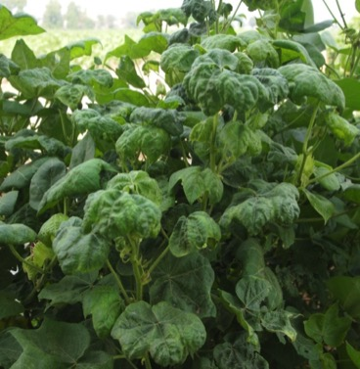
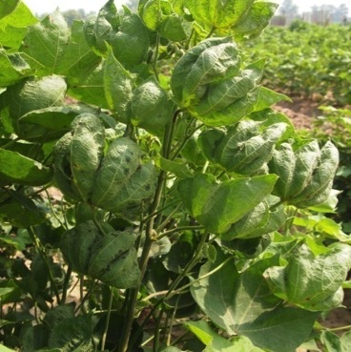
Cotton leaf curl disease (CLCuD) is the most important disease of American cotton in North India, Pakistan, and China.

Slide 15
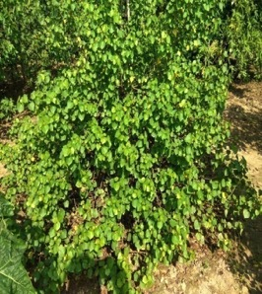
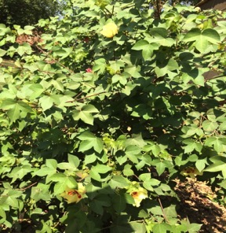
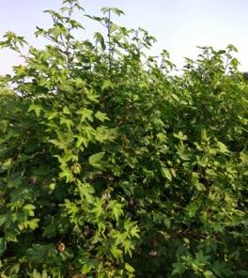
Donors for CLCuD resistance
G. armourianum
(DD)
Synthetic Allotetraploid
G. arboreum
(AA)

Slide 16

G. armourianum

Slide 17
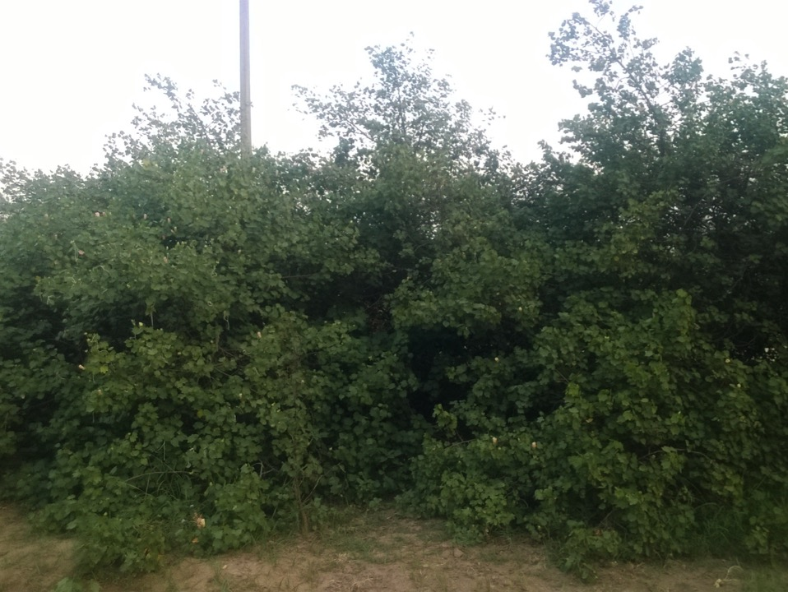
F₁ hybrid between G. hirsutum x G. armourianum

Slide 18
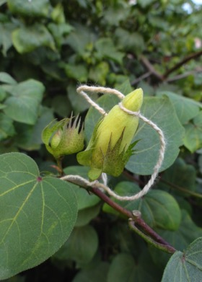
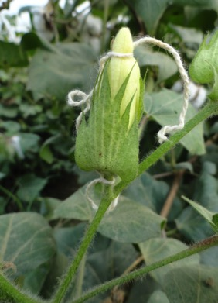
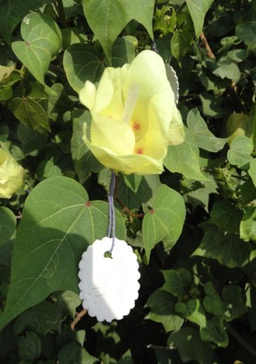
Development of BC₁F₁
Prevention of pollen contamination on female parent
Prevention of pollen contamination on male parent
Pollination

Slide 19
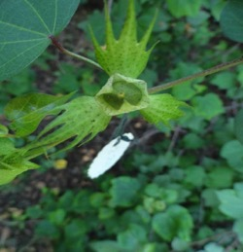
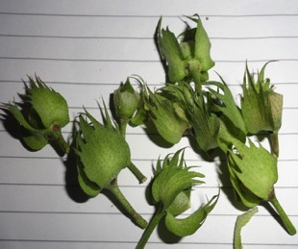
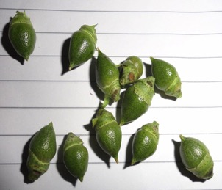
Application of growth regulators
A mixture of growth regulators (GA₃ @ 50 ppm + NAA @ 100 ppm) for 3 consecutive day after pollination.

Slide 20
Cross | Number of pollinations made | Number of bolls picked for culturing 3 DAP | Number of ovules cultured
F₁ x F 1861 | 140 | 121 | 2420
F₁ x LH 2108 | 145 | 129 | 2580
F₁ x F 846 | 117 | 99 | 1980
F₁ x PIL 8 | 117 | 103 | 2060
F₁ x PIL 43 | 126 | 109 | 2180
F₁ x F 2164 | 109 | 94 | 1880
F₁ x LH 900 | 130 | 111 | 2220
F₁ x LH 1556 | 109 | 98 | 1960
F₁ x LH 2107 | 104 | 87 | 1740
F₁ x LH 2076 | 98 | 71 | 1420
Total | 1195 | 1042 | 20440

Slide 21
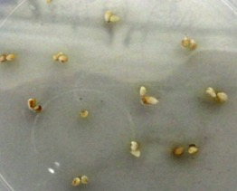
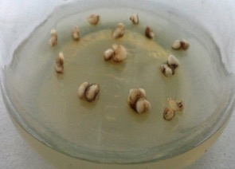
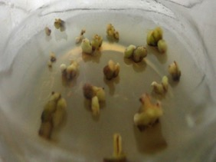
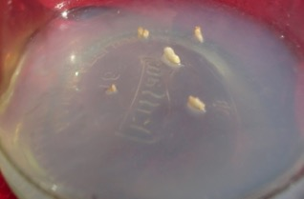
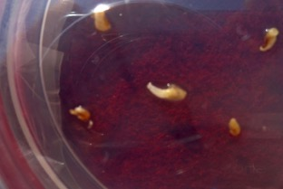
Ovule Culture
One week old ovules
One month old ovules
Three months old ovules
Dead and atrophied embryos excised from three months old ovules

Slide 22
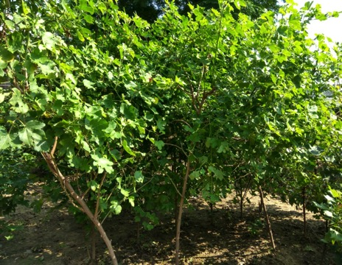
Development of BC₁F₁ through direct hybridization between F₁ hybrid (G. hirsutum x G. armourianum) and G. hirsutum
No. of pollinations | Seeds obtained | Seeds germinated
15898 | 5 | 4
4 BC₁F₁ plants
2 resistant to CLCuD
2 susceptible to CLCuD

Slide 23
Development of BC₂F₁ population
Plant No. | No. of flowers pollinated | Seeds obtained/ sown | Seeds germinated | Per cent germination
2 (R) | 464 | 1551 | 129 | 8.7
3 (R) | 306 | 50 | 0 | 0

Slide 24
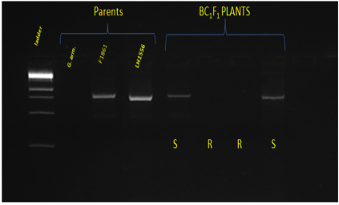
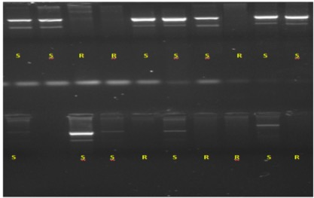
Confirmation of CLCuD resistance/susceptibility using virus specific markers
Total genomic DNA from the individual CLCuD resistant and susceptible BC₁F₁ as well as BC₂F₁ plants was extracted and amplified using virus specific primers.
Presence of virus was detected in CLCuD susceptible plants, whereas no virus specific bands could be amplified in the CLCuD resistant plants.
A
B
Confirmation of CLCuD resistance and susceptibility in the parents, BC₁F₁ (A) and BC₂F₁ plants (B)

Slide 25
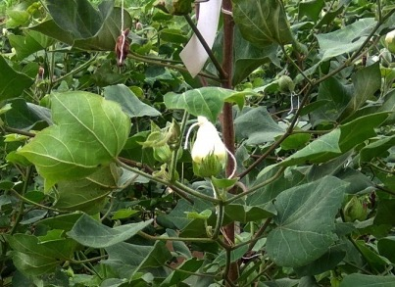
Development of BC₂F₂ seeds
Individual BC₂F₁ plants were self-fertilized to produce BC₂F₂ seeds. During kharif 2018 crop season, individual plant to progenies would be grown for the identification of SSR marker(s) linked to CLCuD resistance.

Slide 26
Marker analysis of parents and backcross derivatives
A total of 114 microsatellite markers were used to distinguish G. armourianum acc. PAU 1 and G. hirsutum parental lines at the molecular level, of which 8 primers did not amplify. Of the remaining 106 markers, 57 (53.7%) were observed to be polymorphic.
Total number of amplified SSR markers | Number of polymorphic markers | Per cent polymorphism
106 | 57 | 53.7
These 57 polymorphic markers between the parental species were employed to detect the presence of introgressed segment in the CLCuD resistant BC₁F₁ plant that was used for the development of BC₂F₁ population. Eight microsatellite markers detected the presence of introgressed segments in the CLCuD resistant BC₁F₁ plant.
Primers detecting the introgression from G. armourianum in the BC₁F₁ plant
BNL 2667, BNL 3065, BNL 3806, TMB 0436, TMB 1271, NAU 0905, NAU 6316, and JESPR 0056

Slide 27
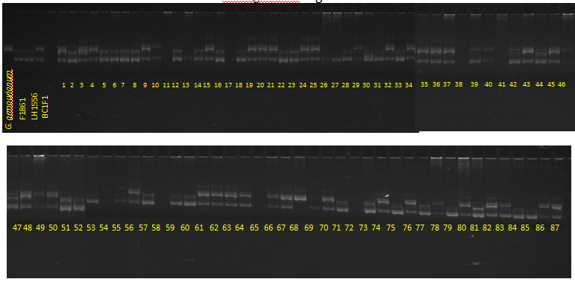
Fig. Introgressed G. armourianum specific segments in the BC₂F₁ population

Slide 28
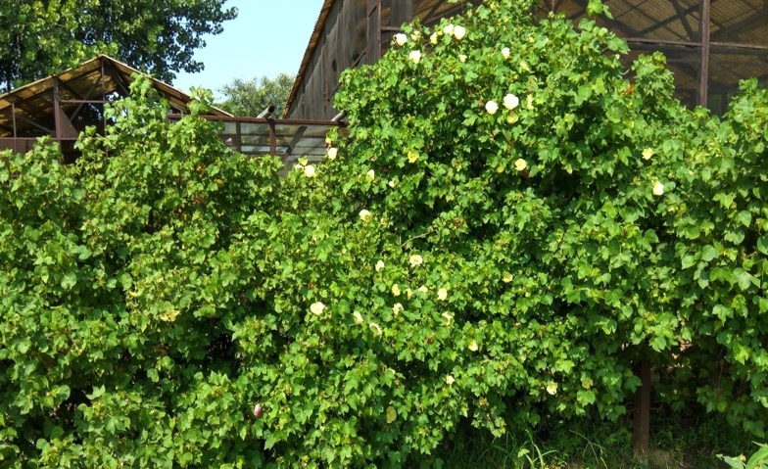
Donor 2: Synthetic Allotetraploid

Slide 29
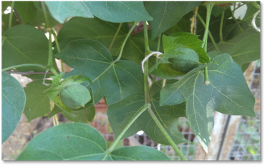
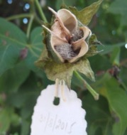
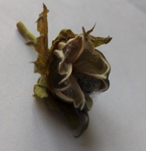
Flowers pollinated: 3158
Mature crossed bolls obtained: 28
Seeds obtained: 25
Crossed bolls retained on the Synthetic amphidiploid
Opened bolls containing F₁ seeds

Slide 30
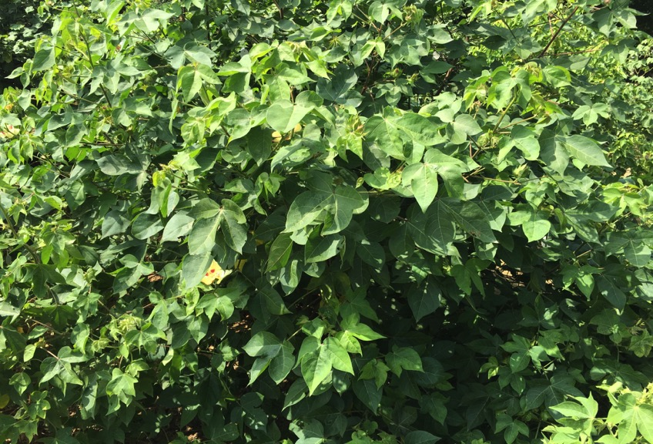
F₁ hybrids between G. hirsutum Acc. PIL 43 x Synthetic amphiploid

Slide 31
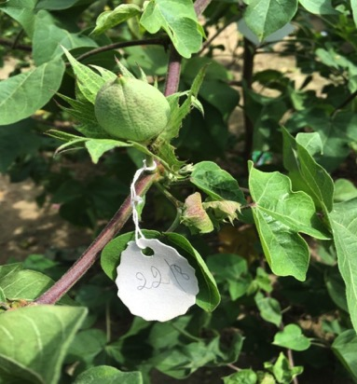
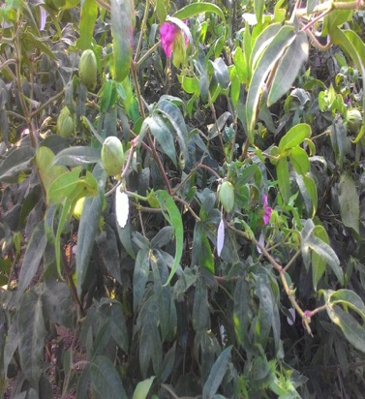
a
b
Back crosses : (a) F₁ (SA x PIL 43); (b) PIL 43 x SA

Slide 32
Backcross | Flowers pollinated | Bolls set | Per cent setting | Seeds obtained
 |  |  |  | 1868
F₁ x PIL 43 | 2173 | 15 | 0.69
PIL 43 x F₁ | 5261 | 92 | 1.74

Slide 33
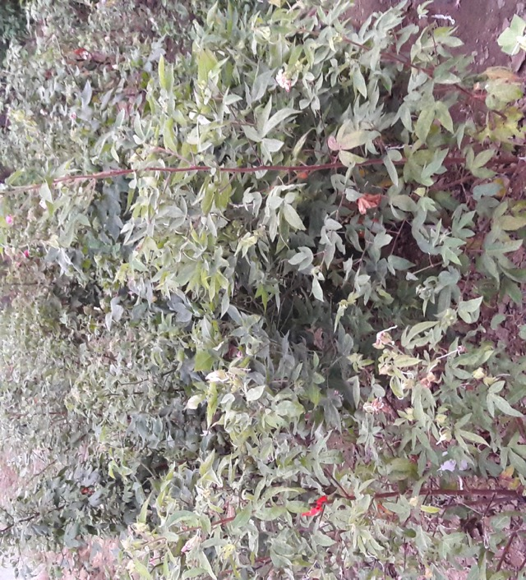
Field view of BC₁F₁ population

Slide 34
Documentation of polymorphism between Synthetic tetraploid and American cotton
A total of 305 SSR primer pairs have been employed to detect polymorphism between the parental lines, of which 123 markers were observed to be polymorphic.
Total number of SSR markers used | Number of polymorphic markers | Per cent polymorphism
305 | 123 | 40.3

Slide 35
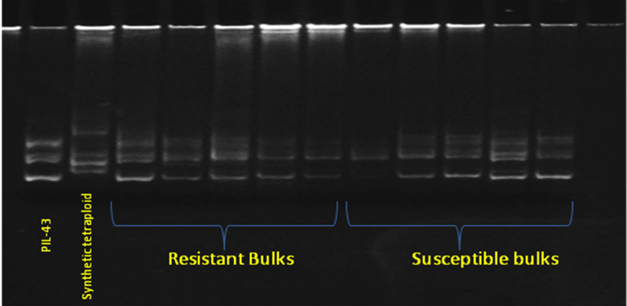
Bulked Segregant Analysis
CLCuD resistant and susceptible plants were identified after field screening. The DNA from the individual plants was extracted and bulks (of resistant and susceptible plants) were made. The polymorphic SSR markers between the parents are being used to find out uncommon bands between the bulks.
BSA in the CLCuD resistant and susceptible bulks in the BC₁F₁ generation

Slide 36
Development of interspecific hybrids between G. hirsutum and G. arboreum
American cotton lines namely LH 2108, LH 2107, LH 1556, LH 900, and F 846 were used as female parents and were pollinated with desi cotton lines viz., LD 949, LD 909, LD 902, and LD 491.
A total of 12392 flowers were pollinated and 621 seeds were obtained.
Four of the plants were found to be true interspecific hybrids.
Nevertheless, the interspecific hybrids between G. hirsutum x G. arboreum were back crossed with the recurrent American cotton parent and 140 BC₁F₁ seeds were recovered.

Slide 37
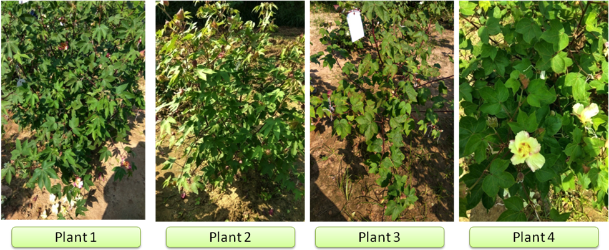












Interspecific F₁ hybrids between G. hirsutum x G. arboreum

Slide 38
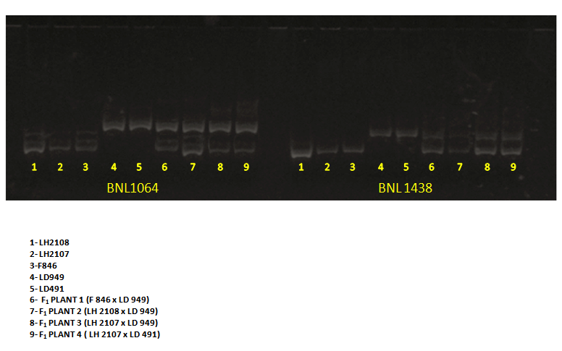
Molecular confirmation of F₁ hybrids using SSR markers

Slide 39
Attitudes are more important than facts.
(Karl Menninger)

Slide 40


Acknowledgements
Punjab Agricultural University
International Cotton Advisory Committee

