Slide 1
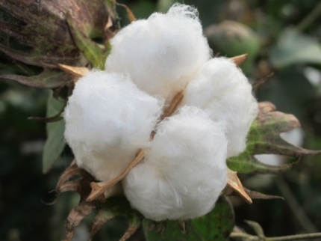

Construct a High-density Genetic Map and Its Application to Genetic Regulation Analysis for Yield and Fiber Quality Traits
Youlu Yuan
Institute of Cotton Research, CAAS
State Key Laboratory of Cotton Biology China
yuanyoulu@caas.cn

Slide 2
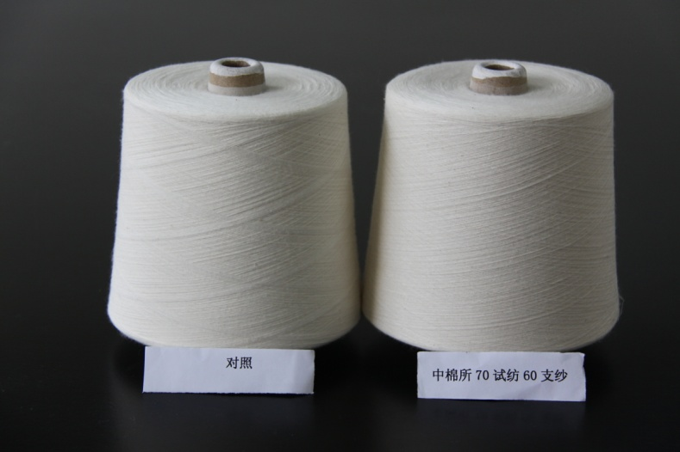
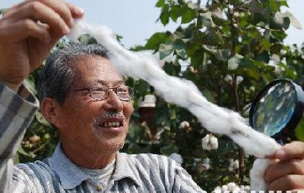
♦ Cotton plays a important role in the world economy by producing natural fiber for textile industry and edible oil for human consumption
♦ Modern high-speed textile operations around the world require long, strong and fine cotton fibers.

Slide 3
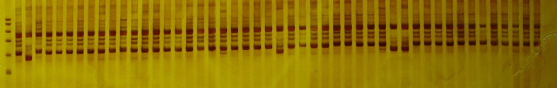
♦Conventional breeding procedure had difficulty in further improving fiber quality due to its high cost, long duration, and low selective efficiency.
♦ DNA markers provide an opportunity to overcome the shortcoming of conventional breeding in cotton.

Slide 4
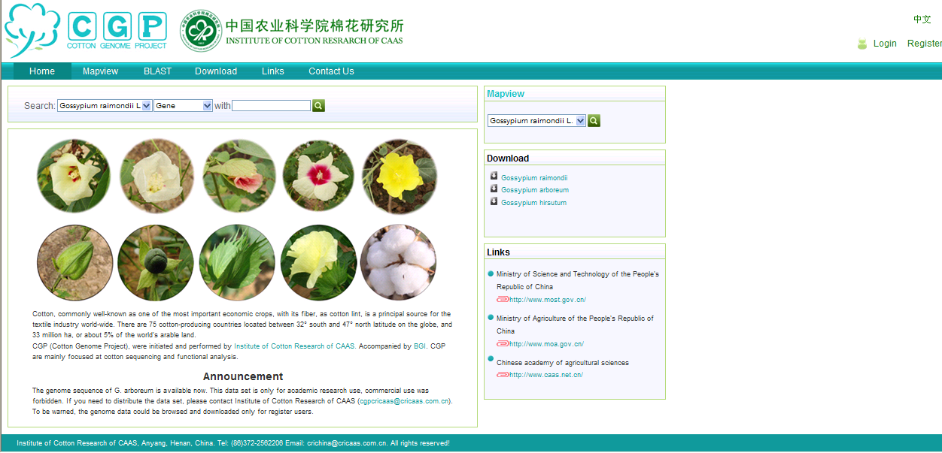

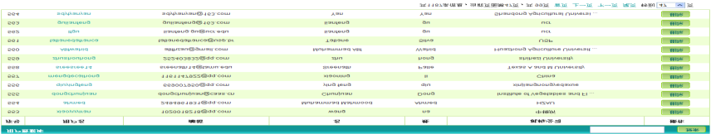
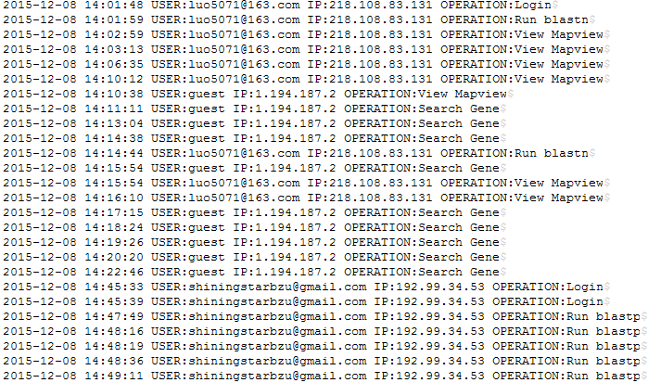
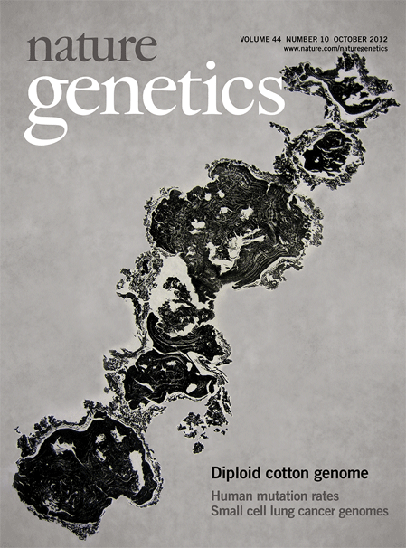
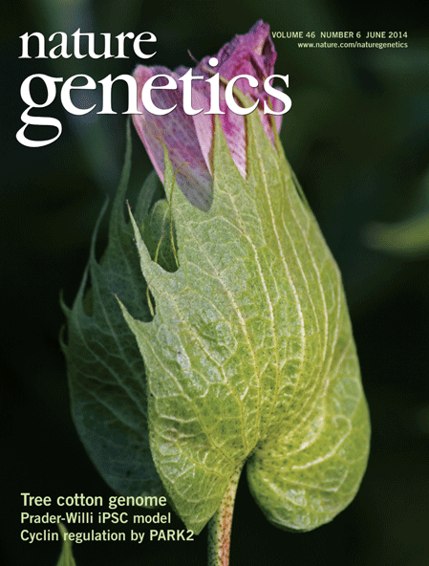

The progress of cotton genome research in China
the sequencing of (Gossypium raimondii)(2012 , 2013)
the sequencing of Gossypium arboreum）(2014)
the sequencing of Gossypium hirsutum and Gossypium barbadense(2015,2016)
1.Nature Genetics, 2012
2.Nature ,2012
3.Nature Gen, 2014
4.Nature Biotech,2015
5.Nature biotech,2015
6.Scientific Reports,2015
7.Scientific Reports,2015

Slide 5
Major marker
Genetics map construction with SSR markers
Genetics map construction with SNP markers discovered by cotton63K chip
Genetics map construction with SNP markers discovered by SLAF-Seq (specific locus amplified fragment sequencing )
Genome-wide consensus map construction and its utilization

Slide 6
Genetics map construction and QTL identification with SSR markers

Slide 7
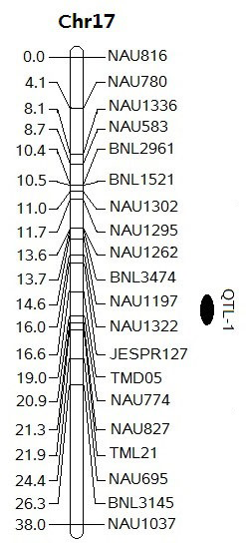
Cotton fiber quality molecular marker-assisted selection
Shen et al. (2001), Guo et al. (2005),and Shi et al. (2007)
one Major QTL of fiber strength from：7235
developed by crossing G. anomalum with G. hirsutum L., then backcrossing with Acala 3080 and PD 4381
Zhang and Yuan et al., (2003),TAG
Shen et al.,(2005), Mol Breed

Slide 8
Up to 2001,A few stable or common QTLs have been reported
►►Therefore, we constructed F₂, F_{2:3}, and RILs populations to screen stable QTL associated to fiber quality across multiple generations and environments.

Slide 9
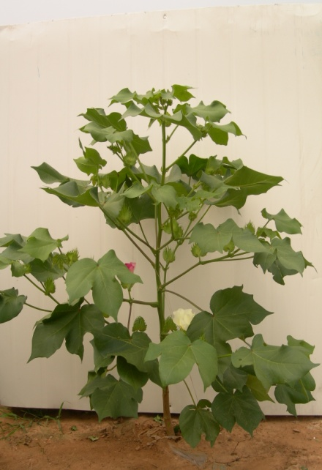
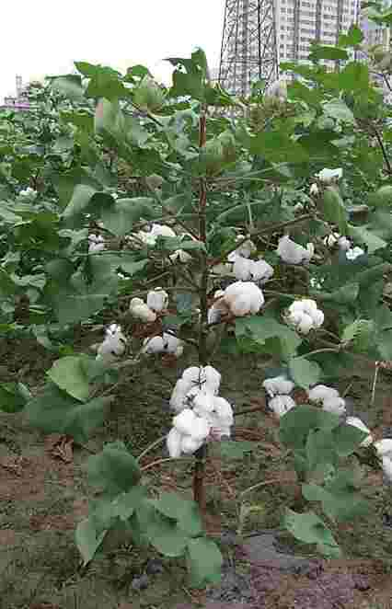
Parents selection
0-153:
G. arboreum introgression line with superior fiber quality from Sichuan agricultural university
sGK9708:
the selected line from the commercial transgenic cultivar CCRI41, resistant to budworm, bred in cotton research institute, CAAS, China
0-153
sGK9708

Slide 10
Year | parents | Fiber strength cN/tex | Fiber length mm | Micronaire
2003 Anyang | sGK9708 | 25.00±0.31 | 27.22±0.14 | 3.94±0.11
 | 0-153 | 32.31±0.72 | 28.55±0.38 | 4.33±0.19
2004 Anyang | sGK9708 | 25.00±0.21 | 28.68±0.11 | 4.39±0.11
 | 0-153 | 35.88±0.44 | 29.04±0.20 | 4.29±0.07
2007 Anyang | sGK9708 | 25.65±1.20 | 27.44±0.01 | 4.68±0.18
 | 0-153 | 33.75±1.06 | 31.14±0.17 | 4.50±0.09
2008 Anyang | sGK9708 | 25.60±0.71 | 28.18±0.08 | 5.35±0.12
 | 0-153 | 32.60±0.85 | 31.24±0.06 | 5.00±0.13
2008 Quzhou | sGK9708 | 26.70±1.56 | 27.54±0.87 | 5.37±0.03
 | 0-153 | 34.50±0.57 | 30.21±0.51 | 4.28±0.11
2008 Linqing | sGK9708 | 24.20±0.28 | 26.67±0.11 | 5.19±0.14
 | 0-153 | 33.40±1.27 | 30.00±0.68 | 4.54±0.23

Slide 11
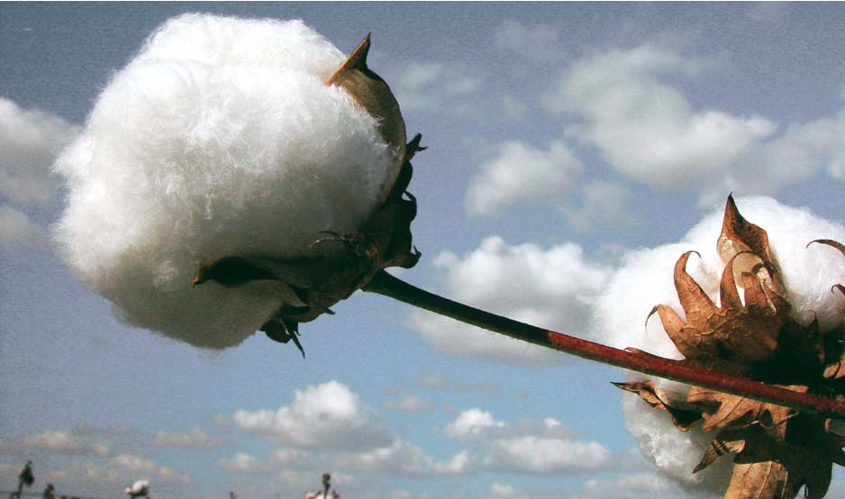
Procedure of RIL construction
sGK9708♀×0-153♂
↓
F₁
↓U
F₂
↓U
F _{2：3}
F _{2：6}
F _{6：8(RIL)}
250 plants grown in Anyang Henan Province
in 2003
196 family lines were selected in 2004
Two plants were selected for purification
Grown in Anyang in 2007 and
in Anyang, Quzhou Hebei Province,
Linqing Shandong Province in 2008
Sun et al.Mol Breeding,2012

Slide 12
The 22 environments conducted for RIL evaluation
Year | En.1 | En.2 | En.3 | En.4
2007 | Anyang | - | - | -
2008 | Anyang | Quzhou | Linqing | -
2009 | Anyang | Linqing | Akesu | -
2010 | Anyang | Gaoyi | Zhengzhou | -
2011 | Anyang | Zhengzhou | - | -
2012 | Zhengzhou | - | - | -
2013 | Anyang | - | - | -
2014 | Anyang | Alaer | Shihezi | Kuerle
2015 | Anyang | Alaer | Shihezi | Kuerle

Slide 13
Marker analysis (to 2009)
♦Cotton genome DNA extraction: Paterson et al.(1993) with some modification
F₂(183) RIL(196)
♦ A total of 5742 SSR primer pairs were used to screen for polymorphism between the two parents
BNL (Brookhaven National Laboratory, NY),NAU (Nanjing Agricultural University, China),
CIR(French Agricultural Research Centre for InternationalDevelopment, FRA),
CM and JESPR (Texas A&M University, USA), TM and MGHES (USDA-ARS, Texas),
MUCS and MUSS (University of California Davis, USA), and DPL (Delta and Pine Land, USA).
►201 SSRs (3.5%) showed polymorphisms between the two parents

Slide 14
F₂ population (183 plants)
♣Of 229 polymorphic loci,155 were localized into 26 linkage groups, covering a total map distance of 959.4 cM, approximately 21.32% of the total length of the cotton genome (Rong et al. 2004).
♣ One hundred and ten loci (48.0%) showed severe segregation distortions

Slide 15
Part of linkage groups for F₂ population

Slide 16
RIL population (196 lines)
♣ Of 217 polymorphic loci, 190 loci were localized into 34 linkage groups with a total map distance of 700.9 cM, approximately 15.75% of the total length of the cotton genome.
♣ Severe segregation distortions were observed with 93 (43.3%) out of 217 loci.

Slide 17
9 QTLs could be identified in both early and advanced generations
Traits | QTL | Population | R²%
Strength(2) | qFS-C7-1 | F₂ and F_{2:3} , RILs (07AY, 08AY, 08QZ, and 08LQ) | 17.73—27.86
 | qFSC25-1 | F₂ and F_{2:3} , RILs (07AY, 08AY, 08QZ, and 08LQ) | 14.25—21.36
Length(1) | qFL-C7-1 | F₂ and F_{2:3} , RILs (08LQ)
Micronaire(4) | qFM-C7-1 | F_{2:3} , RILs (07AY, 08AY, 08QZ)
 | qFM-C14-1 | F_{2:3} , 08QZ
 | qFM-C16-1 | F_{2:3} and 08LQ
 | qFM-C19-1 | F_{2:3} ,07AY and 08AY.
uniformity (1) | qFU-C7-1 | F_{2:3} ,07AY, 08AY
Elongation(1) | qFE-C15-1 | F₂ and F_{2:3} , RILs (07AY, 08AY)
Sun et al.Mol Breeding,2012

Slide 18
The genetic map constructed by SSR markers
The map harbored 793 markers and spanned a total distance of 4110cM with 5.2cM between adjust markers, covered the 93.2% of the whole genome of upland cotton(to 2016)
Marker’s Name | Number | % | Marker’s Name | Number | %
SWU | 321 | 41% | DOW | 9 | 1%
NAU | 133 | 17% | JESPR | 7 | 1%
CGR | 47 | 6% | CSHES82a | 7 | 1%
DPL | 41 | 5% | MUCS | 6 | 1%
HAU | 40 | 5% | CER | 5 | 1%
BNL | 24 | 3% | COT | 5 | 1%
PGML | 24 | 3% | DC | 5 | 1%
GH | 23 | 3% | ICRI | 4 | 1%
NBRI | 19 | 2% | CM | 3 | 0%
MUSS | 14 | 2% | TMK | 2 | 0%
SHH | 13 | 2% | TMP | 2 | 0%
SHIN | 10 | 1% | MGHES | 1 | 0%
TMB | 9 | 1% | C2 | 1 | 0%
CIR | 9 | 1%

Slide 19
QTL identification by SSR Map:
Trait | Total QTL | Stable QTL | QTL with the most environment | QTL with the largest PVE
Fiber length | 31 | 14 | 6 | 13.1 %
Fiber uniformity | 32 | 5 | 6 | 18.2 %
Micronaire | 35 | 10 | 5 | 16.7%
Fiber elongation | 32 | 10 | 5 | 17.9 %
Fiber strength | 35 | 8 | 7 | 26.7 %
total | 165 | 47
Jamshed et al. BMC Genomics (2016) 17:197

Slide 20
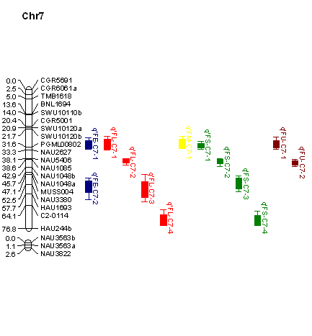
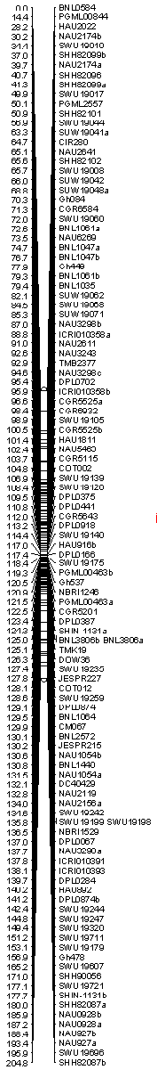
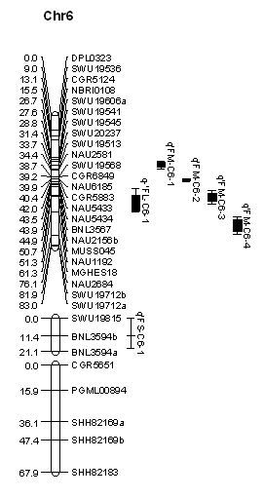
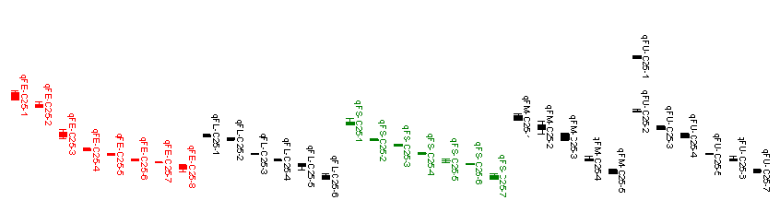
Chr 25 Chr 7 Chr 6

Slide 21
Genetics map construction and QTL identification with SNP markers discovered by cotton63K chip
Zhang zhen etal., Crop Sci. 2017，57:774–788

Slide 22
Map constructed by 63K SNP Array

Slide 23
Map constructed by 63K SNP Array
No.Chromosome | Total of SSR.Markers | Total of SNP Markers | Total of Markers | SDMs_Num | SDMs_Per | Genetic Distance (cM) | Average Distance (cM) | Max Gap | No.Gap more than 5cM | X2_Value | P_Value | SDR_Region
Chr1 | 5 | 107 | 112 | 35 | 31.20% | 125.42 | 1.13 | 8.27 | 5 | 5.48 | 0.20 | 3
Chr2 | 4 | 54 | 58 | 9 | 15.50% | 74.52 | 1.31 | 4.34 | 0 | 2.26 | 0.48 | 1
Chr3 | 7 | 100 | 107 | 27 | 25.20% | 98.42 | 0.93 | 4.46 | 0 | 4.21 | 0.35 | 1
Chr4 | 6 | 60 | 66 | 8 | 12.10% | 87.29 | 1.34 | 7.48 | 1 | 4.20 | 0.25 | 0
Chr5 | 5 | 119 | 124 | 45 | 36.30% | 102.49 | 0.83 | 5.56 | 1 | 6.89 | 0.19 | 2
Chr6 | 3 | 43 | 46 | 20 | 43.50% | 52.85 | 1.17 | 4.54 | 0 | 14.43 | 0.19 | 1
Chr7 | 2 | 97 | 99 | 9 | 9.10% | 123.93 | 1.27 | 10.32 | 3 | 2.83 | 0.39 | 0
Chr8 | 0 | 21 | 21 | 8 | 38.10% | 125.75 | 6.29 | 28.17 | 6 | 15.80 | 0.27 | 1
Chr9 | 3 | 91 | 94 | 24 | 25.50% | 104.60 | 1.13 | 7.92 | 7 | 6.90 | 0.29 | 2
Chr10 | 0 | 68 | 68 | 38 | 55.90% | 95.37 | 1.42 | 6.93 | 4 | 21.46 | 0.16 | 2
Chr11 | 2 | 28 | 30 | 3 | 10.00% | 121.62 | 4.19 | 11.44 | 10 | 2.71 | 0.41 | 0
Chr12 | 2 | 89 | 91 | 11 | 12.10% | 106.61 | 1.19 | 5.51 | 3 | 3.41 | 0.24 | 0
Chr13 | 5 | 151 | 156 | 76 | 48.70% | 162.05 | 1.05 | 5.18 | 1 | 5.24 | 0.09 | 2
Chr14 | 6 | 305 | 311 | 217 | 69.80% | 169.93 | 0.55 | 5.96 | 1 | 10.64 | 0.12 | 2
Chr15 | 4 | 27 | 31 | 7 | 22.60% | 95.96 | 3.20 | 10.16 | 6 | 4.38 | 0.21 | 0
Chr16 | 3 | 175 | 178 | 72 | 40.40% | 194.96 | 1.10 | 13.59 | 5 | 11.55 | 0.22 | 3
Chr17 | 1 | 60 | 61 | 7 | 11.50% | 96.45 | 1.61 | 13.37 | 3 | 2.52 | 0.43 | 0
Chr18 | 1 | 96 | 97 | 8 | 8.20% | 126.18 | 1.31 | 13.89 | 4 | 2.64 | 0.27 | 0
Chr19 | 1 | 56 | 57 | 11 | 19.30% | 100.59 | 1.80 | 9.71 | 6 | 3.81 | 0.39 | 1
Chr20 | 1 | 62 | 63 | 19 | 30.20% | 92.47 | 1.49 | 10.75 | 5 | 10.49 | 0.24 | 2
Chr21 | 2 | 89 | 91 | 5 | 5.50% | 103.81 | 1.15 | 4.79 | 0 | 1.78 | 0.46 | 0
Chr22 | 2 | 64 | 66 | 8 | 12.10% | 98.40 | 1.51 | 9.89 | 3 | 2.29 | 0.43 | 1
Chr23 | 0 | 131 | 131 | 62 | 47.30% | 114.01 | 0.88 | 8.30 | 2 | 16.12 | 0.14 | 2
Chr24 | 1 | 46 | 47 | 7 | 14.90% | 89.03 | 1.94 | 5.46 | 1 | 6.95 | 0.29 | 1
Chr25 | 8 | 121 | 129 | 93 | 72.10% | 93.43 | 0.73 | 3.93 | 0 | 18.49 | 0.06 | 3
Chr26 | 3 | 56 | 59 | 5 | 8.50% | 109.62 | 1.89 | 7.68 | 3 | 3.19 | 0.38 | 0
Total | 77 | 2316 | 2393 | 834 | - | 2865.73 | 1.20 | 28.17 | 80 | - | - | 30

Slide 24
QTL identification by Chip Map:
1. This research identified 63 QTLs for fiber strength and 16 of them were stable.
2. These stable QTLs could explain 4.24%-13.55% of the observed phenotypic variation.

Slide 25
Genetics map construction and QTL identification for boll weight with SNP markers discovered by SLAF-Seq
Zhang zhen etal. BMC plant biology, 2016

Slide 26
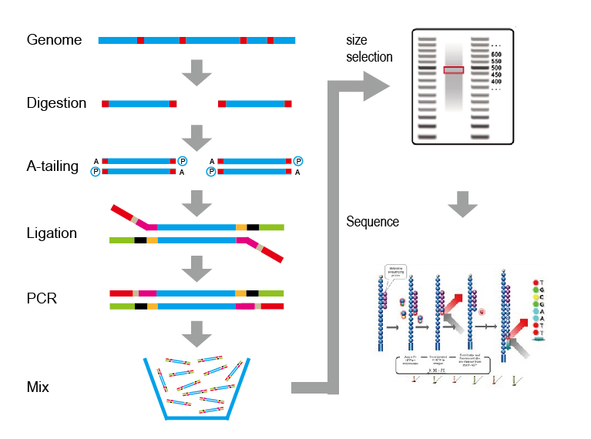
The Technical process of the SLAF-seq
Enzyme digestion
Modification of restriction fragment
Connect the adapter
PCR
Mix the Sample
Cataphoresis and select the restriction fragments that were fitness

Slide 27
Map constructed by SLAF-Seq:

Slide 28
Map constructed by SLAF-Seq:
Chromosome Number | Marker Number | Total Distance | Average Distance | Largest Gap | Nmuber of Gap(>5cM) | Number of SDMs | Persentage of SDMs | X²_Value | P_value | SDR Region | Number of RHs
Chr01 | 297 | 140.42 | 0.47 | 4.48 | 0 | 82 | 27.61% | 2.50 | 0.28 | 9 | 32
Chr02 | 180 | 136.88 | 0.76 | 5.42 | 1 | 12 | 6.67% | 1.36 | 0.44 | 1 | 35
Chr03 | 218 | 159.93 | 0.73 | 4.15 | 0 | 47 | 21.56% | 2.36 | 0.40 | 4 | 0
Chr04 | 574 | 142.01 | 0.25 | 3.61 | 0 | 27 | 4.70% | 1.14 | 0.43 | 0 | 86
Chr05 | 434 | 242.56 | 0.56 | 4.22 | 0 | 106 | 24.42% | 2.46 | 0.29 | 10 | 0
Chr06 | 101 | 92.62 | 0.92 | 4.76 | 0 | 26 | 25.74% | 2.37 | 0.43 | 1 | 16
Chr07 | 318 | 132.96 | 0.42 | 3.56 | 0 | 36 | 11.32% | 1.58 | 0.35 | 1 | 1
Chr08 | 56 | 45.12 | 0.81 | 3.56 | 0 | 13 | 23.21% | 2.32 | 0.26 | 0 | 0
Chr09 | 274 | 156.33 | 0.57 | 5.07 | 1 | 60 | 21.90% | 2.30 | 0.32 | 5 | 55
Chr10 | 133 | 113.33 | 0.85 | 6.69 | 3 | 17 | 12.78% | 1.86 | 0.32 | 1 | 32
Chr11 | 88 | 112.62 | 1.28 | 5.71 | 1 | 24 | 27.27% | 2.50 | 0.30 | 3 | 0
Chr12 | 273 | 178.26 | 0.65 | 5.07 | 1 | 85 | 31.14% | 2.85 | 0.28 | 8 | 37
Chr13 | 604 | 185.33 | 0.31 | 4.15 | 0 | 44 | 7.28% | 1.43 | 0.40 | 1 | 106
Chr14 | 408 | 173.03 | 0.42 | 4.46 | 0 | 238 | 58.33% | 4.98 | 0.18 | 18 | 67
Chr15 | 29 | 41.39 | 1.43 | 3.56 | 0 | 8 | 27.59% | 2.76 | 0.33 | 1 | 1
Chr16 | 399 | 178.54 | 0.45 | 3.61 | 0 | 152 | 38.10% | 3.38 | 0.28 | 13 | 0
Chr17 | 102 | 101.64 | 1 | 4.79 | 0 | 9 | 8.82% | 1.28 | 0.43 | 0 | 29
Chr18 | 172 | 136.45 | 0.79 | 5.07 | 1 | 43 | 25.00% | 2.67 | 0.27 | 3 | 1
Chr19 | 109 | 94.13 | 0.86 | 4.76 | 0 | 18 | 16.51% | 2.10 | 0.35 | 2 | 24
Chr20 | 60 | 48.44 | 0.81 | 4.15 | 0 | 9 | 15.00% | 2.27 | 0.28 | 0 | 11
Chr21 | 174 | 163.73 | 0.94 | 5.71 | 1 | 29 | 16.67% | 1.77 | 0.43 | 2 | 40
Chr22 | 75 | 65.91 | 0.88 | 4.46 | 0 | 4 | 5.33% | 1.22 | 0.50 | 0 | 14
Chr23 | 142 | 127.61 | 0.9 | 4.76 | 0 | 31 | 21.83% | 2.26 | 0.32 | 3 | 36
Chr24 | 60 | 76.99 | 1.28 | 4.76 | 0 | 6 | 10.00% | 1.39 | 0.47 | 0 | 12
Chr25 | 166 | 124.21 | 0.75 | 5.39 | 1 | 84 | 50.60% | 4.62 | 0.16 | 6 | 39
Chr26 | 75 | 88.93 | 1.19 | 7.02 | 1 | 15 | 20.00% | 2.13 | 0.35 | 1 | 19
Total | 5521 | 3259.37 | 0.78 | 7.02 | 11 | 1225 | -- | -- | -- | 93 | 693

Slide 29
QTL identification by SLAF-Seq Map:
1. This research identified 146 QTLs for boll weight and 16 of them were stable.
2. These stable QTLs could explain 4.15%-14.70% of the observed phenotypic variation.

Slide 30
Genome-wide consensus map construction and its utilization
The three maps comparison:
Map | Total Markers | Total Distance | Average Distance
SSR Map | 793 | 4110 cM | 5.2 cM
SLAF-Seq Map | 5521 | 3259.37 cM | 0.78 cM
Chip Map | 2398 | 2,856.73 cM | 1.20 cM
combine | 8295 | 5197.17 | 0.88

Slide 31
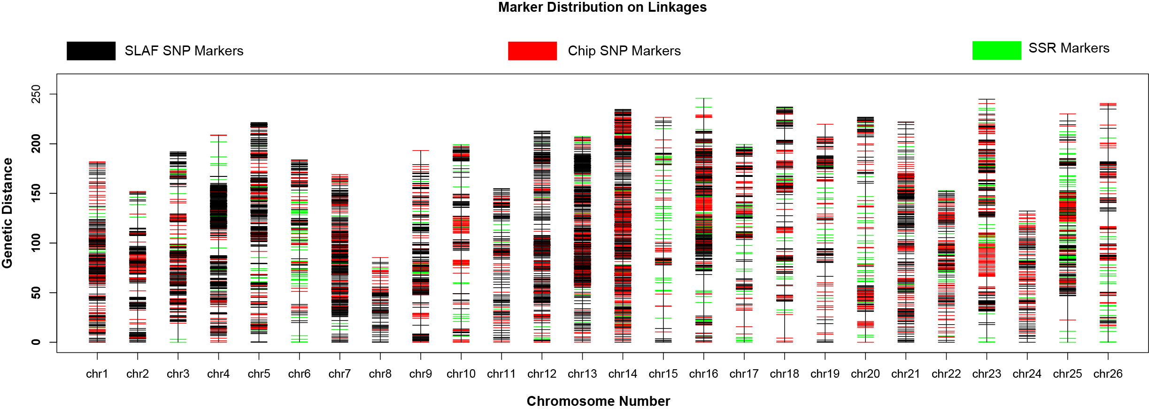
The combine genetic map:

Slide 32
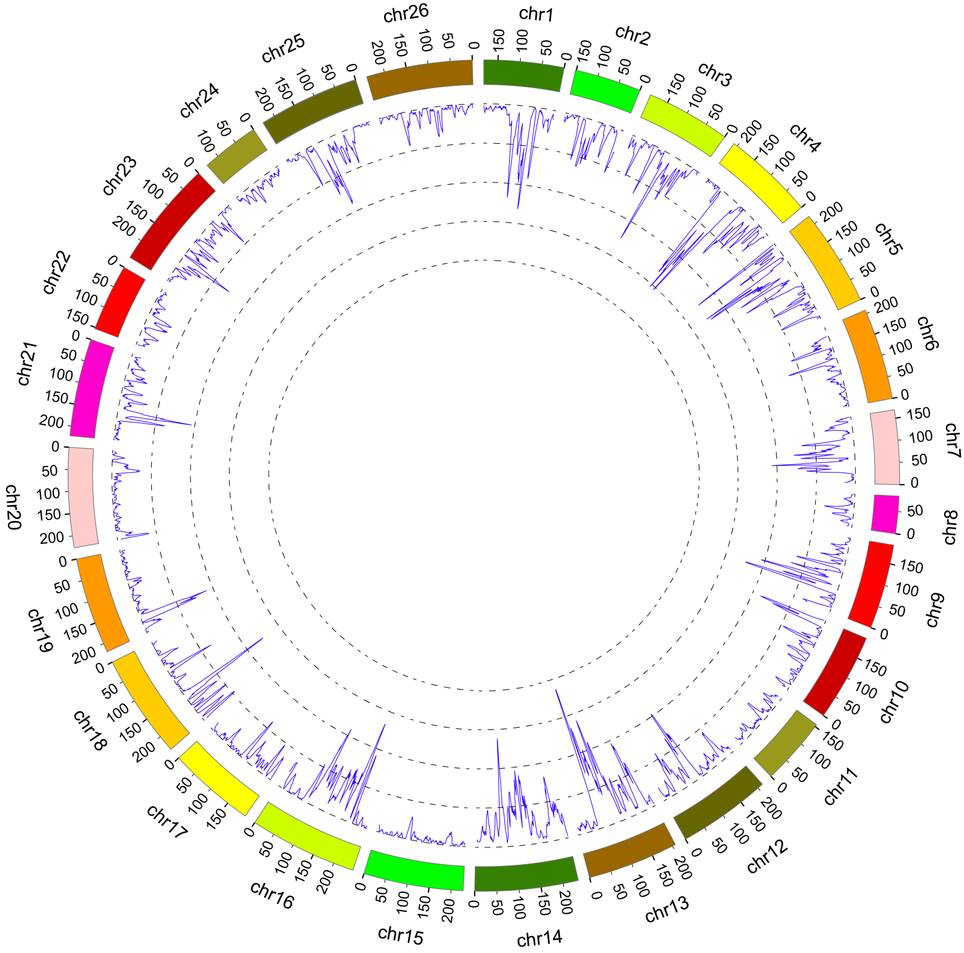
Fig 1. Marker density analysis across the whole genome in the integrated linkage map

Slide 33
The detail information of the combine map:
No.Chr | MarkerNum | Total_CM | Aver_CM | Largest Gap | SLAF Marker Num | ChipNum | SSRNum | Nmuber of Gap(>5cM) | Number of SDMs（P=0.05） | Percentage of SDMs | X²_Value | P_value | SDR Region | Number of RHs
chr01 | 414 | 181.81 | 0.44 | 6.766 | 297 | 108 | 9 | 1 | 119 | 28.74% | 2.84 | 0.21 | 3 | 38
chr02 | 238 | 151.99 | 0.64 | 11.182 | 180 | 54 | 4 | 6 | 21 | 8.82% | 1.32 | 0.45 | 2 | 31
chr03 | 329 | 191.94 | 0.59 | 16.295 | 218 | 100 | 11 | 5 | 68 | 20.67% | 2.35 | 0.48 | 3 | 32
chr04 | 646 | 208.85 | 0.32 | 15.122 | 574 | 60 | 12 | 7 | 8 | 1.24% | 0.94 | 0.47 | 1 | 32
chr05 | 571 | 221.34 | 0.39 | 8.128 | 434 | 119 | 18 | 5 | 196 | 34.33% | 2.87 | 0.29 | 5 | 19
chr06 | 181 | 207.63 | 1.15 | 16.981 | 101 | 42 | 38 | 3 | 76 | 41.99% | 6.80 | 0.35 | 4 | 17
chr07 | 422 | 168.99 | 0.4 | 4.763 | 318 | 97 | 7 | 0 | 29 | 6.87% | 1.13 | 0.45 | 2 | 37
chr08 | 78 | 85.3 | 1.11 | 4.79 | 56 | 21 | 1 | 0 | 20 | 25.64% | 7.01 | 0.31 | 1 | 19
chr09 | 376 | 193.16 | 0.52 | 14.155 | 274 | 91 | 11 | 5 | 90 | 23.94% | 2.60 | 0.40 | 7 | 26
chr10 | 218 | 199.12 | 0.92 | 9.899 | 133 | 68 | 17 | 11 | 74 | 33.94% | 9.36 | 0.24 | 2 | 21
chr11 | 120 | 154.86 | 1.3 | 5.388 | 88 | 28 | 4 | 1 | 5 | 4.17% | 1.55 | 0.33 | 1 | 25
chr12 | 368 | 212.73 | 0.58 | 4.763 | 273 | 89 | 6 | 0 | 89 | 24.18% | 2.61 | 0.24 | 5 | 44
chr13 | 766 | 207.22 | 0.27 | 5.074 | 604 | 151 | 11 | 1 | 64 | 8.36% | 1.67 | 0.36 | 6 | 41
chr14 | 727 | 234.63 | 0.32 | 2.977 | 408 | 305 | 14 | 0 | 477 | 65.61% | 7.32 | 0.15 | 2 | 57
chr15 | 85 | 226.61 | 2.7 | 13.196 | 29 | 27 | 29 | 18 | 8 | 9.41% | 1.49 | 0.38 | 1 | 16
chr16 | 620 | 245.76 | 0.4 | 16.17 | 399 | 175 | 46 | 8 | 202 | 32.58% | 5.37 | 0.28 | 5 | 45
chr17 | 184 | 199.41 | 1.09 | 16.587 | 102 | 60 | 22 | 10 | 11 | 5.98% | 1.01 | 0.51 | 1 | 22
chr18 | 286 | 236.88 | 0.83 | 23.662 | 172 | 96 | 18 | 15 | 52 | 18.18% | 2.10 | 0.31 | 4 | 18
chr19 | 180 | 219.65 | 1.23 | 13.951 | 109 | 56 | 15 | 14 | 50 | 27.78% | 2.67 | 0.35 | 5 | 15
chr20 | 150 | 226.79 | 1.52 | 13.514 | 60 | 62 | 28 | 12 | 43 | 28.67% | 6.03 | 0.34 | 4 | 30
chr21 | 271 | 221.93 | 0.82 | 5.44 | 174 | 89 | 8 | 2 | 8 | 2.95% | 0.90 | 0.53 | 2 | 44
chr22 | 149 | 152.86 | 1.03 | 4.763 | 75 | 64 | 10 | 0 | 2 | 1.34% | 0.54 | 0.65 | 0 | 16
chr23 | 302 | 244.88 | 0.81 | 13.294 | 142 | 131 | 29 | 7 | 109 | 36.09% | 7.95 | 0.22 | 6 | 25
chr24 | 109 | 132.17 | 1.22 | 3.905 | 60 | 46 | 3 | 0 | 16 | 14.68% | 1.82 | 0.43 | 1 | 19
chr25 | 353 | 230.04 | 0.65 | 24.358 | 166 | 121 | 66 | 7 | 249 | 70.54% | 12.16 | 0.10 | 8 | 45
chr26 | 152 | 240.62 | 1.59 | 16.073 | 75 | 56 | 21 | 12 | 22 | 14.47% | 1.86 | 0.42 | 3 | 18
Total | 8295 | 5197.17 | 0.88 | 24.358 | 5521 | 2316 | 458 | 150 | 2108 | -- | -- | -- | 84 | 752

Slide 34
Statistical analysis of the parents and the RIL population across 22 environments
Traits | Parents† |  |  |  | RIL population
 | P1 | P2 | P1-P2 | P-value | Range | Average | standard error | SD | variance | Skewness | Kurtosis
FS | 32.79 | 26.79 | 6.00 | <0.001*** | 26.89-36.20 | 30.51 | 0.11 | 1.59 | 2.52 | 0.32 | 0.29
FL | 29.67 | 28.06 | 1.62 | <0.001*** | 26.70-32.32 | 29.45 | 0.08 | 1.09 | 1.19 | -0.25 | -0.14
FM | 4.68 | 4.77 | -0.09 | ns‡ | 3.47-5.22 | 4.45 | 0.02 | 0.33 | 0.11 | -0.04 | -0.02
BW | 4.46 | 5.25 | -0.79 | <0.001*** | 3.76-5.55 | 4.55 | 0.02 | 0.32 | 0.10 | 0.28 | 0.06
LP | 39.04 | 41.63 | -2.59 | <0.01** | 36.09-44.48 | 40.33 | 0.13 | 1.86 | 3.45 | -0.02 | -0.63
SI | 10.46 | 11.06 | -0.61 | ns | 8.66-12.52 | 10.42 | 0.05 | 0.70 | 0.49 | 0.24 | 0.27
†P1: 0-153, P2: sGK9708. ‡ns: not significant

Slide 35
Correlation analysis of the traits relating to fiber quality and yield
 | FS | FL | FM | BW | LP
FL | 0.732**
FM | -0.321** | -0.364**
BW | -0.095 | 0.104 | 0.285**
LP | -0.523** | -0.588** | 0.233** | -0.070
SI | 0.468** | 0.462** | -0.192** | 0.428** | -0.410**
**: significant correlation at the level of 0.01

Slide 36
QTLs identified in single environment and in multiple environments
No. Env | No. QTLs
 | FL | FS | FM | BW | LP | SI
at least in 1 Env | 177 | 156 | 201 | 253 | 179 | 187
at least in 2 Env | 69 | 63 | 63 | 98 | 64 | 66
at least in 3 Env | 44 | 39 | 42 | 58 | 35 | 38
at least in 4 Env | 30 | 31 | 24 | 28 | 22 | 24
at least in 5 Env | 21 | 24 | 15 | 20 | 14 | 14

Slide 37
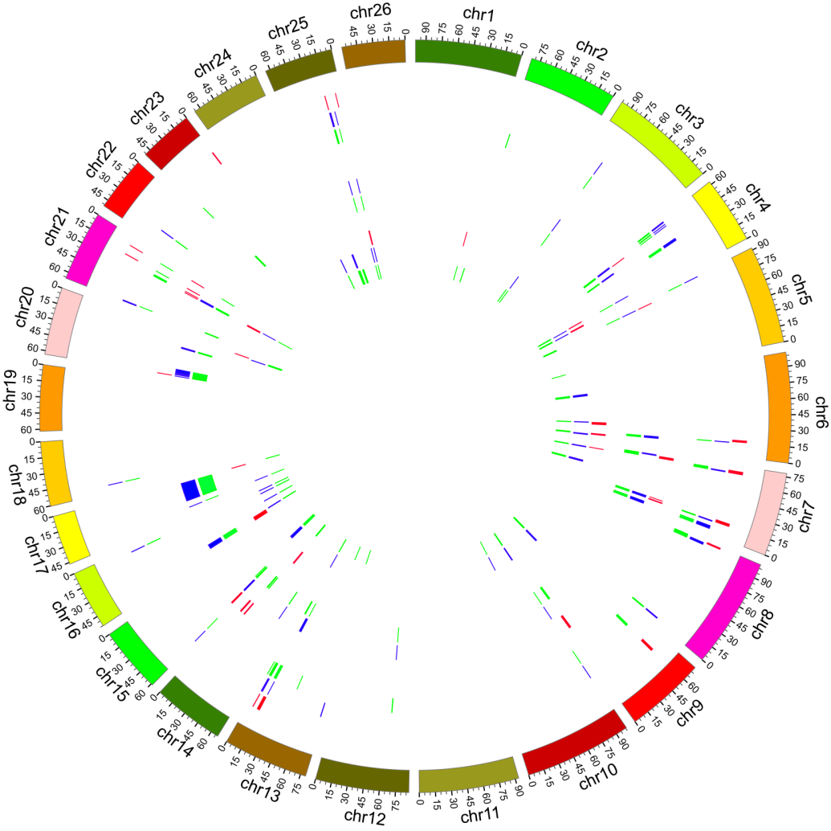
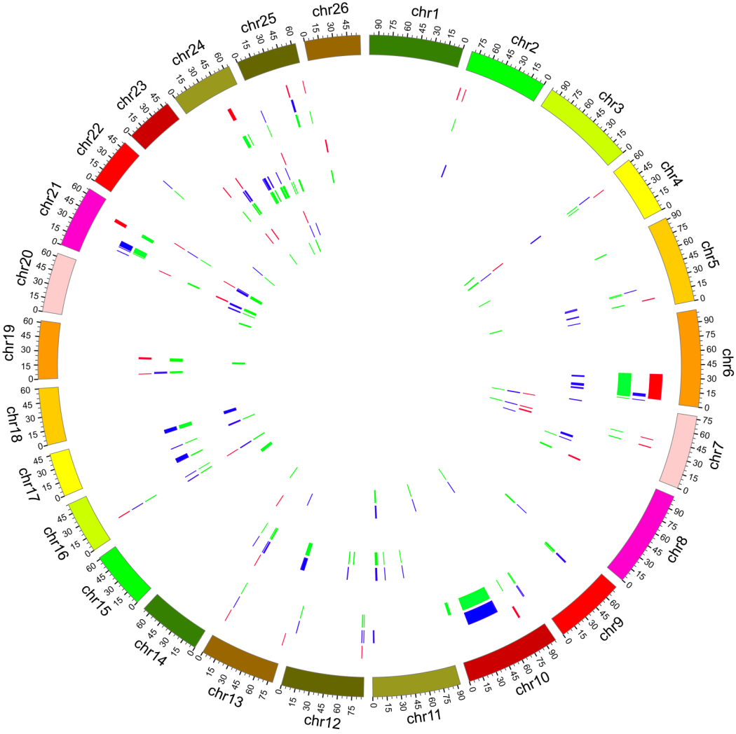
QTL identification and distribution

Slide 38
Clustering information of the QTLs identified at least in three environments
No. Env | No. QTLs
 | FL | FS | FM | BW | LP | SI
at least in 3 Env | 44 | 39 | 42 | 58 | 35 | 38
Clustered | 32 | 29 | 18 | 30 | 18 | 29
Positive clustered | 29 | 26 | 9 | 21 | 4 | 21
Negative clustered | 18 | 14 | 11 | 14 | 18 | 12

Slide 39
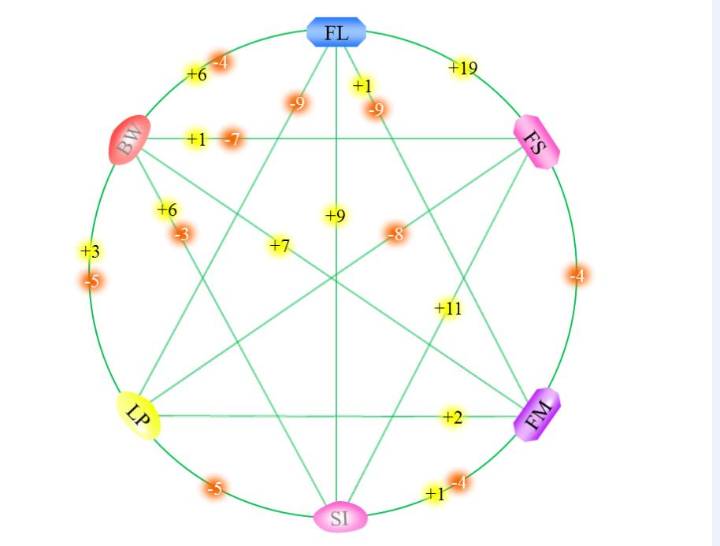
Summery of QTL Clusters

Slide 40
qCluster-chr7-1
QTL Name | Position | LOD | Additive | R2 | LOD1_L | LOD1_R | LOD2_L | LOD2_R
qFS-chr7-2 | 20.91 | 2.63 | 0.54 | 5.94% | 18.50 | 26.50 | 16.20 | 26.50
 | 21.81 | 2.86 | 0.61 | 5.22% | 19.00 | 24.80 | 16.10 | 24.80
 | 21.81 | 4.35 | 0.74 | 8.14% | 20.40 | 24.80 | 19.30 | 25.70
 | 21.81 | 2.64 | 0.59 | 5.35% | 19.90 | 25.70 | 18.90 | 25.70
 | 21.81 | 2.56 | 0.40 | 4.46% | 20.00 | 25.70 | 16.90 | 26.50
 | 21.81 | 2.49 | 0.73 | 5.06% | 17.00 | 24.30 | 8.00 | 26.20
 | 21.81 | 3.08 | 0.68 | 6.27% | 17.70 | 25.60 | 16.20 | 26.50
 | 22.81 | 5.46 | 0.67 | 11.52% | 20.30 | 24.80 | 19.10 | 24.80
 | 22.81 | 4.90 | 0.71 | 9.91% | 18.90 | 25.70 | 17.40 | 26.50
 | 24.81 | 2.55 | 0.73 | 5.18% | 19.10 | 27.30 | 16.20 | 28.10
 | 26.51 | 5.87 | 0.81 | 11.74% | 26.00 | 27.60 | 25.70 | 29.00
 | 27.31 | 9.98 | 0.99 | 18.45% | 26.30 | 29.00 | 25.60 | 30.10
 | 27.31 | 5.44 | 0.66 | 10.27% | 26.60 | 28.10 | 25.70 | 28.10
 | 27.31 | 3.05 | 0.61 | 5.74% | 25.70 | 29.60 | 25.70 | 30.60
 | 27.31 | 3.05 | 0.60 | 5.91% | 26.20 | 29.10 | 22.10 | 29.10
 | 28.11 | 2.43 | 0.40 | 4.90% | 20.70 | 29.00 | 17.00 | 29.60
 | 28.61 | 9.89 | 1.02 | 18.00% | 26.90 | 29.50 | 25.80 | 29.60
qFL-chr7-5 | 26.51 | 2.23 | 0.33 | 4.59% | 21.20 | 28.10 | 18.30 | 28.10
 | 28.61 | 3.33 | 0.45 | 6.31% | 26.20 | 29.10 | 24.90 | 29.10
 | 28.61 | 2.33 | 0.38 | 4.55% | 26.20 | 29.10 | 16.00 | 29.10
qFM-chr7-1 | 26.51 | 2.70 | -0.14 | 5.14% | 24.30 | 28.60 | 21.80 | 29.10
 | 28.11 | 4.73 | -0.16 | 8.69% | 27.30 | 29.10 | 27.30 | 29.60
 | 29.61 | 3.41 | -0.12 | 6.05% | 29.10 | 31.60 | 29.10 | 32.90
 | 29.61 | 3.56 | -0.14 | 6.02% | 27.40 | 30.60 | 26.10 | 30.60
 | 30.11 | 6.11 | -0.24 | 10.88% | 29.40 | 30.60 | 29.10 | 30.60
qSI-chr7-3 | 26.51 | 4.49 | 0.34 | 8.02% | 25.70 | 28.60 | 23.00 | 29.10
 | 27.31 | 2.72 | 0.23 | 4.75% | 26.40 | 28.50 | 25.70 | 29.60
 | 27.31 | 2.79 | 0.29 | 4.90% | 25.70 | 29.10 | 25.70 | 29.60
 | 27.31 | 3.94 | 0.27 | 6.62% | 26.10 | 28.20 | 25.70 | 29.40
 | 27.31 | 2.43 | 0.24 | 4.14% | 26.10 | 28.30 | 25.70 | 29.10
 | 28.61 | 2.47 | 0.29 | 4.62% | 26.10 | 29.10 | 20.80 | 29.10
 | 28.61 | 4.29 | 0.39 | 8.35% | 26.50 | 29.60 | 25.90 | 29.60

Slide 41
qCluster-chr25-1
QTL Name | Position | LOD | Additive | R2 | LOD1_L | LOD1_R | LOD2_L | LOD2_R
qFS-chr25-2 | 111.41 | 2.48 | 0.57 | 4.78% | 108.60 | 112.20 | 106.60 | 112.20
 | 114.41 | 2.62 | 0.63 | 4.88% | 112.90 | 119.60 | 112.90 | 121.70
 | 114.41 | 4.53 | 0.76 | 9.32% | 113.90 | 115.80 | 112.70 | 118.90
 | 116.31 | 3.45 | 0.76 | 6.06% | 115.40 | 118.80 | 115.40 | 120.00
qFL-chr25-7 | 115.41 | 3.92 | 0.42 | 9.14% | 114.20 | 118.40 | 114.50 | 119.60
 | 116.31 | 3.27 | 0.51 | 7.13% | 115.40 | 119.50 | 112.90 | 120.00
 | 116.31 | 6.37 | 0.83 | 13.48% | 115.40 | 118.70 | 115.40 | 119.50
 | 116.31 | 3.41 | 0.55 | 7.51% | 115.40 | 119.30 | 112.90 | 120.90
 | 116.31 | 2.97 | 0.43 | 6.16% | 115.20 | 120.90 | 112.90 | 121.70
 | 116.31 | 3.05 | 0.33 | 6.49% | 114.30 | 119.70 | 112.90 | 121.70
 | 117.31 | 5.26 | 0.66 | 12.33% | 115.90 | 119.30 | 112.90 | 120.00
 | 117.31 | 3.08 | 0.48 | 6.78% | 116.30 | 119.60 | 116.30 | 121.20
qLP-chr25-7 | 115.41 | 3.86 | -0.66 | 8.22% | 112.90 | 118.60 | 112.90 | 120.60
 | 115.41 | 3.37 | -0.66 | 7.72% | 112.90 | 119.30 | 112.90 | 120.20
 | 116.31 | 4.14 | -0.84 | 8.56% | 113.50 | 119.60 | 112.40 | 120.90
 | 116.31 | 4.52 | -0.73 | 9.21% | 114.10 | 120.00 | 112.90 | 121.00
 | 117.31 | 4.01 | -1.27 | 9.26% | 116.20 | 118.30 | 115.80 | 119.40
 | 117.31 | 4.08 | -0.61 | 9.05% | 116.50 | 119.30 | 115.40 | 120.20
 | 117.31 | 3.37 | -0.62 | 7.20% | 116.30 | 120.00 | 116.30 | 121.80
 | 119.31 | 2.60 | -0.67 | 5.81% | 115.00 | 122.20 | 112.90 | 122.20
 | 119.31 | 3.18 | -0.68 | 7.22% | 117.30 | 121.60 | 117.30 | 122.20
qBW-chr25-11 | 119.31 | 3.89 | -0.13 | 8.52% | 117.60 | 121.40 | 116.90 | 122.60
 | 119.31 | 3.90 | -0.15 | 8.32% | 118.20 | 122.70 | 116.30 | 123.70
 | 119.31 | 6.92 | -0.20 | 14.66% | 118.00 | 121.50 | 119.20 | 122.20
 | 119.31 | 6.08 | -0.20 | 14.08% | 118.20 | 121.80 | 117.50 | 122.80

Slide 42
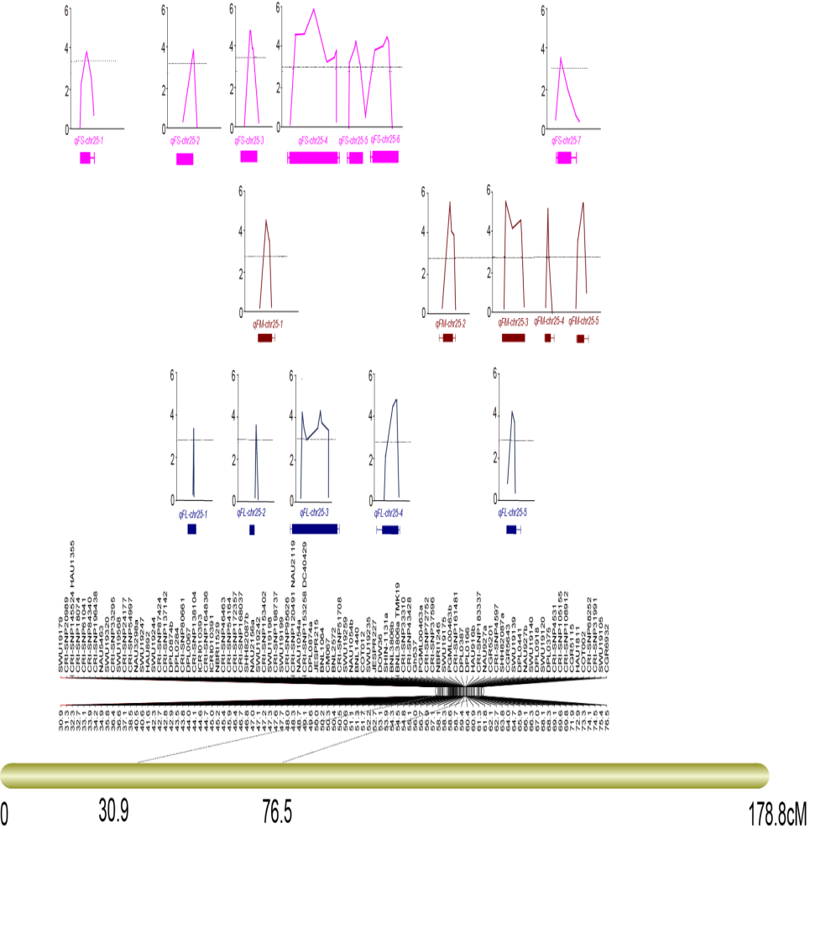
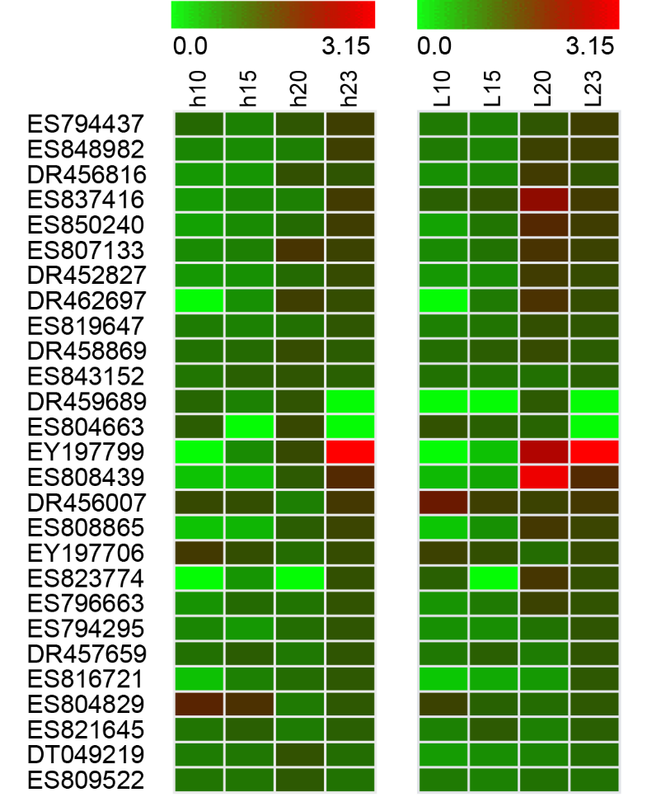
Fine mapping the QTLs on Chr25 for fiber quality and their functional verification
Fine mapping the QTLs for fiber quality PLoS One. 2015; 10(8): e0135430.
Functional verification of the candidate genes

Slide 43
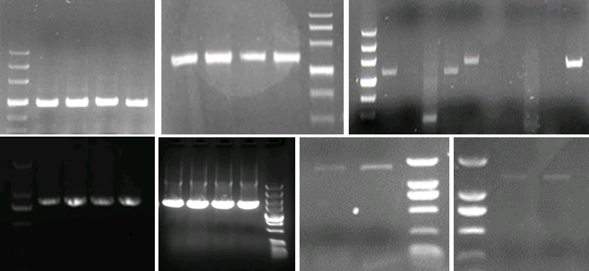
  Cloning 11 genes in the confidence intervals of the QTLs for fiber strength

Slide 44
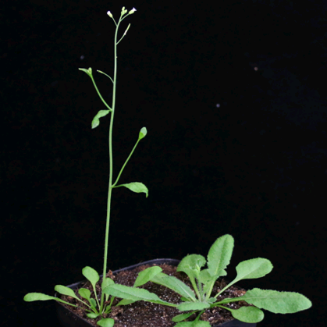
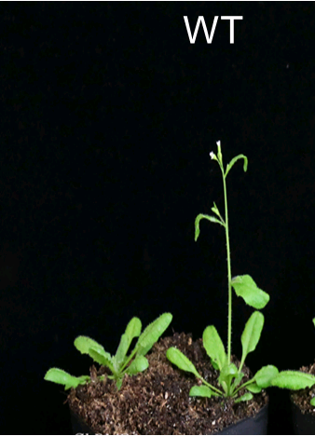
Preliminary functional verification of the six genes
WT

Slide 45
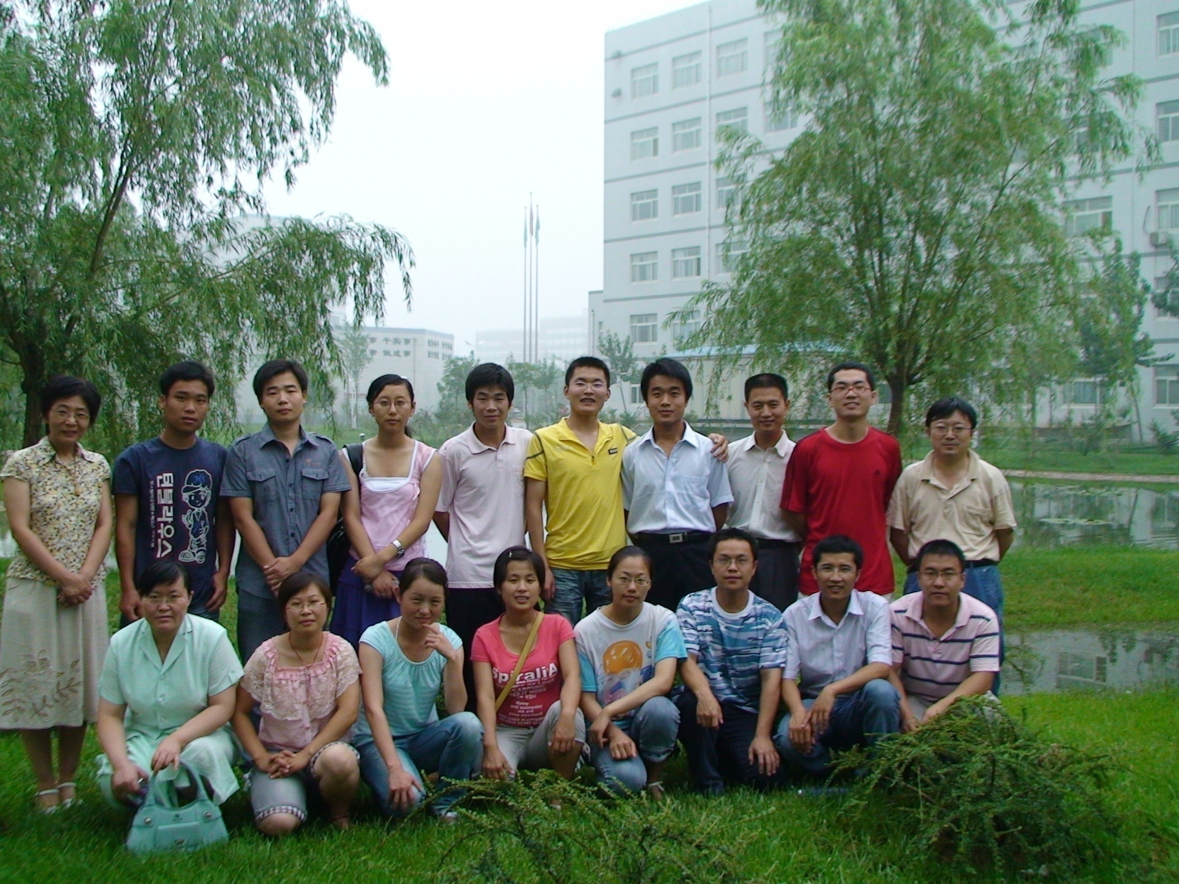
THANK YOU!

