Slide 1
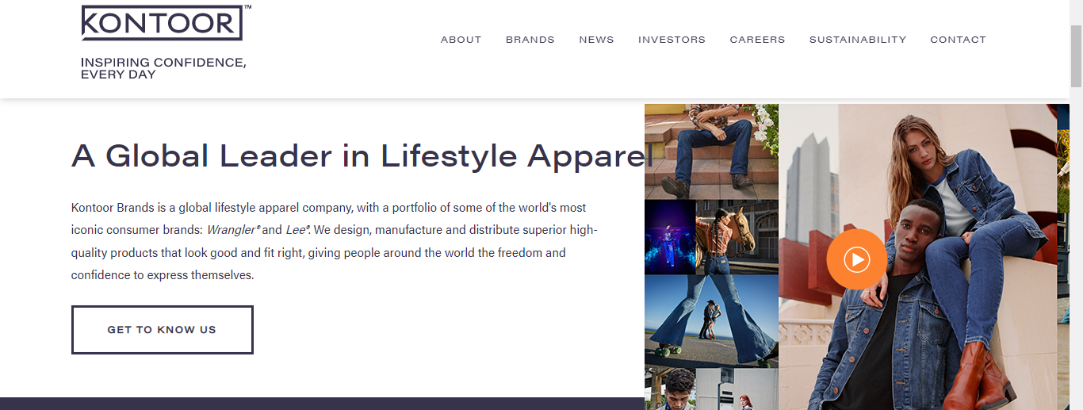
Baseline Environmental Study for Kontoor
Dhruv Agarwal
Sr. Director- Global Innovation, Sustainability, Product Development

Slide 2
Baseline Environmental Study
Objective: Development of a global sustainability-sourcing document. Kontoor wants to have a baseline measurement of the following environmental aspects:
Average Water usage/ha or water usage/ton of lint
Average Fertilizer usage/ha or fertilizer usage/ton of lint
Average Pesticide usage/ha or Pesticide usage/ton of lint
Average Lint Yield/ha
Energy usage/ton of lint
Average GHG/ha or GHG/ton lint
Quantitative or qualitative measurements for
  Soil Erosion: Soil health
  Biodiversity
  Soil Carbon

Slide 3
Countries , Timeline of the Project, Funding
Data for at least the top ten cotton producing countries in the world
Study to be updated every 2 years: to see the changes and the progress made across various countries in the mix
Partial Sponsorship from Kontoor: 10,000 USD

