Slide 1
New Age Environmentally Friendly Technology for Sustainable Production of Cotton and Mitigating Changing Climate
Phillip R. Walesby, V. Kumar, I. M. Maisuria, H.R. Desai, C.J. Patel, Rekha Sojitra and Pinal Chaudhary
Main Cotton Research Station
Navsari Agricultural University
Surat, India 395007
Scriptfert International Limited
The views/interpretations expressed by the presenter may/may not be subscribed by affiliating institutions

Slide 2
BACKGROUND
Since the introduction into India of Bt cotton as the first transgenic crop in 2002, India has witnessed unprecedented growth in every sphere associated to cotton.
Be it cultivation, production, returns, processing, trade and textile, every sector has gained except the pesticide industry.
Prior to the introduction of Bt cotton, average usage of pesticides into the crop during 1997-02 (IX FYP) was 33.4% of the total pesticides used in India. Of this, 65.5% was for bollworms and 32.3% for sucking pests.
The situation changed during 2007-12 (XI FYP). The share of pesticides for bollworm dropped to 18.9% and alarmingly that for sucking pests rose to 84.7% now a major concern.
ETL based applications and IPM/IRM technology did provide solace but have taken the back seat to Bt cotton.
Ecolock_{TM} (Bioclasp_{TM} based technology) helps retain applied and native chemistries in place a for longer time thereby enhancing their efficiency.
It was applied in conjunction with pesticides in order to explore the possibility of a reduction in pesticide applications for sustainable cotton production and to help in mitigating changing climate.

Slide 3
PESTICIDES USED IN THE STUDY
 | Treatments | Doses | Number of sprays
 |  |  | 2011-12 | 2012-13
T1 | Imidacloprid 20SL | 20 g a.i./ha | 6 | 5
T2 | Thiamethoxam 25 WG | 25 g a.i./ha | 6 | 5
T3 | Acetamiprid 20 SP | 15 g a.i./ha | 6 | 5
T4 | Profenphos 50 EC | 1000 g a.i./ha | 5 | 5
T5 | T1+ Ecolock (Eco) | As in T1+ Eco. 2 ml/l | 5 | 4
T6 | T2+ Ecolock | As inT2+Eco. 2 ml/l | 5 | 4
T7 | T3 + Ecolock | As in T3+ Eco. 2 ml/l | 5 | 4
T8 | T4 + Ecolock | As in T4+ Eco. 2ml/l | 5 | 4
T9 | Recommended sprays | Different pesticides | 6 | 5
T10 | Rec. sprays+ Ecolock | As in T9+ Eco. 2ml/l | 5 | 4
T11 | Control (No sprays)

Slide 4
EFFECT OF PESTICIDES WITH AND WITHOUT ECOLOCK_{TM} ON SUCKING PEST POPULATION (2011-13)
TREATMENTS | Leaf hoppers/3 leaves T.V. O.V. |  | Thrips/ 3 leaves T.V. O.V. |  | Aphids / 3 leaves T.V. O.V. |  | White fly / 3 leaves T.V. O.V.
T1. Imidacloprid 200SL | 2.06 | 3.74 | 3.31 | 10.7 | 2.41 | 5.64 | 2.28 | 4.92
T2 . Thiamethoxam 25WG | 2.08 | 3.83 | 3.36 | 11.1 | 2.49 | 6.14 | 2.39 | 5.43
T3. Acetamiprid 20SP | 2.07 | 3.79 | 3.27 | 10.5 | 2.48 | 6.02 | 2.33 | 5.14
T4. Profenophos 50EC | 2.06 | 3.73 | 3.24 | 10.3 | 2.45 | 5.70 | 2.19 | 4.59
T9. Recommended sprays | 2.00 | 3.53 | 3.29 | 10.5 | 2.43 | 5.84 | 2.32 | 5.15
Average |  | 3.72 |  | 10.6 |  | 5.87 |  | 5.05
T5. T1 + Ecolock | 1.95 | 3.31 | 3.07 | 9.1 | 2.15 | 4.27 | 1.94 | 3.51
T6. T2 + Ecolock | 1.96 | 3.38 | 3.09 | 9.2 | 2.28 | 4.96 | 2.15 | 4.38
T7 . T3 + Ecolock | 1.94 | 3.26 | 3.09 | 9.3 | 2.23 | 4.66 | 2.00 | 3.78
T8. T4 + Ecolock | 1.93 | 3.23 | 3.08 | 9.1 | 2.07 | 3.81 | 1.77 | 2.96
T10 T9+ Ecolock + ST (Imida.) | 1.79 | 2.70 | 2.88 | 8.4 | 1.84 | 2.88 | 1.66 | 2.49
Average |  | 3.18 (-15%) |  | 9.0 (-15.7%) |  | 4.12 (-29.8%) |  | 3.42 (-32.2%)
T11 Control (No spray) | 2.46 | 5.56 | 3.53 | 12.3 | 3.09 | 9.25 | 2.57 | 6.43
CD@5% | 0.17 |  | 0.22 |  | 0.06 |  | 0.14
TV*- Transformed values ( square root + 0.5 transformed mean ) OV-Original mean values; Aphids: 2011-12 pooled of 5 STW & 2012-13 pooled of total 7 STW
Leaf hoppers: 2011-12 & 2012-13 pooled of total 15 STW; Thrips: 2011-12 & 2012-13 pooled of total 7 STW..White fly: population measured in 2012-13 only.
Figures in () are % reduction

Slide 5
EFFECT OF PESTICIDES WITH AND WITHOUT ECOLOCK_{TM} ON LADY BIRD BEETLE AND MEALY BUG POPULATION ON COTTON (2011-13)
Treatments | Av. No. of LBB/plant TV* OV |  | Av. Grade of Mealy bug/plant TV* OV |  | % parasitism of Mealy bug AV** OV
T1. Imidacloprid 200SL | 0.88 | 0.24 | 1.20 | 0.98 | 7.81 | 2.29
T2 . Thiamethoxam 25WG | 0.85 | 0.20 | 1.18 | 0.89 | 8.96 | 2.49
T3. Acetamiprid 20SP | 0.86 | 0.23 | 1.15 | 0.83 | 9.74 | 2.93
T4. Profenophos 50EC | 0.80 | 0.14 | 1.10 | 0.71 | 2.71 | 0.58
T9. Recommended sprays | 0.82 | 0.17 | 1.14 | 0.81 | 8.58 | 2.30
Average |  | 0.20 |  | 0.84 |  | 2.12
T5. T1 + Ecolock | 0.87 | 0.24 | 1.14 | 0.79 | 7.56 | 2.13
T6. T2 + Ecolock. | 0.90 | 0.29 | 1.13 | 0.78 | 10.01 | 3.04
T7 . T3 + Ecolock | 0.95 | 0.39 | 1.11 | 0.72 | 11.24 | 3.90
T8. T4 + Ecolock | 0.79 | 0.14 | 1.01 | 0.52 | 4.01 | 0.91
T10 T9 + Ecolock + ST (Imida.) | 0.82 | 0.17 | 1.08 | 0.67 | 7.19 | 1.90
Average |  | 0.25 (+25%) |  | 0.70 (-16.7%) |  | 2.38 (+ 12.3%)
T11 Control (No spray) | 0.97 | 0.44 | 1.50 | 1.77 | 17.93 | 9.78
CD@5% | 0.07 |  | 0.12 |  | 3.7
TV*- Transformed values ( square root + 0.5 transformed mean ) TV** Arcsine transformation OV-Original mean values;
Mealy bug:: 2011-12 pooled of 9 STW & 2012-13 pooled of total 13 STW LBB- 2011-12 pooled of total 4 STW & 2012-13 pooled of total & 7 STW
Figures in () are % increase or decrease.

Slide 6
EFFECT OF PESTICIDES WITH AND WITHOUT ECOLOCK_{TM} ON YIELD PARAMETERS, SEED COTTON AND BIOLOGICAL YIELD (2011-13)
Treatments | NO. OF BOLLS PER PLANT | BOLL WEIGHT (g) | SEED COTTON YIELD (kg/ha) | TOTAL BIOLOGICAL YIELD(MT/ ha)
T1. Imidacloprid 200SL | 32.6 | 3.43 | 1713 | 4.90
T2 . Thiamethoxam 25WG | 32.7 | 3.37 | 1694 | 5.00
T3. Acetamiprid 20SP | 33.8 | 3.33 | 1813 | 5.60
T4. Profenophos 50EC | 33.9 | 3.43 | 2073 | 6.10
T9. Recommended sprays | 34.0 | 3.47 | 1971 | 5.81
Average | 33.4 | 3.41 | 1853 | 5.48
T5. T1 + Ecolock | 34.4 | 3.50 | 1963 | 5.74
T6. T2 + Ecolock | 33.6 | 3.52 | 2046 | 6.23
T7 . T3 + Ecolock | 34.1 | 3.50 | 2149 | 6.40
T8. T4 + Ecolock | 35.7 | 3.52 | 2233 | 6.53
T10 T9 + Ecolock + ST (Imida.) | 35.9 | 3.63 | 2371 | 6.95
Average | 34.7 | 3.53 | 2152 | 6.37
T11 Control (No spray) | 32.7 | 3.27 | 1128 | 3.45
CD@5% | NS | NS | 272 | 0.82

Slide 7
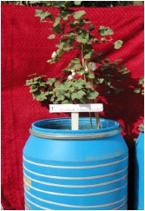
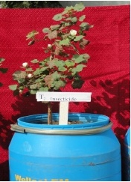
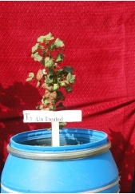
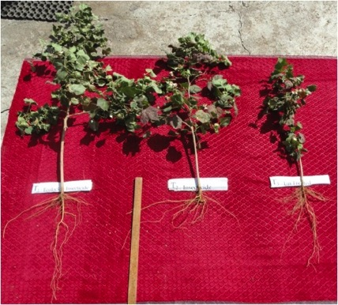
ROOT STUDIES IN LYSIMETER (2011-12)
T1: “Ecolock”+ Insecticide
T2: Insecticide
T3: Untreated
EGL-Cotton India

Slide 8
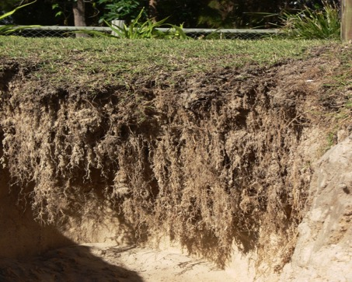
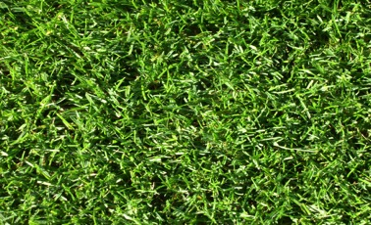
An example of Bioclasp Technology deep rooting in turf grass variety Green Couch growing in saline dune sand Casuarina Beach NSW Australia
An example of Bioclasp Technology deep rooting in turf grass variety Green Couch growing in saline dune sand Casuarina Beach NSW Australia

Slide 9
EFFECT OF PESTICIDES WITH AND WITHOUT ECOLOCK_{TM} ON SOIL PROPERTIES AT HARVEST (2011-13)
Treatments | pH I II |  | O.C.(%) I II |  | N (kg/ha) I II |  | K(kg/ha) I II
T1. Imidacloprid 200SL | 7.07 | 7.43 | 0.30 | 0.57 | 178 | 191 | 567 | 241
T2 . Thiamethoxam 25WG | 7.21 | 7.50 | 0.29 | 0.50 | 199 | 245 | 503 | 296
T3. Acetamiprid 20SP | 7.28 | 7.40 | 0.28 | 0.46 | 171 | 287 | 495 | 240
T4. Profenophos 50EC | 7.33 | 7.80 | 0.28 | 0.46 | 187 | 341 | 471 | 239
T9. Recommended sprays | 7.41 | 7.43 | 0.29 | 0.44 | 253 | 192 | 502 | 322
Average | 7.26 | 7.51 | 0.29 | 0.49 | 198 | 251 | 508 | 268
T5. T1 + Ecolock | 7.39 | 7.00 | 0.37 | 0.52 | 242 | 224 | 476 | 353
T6. T2 + Ecolock | 7.23 | 7.07 | 0.30 | 0.63 | 270 | 326 | 521 | 360
T7 . T3 + Ecolock | 7.27 | 7.50 | 0.27 | 0.51 | 251 | 328 | 555 | 298
T8. T4 + Ecolock | 7.40 | 7.40 | 0.30 | 0.50 | 226 | 341 | 528 | 402
T10 T9 + Ecolock + ST (Imada.) | 7.30 | 7.07 | 0.39 | 0.42 | 242 | 232 | 602 | 318
Average | 7.32 | 7.21 | 0.33 | 0.51 | 246 | 290 | 536 | 346
T11 Control (No spray) | 7.25 | 6.70 | 0.27 | 0.45 | 194 | 254 | 536 | 376
Year I: 2011-12 Year II : 2012-13
average of 0-15, 15-30 and 30-45 cm soil depth

Slide 10
EFFECT OF PESTICIDES WITH AND WITHOUT ECOLOCK_{TM} ON ECONOMICS OF COTTON CULTIVATION (2011-13)
Treatments | Total cost of Cultivation Rs/ha | Gross Return Rs/ha | Net Return Rs/ha | Cost : Benefit Ratio
T1. Imidacloprid 200SL | 32,351 | 62,524 | 30,173 | 1:1.93
T2 . Thiamehoxam 25WG | 33,287 | 61,812 | 28,525 | 1:1.86
T3. Acetamiprid 20SP | 31,983 | 66,174 | 34,191 | 1:2.07
T4. Profenophos 50EC | 35,600 | 75,682 | 40,082 | 1:2.13
T9. Recommended sprays | 33,839 | 71,923 | 38,084 | 1:2.12
T5. T1 + Ecolock | 34,478 | 71,667 | 37,189 | 1:2.08
T6. T2 + Ecolock | 35,248 | 74,679 | 39,431 | 1:2.12
T7 . T3 + Ecolock | 34,181 | 78,438 | 44,257 | 1:2.29
T8. T4 + Ecolock | 37,615 | 81,486 | 43,871 | 1:2.17
T10 T9 + Ecolock + ST (Imida.) | 35,975 | 86,541 | 50,566 | 1:2.41
T11 Control (No spray) | 29,650 | 41,172 | 11,522 | 1:1.39

Slide 11
EFFICIENCY OF FERTILIZER NITROGEN USE (kg Seed Cotton/kg N)
Treatment | 2011-12 | 2012-13 | Average
Pesticides with Ecolock_{TM} | 9.08 | 8.40 | 8.74
Pesticides without Ecolock_{TM} | 8.36 | 7.08 | 7.72
Additional yield per unit N | 0.72 | 1.32 | 1.02
Percent increase due to Ecolock_{TM} | 8.6% | 18.6% | 13.2%

Slide 12
EFFECIENCY OF WATER USE (kg Seed Cotton/ha mm Water)
Treatment | 2011-12 | 2012-13 | Average
Pesticides with Ecolock_{TM} | 15.6 | 15.2 | 15.4
Pesticides without Ecolock_{TM} | 14.3 | 12.1 | 13.2
Additional yield per unit of Nitrogen | 1.2 | 3.1 | 2.2
Percent increase due to Ecolock_{TM} | 8.6% | 25.1% | 16.8%

Slide 13
GREEN HOUSE GAS EMISSIONS (GHG)*
Year | CO2 Emission
 | No. of sprays | Without Ecolock_{TM} |  | No. of sprays | With Ecolock_{TM}
 |  | Kg CO2e/ha | Kg CO2e/t |  | Kg CO2e/ha | Kg CO2e/t
2011-12 | 6 | 1,064 | 530 | 5 | 889 | 408
2012-13 | 5 | 892 | 525 | 4 | 718 | 338
Average | 5.5 | 978 | 528 | 4.5 | 804 | 373
Decrease (%) due to Ecolock_{TM} |  |  |  | -18.2% | -17.8% | -29.4%
* The data may/may not represent absolute values

Slide 14
ENVIROMENT IMPACT QUOTIENT (EIQ) FIELD RATING
Treatment | 2011-12 | 2012-13 | Average
Pesticides without Ecolock_{TM} | 99 | 77 | 88
Pesticides with Ecolock_{TM} | 87 | 62 | 74.5
Percent decrease due to Ecolock_{TM} | -12.9% | -19.5% | -16.2%
* The data may/may not represent absolute values

Slide 15
MAJOR CONCLUSIONS
The study conclusively demonstrated that Ecolock_{TM} mixed with pesticides helped reduce the number of applications, enhanced biomass, yield and economic returns and also improved soil fertility
FIRST CONCLUSION: A STRONG ECONOMIC RATIONALE for ECOLOCK_{TM}
Moreover Ecolock_{TM} is a certified organic product which enhances fertilizer nitrogen and improves water use efficiency as well as reduces GHG emissions and EIQ field ratings in cotton
SECOND CONCLUSION: ECOLOCK_{TM} HAS BROAD AND STRONG EVIROMENTAL CREDNETIALS
The product is user friendly, safe for man and animals alike. No adverse effects have ever been observed or reported during or after the trials
FINAL CONCLUSION: ECOLOCK_{TM} IS SAFE TO USE

Slide 16
