Slide 1


Past Experiences, Present Endeavors and Future Exertions in
Transfer of Cotton Technologies towards Science- led Sustainable Development in India
Usha Rani Joshua Principal Scientist (Agricultural Extension) &
Prakash, A.H., Project Coordinator (Cotton Improvement)
ICAR – Central Institute for Cotton Research,
Regional Station, Coimbatore – 641 003
Tamil Nadu, India
+91 98432 98422 ushajoshua@rediffmail.com

Slide 2

Content
Ultimate objective of the paper
Agricultural Development in India
Agricultural Extension System in India
Indian Cotton Scenario
Cotton TOT in India
Past Experiences – Cotton TOT
Present Endeavors - Cotton TOT
Future Exertions – Cotton TOT
Challenges ahead
Future Perspectives
Lessons for Mid East and Mediterranean regions
Conclusion

Slide 3
“ There is only one thing more painful than learning from experience
and that is not learning from experience ”
- Archibald McLeish
American Poet and Writer

Slide 4
The ultimate objective of this paper………..
To gain a view on what works where and why in transferring cotton technologies in order to identify the new measures that strengthen and improve cotton extension service in India

Slide 5
Agricultural Development in India
Geographical area – 328.73 m ha
Population – 1210 million
Total Cultivators + agricultural laborers – 263.1 million
Gross Cropped Area - 200.86 m ha
Average size of land holding – 1.15 ha
India is among top 3 global producers in - Wheat, Rice, Pulses, Cotton, Peanuts, Fruits & Vegetables
World’s largest herds of buffalo and cattle Livestock population is in India
World’s largest producer of milk
One of the largest & fastest growing poultry sectors in the world
Agriculture development is a state subject
Union Government play a major role in formulation of – Policies, Programmes and Budgetary Support
From
food shortages and import
To
self-sufficiency and exports
From
subsistence farming
To
intensive and technology led cultivation.
Today , India is the front ranking producer of many crops in the world.
Ushered in through the green, white, blue and yellow revolutions

Slide 6
Agricultural Extension System in India
Public Extension System
National Level
Central Ministry of Agriculture, Cooperation and Farmers Welfare
Indian Council of Agricultural Research
Public Extension System
State Level
State Ministry of Agriculture, Horticulture, Animal Husbandry, Fisheries, etc.,
State Agricultural Universities
Other Extension System
Commodity Boards
Non Government Organizations
Financial Institutions
Indian Council of Agricultural Research (ICAR) is an apex body at the national level – to evolve effective Transfer of Technology (TOT) models.
State Agricultural Universities (SAUs) come out with viable models that can be replicated through existing extension machinery besides implementing models evolved by ICAR system.

Slide 7
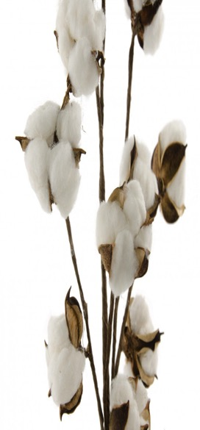
Indian Cotton Scenario
Cotton is the second largest Kharif crop of the country, after Rice contributing 6-7% of the net sown area.
India has the pride of cultivating all the four cultivated species
Cotton plays an important role in the Indian economy as the country's textile industry is predominantly Cotton based.
India is leading in area and production of cotton at world level
Productivity of Cotton Is our major concern for Research, Development and TOT
Towards increasing the Productivity only all our TOT programs are framed out.

Slide 8
Cotton Extension System in India
Central Ministry of Agriculture, Cooperation and Farmers’ Welfare
Government of India
ICAR
CICR & AICRP on Cotton
Private Industries through
CSR
SAUs
KVKs
Directorate of Cotton Development
Non Government / Voluntary Organizations
Individual
State Ministry of Agriculture

Slide 9
Past Experiences
Pre Independence Period
Before 1947
Until the middle of the 18th Century only arboreum and herbaceum varieties of cotton
The first attempt was in 1790 A.D to grow American Cotton in Bombay & Madras province but it was not successful. Then tried in Deccan, Konkon, Hubli in 1840-1842 A.D and in 1846 AD at Punjab. The most significant development was the introduction of Cambodia variety in 1904-05.
Setting up of Indian Cotton Committee (ICC) in 1917 at Bombay further boosted the spread of hirsutum & long staple cotton in India.
It established Indian Central Cotton Committee (ICCC) in 1921 and it became a statutory Body in 1923 and established Central Technological Research Laboratory (CTRL) in 1924 at Bombay.
Since 1924 to 1966, many cotton schemes formulated by ICCC to improve cotton quantitatively & qualitatively helped to double the production during 1966.

Slide 10
44 percent increase in cotton area 55 percent increase in production during the 1st Plan Period (1951-52 to 1955- 56),
24 percent increase due to increased productivity
during 2nd Plan Period (1956-57 to 1960-61)
competition from other crops was the challenge
Post Independence
Phase I
1947-1969
“Cotton Extension Scheme” and “Grow More Cotton” campaigns
sponsored by the Government of India
1950-51
Intensive Cotton Cultivation Scheme (ICCS), popularly known as “Package Programme”, was launched in 1962-63
(special field staff were appointed for dissemination of technical knowledge to farmers, besides providing incentives (Seed, Pesticides, Appliances, Operational cost, Ceiling prices etc.).
12 % increase in production during third plan period
(Due to increase in area and yield)
Severe drought was the challenge
5.497 m bales by the end of 1968-69

Slide 11
Post Independence Era
Phase II
1969-1990
ICCC was abolished and transferred to ICAR
All India Coordinated Cotton Improvement Project in 1967
Intensive Cotton Development Program (ICDP) 1979-80
Cotton Corporation of India in 1970
The area was increased to 7.196 m ha and production was 8.436 m bales and the average yield was 198 kg/ha

Slide 12
Post Independence Era
Phase III
1991-2017
Technology Mission on Cotton
1999- 2014
National Food Security Mission – Commercial crops
(2014 to till date)
The area was increased to 11.86 m ha and production was 33.34 m bales and the average yield was 481 kg/ha

Slide 13
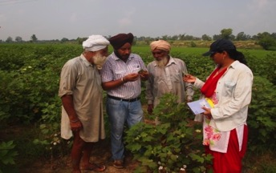

Present Endeavors
Traditional
ICT based
Large Scale Demonstrations
E-Kapas Network

Slide 14
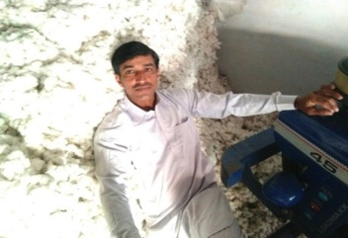
Large Scale Demonstrations - Front Line Demonstrations on Cotton
Seeing is believing is the principle
The field demonstration conducted under the close supervision of scientists of the National Agriculture Research System is called Front Line Demonstration (FLD).
This novel programme was implemented in 1996-97 for cotton crop to demonstrate cotton technologies through All India Coordinated Research Project (AICRP) on cotton and its net working centres.
Yield enhancement is the motive

Slide 15

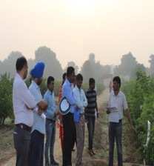
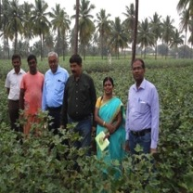
Front Line Demonstration (FLD) in Cotton
Until 2017, more than 20000 FLDs were conducted in the ten cotton growing states of India.
Until 2013, these demonstrations were conducted on Production Technology, Integrated Pest Management and on Farm implements under Technology Mission on Cotton, Mini Mission II.
For the past three years, under the National Food Security Mission (NFSM), these demonstrations are being conducted on ICM, Desi/ELS /Seed production and intercropping
An average of 18.70 percent increase in the seed cotton yield was observed in the demonstration field compared to farmers’ practice

Slide 16

Special features of FLD
Dissemination of good cultivation practices
Farmers to farmers technology dissemination
Yield enhancement
Reduction in cost of cultivation
Inclusive development
Scientists – End users linkage
Direct feed back from the clientele system to the research system

Slide 17

Challenges in FLD
Scientists conduct the demonstration – Pros and Cons
Meager inclusion of modern Information and Communication Technology (ICT) tools
Meager inclusion of other extension innovations

Slide 18
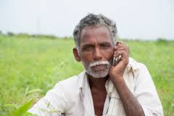
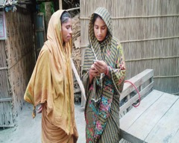
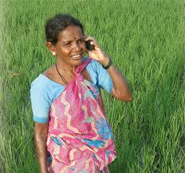
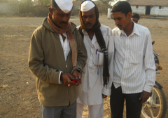
ICT based - e-Kapas Network
The project was functioning under Technology Mission on Cotton-Mini Mission I, a novel approach of the Government of India, to increase the productivity of cotton in the country.
The project has been functioning in 17 centres across the ten cotton growing states of the country under the leadership of Central Institute for Cotton Research, Nagpur.
Farmers interested in e-Kapas network register with their local state centres by registering their mobile numbers. Centres send regular Voice SMS about cotton genotypes, production and protection technologies along with weather and market reports in their local languages to the registered growers.
Under e-Kapas Network project, around 0.5 million cotton growers in the country had registered as beneficiaries and developed a data base of e-Kapas network beneficiaries.
Until February 2017, more than 14.00 million voice SMS alerts were sent to the e-Kapas beneficiaries.

Slide 19


Weekly voice SMS during the entire crop season, weekly advisory through website for knowing the do’s and don’ts in cotton cultivation
e-Kapas
Around 0.5 million farmers >14 million voice sms
www.cicr.org.in

Slide 20
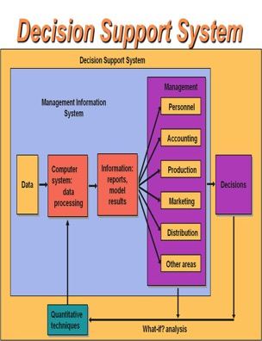
Decision Support System for selecting a suitable cotton variety / hybrid
CICR Scientists had developed a DSS for selecting a suitable cotton variety / hybrid suited to their locations

Slide 21

Mobile apps to know the strategies to manage the pests and diseases
CICR Scientists had developed a mobile app for Pest Management in cotton
That can be used for managing the pests in cotton cultivation

Slide 22

Challenges faced in these individual TOT efforts
Increasing the productivity in cotton is always a concern
Extension programs are blamed for the yield gap
All TOT programs are not successful all the times
Dependent of sponsorships
Not always farmer friendly
Not always inclusive
Lack of extension innovations
Study say that cotton TOT programs are having medium level of women friendliness
There are few programs which are best and farmer friendly programs
But they are all scattered and attempted independently

Slide 23
Future Exertions
Why not an Integrated approach to be followed in Management
of Extension or TOT mechanisms????
1. As like package of technical practices in cotton,
an integrated package of best TOT practices
to be adopted step by step chronologically during various stages of cotton cultivation
either by the change agents or by the farmers to deliver or get extension support for doubling the yield and income
from cotton cultivation.

Slide 24

Proposed Synergistic TOT approach for Profitable and Sustainable Cotton Cultivation in India by CICR
The proposed synergistic TOT approach for profitable and sustainable cotton production in India will be a convergence of all customary and contemporary extension methods tailored for cultivation of cotton crop in India. It includes,
Decision Support System for selecting a suitable variety / hybrid,
Front Line Demonstration for cultivating a new variety / hybrid,
Soil sampling and soil health card before land preparation,
A booklet with entire package of practices for ready reference during cultivation,
Weekly voice SMS during the entire crop season,
Weekly advisory through website for knowing the do’s and don’ts in cotton cultivation,
Short duration video films to accurately understand a particular technology,
Using Whatsapp group for clarifying the suddenly occurring pests / diseases / disorders,
Mobile apps to know the strategies to manage the pests and diseases,
Method demonstration to disseminate the best harvesting and post harvesting practices,
Market intelligence to sell the seed cotton for the best price,
Personal field visits by the Scientists and Exposure visits by the farmers to see and believe the advantages of technologies,
Specialized training programs to improve the skill and Radio broadcast and video telecast for spreading the success of this package to mass farmers.

Slide 25
2. TOT approach………….towards Science- led Sustainable Development in India is the aim……..
Developing TOT Models that address
Water Use / Input Use Efficiency
Precision Farming
Good Practices
Bringing down the cost of production
Robotics, autonomous and intelligent machines to share information and labor in cotton farming
Novel structured buy back system

Slide 26
Future Exertions
Why not TOT through Cotton Industries in India?
As like Sugarcane cultivation in India,
TOT through Industries may be attempted ………………

Slide 27

Challenges Ahead developing a new TOT innovation for cotton in India
Issues due to negative impact of Bt cotton Cultivation
viz.,
new emerging pests and diseases
Imbalance in the staple length wise lint supply
Sustainability issues
Traceability issues
Labor Issues

Slide 28

Way Forward…….
Development of field tested and refined package of Best Farmer Friendly Transfer of Technology Practices through convergence of all customary and contemporary extension methods tailored for cultivation of cotton crop
Development of a TOT model to transfer technologies through Industries.

Slide 29

Concluding Suggestion
Replicating the success of proven cotton TOT models adopted in India viz.,
Front Line Demonstrations
and e-Kapas network
may be attempted
in other need based Middle East cotton growing countries……….

Slide 30

Acknowledgement
Sincere thanks to
Dr. Kai Hughes, Executive Director and
Dr. K. R. Kranthi, Head Technical Section, ICAC
The Organizing committee of 13th Meeting Prof. Negm and Dr. Susan, Egypt
The ICAR and the Director, ICAR-CICR, Nagpur
The Project Coordinator and Head, ICAR-CICR, Coimbatore

Slide 31



