Slide 1
Welcome
SELECTION OF SHORT DURATION COTTON (Gossypium hirsutum) GENOTYPES FOR BREEDING PROGRAM
breeding discipline

Slide 2
Objectives
Various plant characteristics have been used to determine earliness in cotton. This research was conducted with the following objective:
To identify short duration cotton genotypes by confirming the results of first year experiment.
.

Slide 3
Experimental Details
Experimental Materials:
Seeds of 25 genotypes identified as short duration cotton genotypes from 100 genotypes from CDB gene Bank from the results of the experiment of 2015-2016.
Experimental Location:
Experimental field of Cotton Research, Training and Seed Multiplication Farm, CBD, Sreepur, Gazipur.
Date of Sowing : 24 July, 2016
Design : RCBD
Unit Plot size : 4.50 m x 2.70 m

Slide 4
Data recorded on:
Days to first flowering
Number of monopodial branch
Number of sympodial branch
Number of secondary fruiting branch
Number of bolls per plant
Plant height (cm)
Days to first boll opening
Percent first pick days to boll maturity
Earliness index
Seed cotton yield per plant (g) & yield (t/ha)

Slide 5
Table 1. Analysis of variance (ANOVA) for 13 important traits related to earliness and yield of 25 short duration cotton genotypes
Sources of Variation | df | DFF | NFB | PH | NMB | SFB | NSB | NBP | PFP | PSP | PTP | DBO | ERI | YPP
Replication | 2 | 6.65 | 0.47 | 401.91 | 0.06 | 0.16 | 2.56 | 41.24 | 288.11 | 4.29 | 149.62 | 3.04 | 0.087 | 777.31
Genotypes | 24 | 7.86* | 0.32* | 577.75* | 0.12** | 1.77* | 1.80ns | 16.63ns | 336.64** | 146.31** | 45.89ns | 3.79ns | 0.059** | 640.48**
Error | 48 | 4.71 | 0.17 | 234.95 | 0.04 | 0.92 | 1.64 | 16.66 | 63.89 | 34.28 | 28.79 | 3.47 | 0.016 | 292.02
CV (%) | -- | 3.54 | 7.34 | 13.03 | 21.02 | 28.26 | 8.39 | 16.08 | 17.86 | 12.25 | 64.84 | 3.06 | 5.06 | 16.32
RE |  | 1.01 | 1.05 | 1.02 | 1.01 | 0.98 | 1.02 | 1.04 | 1.09 | 0.98 | 1.11 | 1.00 | 1.12 | 1.04

Slide 6
Table 2. Mean performance for 13 important traits related to earliness and yield of 25 selected genotypes of cotton
Acc. No. | DFF | NFB | PH | NMB | SFB | NSB | NBP | PFP | PSP | PTP | DBO | ERI | YPP | YTH
BC-0002 | 60.33 | 5.40 | 120.87 | 0.93 | 3.40 | 15.33 | 26.47 | 46.38 | 48.86 | 4.75 | 122.00 | 0.81 | 103.90 | 2.48
BC-0111 | 63.33 | 6.03 | 122.63 | 1.43 | 5.13 | 16.00 | 24.97 | 41.01 | 50.91 | 8.48 | 122.67 | 0.77 | 108.19 | 2.65
BC-0119 | 62.33 | 5.70 | 121.67 | 0.97 | 3.20 | 15.13 | 25.53 | 42.37 | 51.65 | 6.21 | 123.00 | 0.79 | 87.86 | 2.11
BC-0289 | 59.00 | 5.57 | 119.33 | 1.13 | 3.23 | 15.23 | 24.37 | 46.98 | 47.44 | 5.63 | 121.67 | 0.80 | 117.97 | 2.78
BC-0304 | 63.33 | 5.53 | 69.47 | 0.83 | 3.27 | 14.67 | 23.20 | 33.08 | 51.49 | 15.43 | 122.00 | 0.73 | 105.19 | 2.48
BC-0305 | 61.00 | 5.87 | 125.87 | 1.03 | 4.33 | 15.47 | 27.07 | 33.14 | 55.32 | 10.98 | 121.67 | 0.74 | 106.78 | 2.57
BC-0319 | 60.00 | 6.00 | 105.20 | 0.60 | 2.10 | 14.67 | 22.37 | 46.49 | 50.42 | 7.75 | 121.33 | 0.79 | 90.65 | 2.12
BC-0332 | 60.33 | 5.47 | 135.17 | 0.77 | 3.43 | 15.93 | 27.20 | 48.37 | 41.90 | 9.07 | 121.33 | 0.80 | 96.35 | 2.28
CB-0333 | 60.67 | 5.53 | 121.10 | 0.70 | 2.97 | 15.27 | 25.03 | 42.97 | 48.15 | 9.24 | 122.67 | 0.78 | 116.03 | 2.75
BC-0335 | 60.00 | 5.37 | 121.13 | 1.23 | 4.63 | 15.60 | 23.23 | 43.48 | 49.72 | 6.80 | 122.33 | 0.79 | 114.56 | 2.64
BC-0337 | 62.00 | 5.93 | 121.23 | 0.77 | 2.50 | 14.50 | 23.50 | 31.39 | 55.84 | 12.77 | 122.00 | 0.73 | 124.62 | 2.97
BC-0349 | 62.00 | 5.57 | 97.70 | 0.73 | 3.03 | 14.17 | 33.13 | 48.66 | 46.77 | 4.57 | 123.33 | 0.81 | 85.25 | 2.05
BC-0353 | 58.33 | 5.87 | 124.77 | 1.20 | 4.07 | 15.77 | 27.37 | 46.45 | 45.24 | 8.25 | 121.33 | 0.79 | 126.59 | 3.00
BC-0358 | 61.00 | 5.43 | 124.23 | 1.00 | 3.90 | 14.97 | 26.50 | 20.52 | 58.64 | 20.84 | 122.00 | 0.67 | 119.15 | 2.90
BC-0366 | 60.00 | 5.43 | 127.70 | 0.73 | 2.27 | 15.73 | 25.80 | 35.33 | 53.23 | 11.44 | 120.33 | 0.75 | 122.20 | 3.00
BC-0378 | 62.33 | 6.27 | 119.23 | 1.10 | 3.80 | 15.00 | 26.20 | 43.86 | 45.21 | 10.91 | 121.67 | 0.78 | 93.46 | 2.26
BC-0382 | 62.00 | 5.53 | 125.67 | 1.03 | 3.37 | 15.17 | 24.30 | 69.04 | 31.44 | 6.23 | 121.33 | 0.86 | 89.53 | 2.12
BC-0383 | 64.33 | 5.23 | 97.87 | 1.03 | 3.27 | 14.17 | 22.03 | 54.93 | 38.36 | 6.28 | 124.00 | 0.83 | 77.58 | 1.90
BC-0386 | 60.00 | 5.33 | 128.97 | 1.00 | 3.13 | 15.23 | 27.43 | 55.24 | 43.99 | 6.20 | 119.00 | 0.82 | 124.32 | 3.03
CB-10 | 63.33 | 5.67 | 119.30 | 1.23 | 4.43 | 14.87 | 25.70 | 45.86 | 50.69 | 3.45 | 123.33 | 0.81 | 100.14 | 2.44
CB-12 | 61.33 | 6.30 | 122.47 | 1.00 | 3.50 | 15.40 | 25.63 | 44.68 | 51.78 | 3.53 | 121.33 | 0.80 | 105.49 | 2.55
CB-14 | 58.67 | 4.87 | 127.30 | 1.10 | 4.10 | 16.33 | 26.73 | 29.36 | 58.35 | 12.28 | 121.00 | 0.72 | 110.25 | 2.58
CC-8 | 60.67 | 5.90 | 109.30 | 0.77 | 2.67 | 14.77 | 24.30 | 61.32 | 34.51 | 4.16 | 120.33 | 0.86 | 91.11 | 2.19
SR-15 | 63.00 | 5.90 | 128.40 | 0.77 | 2.70 | 17.90 | 24.03 | 44.53 | 46.39 | 9.09 | 123.00 | 0.78 | 117.74 | 2.64
WIN-6 | 63.33 | 5.70 | 103.63 | 0.90 | 2.40 | 14.67 | 21.40 | 52.93 | 39.33 | 7.74 | 123.33 | 0.82 | 81.61 | 1.97
Mean | 61.31 | 5.66 | 117.61 | 0.96 | 3.39 | 15.28 | 25.34 | 44.34 | 47.83 | 8.48 | 121.92 | 0.79 | 104.60 | 2.50
Max | 64.33 | 6.30 | 135.17 | 1.43 | 5.13 | 17.90 | 33.13 | 69.04 | 58.64 | 20.84 | 124.00 | 0.86 | 126.59 | 3.03
Min | 58.33 | 4.87 | 69.47 | 0.60 | 2.10 | 14.17 | 21.40 | 20.52 | 31.44 | 3.45 | 119.00 | 0.67 | 77.58 | 1.90
SE(±) | 1.25 | 0.24 | 8.84 | 0.12 | 0.55 | 0.74 | 2.35 | 4.61 | 3.38 | 3.10 | 1.08 | 0.02 | 9.87 | 1.02

Slide 7
Days to first flowering
Majority of genotypes produced first flower within a week.
Days to first flowering ranges from 58.33 to 64.33 days after sowing which recognizes their earliness in flowering and maturity.
In original germplasm consists of 100 genotypes required 49 to 68 days for flowering after seed sowing (Akter 2016).
Genotype | BC-0353 | BC-0383
Days to first flowering | 58.33 (Lowest) | 64.33 (Highest)

Slide 8
Days to first ball opening
Majority of genotypes open first ball within five days.
Days to first ball opening was observed minimum 119 days in BC-0386 to maximum 124 days after sowing in BC-0383.
In original germplasm consists of 100 genotypes 100 to 141 days for first ball opening after seed sowing (Akter 2016).
Genotype | BC-0386 | BC-0383
Days to first ball opening | 119 days (Lowest) | 124 days (Highest)

Slide 9
1st picking percentage
The results of 1st picking percentage showed that it ranges from 20.52 to 69.04 % among 25 genotypes.
The highest 1st picking percentage (69.04 %) was observed in the genotype BC-0383 and the lowest (20.52 %) in BC-0358.
Genotype | BC-0382 | BC-0358
1st picking percentage | 69.04 % (Highest) | 20.52 % (Lowest)

Slide 10
Number of sympodial branch
Mean number of sympodial branch ranges from 14 to 18 among the genotypes whereas mean number of sympodial branches in original germplasm consists of 100 genotypes ranges from 12 to 24 (Akter 2016).
The highest number of sympodial branches per plant were found in SR-15.
The lowest number of sympodial branches per plant were found in BC-0383 and BC-0349.
Genotype | SR-15 | BC-0383 and BC-0349
Number of sympodial branch | 17.90 (Highest) | 14.17 (Lowest)

Slide 11
Number of monopodial branches
The number of monopodial branches ranges from 0.60 (BC-0319) to 1.43 (BC-0111).
Number of secondary fruiting branches
The genotype BC-0111 (5.13) produced the highest number of secondary fruiting branches per plant and the lowest in BC-0319 (2.10).
Genotype | BC-0111 | BC-0319
Number of monopodial branches | 0.60 (Lowest) | 1.43 (Highest)
Genotype | BC-0111 | BC-0319
Number of secondary fruiting branches | 5.13 (Highest) | 2.10 (Lowest)

Slide 12
Plant height
It was observed in this experiment that plant height ranges from 69.47 to 135.17 cm.
The lowest plant height was observed in BC-0304 and the highest was observed in BC-0332.
Number of bolls per plant
The genotype BC-0349 (33.13) produced the maximum number of bolls per plant while genotype Winall-6 formed minimum number of bolls (21.40)
Genotype | BC-0304 | BC-0332
Plant height | 69.47 cm (Lowest) | 135.17 cm (Highest)
Genotype | BC-0349 | Winall-6
Number of bolls per plant | 33.13 (Highest) | 21.40 (Lowest)

Slide 13
Seed cotton yield per plant (g)
Seed cotton yield per plant ranges from 77.58 to 126.59 g per plant.
The highest seed cotton yield per plant (126.59 g) was found in the genotype BC-0353 followed by 124 g in BC-0337 and BC-0386.
The lowest seed cotton yield per plant was observed in BC-0383 (77.58g) followed by BC-0349 (85.00g).
Genotype | BC-0353 | BC-0349
Seed cotton yield per plant (g) | 126.59 g (Highest) | 77.58g (Lowest)

Slide 14
Seed cotton yield (t/ha)
Seed cotton yield per plot were converted into ton per hectare
Ranged from 1.90 to 3.05 t/ha among the genotypes
The highest seed cotton yield was observed in the genotype BC-0386 (3.05 t/ha) followed by BC-0353 and BC-0.66 (3.00 t/ha).
The lowest yield was obtained from the genotype BC-0383 (1.90 t/ha) followed by Winall-6 (1.97 t/ha).
Genotype | BC-0386 | BC-0383
Seed cotton yield (t/ha) | 3.05 t/ha (Highest) | 1.90 t/ha (Lowest)

Slide 15
Earliness index (Bartlett’s earliness index )
The genotype BC-0382 and CC-8 had the highest (0.86) value of earliness index indicated that this genotypes were rated as the earliest genotypes followed by BC-0383 (0.83), BC-0386 (0.82), Winall-6 (0.82).
BC-0358 as late genotype among the 25 genotypes having the lowest value (0. 67) of earliness index.
Genotype | BC-0382 and CC-8 | BC-0358
Earliness index | 0.86 (Highest) | 0.67 (Lowest)

Slide 16
Table 4. Correlation among 10 important traits related to earliness and yield of 25 short duration cotton genotypes
 | DFF | NFB | PH | NMB | SFB | NSB | NBP | DBO | ERI | YPP
DFF | 1.00 | -0.0703 | -0.2248* | 0.0564 | -0.0122 | -0.0775 | -0.0994 | 0.6159 | 0.1248 | -0.3346**
NFB |  | 1.00 | 0.0831 | -0.0424 | 0.0416 | 0.0683 | 0.1027 | -0.1774 | -0.0252 | -0.0087
PH |  |  | 1.00 | 0.2190* | 0.2328 | 0.4375 | 0.2205* | -0.1758 | -0.1726 | 0.4080**
NMB |  |  |  | 1.00 | 0.8030** | 0.1059 | 0.1025 | 0.0730 | -0.0664 | 0.1499
SFB |  |  |  |  | 1.00 | 0.2326* | 0.2577* | 0.0387 | -0.1421 | 0.2796**
NSB |  |  |  |  |  | 1.00 | 0.1472 | -0.0718 | -0.2429* | 0.5177**
NBP |  |  |  |  |  |  | 1.00 | -0.1556 | -0.1552 | 0.2486*
DBO |  |  |  |  |  |  |  | 1.00 | 0.0621 | -0.3067**
ERI |  |  |  |  |  |  |  |  | 1.00 | -0.4300**
YPP |  |  |  |  |  |  |  |  |  | 1.00

Slide 17
Correlation Coefficients
Positive and significant correlation between
Plant height
Number of sympodial branches per plant
Secondary fruiting branches per pant
Number of balls per plant
& seed cotton yield indicates that these traits are able to enhance the yield.

Slide 18
Table 3. Genotypes showing better mean performance for important traits
Acc. No. | DFF | PH | NMB | SFB | NSB | NBP | PFP | DBO | ERI | YPP | YTH
BC-0111 | 63.33 | 122.63 | 1.43 | 5.13 | 16.00 | 24.97 | 41.01 | 122.67 | 0.77 | 108.19 | 2.65
BC-0304 | 63.33 | 69.47 | 0.83 | 3.27 | 14.67 | 23.20 | 33.08 | 122.00 | 0.73 | 105.19 | 2.48
BC-0319 | 60.00 | 105.20 | 0.60 | 2.10 | 14.67 | 22.37 | 46.49 | 121.33 | 0.79 | 90.65 | 2.12
BC-0349 | 62.00 | 97.70 | 0.73 | 3.03 | 14.17 | 33.13 | 48.66 | 123.33 | 0.81 | 85.25 | 2.05
BC-0353 | 58.33 | 124.77 | 1.20 | 4.07 | 15.77 | 27.37 | 46.45 | 121.33 | 0.79 | 126.59 | 3.00
BC-0378 | 62.33 | 119.23 | 1.10 | 3.80 | 15.00 | 26.20 | 43.86 | 121.67 | 0.78 | 93.46 | 2.26
BC-0382 | 62.00 | 125.67 | 1.03 | 3.37 | 15.17 | 24.30 | 69.04 | 121.33 | 0.86 | 89.53 | 2.12
BC-0383 | 64.33 | 97.87 | 1.03 | 3.27 | 14.17 | 22.03 | 54.93 | 124.00 | 0.83 | 77.58 | 1.90
BC-0386 | 60.00 | 128.97 | 1.00 | 3.13 | 15.23 | 27.43 | 55.24 | 119.00 | 0.82 | 124.32 | 3.03
CB-14 | 58.67 | 127.30 | 1.10 | 4.10 | 16.33 | 26.73 | 29.36 | 121.00 | 0.72 | 110.25 | 2.58
CC-8 | 60.67 | 109.30 | 0.77 | 2.67 | 14.77 | 24.30 | 61.32 | 120.33 | 0.86 | 91.11 | 2.19
SR-15 | 63.00 | 128.40 | 0.77 | 2.70 | 17.90 | 24.03 | 44.53 | 123.00 | 0.78 | 117.74 | 2.64
WIN-6 | 63.33 | 103.63 | 0.90 | 2.40 | 14.67 | 21.40 | 52.93 | 123.33 | 0.82 | 81.61 | 1.97

Slide 19
Selection of Parents for hybridization
Selection Criteria
Considering two (2) years data
Earliness or crop duration
Plant height
Node number for sympodial branch
Number of sympodial branches per plant
Secondary fruiting branches per pant
Number of balls per plant
Seed Cotton Yield per plant (g) and yield (t/ha)
GOT (%)
Eight (8) cotton genotypes (BC-0349, BC-0378, BC-0382, BC-0386, CB-14, SR-15, CC-8 and Winall-6 were selected as parents for future breeding program.

Slide 20
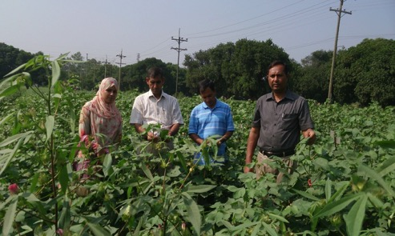
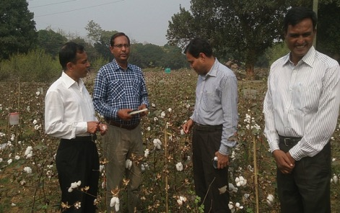
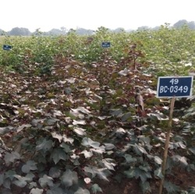
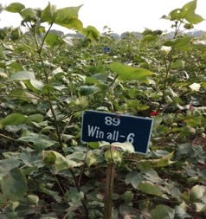
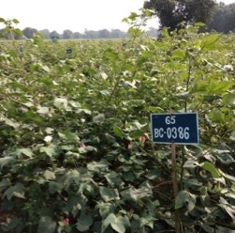
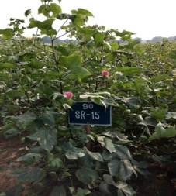
Fig 1. Showing growth and development of several promising cotton genotypes in the field condition.

Slide 21
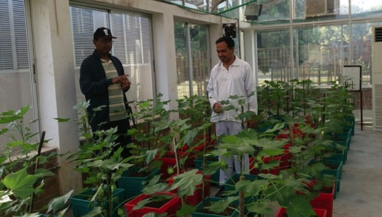
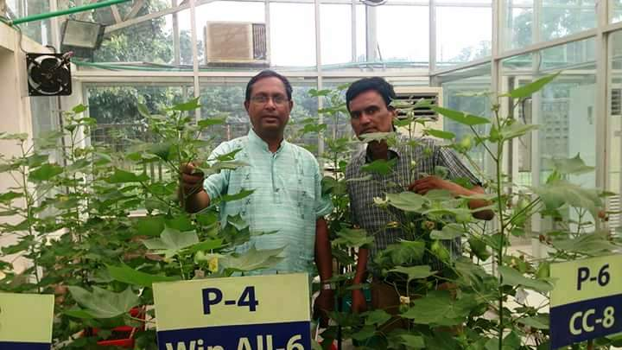
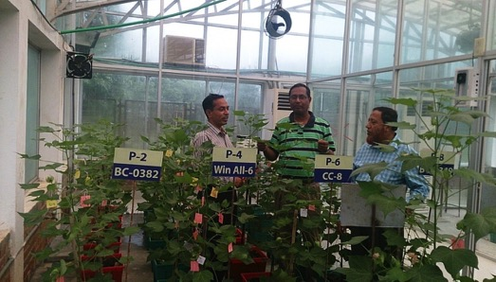
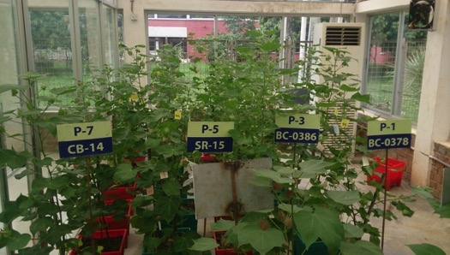
Fig 2. Showing growth and development of several promising cotton genotypes for breeding program in controlled condition

Slide 22
CONCLUSION
Considering earliness and other yield contributing characters eight cotton genotypes are identified as short duration with high yield potential for future breeding program. The selected genotypes are BC-0349, BC-0378, BC-0382, BC-0386, CB-14, SR-15, CC-8 and Win all 6.
Correlation studies indicates that plant height, number of sympodial branches per plant, secondary fruiting branches per pant, number of balls per plant are the yield contributing traits In cotton.

Slide 23
Thank You

