Slide 1
Transgenic Cotton : Gateway to Sustainable Cotton Production- Experience India
V.Kumar
Former Research Scientist (Cotton)
Main Cotton Research Station, NAU
Surat, India
ICAC 13th Meeting of IRCR Network on Cotton
2-6 February 2018, Luxor, Egypt
Views/interpretations expressed by the presenter may/may not be subscribed by the affiliating institute

Slide 2
The Three Milestones of Indian Agriculture
Introduction of Norin 10-Brevor 14 dwarfing gene in wheat which led to green revolution in the mid 60s.
Release of first commercially successful hybrid cotton
Hybrid-4 in early 70s which led to white revolution.
Release of first GM crop i.e., Bt cotton in the beginning of current century leading to gene revolution?

Slide 3
Cotton in last five decades in India
 |  | Productivity |  |  | Production
Year |  | Av. Produc tivity (Kg/ha) | Average increase in Yield (Kg/ha /year) | CAGR | Av. Production (lakh bales) | Average increase in production (lakh bales /year) | CAGR
Pre Hybrid era | 1960-61 to 70-71 | 117 |  |  | 51.27
Post Hybrid era | 1971-72 to 01-02 | 214 | 3.24 | 1.97 | 101.33 | 1.67 | 2.22
Post Hybrid + Bt era | 2002-03 to 11-12 | 473 | 28.77 | 8.25 | 267.95 | 18.51 | 10.21

Slide 4
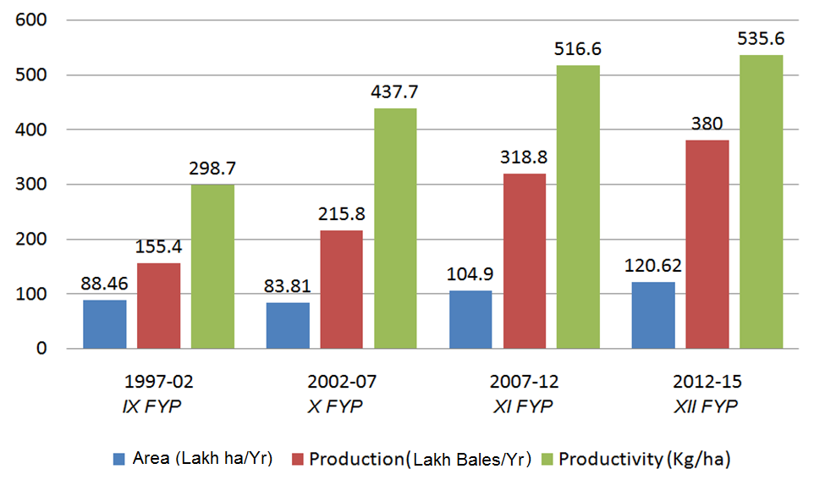
Average area, production & productivity of cotton in India

Slide 5
Increase in average productivity & CAGR of lint in India
(over previous FYP)

Slide 6
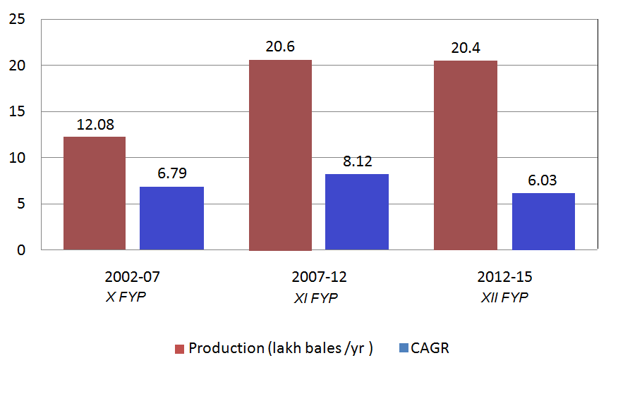
Increase in average production & CAGR of lint in India
(over previous FYP)

Slide 7
Seed cotton yield (kg/ ha) of Bt Vs non-Bt hybrids
Hybrid | 2008-09 | 2009-10 | 2010-11 | Pooled
RCH-2 (BG-II) | 4088 | 3183 | 2744 | 3338
RCH-2 (Non Bt) | 2651 | 1999 | 1524 | 2058
CD @ 5 % | 668 | 426 | 371 | 161
CV (%) | 13.8 | 11.4 | 11.6 | 12.9

Slide 8
Economics of cotton cultivation (Rs/ha)
Operations/Inputs | BT | Non Bt
Cultural operations | 26100 | 26100
B Labour
Plant protection | 1350 | 2700
Picking | 13360 | 8240
Total (B) | 14710 | 10940
C. Input cost
Seed | 2790 | 1350
Insecticide | 2300 | 5900
Total (C) | 5090 | 7250
Total cost (Rs/ha) ( A+B+C) | 45900 | 44290
Production (Kg/ha) | 3338 | 2058
Gross income(Rs/ha) | 150210 | 92610
Net profit (Rs/ha) | 104310 | 48320
Based on three years average yield

Slide 9
Import & export of cotton in India

Slide 10
Average usage of insecticides per year in cotton in India (metric tonnes)
Period | Sucking pests | Bollworms | Total | Insecticide kg/ha
1997-02 | 3798.6 (32.3) | 7696.4 (65.5) | 11750.4 [33.4] | 1.328
2002-07 | 2563.2 (34.8) | 4464.0 (60.6) | 7362.4 [23.3] | 0.878
2007-12 | 5428.0 (84.7) | 564.8 (8.8) | 6708.4 [18.9] | 0.611
( ) figures indicate per cent of total insecticides used in cotton [ ] figures indicate percent insecticides in cotton of the total used in India

Slide 11
Estimated nutrient mining (kg/ha)* by cotton in Gujarat
F Y P N P2O5 K2O
IX (375) 57.38 11.21 78.75
X (580) 88.74 17.34 121.80
XI (674) 103.12 20.15 141.54
*based on average lint productivity kg/ha()

Slide 12
Green house gas (GHG) emission from pesticide application in cotton
Year | Non Bt Cotton |  |  | Bt Cotton
 | No. of sprays | Emission due to pesticide |  | No. of sprays | Emission due to pesticide
 |  | kgCO₂e/ha | kgCO₂e/t |  | kgCO₂e/ha | kgCO₂e/t
2008-09 | 11 | 1973 | 744 | 5 | 888 | 198
2009-10 | 8 | 1460 | 730 | 4 | 717 | 225
2010-11 | 8 | 1471 | 965 | 5 | 905 | 330
Average Reduct. (%) | 9 | 1635 | 794 | 4.7 (-47.8) | 837 (-48.8) | 251 (-68.4)
* The data may/may not represent absolute values

Slide 13
Environment impact quotient (EIQ) field rating
Year | Non Bt Cotton | Bt Cotton | % Reduction
2008-09 | 92.18 | 20.38 | 77.9
2009-10 | 55.63 | 20.94 | 62.4
2010-11 | 47.93 | 31.44 | 34.4
Average | 65.25 | 24.25 | 58.2
EIQ Field Rating= EIQ x % a.i. x Rate
* The data may/may not represent absolute values

Slide 14
Fertilizer N use efficiency (kg/kg N) of Bt Vs non-Bt hybrids
Hybrid | 2008-09 | 2009-10 | 2010-11 | Average
RCH-2 (BG-II) | 17.0 | 13.3 | 11.4 | 13.9
RCH-2 (Non Bt) | 11.0 | 8.3 | 6.4 | 8.6
Addl. Seed cotton yield per unit N in Bt (%) | 6.0 (54.5) | 5.0 (60.2) | 5.0 (78.1) | 5.3 (61.6)
Fertilizer NPK @ 240 : 0 : 0 kg/ha

Slide 15
Irrigation water use efficiency (kg/ha.mm of water) of Bt Vs non-Bt hybrid
Hybrid | 2008-09 | 2009-10 | 2010-11 | Average
RCH-2 (BG-II) | 29.2 | 22.7 | 39.2 | 30.4
RCH-2 (Non Bt) | 18.9 | 14.3 | 21.8 | 18.3
Addl. Seed cotton yield per unit water in Bt (%) | 10.3 (54.5) | 8.4 (58.7) | 7.4 (33.9) | 8.7 (47.5)
Irrigation : 2008-09 and 2009-10 →140 mm 2010-11 → 70 mm

Slide 16
Energy use estimates for US cotton production
Bt cotton produces more energy than it uses in its production vis-a-vis conventional cotton
Source: Cotton Incorporated, 2009

Slide 17
Green house gas emissions from US cotton production
Bt cotton stores more CO2 than it emits in its production vis-a-vis conventional cotton
Source: Cotton Incorporated, 2009

Slide 18
On the social front, Bt cotton fulfilled the third dimension of sustainability fully well and positively. Upto 95 % area covered under Bt cotton and near 50 % increase in total cotton area in India is the best testimony that the technology was well received by the society.
Higher returns and disposable income, lesser exposure to pesticides ensured better health and nutrition to the farmers.
To conclude
India has immensely benefitted from Bt transgenic technology in terms of economic gains to all stake holders, better and safer environment, social upliftment and therefore, sustainable cotton production.
Recently some issues said to be associated with Bt cotton have emerged. No technology is risk free, especially if it is over exploited and injudiciously implemented.

Slide 19
