Slide 1
Overview of the Cotton Sector in Zimbabwe: Policy, Regulation and National Strategies
AGRICULTURAL MARKETING AUTHORITY
Marketing & Economic Research Department

Slide 2
Outline of Presentation
Importance of cotton production in Zimbabwe
Structure of the cotton industry
Players in the cotton sector
Cotton production trends
Cotton producer prices
The role of AMA in regulating the cotton sector
Key issues affecting the cotton sector
National strategies in the cotton sector

Slide 3
Importance of Cotton Production in Zimbabwe
Cotton remains an important crop for improving rural livelihoods.
It is a drought tolerant crop that is most suitable in semi-arid areas of Zimbabwe.
The crop is grown by over 200 000 smallholder farmers.
It is a major source of livelihood for approximately 600 000 people, including farmers, farm workers, their families and industrial workers.
It contributes immensely to income, employment and export earnings.
It is a source of raw material for the textile and oil expressing industry. The stockfeed industry relies on cotton cake for the manufacture of animal feed.

Slide 4
THE COTTON VALUE CHAIN IN ZIMBABWE
SEED COTTON PRODUCTION
Merchants and Ginners
Spinning Factories
Knitting
Policy & Regulatory Services
Min of Agriculture
AMA
DR&SS
Cotton Company of Zimbabwe
Zim Spinners & Weavers
David Whitehead
Twine & Cordage
SinoZim
Sumberero
Twine and Allied
Textiles
Garment Manufacture
China Africa Cotton
Research
Cotton Research Instititute
Quton
Hosiery
Health & hygiene
Southern Cotton
Extension Services
Agritex
Famers Unions
Ginners
200 000
Farmers
Alliance
Vegetable oil
Cotton seed processors
Consumers
Agrochemical and fertiliser Companies
Stock feed manuf.
Grafax
Surface Wilmar
United Refineries
Olivine
ETG Parrogate
Alliance
Cangrow
Grafax
Linters
Water, electricity, fuel
Cotton meal and cake
ETG Parrogate
Labour force

Slide 5
Key Players in Cotton Production
Farmers
Farmer Organizations
Service Providers
over 200 000 smallholder farmers involved in cotton production
3 Farmer Unions are actively involved in cotton production - ZFU, ZCFU and ZNFU.
Independent farmer groups also get involved in cotton production and marketing.
AMA – Regulatory function
Cotton Research Institute
Research Services Division
Agritex
Ministry of Lands and Agriculture
Ministry of Industry & Commerce
Input suppliers

Slide 6
Key Players in Cotton Value Addition
Five Contractors/Ginners and their Areas of operation
ZITMA
Cottco – countrywide
ETG Parrogate – Masvingo, Manicaland
China Africa – Gokwe, Sanyati
Alliance - Gokwe, Sanyati, Kadoma
Southern Cotton – Mbire, Muzarabani, Rushinga. Makonde, Sanyati, Kadoma, Gokwe
National Ginning Capacity – 600 000t
Average ginning outurn 41% lint; 58% cotton seed
There are currently 28 members who include
Spinners
Weavers
Knitters
Dyers
Printers
OIL EXPRESSORS

Slide 7
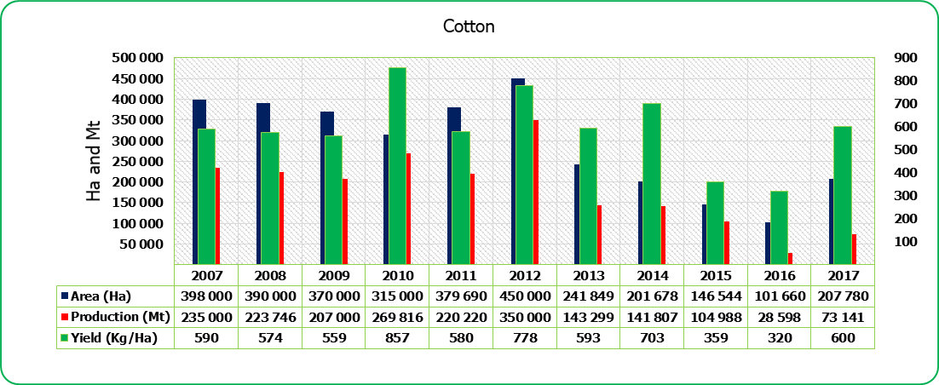
Cotton Production Trends

Slide 8
Cotton Producer Prices
2017 marketing season – US47-52c/kg
2016 marketing season – US35-52c/kg
2015 marketing season – US30-33c/kg
2014 marketing season – US40–70c/kg
2013 marketing season – US40 - 53c/kg
2012 marketing season - US35 – 40c/kg
2011 marketing season - US85/c/kg

Slide 9
The Role of AMA in Regulating the Cotton Sector
AMA is a statutory body (CAP 18:24)
Regulates the production and marketing of cotton
Administers S.I. 142 (2009) and S.I. 63 (2011)
  Grower registration
  Lincencing contractors, buyers and ginners
  Manning of CDPs and CBPs in cotton growing areas – 280 in 2018
  Manning of Grading and Ginning Depots
  Monitors seed cotton grading and lint classification
  Monitors marketing and export of cotton
  Administers the AMF for the cotton sector. Raises resources for:-
      cotton research and training
      Monitoring contract production and marketing
Undertake economic research in the cotton sector
NB: Cotton Research, Plant Pest and Disease Control regulations are administered by the Department of Research & Specialist Services

Slide 10
Key Issues Affecting the Cotton Sector
Viability of cotton production – international prices affected by subsidies
International price volatility
Low yield per hectare – Average national yield is 700kgs/ha of seed cotton despite high yield potential of local varieties.
High input costs
Sustainability of contract schemes
Recurrent droughts

Slide 11
National Strategies in the Cotton Sector
Comprehensive Cotton Production & Marketing Framework (SI 142 & 63)
Cotton Input Support Schemes. There is need to improve yield and productivity.
Research and Development – Dedicated Cotton Research Institute; Quton
Farmer Training Programme to improve seed cotton yields
Cotton to Clothing Strategy

Slide 12
Conclusion
Opportunities are abound in Zimbabwe’s Cotton Industry
Conducive climate for cotton production – Contractors should increase investment in cotton production.
About 70% of cotton is exported as raw lint – the sector yearns for increased investment in spinning, weaving and textile industry to utilize the lint that is produced.
Research and Development Programmes are critical to improve cotton yield per hectare.
As AMA we remain committed to foster growth of the sector by providing a level playing field for all the players in the cotton industry in Zimbabwe.

Slide 13
THANK YOU

