Slide 1

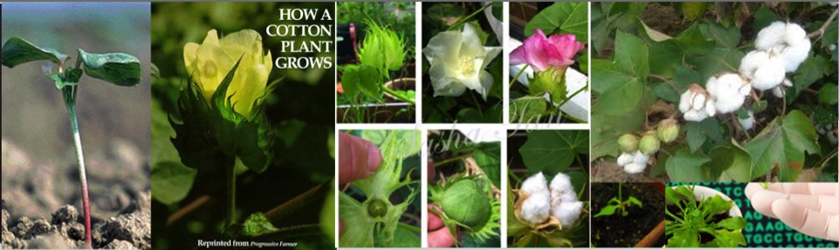
Genetic Modification of Cotton to Control Insects, Weeds and CLCuV
Dr. Abdul Qayyum Rao
Assistant Professor
CEMB, University of the Punjab
Lahore, Pakistan

Slide 2
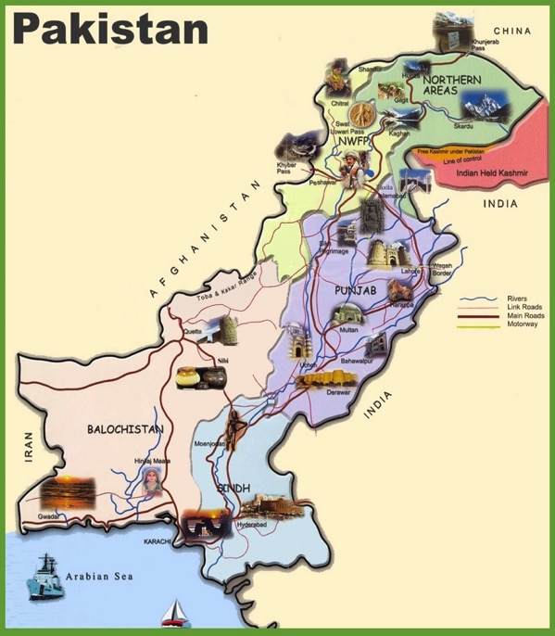
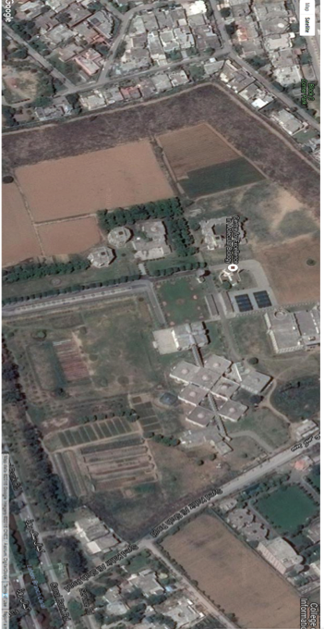
Field for Experiments trials
Hostels
Admin
My Lab
Labs
Labs
Field Containments

Slide 3





























Plant Molecular Biology
CEMB,
University of the Punjab
Plant Molecular Biology
Health Molecular Biology
Plant Biotechnology
Plant Genomics
Seed Biotechnology
Plant Biotechnology
Plant Transformation
Plant Biosafety
Insects Resistance
Weedicide Resistance
Virus Resistance
Fiber improvment
Physiological improvement
Edible vaccine
CRISPR Based strategy
RNAi based Strategy

Slide 4
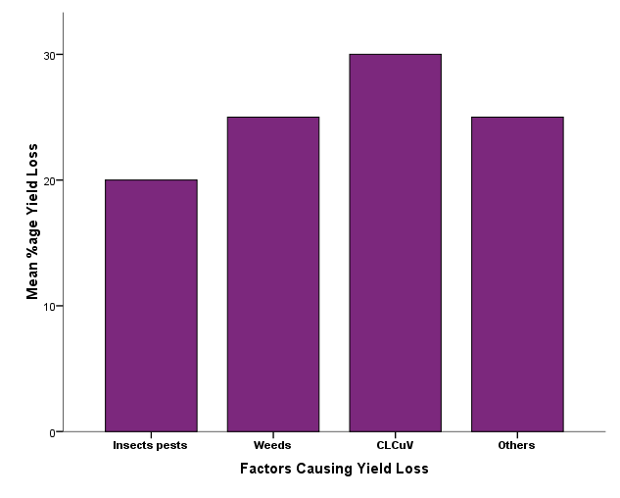
Cotton yield Losses
30%
Asad et al. 2008
Ahmad et al 2017
25%
25%
20%
Khan and Khan et al. 2003
Latif et al 2015
Haq et al. 2008
Puspito et al 2016

Slide 5
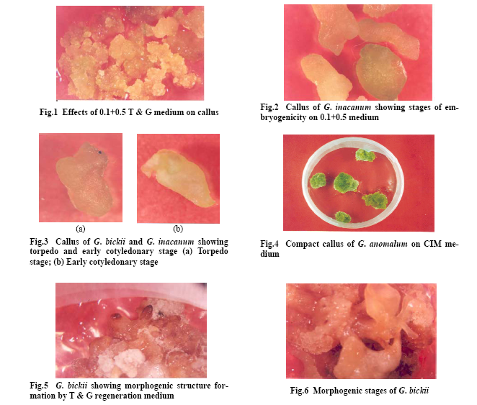
Somatic Embryogenesis of Local and Wild Relatives

Slide 6
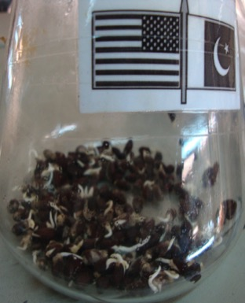
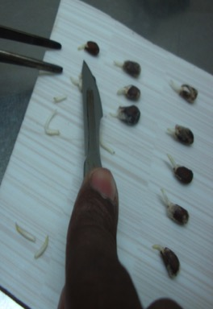
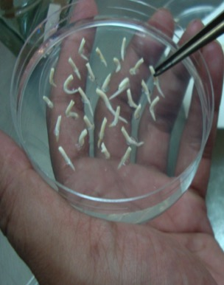
Steps of Cotton Transformation
Agrobacterium-mediated Shoot-apex method
Germination of embryos in sterilized flask
Embryos are taken out
Agrobacterium-treated embryos are implanted on MS medium

Slide 7
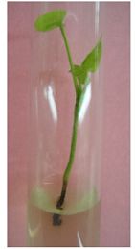
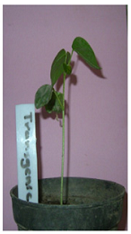
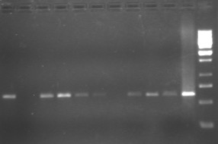
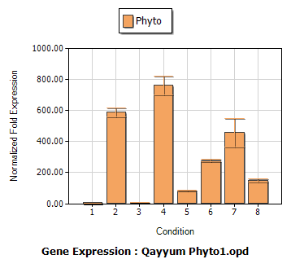
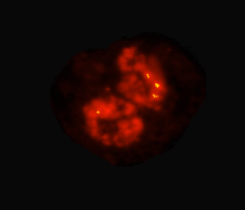

Schematic Overview of Transgenic Plant Processing
1 2 3 4 5 6 7 8 9 10 11 12
646 bp
Putative Transgenic Plants
Transgenic Plant
Confirmation of Transgene through PCR
Copy no. of Transgene by FISH
ELISA of plants

Slide 8
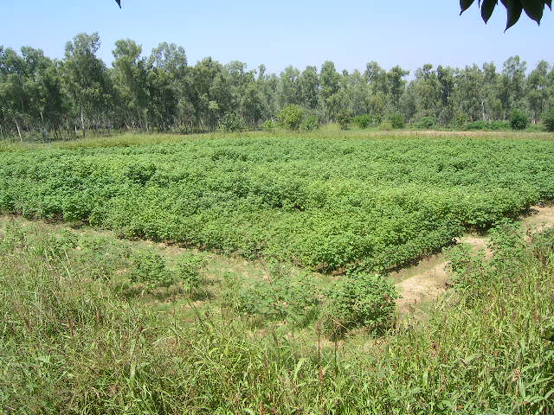
FIELD TRIAL OF TRANSGENIC COTTON
A
B
C
An aerial view of the Bt Cotton planted under biosafety guidelines.
A: Bt Plants B: Non-Bt Refugia
C: Sorghum Boundary to entrap Bt genes from horizontal flow

Slide 9
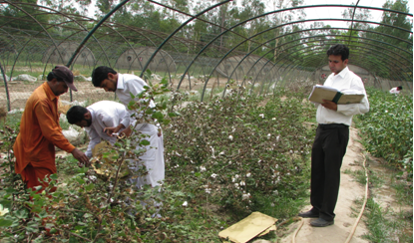
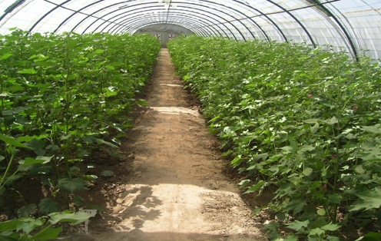
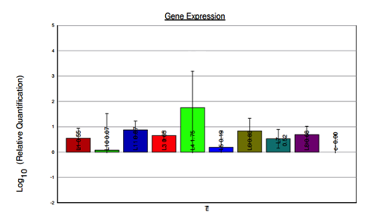
DEVELOPMENT OF CEMB INSECT RESISTANTCOTTON
mRNA Expression
Temporal Expression

Slide 10
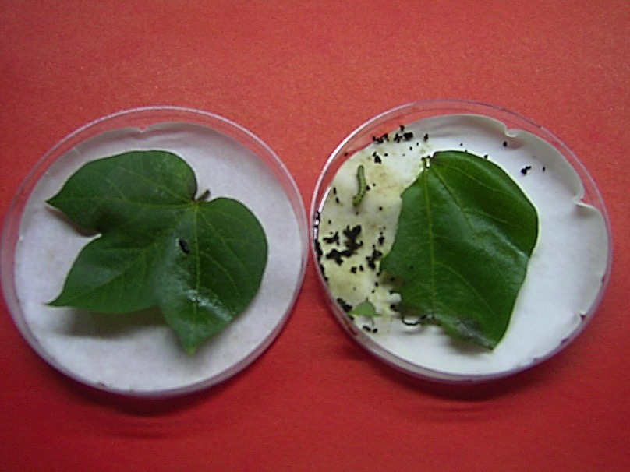
Leaf Bioassay
Alive Larvae
Dead Larvae
Transgenic
Control
Cotton Leaf Bioassay with Heliothis armigera

Slide 11
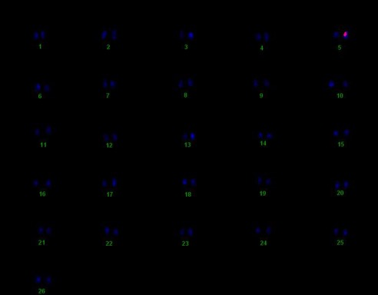

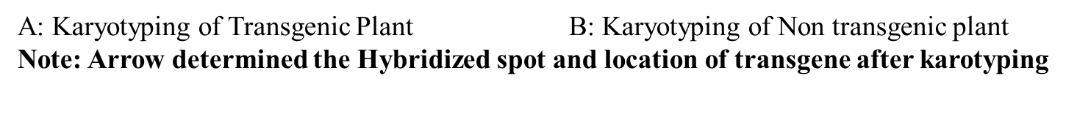
Karyo-typing (FISH) of transgenic cotton plant #
CC4-17(2)
Fig: FISH and Karyotyping of CC4-17(2) Plant of Construct 4 Showing One Copy No

Slide 12
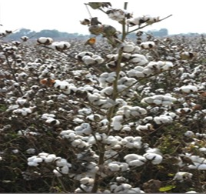
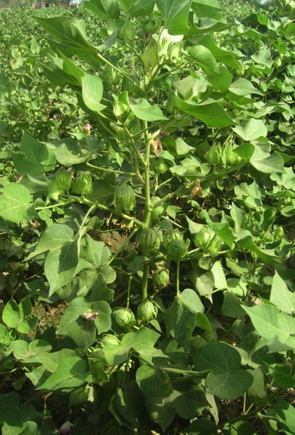

Commercialized CEMB-33 and CA-12

Slide 13
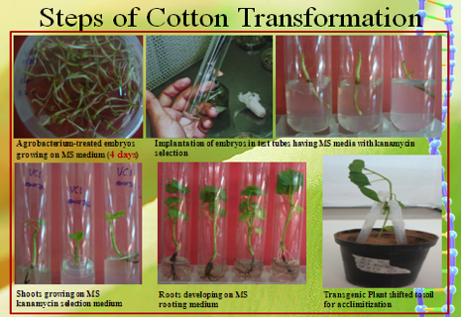
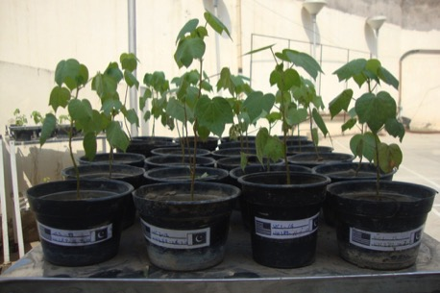
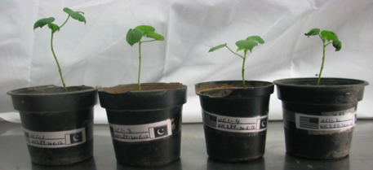
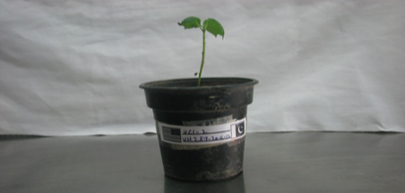
Development of weedicide Resistant Cotton
Fig: Different Stages of Putative Transgenic Plants
Fig: Putative transgenic plants with construct 1 under acclimatization stage
Fig:Acclimatization of Putative Transgenic
Plants of Construct 2
Fig:Acclimatization of Putative Transgenic
Plants of Construct 3

Slide 14
Fluorescence in situ hybridization and Karyo-typing (FISH)
Fig: FISH and Karyotyping of MC1-3 Plant of Construct 1
Raw Data
Metastatic Data

Slide 15
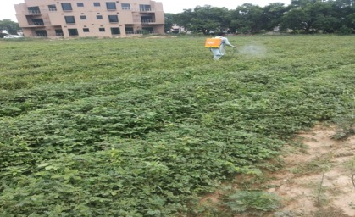
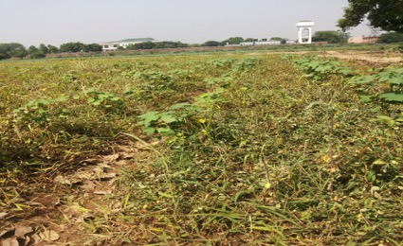
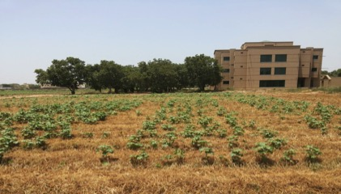
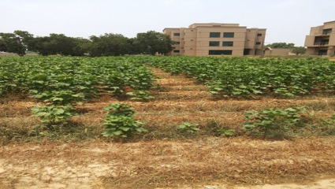
Glyphosate Spray Assay of transgenic cotton plants at T₃ generation @1900ml/acre
Spray of Glyphosate
After 4 Days
After 10 days
After 1 month

Slide 16
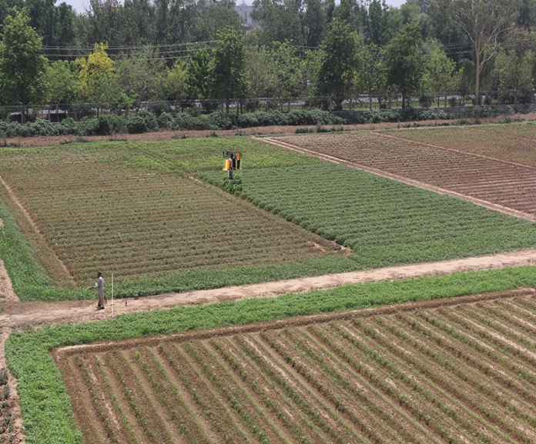
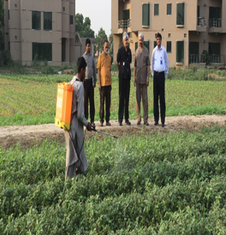
Annexure-II
Different stages of weedicide resistant Cotton after temporal spray of Galaxy in Contained Premises of CEMB
Galaxy Spray after 20 days of Sowing
Galaxy Spray after 30 days of Sowing
Galaxy Spray after 40 days of Sowing
Galaxy Spray after 25 days of Sowing

Slide 17
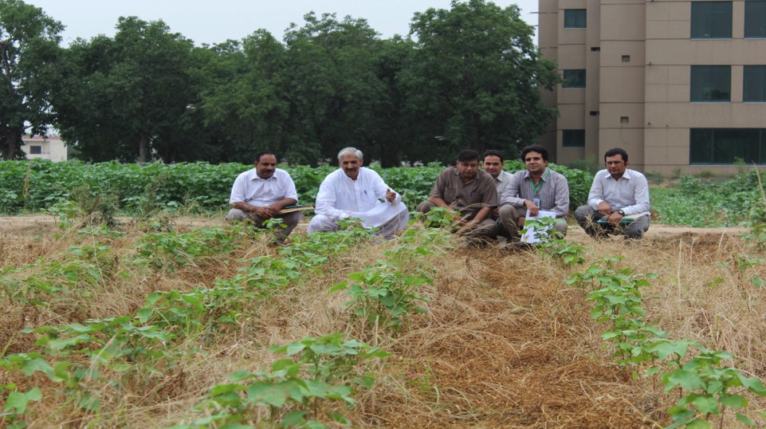
Glyphosate Spray test on transgenic cotton (GTGene, Cry1Ac, Cry2A) plants in contained field settings

Slide 18
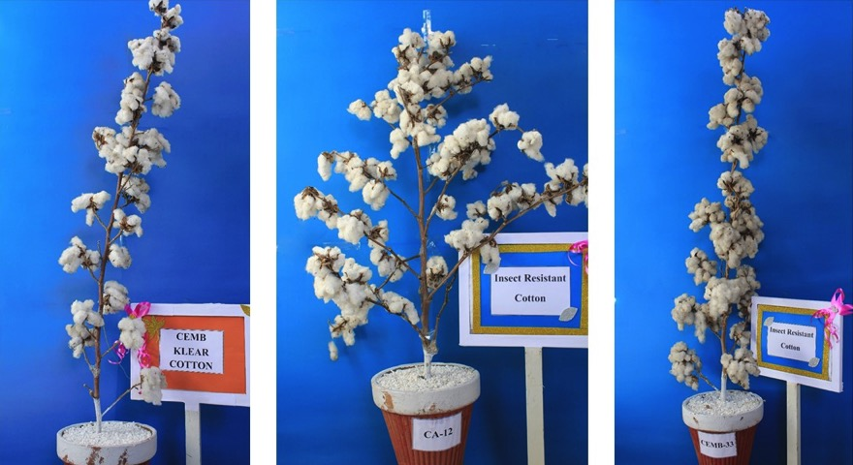
CEMB KLEAN COTTON WITH
CEMB-33 AND CA-12
CEMB KLEAN COTTON
CA-12
CEMB -33

Slide 19
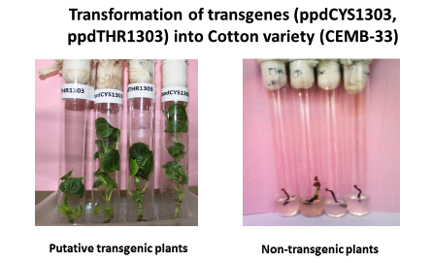
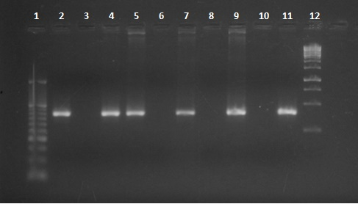
400bp
PCR from genomic DNA of transgenic plants
Lane 1: 50bp ladder Lane 2-9: PCR product
Lane 11: Positive control Lane10: Negative control Lane12: 1kb Ladder
Relative expression of Phytoene desaturase in transgenic cotton plants

Slide 20
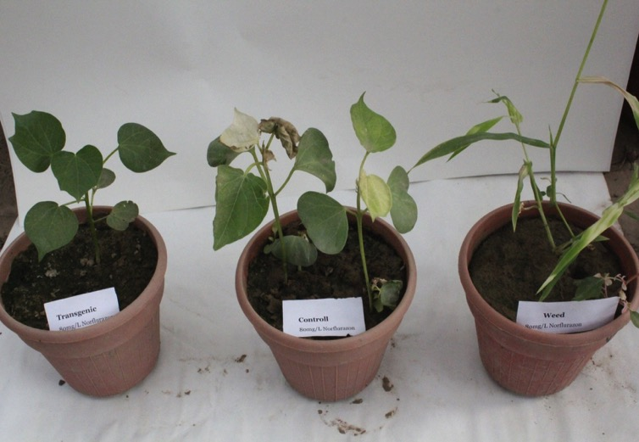
Transgenic VS control after 3 days
of Norflurazon spray @ 80mg/L

Slide 21
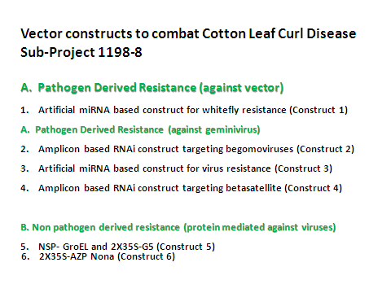
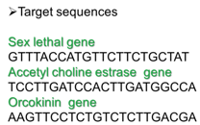
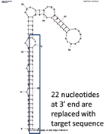
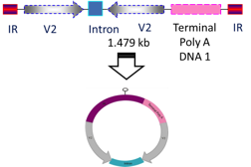

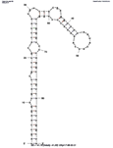
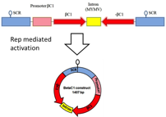



Slide 22
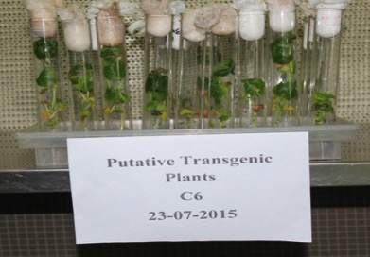
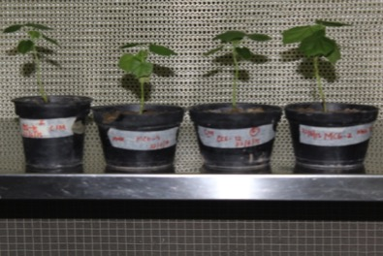
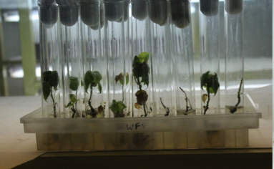
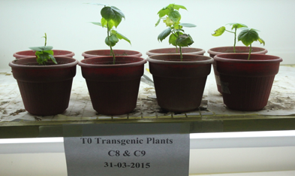
Transformation of different Construct to Control CLCuV
Construct 6 putative transgenic plants
Construct 8 and 9 transgenic plants

Slide 23
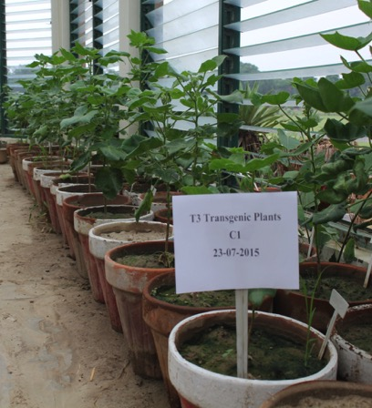
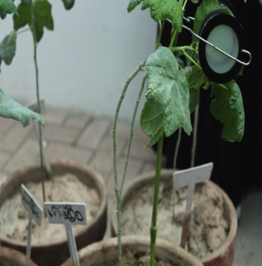
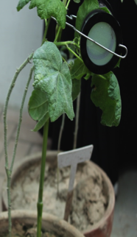


Whitefly feeding assay
Transgenic plants with whitefly clippers having ten whitefly

Slide 24

Pathogen derived Resistance against vector (Whitefly)
A: Both cages with transgenic control and non-transgenic plants; B, C: WF1 Transgenic plants with Control non-transgenic plant; D,E: Inner view of cages.

Slide 25
Determination Of CLCV Titer of Transgenic And Control Plants of Construct Wf1 after Transmission Assay (Construct: 9)
Absolute quantification of β DNA molecule/µl of transgenic cotton plants having Wf1 construct; NT₁: Symptomatic non-transgenic control plant, NT₂: Asymptomatic non-transgenic plant, NT₃: Asymptomatic control non-transgenic plant, Wf1, Wf2: Symptomatic transgenic cotton plants Wf3, Wf4 and Wf5: Asymptomatic transgenic plants.

Slide 26





Non Pathogen derived Resistance against CLCuV
Virus resistant transgenic cotton plants of T1 generation in PARB Project #426

Slide 27

T1 Generation
Difference of Fruiting and Growth
Effect of Virus Symptoms but recovery in Transgenic Cotton Plants
Comparison of Transgenic and Control non Transgenic Plants of T1 generation

Slide 28




Pathogen Derived Resistance against CLCuV
SOWING 30-04-2015
301bp
301bp
Symptomless Plants through out season

Slide 29







Determination of integration and copy no through Southern Blot analysis
1 2 3 4 5 6
Note:
Restriction Digestion was done by using
HindIII Enzyme
Probe Labeling and Detection was done by Using
Dig Labeling Kit Cat# 11585614910
1 2 3 4 5 6
Lane 1: 1 Kb Ladder
Lane 2: Negative Control
Lane 3: Vc1-12
Lane 4: Mc1-3
Lane 5: VC1-1
Lane 6: Digested Plasmid DNA as Positive Control

Slide 30
Fluorescence in situ hybridization and Karyo-typing (FISH) of microRNA159 plant MC1(3)-2

Slide 31



An alternative way of exploring wax role against CLCuV Transmission
A
B
Figure: Plants after incubation of whiteflies (A) Wax mutant GaWM3 showing symptoms of upward curling (B) Gossypium arboreum - 786 have no symptoms on it while (C) Gossypium hirsutum - MNH 93 showing severe leaf curling, enation and thickening of leaf veins.
C

Slide 32





Dye assay of Whitefly for wax as Barrier
Fly Fed on Gossypium arboreum mutant
Fly Fed on Gossypium arboreum
Fly Fed on Gossypium harkasnessi
Fly Fed on Gossypium hirsutum
Normal Fly from Field

Slide 33




Visit of USDA and ICARDA Team
Visit of USDA and ICARDA Team on 25-03-2013
Morphology of Transgenic Plants in Tunnel
Close Overview of Plant Architecture

Slide 34

2012

Slide 35



Work at KIT

Slide 36





Application of State of the art Technology
x
x
x
Happy Cotton and Healthy Economy

Slide 37





CEMB Appreciations and Awards

Slide 38


First Technology Award on production of Insect Resistant Cotton March, 2015

Slide 39

First Technology Award on production of Klean Cotton on November 2015
University of Hari Pur 5th Invention to Innovation Summit 2015

Slide 40
Acknowledgements and Request
Thankful to
ICAC
ICRA,
Especially Dr. Keshav Kranthi, Michael FOK and Prof Negm
CEMB has newly constructed furnished Auditorium
Furnished Guest house within walled area.
Request
ICAC is therefore requested
to give a chance to
CEMB, Lahore Pakistan for hosting ICAC meeting in future

Slide 41


Thankyou/Danke

