Slide 1
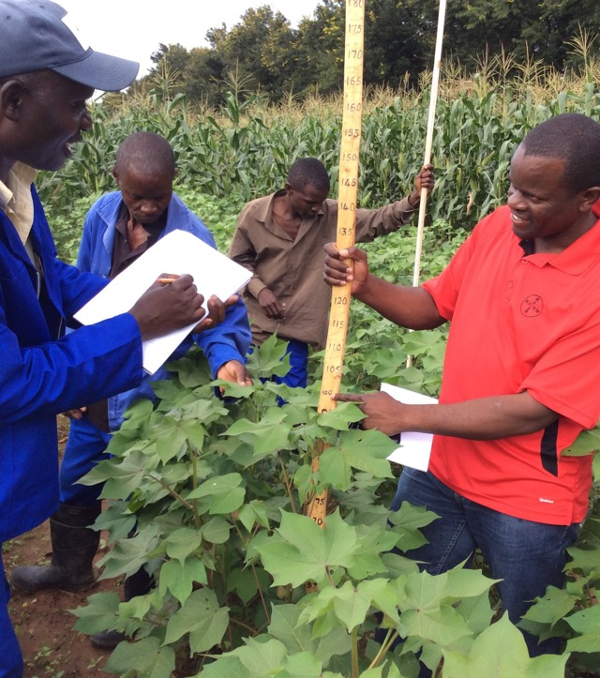
Public and Private Sector Contribution to Cotton Production
SEACF Meeting, Harare
Greetings to you all
  3-6 July 2018 / Fungayi & Farai

Slide 2
Agenda
1. Introduction (slide 3)
2. Major challenges in cotton production (slide 4)
3. Cotton inputs (slides 6-7)
4. Unpacking the role of R&D agrochemical companies(slide 8)
5. How does Bayer respond to pest challenges
6. Demo trials & stewardship training (slide 10)
7. Photo of demo trial (slide 11)
8. Parameters for introducing new chemistry (slide 12)
9. Cotton Farmers (slide 13)
10. Cotton/Ginners Merchants (slide 14)
11. Yarn, textile and clothing manufacturers (slide 15)
12. Cotton VC for South Africa (slide 16)
13. How Cotton SA industry created 5,500 jobs (slide 17)
14. Achievements, constraints and ultimate goals (slide 18)

Slide 3
Introduction
Cotton is one of the export crops of in east and southern Africa
Cotton is mostly grown by smallholder farmers providing labour to rural households.
Before 1990 most cotton marketing and trade were handled by governments and cooperative unions.
After 1990 governments eliminated monopoly and liberalised the cotton industry and allowed entry of private ginners/merchants
However there are still many challenges to be resolved

Slide 4
Excerpt of the Zimbabwe Cotton Value Chain
Source: Cotton Value Chain Analysis, 2009

Slide 5
Major challenges in cotton production
Low cotton yields and poor quality seed cotton production
Lack of access to credit for key inputs for cotton production
Under funded national agricultural extension services
Lack of contract integrity by smallholder farmers
Side marketing to dodge repaying cotton input advances
Use of chemicals-off label
Persistent use of the chemicals from same group/resistance
Lack of high yielding cotton cultivars (restrictions on GMOs)
Side selling of free inputs from Government
Outdated technology
Lack of investment into the cotton industry

Slide 6
A closer look at the cotton value chain
1. Cotton Inputs:
Seeds, certified seed, government cotton research institutes
- Public sector responsibilities to develop high yielding good quality cotton cultivars – funding challenges
- Private companies can play a big role, i.e. Bayer sales GMO cotton planting under license from Monsanto (can yield up to 8.2mt/ha under irrigation)
Seed multiplication: ginners, farmers, agriculture tertiary institutions
Can produce under license and strict supervision
Maintain genetic purity and seed vigour

Slide 7
Cotton inputs continued…
Extension services; government departments, farmers and ginners
Synergies between the public institutions and private sector
- Funding assistance from NGO programs
Agro-chemicals and fertilisers
R&D Companies (unpack their role in next few slides)
Generic companies
Water, electricity and fuel:
- Government or private sector (constant and uninterrupted supply)
Labour force – minimum wages, labour laws (restrictive)

Slide 8
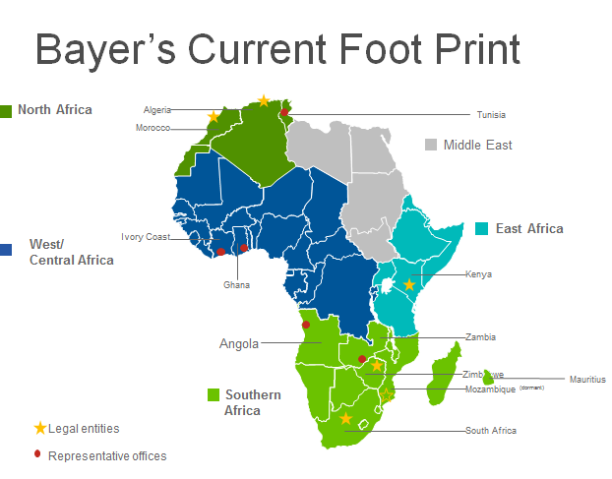
Unpacking the role of R&D agrochemical companies

Slide 9
How does Bayer respond to pest challenges
Identify the pest causing economic losses, search globally for chemical products that have been developed to control the pest
Gather information on crop production hectares, number of treatments, practical use rate, selling price, COGS
Conduct a viability assessment, NPV, IGM, Pay back time etc.
Sign contracts for research trials with credible partner organisations, like CRI to conduct research trials for three years
Conduct Minimum Residue Tests
Prepare a dossier and submit application for registration
Organise a product launch and sell the product to the farmers through channel partners

Slide 10
Demos trials and stewardship training
Conduct on farm demo trials in the target market segments
They are useful tools for practical training of farmers and extension staff
Bayer also provides training on stewardship – safe use, transport and storage of crop chemicals
Training on product knowledge and crop protection management

Slide 11
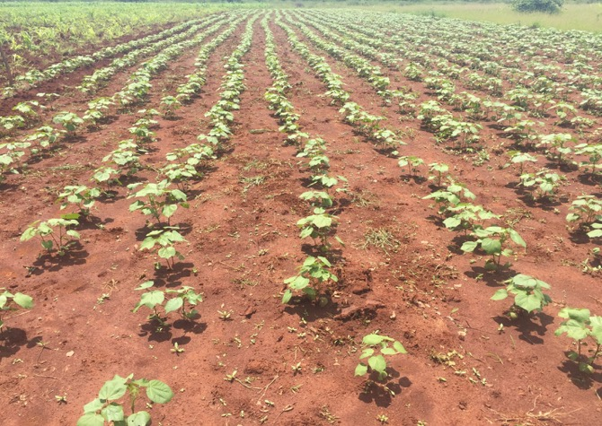
Demo – trial planted in a target market segment

Slide 12
Parameters for introducing new chemistry
Develop products that target a specific pest
Products with a low environmental toxicological profile
Low dosage rates
Products that are safe to users and to the environment (WHO class III and above)
Products that are tolerant to bees and other beneficial pests
Introduce active ingredients in different family groups for resistance management

Slide 13
Cotton Farmers
Commercial farmers – production under irrigation and dryland, high input regime
Have cooperatives and own ginneries
Utilise hybrids and GMO cultivars
2. Medium scale – dryland/irrigation production
Contract production from ginners who provide input advances
3. Smallholder – mainly dryland
- Contract production by ginners who provide input advances, extension, training and a ready market for the seed cotton

Slide 14
Cotton Ginners/Merchants
Identify cotton production areas and organise farmers into groups
Provide input advances to contract farmers
Produce, treat and distribute cotton planting seed
Provide extension services, training and production guidelines
Provide the demand pull by buying all the seed cotton produced
Process the seed cotton to lint, ginned seed for local and export market

Slide 15
Yarn, textile and clothing manufacturers
Balance local demand versus exports
Value addition to generate more revenue
Employment creation
Trade policy and guidelines to curb local market distortions
Investment is spinning and weaving technologies to compete globally
Cotton from farmer to retail (clothes with labels indicating local production)

Slide 16
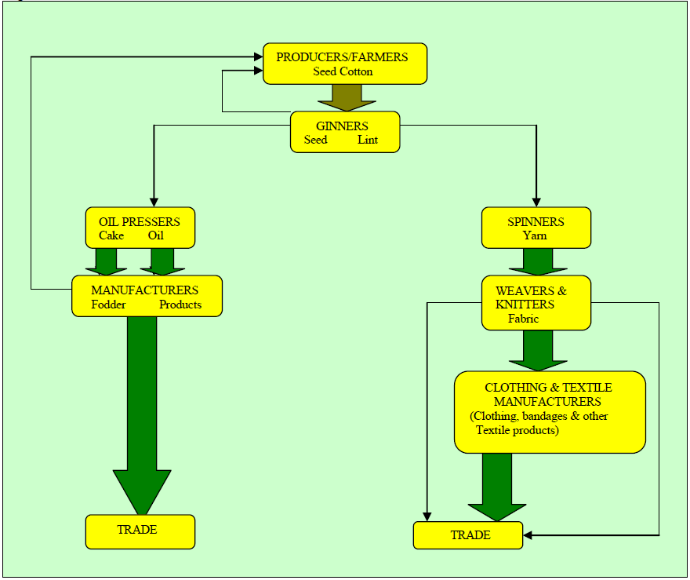
Cotton Value Chain for South Africa
Soure: Adapted from Cotton South Africa, 2014

Slide 17
How Cotton SA Industry Created 5,500 Jobs
Sharing best practices – 5 Year Plan
On 1 April 2014, Department of Industry & Trade (DTI) launched 5 year plan to improve capacity, competitiveness and create jobs
Established a national textile cluster (SASTAC) and provided R200m grant
Cotton industry formed the Sustainable Cotton Cluster in May 2014
Entire cotton VC; farmers, ginneries, spinners, dyers, finishing plants, weavers, retailers and consumers were brought together
Mr Price Group served as first pilot for the integrated supply chain program
Edcon, Clicks and Woolworth joined in (from farm to retail)
Cotton Cluster has established 11 VCs (t-shirts, chinos, towels) >R2billion

Slide 18
Achievements, Constraints & Ultimate Goals
Lint production has increased sevenfold from 25,000 bales in 2013 to 180,000 bales this season
Investment in 3 ginneries worth R200m
Investment in harvesting machines to consolidate picking and baling
Created 5,500 jobs from farm to retail
Provided funding support for 1,000 small farmers (4,500ha)
Constraint: spinning and weaving capacity is almost 1000%
Ultimate goals: increase productivity utilising biotechnology
Increase local beneficiation by doing import substitution of 4 basic retail items
Create more than 75,000 new jobs

Slide 19

Thank you!
Bye-Bye

