Slide 1
Best Management Practices (BMP’s)
14th Southern and Eastern Africa Cotton Forum (4-6 July 2018)
Blaise Desouza
ICAR-Central Institute for Cotton Research, Nagpur

Slide 2

Some BMP technologies that can be adopted after suitable modifications to suit the local conditions

Slide 3
Reduced/conservation tillage systems

Slide 4
Planting dates – rainfed central India
Timely planting in rainfed areas ensures crop taking full advantage of rainfall
Avoidance of late-season pests

Slide 5
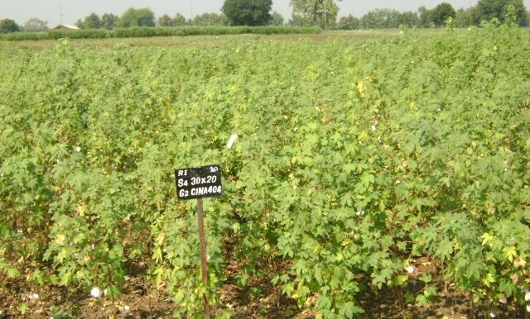
Spacing, plant population, canopy management
45 to 60 cm (1.5 - 2 feet) and 10 cm between plants
166,0000 to 222,000 plants/hectacre

Slide 6
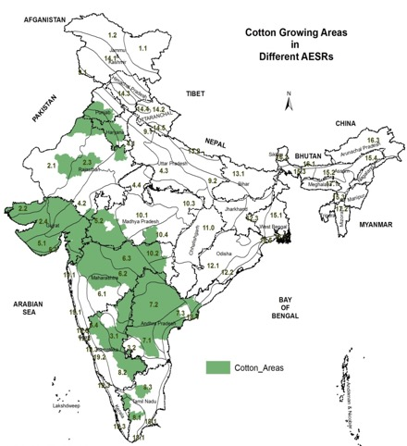
Planting the right variety
Cotton is predominantly grown in India under arid, semi-arid and sub-humid conditions in the agro-eco regions (AER) 2 to10
Within Central zone
there area areas with 50 mm to 200mm available water capacity (mm/m), locations with shallow (< 50 cm) to very deep (>150 cm) soils of various textures,
varying from 300 to 1200mm
LGP from 60 days (irrigated?) to more than 210 days.
Agro-ecoregion based
Climate and soil type

Slide 7
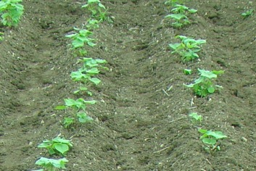
Ridge and furrow cultivation
Water requirement is critical during peak boll formation phase. Rain-fed cotton suffers most, especially in long duration varieties / hybrids.
Method of soil and water conservation practiced in the low rainfall areas

Slide 8
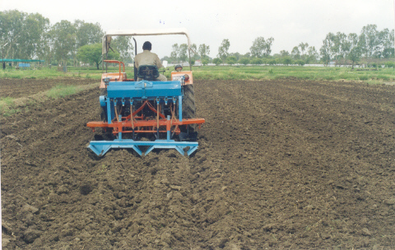
Making Broad bed furrows and
planting on beds across slope

Slide 9
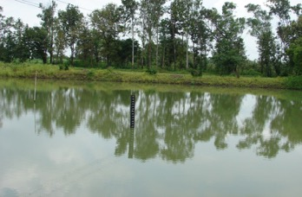
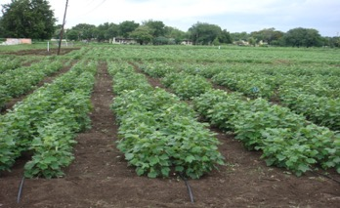
Rain water harvesting and recycling
Recycling harvested rain water to provide 1-2 protective irrigations
Yield improved by 30%
Drip method of irrigation for improved efficiency

Slide 10
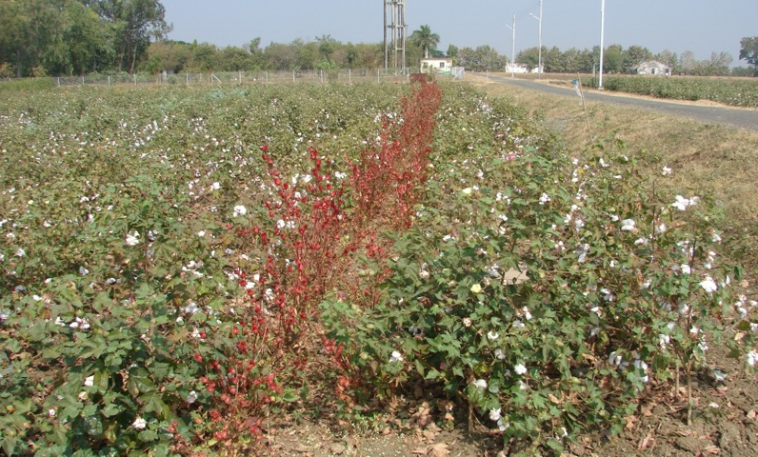
Crop diversification – intercropping and crop rotation
Better to have intercrops – legumes, some local vegetables etc.
Important that they are compatible fast growing and early maturing <60 days

Slide 11
Matching Nutrient Supply with Crop Demand
  Right Rate
  2. Right Balance
  3. Right Timing

Slide 12
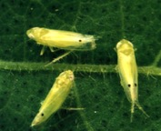
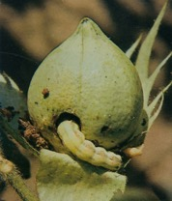
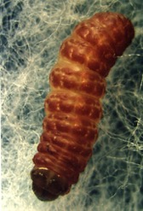
Insect Management
IPM and IRM based strategies
Advocate least use of insecticide
Following the window based strategy

Slide 13
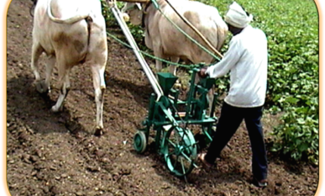
Implements for Small farmers
Specially designed for small holdings
Mechanization helps in improving productivity
Reduce drudgery

Slide 14
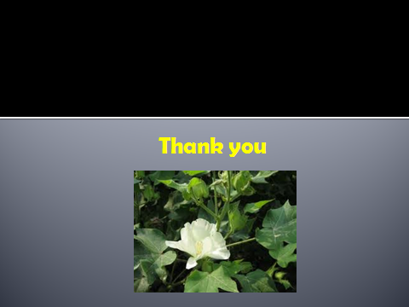
Acknowledgements
Thankful to the ICAR and CICR for deputing me to attend the SEACF
Thank the ICAC for the invitation and sponsorship
Thank the local organizers for the kind hospitality

