Slide 1

Conservation Agriculture – the BMP for Sustainable Cotton Production in Africa: Indian Experiences
Blaise Desouza
ICAR-Central Institute for Cotton Research, Nagpur, Maharashtra
India
Email: blaise_123@rediffmail.com

Slide 2
Outline
Introduction
Methodology
Findings
Applications to the African context
Conclusions

Slide 3
Introduction
Productive Soil - high yields
Soil Neglect leading to deterioration
Soil degradation increasing due to
Increased soil disturbance
Reduced organic additions
Heavy reliance on fertilizer inputs

Slide 4
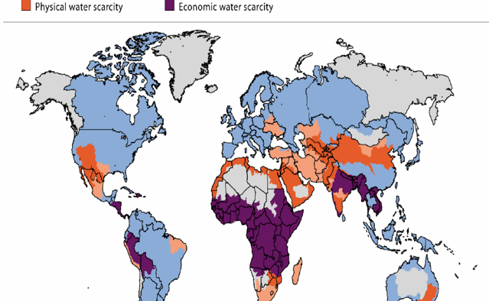
Increasing water stress – low productivity
Source: International Water Management Institute
Adapted from Kumar (2013)

Slide 5
Can we reverse soil degradation?
Yes - adopt right management options
Conservation Agriculture (CA) - Best Management Practices (BMP)

Slide 6
Conservation Agriculture!!
CA is based on the following three principles:
Minimum soil disturbance
Increased soil cover
Crop rotations

Slide 7
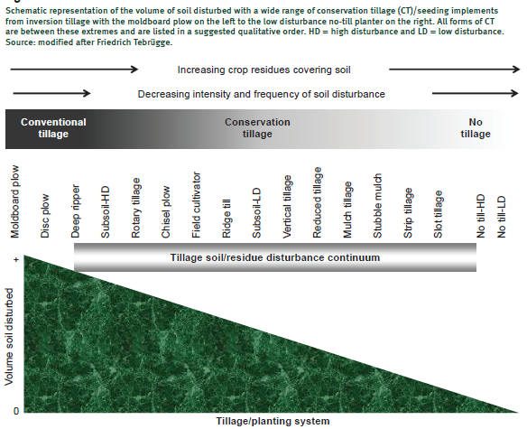
Minimum soil disturbance
Any reduction in tillage from the conventional practice is a form of CA, such as reduced tillage, stubble tillage, no-tillage.
Adapted from: Reicosky (2015)

Slide 8
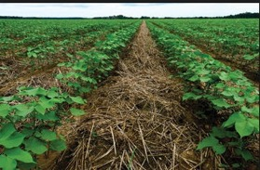
Soil residue cover
Essential to keep the soil covered with crop residue within the field (rather than removal and burning)
Because cotton is a low crop residue generating crop, grow a cover crop either before or after cotton.
Select cover crops that can grow on residual moisture and are drought hardy
Preferential to grow legumes because of N benefits

Slide 9
Crop rotations
Avoid monocrop for long-term
Diversified crop system
Legumes - part of the cropping system
Include cereals in the rotation – provides benefit of food as well as fodder

Slide 10
What farmers are doing now?
Excessive tillage operations
Hand weeding!!! (production cost increased)
Burning crop residues

Slide 11
Why till the soils?
Provide a good seed bed - ensures a good crop stand.
Free of weeds (possible by using pre-emergence herbicide)
Summer plowing - to reduce problem of nematodes and destroy over-wintering population

Slide 12
Methodology
Field Experiment continued over 9 years at the same site with a fixed plot layout
Split Plot Design
Main Plots were Tillage Treatments
Conventional tillage (Farmers practice)
Reduced tillage₁ – two hoeing
Reduced tillage₂ – no hoeing
Sub-plots
Without residue
With residue (cotton crop and other crop; legume covers)

Slide 13
Results

Slide 14
Seed cotton yield as affected by tillage system over years (1996 to 2008)
Reduced tillage systems with crop residue recycled yields higher for the Upland cotton cultivars as well as hybrids
Vice versa for the Asiatic cotton cultivars
Blaise and Ravindran (2003)
Blaise (2006)
Blaise (2011)

Slide 15
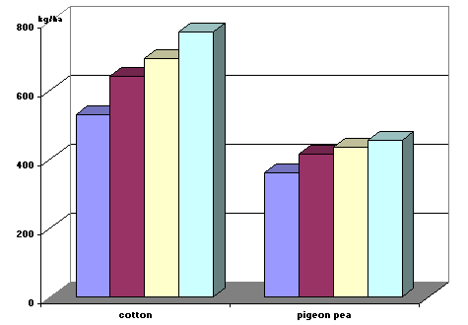
Results of on-farm trials
Increased boll retention
High seed cotton yields
Profitable
Blaise et al. 2005

Slide 16
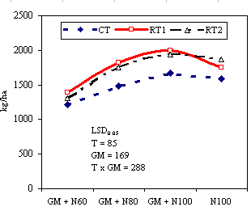
Conservation tillage with legume cover and nitrogen
CT
RT
CT: Conventional Tillage
RT: Reduced Tillage
GM: Live Green manure In situ
N: Nitrogen rates (kg/ha)
Blaise (2011);
Blaise et al. (2017)

Slide 17
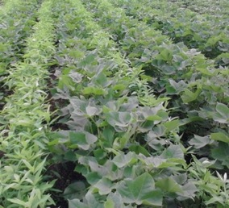
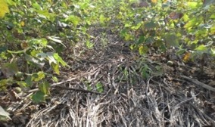
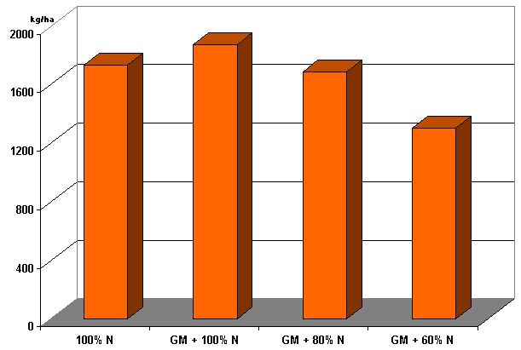
Potential to save 20 kg N by in situ green manure
a
ab
b
c
Blaise (2011)

Slide 18
Impact of cover cropping studies (2012-17)
Seed cotton yield
Generally, Cover plots yielded equivalent to weed free
Pearl millet and Sorghum depressed seed cotton yield when grown as cover crops
Vice versa when applied as mulch
Polythene mulch hastened maturity
Newspaper mulch as effective as the weed free plot
Soil Analysis
Soil microbiological and biochemical properties were better in the cover crop plots than those without
SEM-XRD Analysis done shows better soil aggregation
The images also clearly indicate that C accretion increased
Furthermore, from the Analysis, O2 content and pore space was greater in the cover than without cover crop treatments

Slide 19
New cover and mulch options available
Legumes – native and indigenous
Cereals – sorghum, pearl millet
Oilseeds – sesame
Aromatic plants ???

Slide 20
Learning Lessons for Africa
Water scarcity
Impoverished soils/soil degradation
Lot of similarities between Africa and the SAT of India –
Mostly rain dependent cotton
Manual labour dependence
Traditional farming systems
However, traditional and inefficient tools still used in most parts of Africa

Slide 21
If Conservation Systems are so good, why not followed!!
Plenty of challenges exist:
Crop residues competing uses for animal and fuel
If herbicide is not used how can we check the weeds
Alternative to fertilizer application
Slow adoption due to understanding
Lack of evidence and data

Slide 22
What is immediately needed?
Identify cotton cultivars - short duration and compact growth habit
Research – collaborative
Efficient transfer of technology
Cotton mechanization and small farm equipment to improve farm labour efficiency
Identifying crops that are indigenous and fix Nitrogen
Crops that are compatible with cotton for intercropping

Slide 23
Acknowledgements
Thank ICAR for deputing me to attend the 14th SEACF
Thank Dr. K R Kranthi, Technical Head, ICAC and the organizers for inviting me
Thank Mr. Kai Hughes, ICAC and his team for financial support
Thank the host organizers especially Lawrence, Washington and their team
I am grateful to my fellow colleagues of the Crop Production Division (Drs. Manikandan, Savitha Santosh and Mr. RM Ramteke)

Slide 24

Thank you

