Slide 1

EVALUATION OF FIBER AND YARN TECHNOLOGICAL PROPERTIES OF ADVANCED GREEK COTTON LINES
Dr. Eleni Tsaliki ¹, Dr. prof. Mohamed Negm², Dr. Apostolos Kalyvas¹
¹ Plant Breeding and Genetic Resources Institute
PO Box 60458 Post code 57001 Thermi Thessaloniki Greece
e-mail: tsaliki@ipgrb.gr
² Cotton Research Institute, Giza, Egypt

Slide 2
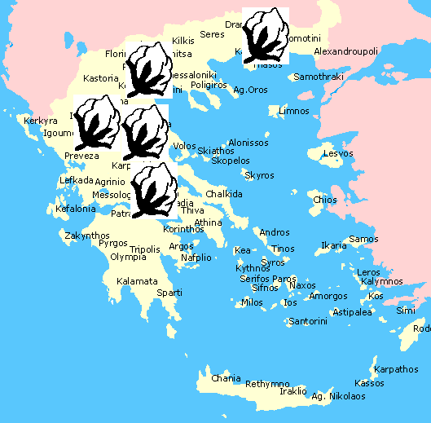

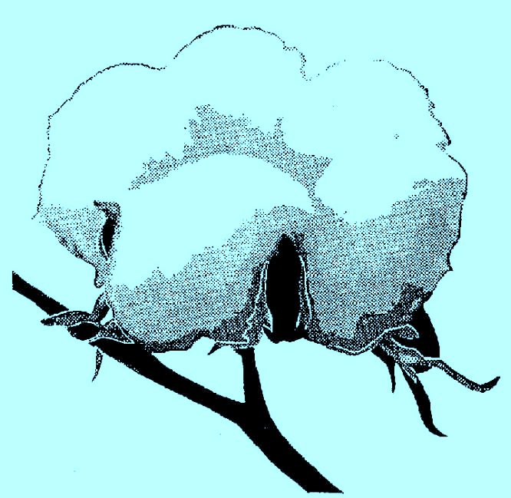
Cotton - Greek national product
8 % of total agricultural output
More than 55,000 farmers
Average cultivated area 250000 ha (nearly 50% of the irrigated land)
80 % of the EU production

Slide 3

Cultivation area in Greece 269323,5 ha -2015
Source: www.elstat.gr

Slide 4
Total Seedcotton yield
817574 tn -2015
Source: www.elstat.gr

Slide 5
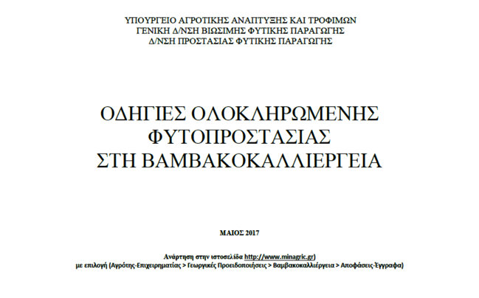

www.minagric.gr

Slide 6
Integrated Management System in Cotton
SEED SELECTION
TILL 60% OPENING OF BOLLS (95 DAYS)
SOWING - FIRST 45 DAYS
DEFOLIATION – HARVESTING - GINNING
AFTER HARVESTING

Slide 7

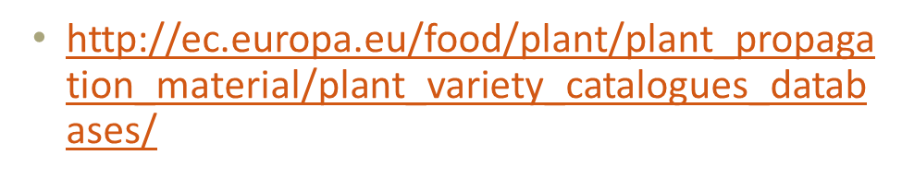
201 varieties
Greece 116
Bulgaria 23
Italy 2
Spain 75

Slide 8
AIM OF THE STUDY
New germplasm is available almost every year and it is important for producers to note genotypic and phenotypic differences in varieties in their region in order to obtain high yields and good fiber quality.
The importance of cotton crop in Greek economy compels plant breeders to make consistent efforts for the genetic improvement of fiber yield and quality.
New varieties with high yield and fiber properties that ensure their commercial success to be included in Greek National Catalogue.

Slide 9
MATERIALS AND METHODS
2 years, 3 replications, RCB
Seven cotton genotypes developed from cotton breeding programs of the IPBPR and one reference variety
Experimental fields of Plant Breeding and Genetic Resources Institute (IPBPR)
Each plot consisted of two rows of 10 m length and within row spacing were 0.90m

Slide 10
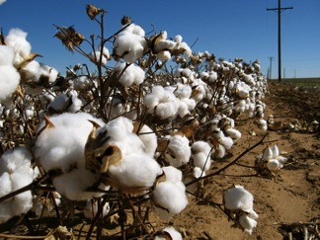
Cultivation data
 | 2012 | 2013
Sowing date | 22 May | 9 May
Harvesting date | 15 November | 9 October
Min temperature | 3ºC (9/11/12) | 8,8ºC (27/5/2013)
Max temperature | 39ºC (7/8/12) | 37,2 ºC (4/8/2013)
Average min temperature | 17,3ºC | 18,0ºC
Average max temperature | 29,3ºC | 30,5ºC
Rainfall | 123,3 mm | 94,40mm

Slide 11
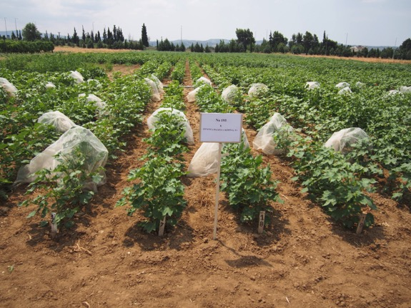
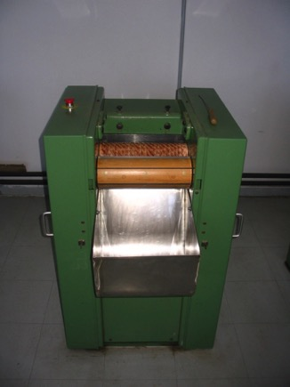
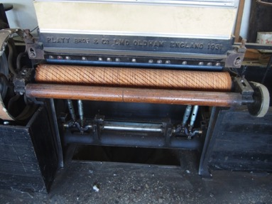
Hand picked and roller ginned

Slide 12
Cotton fiber evaluation 2012

Slide 13
Cotton fiber evaluation - 2013

Slide 14
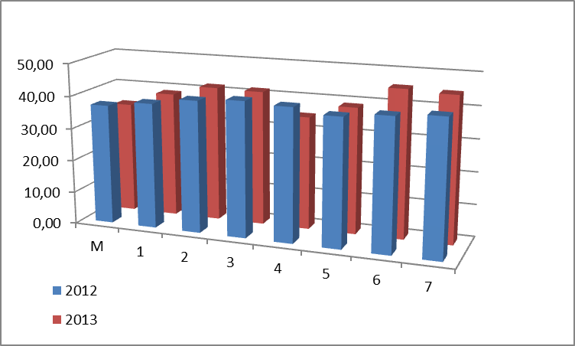
Lint (%)
Experimental roller gin

Slide 15
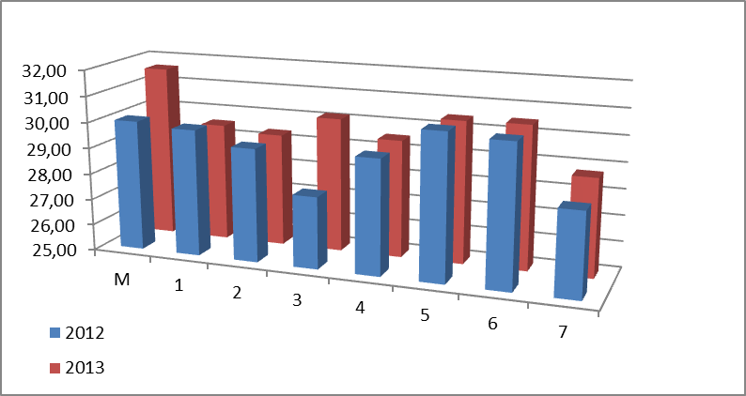
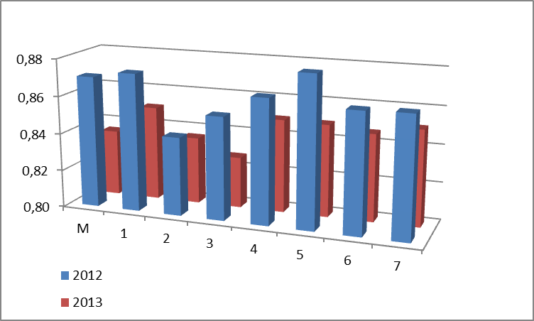
Length (mm) – Maturity index

Slide 16
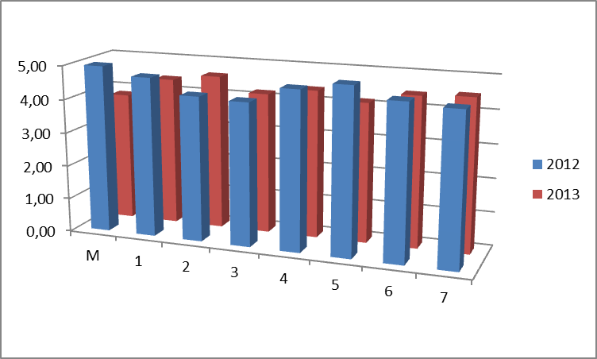
Micronaire

Slide 17
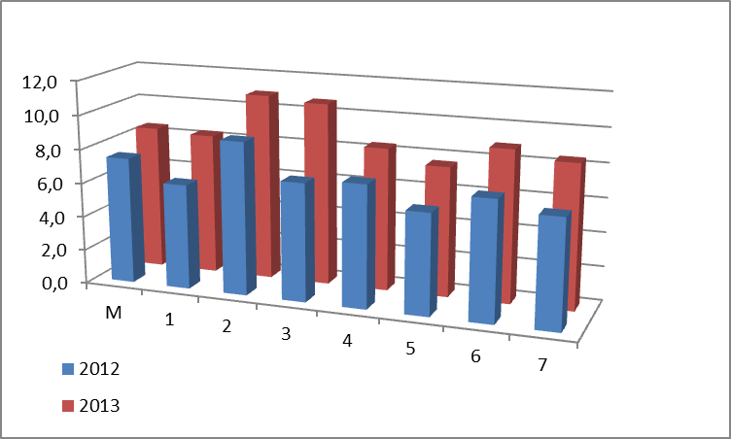
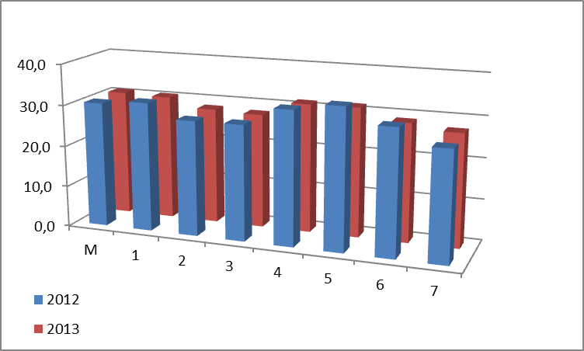
Elongation - Strength

Slide 18
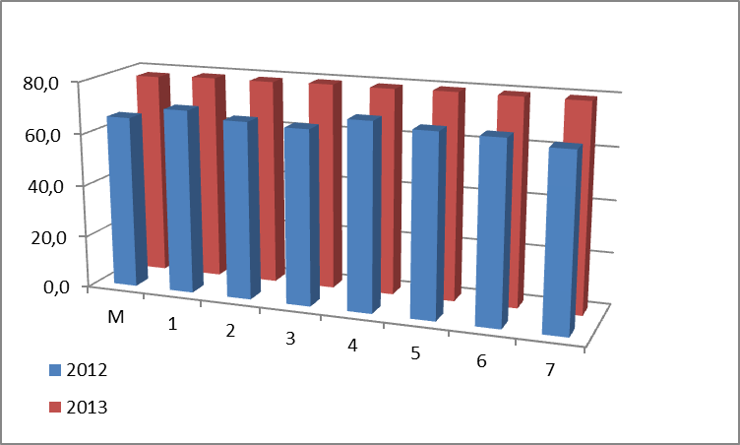
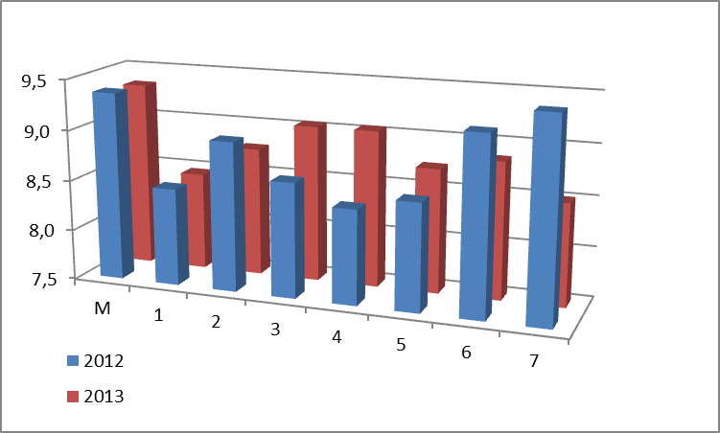
Colour (Rd-b)

Slide 19
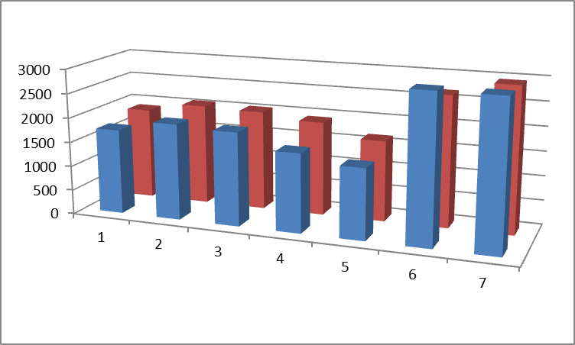
Lea count strength product (LCSP)
Good-Brand Lea Tester

Slide 20
Registration of varieties
Application to Variety Research Institute of Cultivated Plants ( V.R.I.C.P.) is a controlling service of the Ministry of Agriculture
8 kg seed (breeder’s category) + fee 1200,00euros
2 years experiments
Registration to National catalogue
Registered variety
certified seeds

Slide 21

Hellenic Agricultural Organization – DEMETER was established in 2011 following the merge of 4 organizations which are involved in activities in the agricultural sector
HAO –DEMETER functions as a legal entity of the public sector supervised and financed, more than 51%, by the Greek Ministry of Agricultural Development & Food.
After reorganization, in 1/1/2015 the Agricultural Research Centre of Northern Greece, the Institutes of Cotton and Industrial Plants, Plant Protection, Cereals and Pomology have been merged forming the Institute of Plant Breeding and Genetic Resources
    Cereals, 67 varieties of wheat, barley, oat, rice, rye, triticale
    Vegetables, 18 varieties of tomato, egg plant, peppers
    Cotton, 8 varieties
    Tobacco, 34 varieties (unique distributor in Greece)

Slide 22
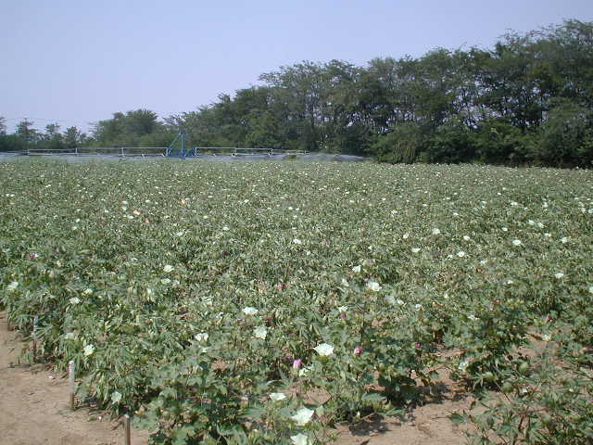
THANK YOU
FOR YOUR ATTENTION

