Slide 1
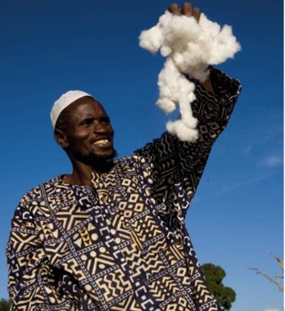
COTTON SECTOR IN BANGLADESH
& BMP FORAFRICA
Dr. Md. Farid Uddin
Executive Director
Cotton Development Board
Ministry of Agriculture
mfaridcdb@gmail.com

Slide 2
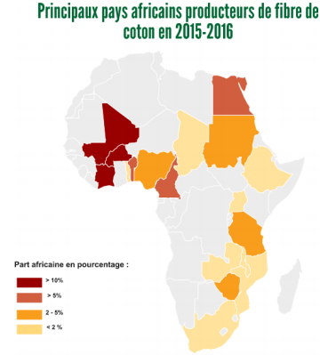
Africa in the global Cotton production
From 100 countries in the world producing cotton, 25 are from Africa
53 counties in Africa, then almost 50% of them produce cotton
Africa contributes approximately 6% of the global cotton supply
10 countries from West and Central Africa contribute 4% of the global cotton supply
Rainfed and hand picked cotton
Bangladesh imports 18% cotton from African countries

Slide 3
Bangladesh Agriculture at a Glance
4th position in Rice production of world
3rd position in vegetable production of world
4th position in fish production of world
Self sufficient in food production
BRRI released 91 HYV rice varieties
BRRI released Zinc enriched variety
Research and Development on Golden rice
Bangladesh will withdraw from LDC list in March 2018.
Bangladesh is going to be middle income country in vision 2020-2021

Slide 4
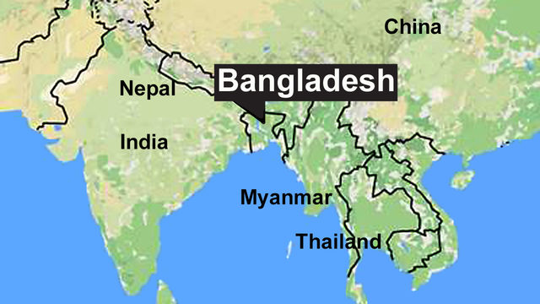
Bangladesh in the Spotlight
Goldman Sachs Included Bangladesh in the Next 11 emerging countries
JP Morgan lists Bangladesh among its ‘Frontier Five’ emerging economies
Bangladesh has demonstrated a consistent GDP growth of 7.05% in 2016-17
It steadily maintained a strong GDP growth of 6+ % over for the last 20 years.
From 1990 to 2015, the incidence of poverty is reduced to 50%

Slide 5

Bangladesh Textile and Apparel Industry
Bangladesh has shown a phenomenal growth in the Textile and Apparel Sector during the last twenty years.
For Apparel Export Bangladesh is No. 2 in the world
With about $28.15 billion exports in 2017, Textile and Apparel sector is the most vital industrial sector in the country
They represent 13 percent of GDP and around 86 percent of total exports.

Slide 6
CONTRIBUTION OF TEXTILES IN BANGLADESH:
Investment in the Primary Textile Sector: over 4.5 billion US$.
Value addition in knit & woven RMG are over 70% & 35% respectively.
Textile sector contributes more than 13% in GDP.
Over 86% of the export earning comes from Textiles & Textile related products.
Around 90% yarn demand for knit RMG & 35-40% yarn demand for woven RMG are met by Primary Textile Sector (PTS).

Slide 7
CONTRIBUTION OF TEXTILES IN BANGLADESH
Local fabric demand & the yarn demand for handloom are also met by Primary Textile Sector (PTS).
Backward & Forward linkage industries provide employment for more than 5 million people where 80% are female.
PTS industries producing around 1200 MW power through Captive Generator.
Generate huge cliental base for Banking, Insurance, Shipping, Transport, Hotel, Cosmetics, and Toiletries & related economic activities.

Slide 8
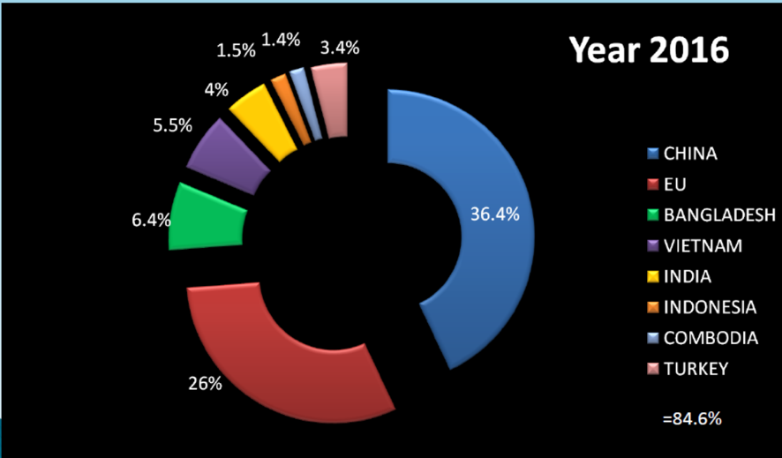
Source: World Trade Statistical Review 2017
Global Majors RMG Market Players

Slide 9

Number and Employment in RMG of Bangladesh
YEAR | NUMBER OF GARMENT FACTORIES | EMPLOYMENT IN MILLION WORKERS
2012-13 | 5876 | 4
2013-14 | 4222 | 4
2014-15 | 4296 | 4
2015-16 | 4328 | 4
2016-17 | 4482 | 4

Slide 10
TOTAL EXPORT AND EXPORT OF RMG OF BANGLADESH
YEAR | TOTAL EXPORT OF BANGLADESH | EXPORT OF RMG | % OF RMG’S TO TOTAL EXPORT
 | (IN MILLION US$) | (IN MILLION US$)
2012-13 | 27027 | 21516 | 79.61
2013-14 | 30187 | 24492 | 81.13
2014-15 | 31209 | 25491 | 81.68
2015-16 | 34257 | 28094 | 82.01
2016-17 | 34656 | 28150 | 81.23

Slide 11
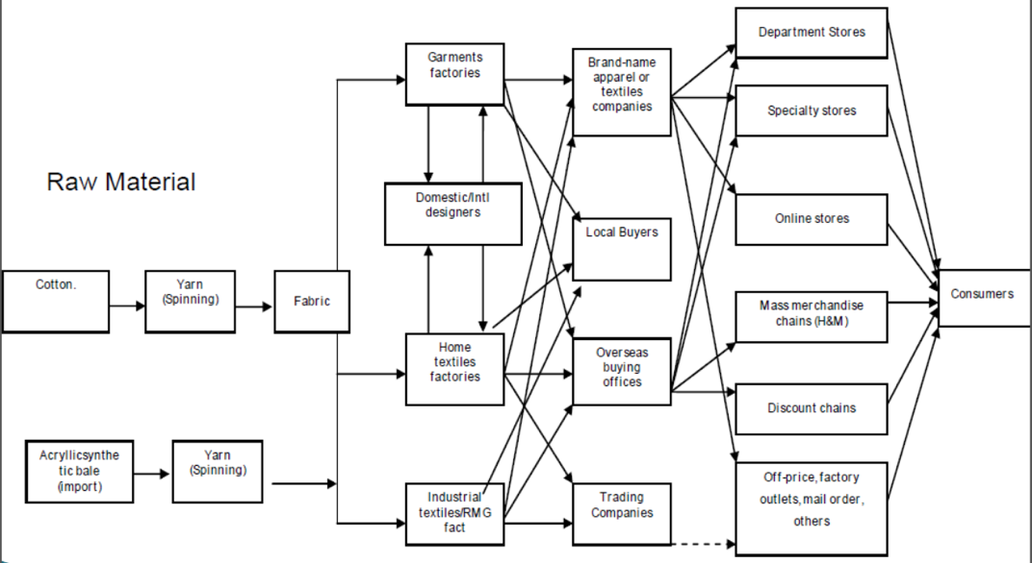
RMG Value Chain of Bangladesh

Slide 12
Factors triggered to RMG
Three synergic factors triggered the textile and Apparel boom in Bangladesh.
  Resources
  Opportunities and
  Policy decision.

Slide 13
Factors that triggered to RMG
  Resources
Abundant labor forces
A competitive advantage in producing labor intensive goods.
Low cost energy and natural gas
  Opportunities
DUTY FREE access to European market through Multi Fibre Arrangement (MFA).

Slide 14
Factors that triggered to RMG
  Policy decision
Elimination or reduction of import tariffs on necessary raw materials
•Simplification of customs procedure
••The Market expansion measures

Slide 15
Government Support to RMG
Avoidance of double taxation for joint venture projects
Income tax exemption for up to three years for foreign technicians
Duty free facilities on dyes and chemicals
Duty free import of capital machinery
Closer monitoring of linkage in the market
Appointment of advisory committee to represent the industry to the government
Improvement of research and computer technology etc

Slide 16
Core Advantages
Price
Price attractiveness is the first and foremost reason of purchasing from Bangladesh
Capacity
Bangladesh has the capacity for high volume supply in market
Bangladesh has 4822 RMG factories
Indonesia has 2450 RMG factories
Vietnam has 2000 RMG factories
Cambodia has 260 RMG factories

Slide 17
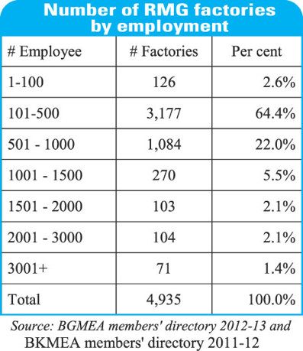
RMG Factories by Employment
Textile and Spinning Mills-
Yarn Manufacturing Mills: 425
Fabric Manufacturing Mills: 796
Dyeing-Printing-Finishing Mills: 240

Slide 18
Industry Strength
30 years of experience & reputation in garment manufacturing
Competitive Price
International standard quality
Vibrant population, 70% below 40 years age, quick learning & dedicated
Irresistible & resilient entrepreneurial spirit
Duty free market access in most of the developed countries & PTA in India, China, Korea, Malaysia

Slide 19
Industry Strength
Rapid adoption of environment friendly, energy efficient and green concepts
Rapidly developing backward linkage: Washing-Dying-Finishing-Embroidery, etc.
Versatility of factories to produce different type of products
Increasing trend of direct sourcing through local liaison offices at Dhaka

Slide 20
Three independent associations are responsible for the textile sector:
Bangladesh Textile Manufacturers Association (BTMA),
Represents spinners, woven fabric manufacturers and dyeing units;
Bangladesh Garment Manufacturers and Exporters Association (BGMEA),
Represents the RMG sector, primarily the cutting and sewing units; and
Bangladesh Knitwear Manufacturers and Exporters Association (BKMEA),
Represents the knitwear fabric manufacturers, the fabric dyeing units and the knit
garment cutting and sewing units.
Involvement of three Ministries in Apparel sector
Ministry of Textile and Jute,
the Ministry of Finance and
the Ministry of Commerce

Slide 21
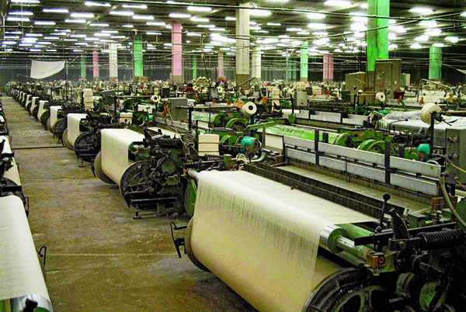
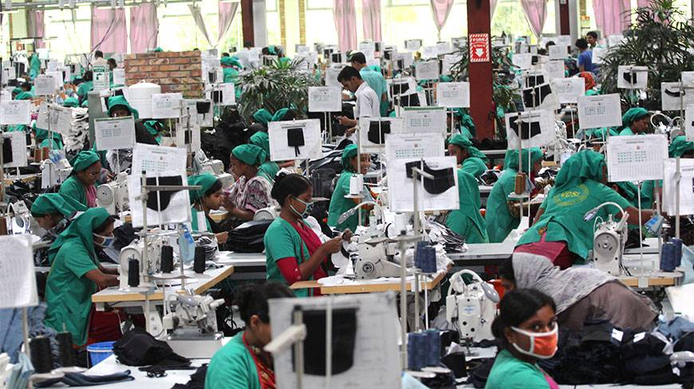
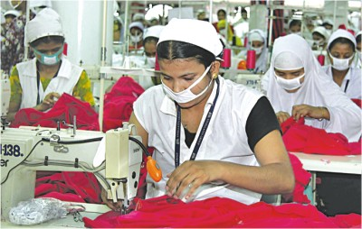
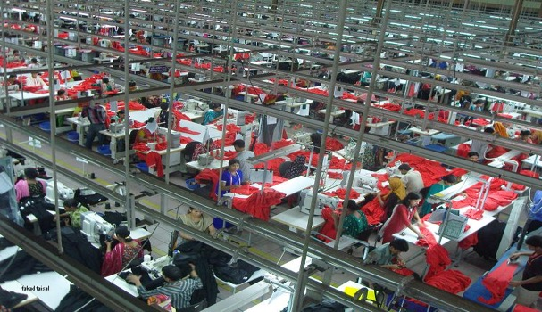

Slide 22
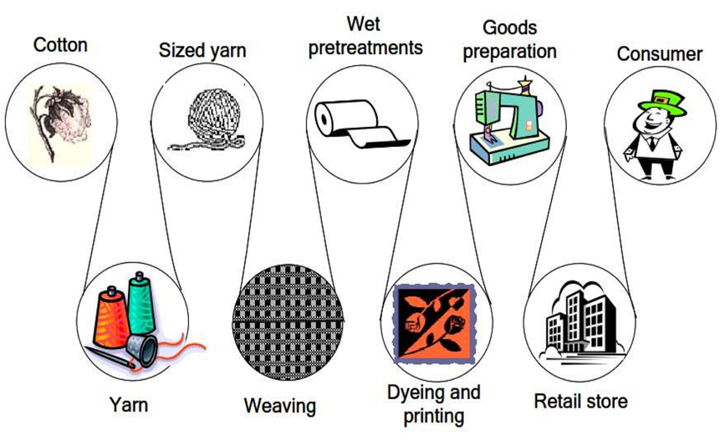
Total Textile Process at a Glance
Raw cotton is the starting point of textile process in Bangladesh

Slide 23
COTTON IMPORT
Total Import-7.2m.bale

Slide 24
Challenges to Cotton Production in Africa
  Smaller scale of production
  Limited access to good quality seeds
  Heavy reliance on insecticides
  Decreasing soil fertility
  Increasing production costs
Volatile markets
Our experience in Bangladesh might be useful for the cotton research and development in Africa

Slide 25
Development of cotton sector in Africa
  Increasing the scale of production:
  -Larger scale projects and a better support by national services and policies will definitively contribute to bring down production costs, increase productivity
  Improving access to good quality seeds:
  Public research institutes capacity need to be strengthened to produce sufficient quantity of good quality seed
  Promoting IPM practices:
  -A country-specific practical training programme for smallholders and export-oriented farmers needs to be developed.
  -smallholders should be first on GAP and some the basic principles of IPM, whereas the focus for export-oriented farmers can be fully on IPM.

Slide 26
Development of cotton sector in Africa
  Adaptation of Integrated soil fertility management practices:
  -Integrated Soil Fertility Management practices need to be promoted combining agronomic practices relating to crops, mineral fertilizer
  - organic inputs and other amendments that are tailored for different
  -cotton based cropping systems, soil fertility status and socioeconomic profiles.
  Improving income from cotton:
  -Cotton production cost should be rationalized by increasing per hectare production as well as diversification of cotton product and byproduct.
  -Subsidy to the farmers:
  Subsidy in inputs and cotton price will help farmers to cope with volatile markets.

Slide 27


Our Gratitude to….
 | THE SOUTHERN AND EASTERN AFRICAN COTTON FORUM (SEACF)

Slide 28


