Slide 1
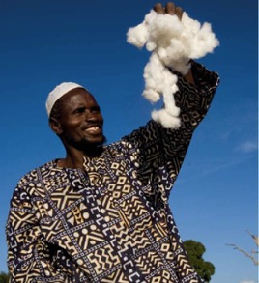
NOVEL IDEAS TO ENHANCE COTTON PRODUCTION AND VALUE OF BYPRODUCTS IN AFRICA
Dr. Md. Farid Uddin
Executive Director
Cotton Development Board
Ministry of Agriculture
mfaridcdb@gmail.com

Slide 2
Challenges to Cotton Production in Africa
  Smaller scale of production
  Limited access to good quality seeds
  Heavy reliance on insecticides
  Decreasing soil fertility
  Increasing production costs
Volatile markets
Our experience in Bangladesh might be useful for the cotton research and development in Africa

Slide 3
Development of cotton sector in Africa
  Increasing the scale of production:
  -Larger scale projects and a better support by national services and policies will definitively contribute to bring down production costs, increase productivity
  Improving access to good quality seeds:
  Public research institutes capacity need to be strengthened to produce sufficient quantity of good quality seed
  Promoting IPM practices:
  -A country-specific practical training programme for smallholders and export-oriented farmers needs to be developed.
  -smallholders should be first on GAP and some the basic principles of IPM, whereas the focus for export-oriented farmers can be fully on IPM.

Slide 4
Development of cotton sector in Africa
  Adaptation of Integrated soil fertility management practices:
  -Integrated Soil Fertility Management practices need to be promoted combining agronomic practices relating to crops, mineral fertilizer
  - organic inputs and other amendments that are tailored for different
  -cotton based cropping systems, soil fertility status and socioeconomic profiles.
  Improving income from cotton:
  -Cotton production cost should be rationalized by increasing per hectare production as well as diversification of cotton product and byproduct.
  -Subsidy to the farmers:
  Subsidy in inputs and cotton price will help farmers to cope with volatile markets.

Slide 5
Cotton Research and Development in Bangladesh

Slide 6
Seed
Production
Extension
Research
CDB
Activities
Credit
Distribution
Training
Marketing & Ginning

Slide 7
THRUST AREAS FOR COTTON CULTIVATION IN BANGLADESH
Drought area
Hill area
Char area
Coastal area

Slide 8
Cotton Research Management
Farmers
Participatory trial
Researcher
Annual Research Review
Technology
Technology
Problems
Problems
University
Professor
NARS Scientist
Extension Personnel

Slide 9
Utilization of Cotton Genetic Resources
Sl. No. | Name of the crop (English) | Scientific Name | Collected Germplasm (Number) | Cultivated/ Wild
1. | Cotton | Gossypium hirsutum Gossypium arboreum | 520 10 | Cultivated
Sl. No. | No. of germplasm morphologically characterized | No. of germplasm molecular characterized | No. of germplasm regenerated | No. of variety developed
1. | 530 | 0 | 530 | 19

Slide 10
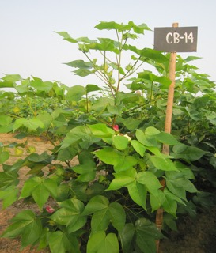
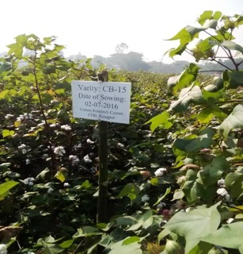
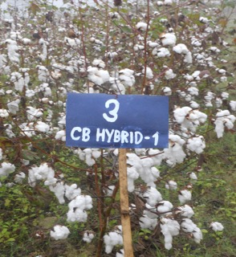
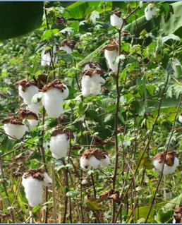
New varieties and hybrids

Slide 11
Cotton fiber quality
Sl. No | Fibre Characters | Indian Cotton | Bangladeshi Cotton |  |  | CIS Cotton
 |  |  | CB-12 | CB-14 | Rupali-1
1. | Fibre length (mm) | 27.5-29.50 | 31.05 | 31.44 | 31.80 | 27.64-28.68
2. | Micronaire (µg/inch) | 3.20-4.83 | 4.43 | 5.05 | 5.20 | 4.81-5.15
3. | Fibre Strength (g/tex) | 28-34 | 33.16 | 33.64 | 32.56 | 27.1-30.60

Slide 12
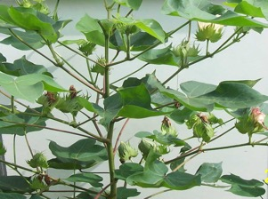
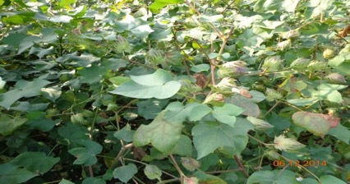
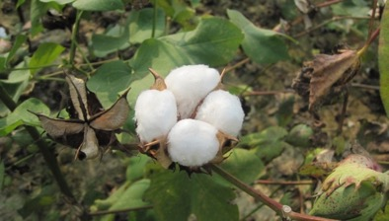
Growing Season of Upland Cotton
(Kharif II)
 | July | Aug. | Sept. | Oct. | Nov. | Dec.
Land Preparation & Sowing
Crop Management
Harvesting

Slide 13
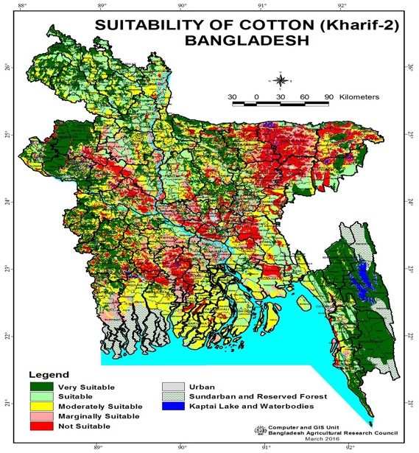

Slide 14
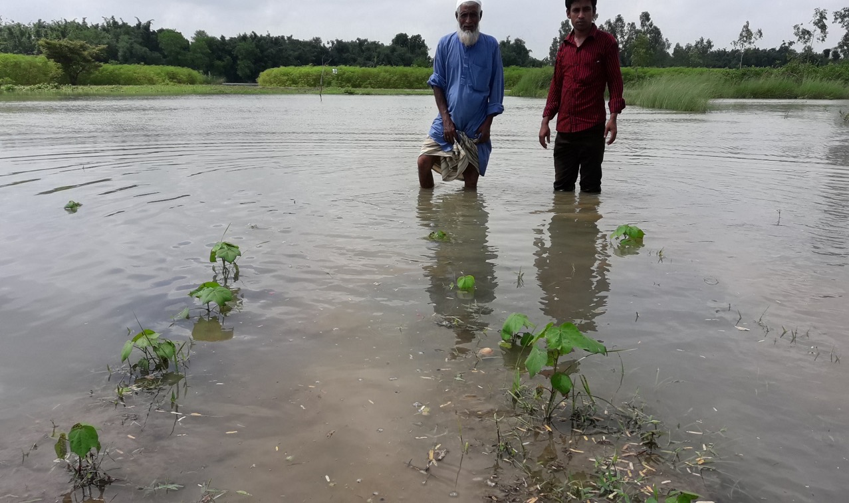
Impact of Climate Change

Slide 15



Growing Season of Upland Rabi Cotton
 | Nov | Dec | Dec- March |  | Aprl | May
Land Preparation & Sowing
Crop Management
Harvesting

Slide 16
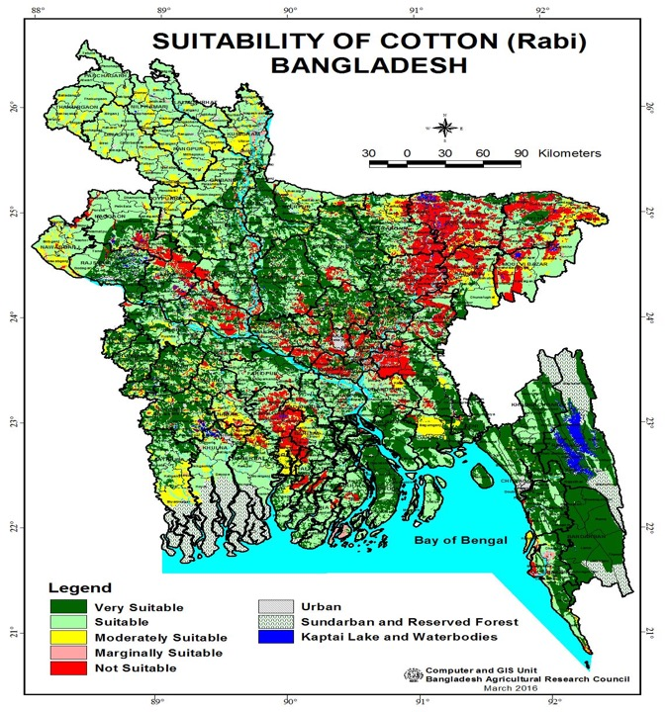

Slide 17
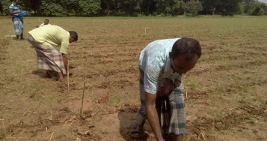
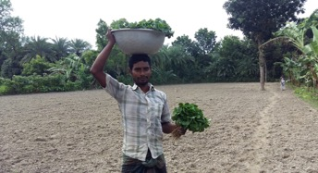
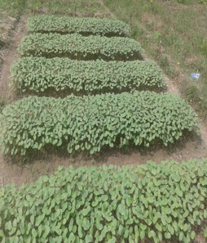
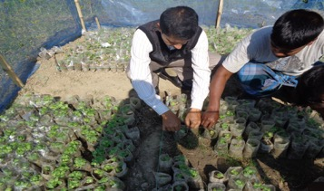
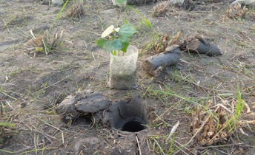
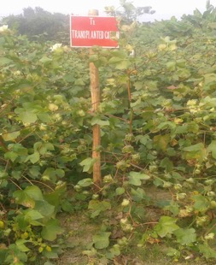
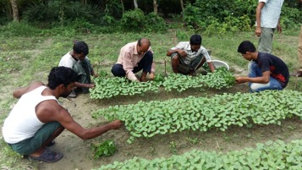
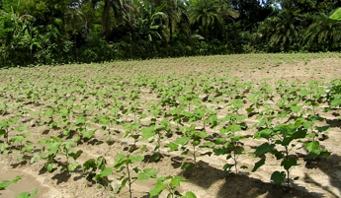
Transplanting Technology

Slide 18
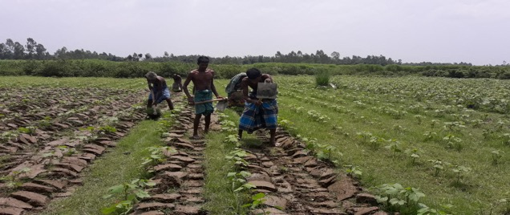
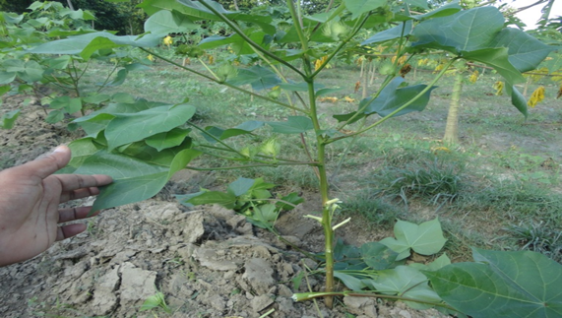
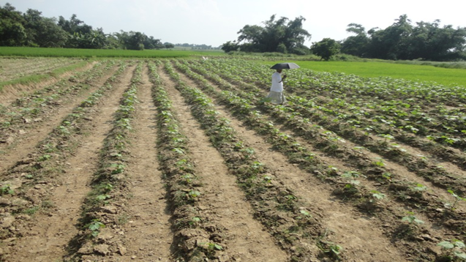
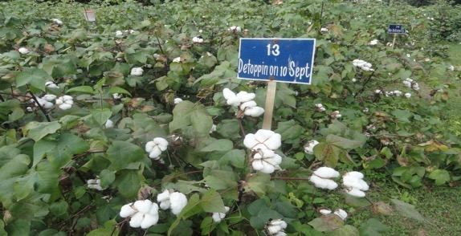
Earthing up and canopy management

Slide 19
Table 1: Effect of vegetative branch removal on different parameters of Cotton
Treatment | Plant height (cm) | Number of sympodial/plant | Number of bolls/plant | Single boll wt | Seed cotton yield (t/ha)
T₁ | 154.67ab | 19.50bc | 25.03a | 5.27b | 2.29bc
T₂ | 150.17b | 18.66c | 22.13a | 5.61a | 2.23c
T₃ | 173.47a | 21.63a | 25.26a | 5.73a | 2.52a
T₄ | 157.67ab | 20.60ab | 24.33a | 5.58a | 2.42abc
T₅ | 155.47ab | 19.93bc | 25.60a | 5.55ab | 2.57a
T₆ | 168.83ab | 20.10b | 26.76a | 5.54ab | 2.48ab
Level of significance | * | ** | ns | * | **
LSD | 20.605 | 1.3 | 6.3 | 0.29 | 0.23
T₁ : No removal of vegetative branches,T₂: Removal of vegetative branches at 35 DAS,T₃ : Removal of vegetative branches at 45 DAS, T₄: Removal of vegetative branches at 55 DAS,T₅: Removal of vegetative branches at 65 DAS,
T₆: Removal of vegetative branches at 75 DAS.

Slide 20
Effect of detopping at various dates on Cotton
Treatment | Days of de-topping | Un-burst bolls/Plant | Yield (t/ha) | Crop duration | Date of final Harvest
Detopping on 10 September | 64 | 2.1 | 3.24 | 145 | : 30 Nov 16
Detopping on 20 September | 74 | 1.5 | 3.54 | 152 | 7 Dec 16
Detopping on 30 September | 84 | 1.7 | 3.71 | 157 | 10 Dec16
Detopping on 10 October | 94 | 2.3 | 3.51 | 163 | 18Dec16
No Detopping |  | 1.7 | 3.64 | 222 | 15Feb17
LSD (5%) | - | 0.67 | 0.01 | 1.03
CV% | - | 0.835 | 5.67 | 17.01
Level of significance | - | NS | ** | **

Slide 21
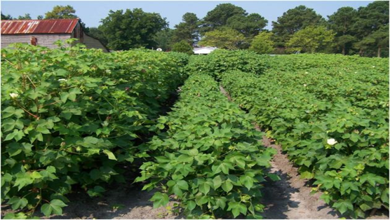
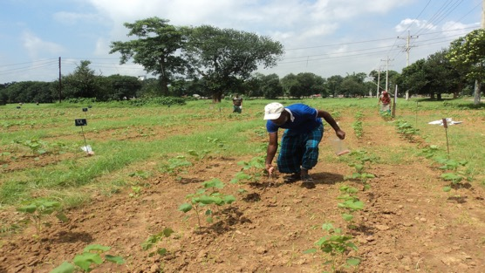
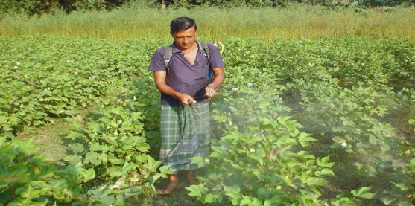
Growth Regulator use
Fertilizer use
Foliar fertilizer spray
Canopy Management and fertilizer use

Slide 22
Fertilizer Application on basis of Yield Goal and Soil Analysis
Yield Goal: 3.5-4.0 t/ha
Soil Analysis Interpretation | Nutrient Recommendation (kg/ha)
 | N | P | K | S | Zn | B | Mg
Optimum | 0-100 | 0-20 | 0-100 | 0-15 | 0-5 | 0-6 | 0- 0.5
Medium | 75-125 | 20-30 | 100-125 | 10-20 | 5-10 | 6-12 | 0.5- 0.9
Low | 125-150 | 30-40 | 125-150 | 20-25 | 10-15 | 15-20 | 0.9-1.4
Very Low | 150-175 | 40-50 | 150-200 | 25-35 | 15-22 | 20-23 | 1.4-2.0

Slide 23
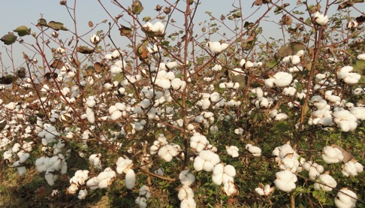
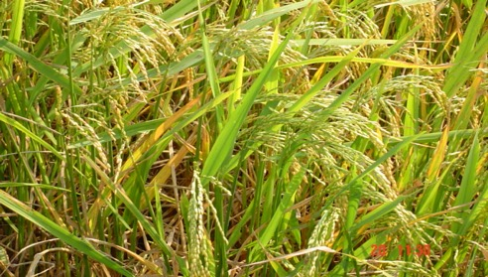
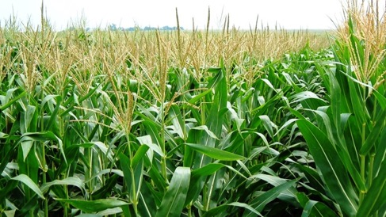
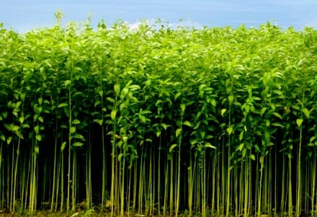
Cotton Based Cropping Pattern
Sowing: mid-January
Sowing: February end
Sowing: Early March

Slide 24
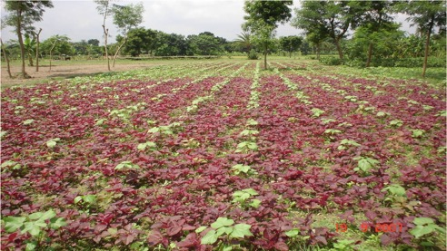
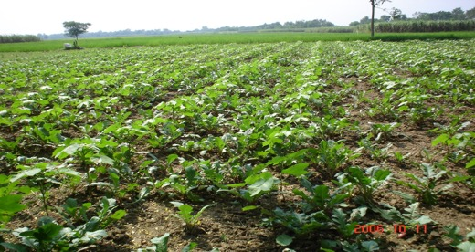
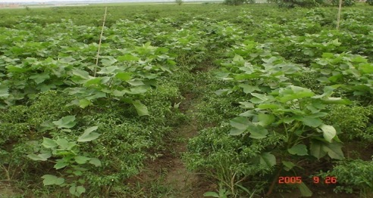
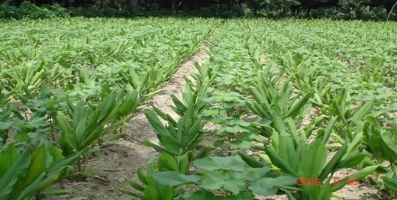
Intercropping with Cotton

Slide 25
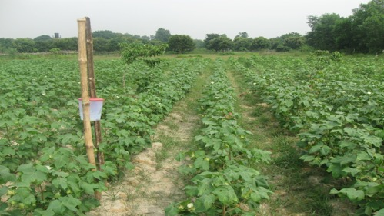
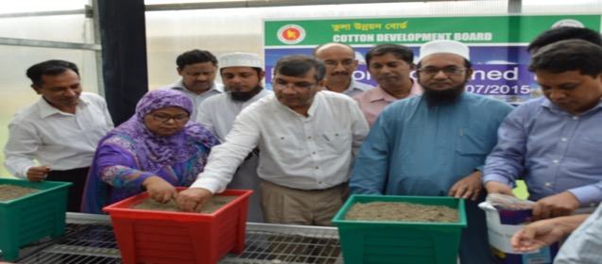
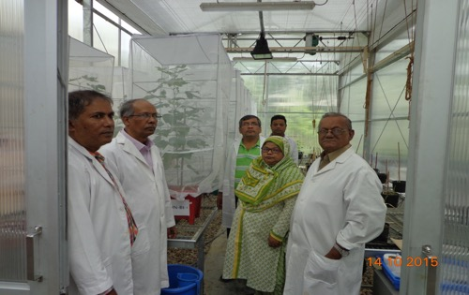
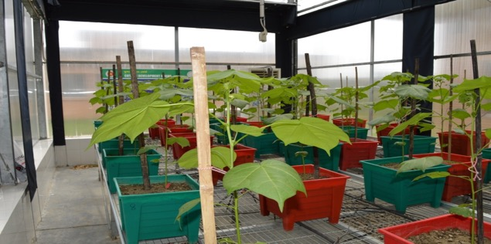
Cotton Pest Management

Slide 26
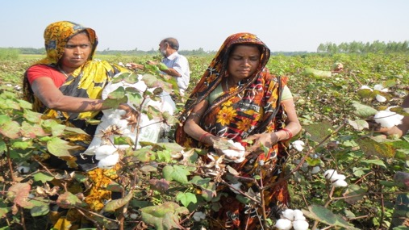
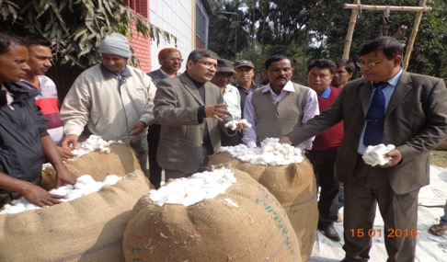
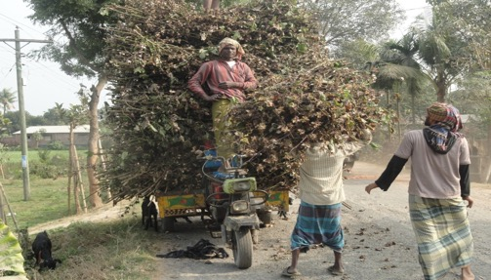
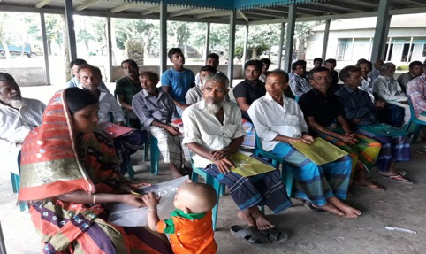
Cotton Harvesting
Marketing
Harvesting
Stalks
Oil
Technology Transfer

Slide 27
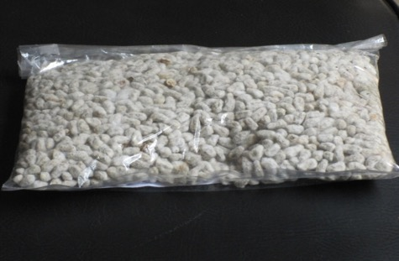
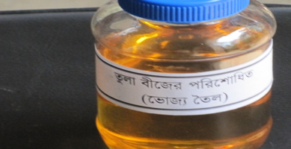

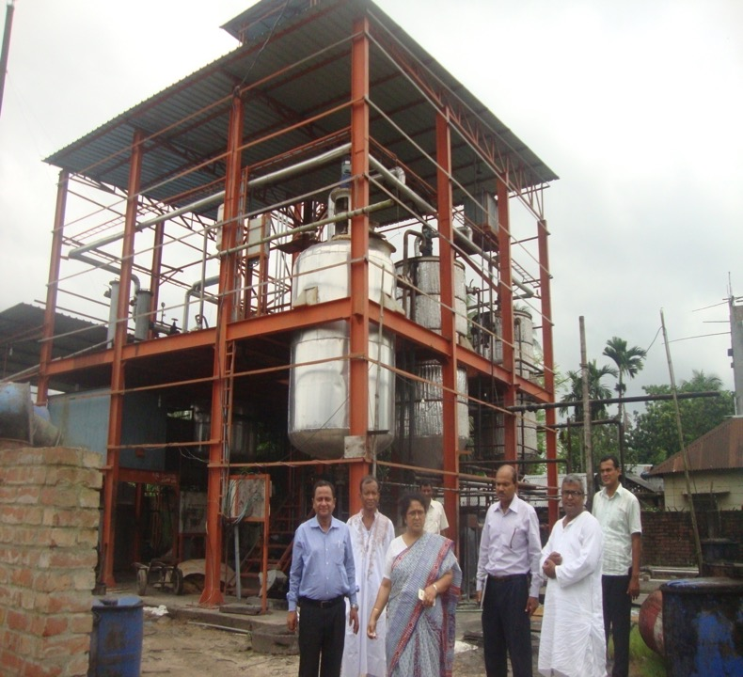

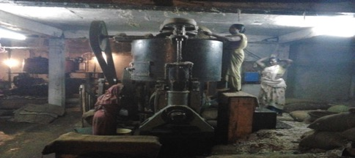
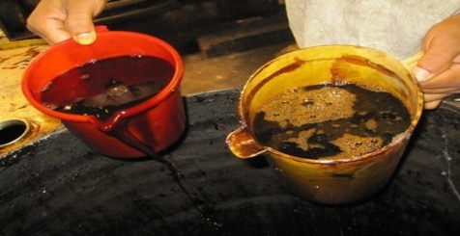
Cotton Seed oil refinery

Slide 28
Land selection: Well drained high and medium high land is used for cotton cultivation
Land Preparation: Land is ploughed deeply in 3-4 times followed by laddering
Variety selection: CDB released HYV varieties are used by the farmers
Sowing time: Depending on weather condition sowing time ranges from mid July to mid August
Seed rate: 8-10 kg ha⁻¹
Spacing: Line to line 90 cm and plat to plant 30 cm depending on soil type and sowing time
Removal of Vegetative Branch

Slide 29
Split Application of Fertilizer: Chemical fertilizers such as N, P, K, S, Zn, B and Mg are applied at 4 splits (basal, 20-25, 40-50, 60-70, 70-80 days after sowing).
Foliar fertilization: Nutrient specially nitrogen, potassium, Boron & Zinc are applied as foliar spray during reproductive stage of cotton
Use of Growth Regulator

Slide 30
Weeding: The cotton field is kept free from weed specially the first 60 days after sowing.
Pest management: IPM based pest management strategies are adopted by the farmers such as regular scouting of pest, using cultural practices like as hand picking of bollworm larvae, use of pheromone trap, use of bio-pesticide, etc.
Harvesting: Harvesting is done manually
Drying and storing: Harvested bolls are dried well and stored in a dry place before selling

Slide 31


Our Gratitude to….
 | THE SOUTHERN AND EASTERN AFRICAN COTTON FORUM (SEACF)

Slide 32


