Slide 1


One Variety, One Zone, One Gin Concept
Cotton Concessions
‘Global best practices for cotton yield enhancement in africa
XIV meeting of southern and eastern Africa cotton forum (SEACF)’
Harare, Zimbabwe, 4 – 6 July 2018
Michael Jenrich
ZAGP/Zimbabwe
Michael_Jenrich@dai.com

Slide 2
Background
10 % of the world’s cotton is grown in Sub-Saharan Africa (world’s fourth largest cotton exporter following the USA, India and Uzbekistan).
The Sahel states along the southern belt of the Sahara alone generate $1.5 billion each year by exporting cotton, which accounts for up to 35-75% of the agricultural export earnings in this region
In western and southern Africa, cotton is cultivated exclusively by smallholder farmers (3 million in number).
18 million people in Sub-Saharan Africa (SSA) live either directly or indirectly from cotton farming.

Slide 3
Cotton Production System
Cotton (Africa) small holder crop
Production support from Buyers (Ginners), contract production
Based on given market and production contracts
  Support through:
    Inputs (seed & crop chemicals)
    Technical support (extension)
Input costs are recovered through sale
Depending on farmers delivering to contracted (and supporting company)

Slide 4
Contract Farming, Advantages
To Farmers: Receive inputs and advisory support that need to increase their productivity – increased income from cotton.
To Ginners: Production is ensured and ginners are able to source the cotton that they require. Quality can be improved, as ginners can concentrate on their (contracted) farmers
To Country: Increased cotton production increases export earnings; more high quality cotton to boost local textile industry; better quality cotton lint means price rises.

Slide 5
Cotton Production System, Challenges
Ensuring the recovery of costs is crucial for the systems to continue
If produce is not delivered to the contracting company, they cant recover costs and support ceases
Buyer who don't invest in inputs and farmers support can pay higher prices
Side selling will undermine and system collapse
Large number of farmers and buyers makes control and contract monitoring and enforcement difficult and costly

Slide 6
Potential Market and Support Set Up
As production and productivity depends on support, the investments need to be safeguarded and encourage increasing in investments
Companies investing in production need to be certain the receive cotton, through, e.g.:
  Growing contract are adhered and can be enforced
  Companies that do not support farmers can’t get buying licence
  Central buying system (were all commodities is traded) and companies get their investment back
  Concession set up, were (One Zone, One Gin Concept) only 1 ginner would be allowed (accredited) to operate in defined areas

Slide 7
Mozambique/Tanzania
Mozambique cotton production is unique in the region, entirely being based on a concession system.
The cotton sector operates in a monopsony system (demand side), where ginning companies are granted concession (provinces) rights as exclusive buyers of cottonseed in their respective areas of concession
Overall set up is controlled an monitored by government
Tanzania is investigating district concession
As district are easier form an administrative point of view
Single district are easier to monitor/control side selling – less leakage at marketing time
Makes the concession more attractive to bidders – thereby potentially getting better offers

Slide 8
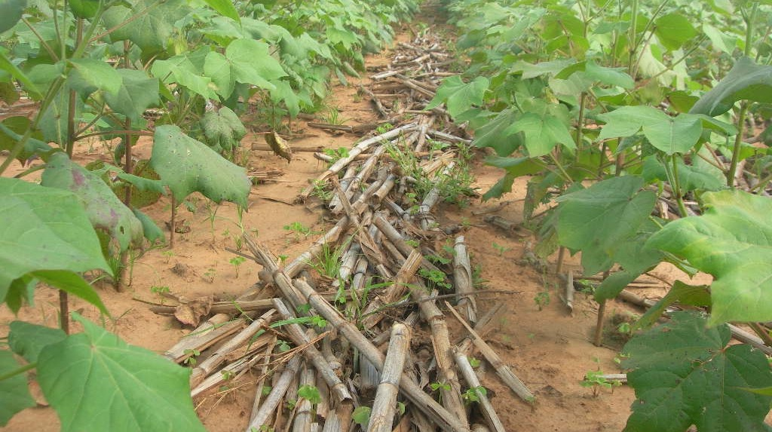

Slide 9
Concessions (e.g. Mozambique)
Exclusive right to purchase all cotton grown within the concession area
Support in organizing district and village task forces and farmer business groups
Support to buyers in recovering loans
Minimum input/extension package provided to all registered cotton farmers
Extension training support offered (compulsory to get concession)
Minimum price set to ensure that farmers receive “fair” market price
Prepared to buy all cotton offered for at least the minimum buying price
Seed and crop chemical supplied to farmers
Other inputs such as fertiliser, herbicide, improve tools etc
Additional offers could be phased in over time if contracts are holding

Slide 10
Multi-Year Concession
Allows ginners to commit to longer term investments (e.g. extension services, tillage services, fertiliser etc.)
Area and production specific support and research, e.g. seed, fertilizer, tillage, longer term support (rotation, groups, credits, etc.)
Link with service providers, banks, tillage, other commodities
Better and stronger relationships of trust built between ginners and farmers – e.g. less likelihood of loan default
Ginners can buffer bad seasons and be forgiving on loan recovery (e.g. in drought) if they can roll these forward to the next season.
Ginners can commit to increased service offering on a year by year basis
Ginners can plan their businesses better and make investments and forward contracts with buyers accordingly knowing that they are guaranteed throughput

Slide 11
Summary
Technical and input provision for cotton production is essential to ensure productivity and viability to producers and buyers
Safeguarding and return of the investment is central to support
Individual control set ups (contract supervision and enforcement) are costly and complex
Control and registration of all buyers is challenging and costly
Controlled systems from field to gin can ensure investment and viability for producers and buyers
Price and service monitoring systems would need to ensure fair trading
Tendered and monitored concession set ups with exclusive production and purchasing based on investment (Gin, infrastructure and support) would ensure need investment in production and productivity
Transparent and effective monitoring an enforcing (public, association etc.) are pivotal

Slide 12
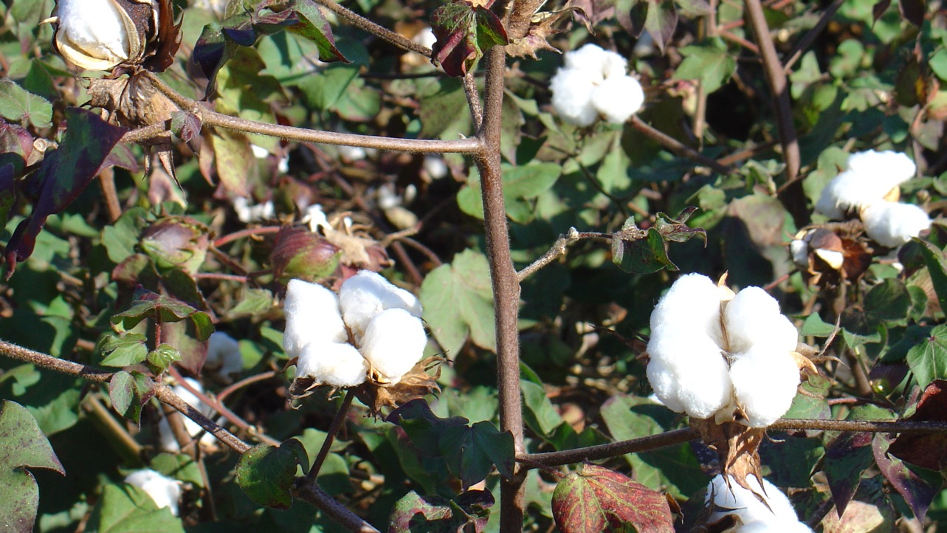
Thank You

