Slide 1

Biotech Cotton
Keshav R. Kranthi
International Cotton Advisory Committee
Washington DC

Slide 2
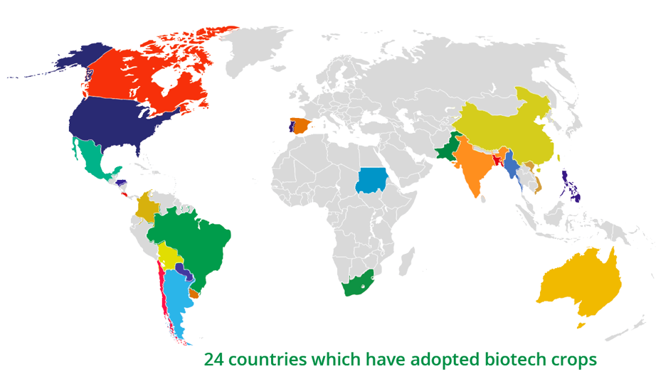
Where are Biotech Crops Grown?
189.8 m hectares
% Global share
USA 40
Brazil 26
Argentina 12
Canada 7
India 6
Others 9
Source: ISAAA, 2017

Slide 3
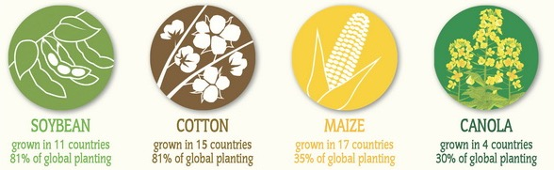
Four Major Biotech Crops
50 13 31 5
99 % Global Share
Source: ISAAA, 2017

Slide 4
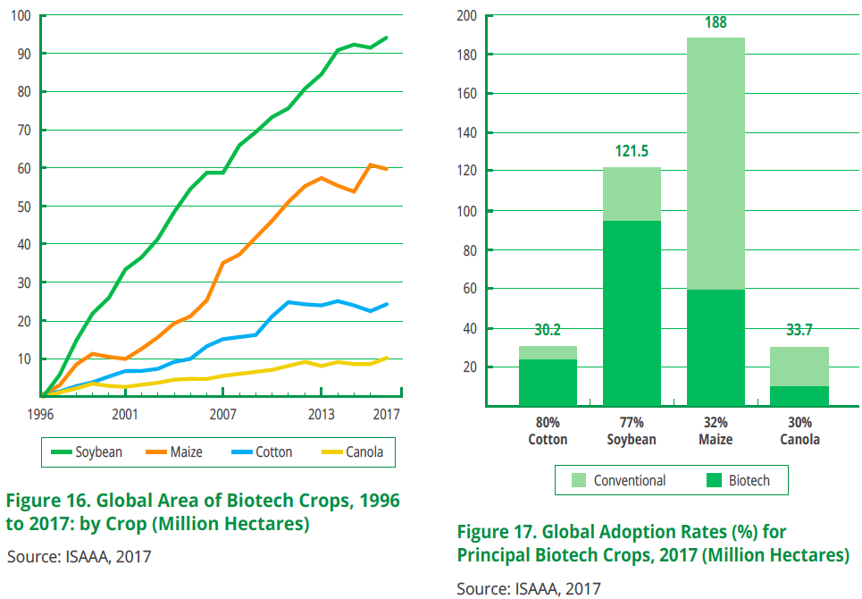

Slide 5
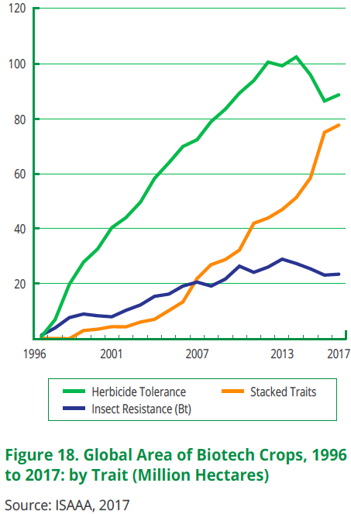
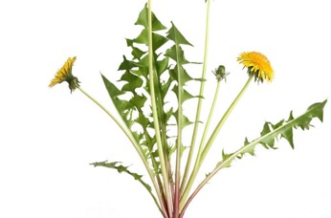
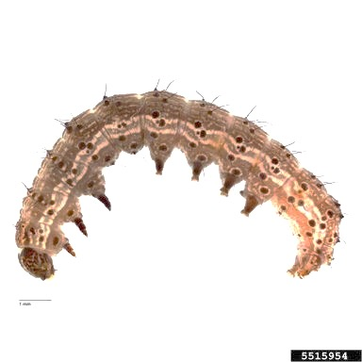
Two Major Traits
Herbicide Tolerance
Insect Resistance

Slide 6
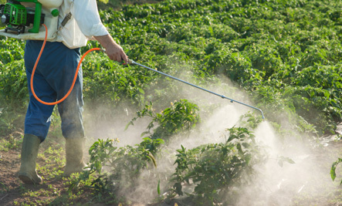
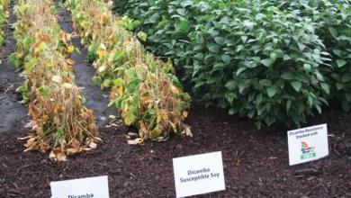
Herbicide Tolerant GM Cotton, Soybean, Maize, Rice, Canola

Slide 7
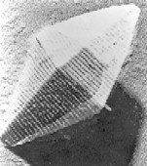
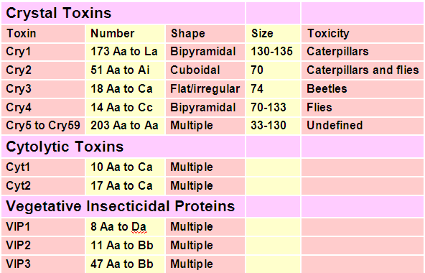
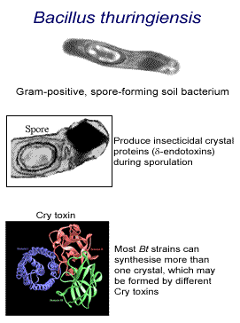
Bt
Bacillus thuringiensis (Bt) is a gram positive soil bacterium that produces insecticidal proteins.
Bt was discovered by Ishawata in 1901 in Japan & first used commercially in France in 1938.
There are 67 subspecies of B. thuringiensis.
There are 329 Cry toxins, 17 Cyt toxins and 65 VIP toxins reported from Bt

Slide 8

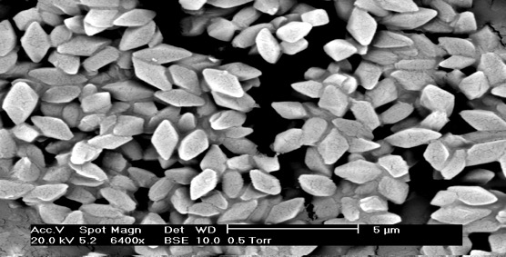
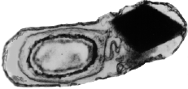
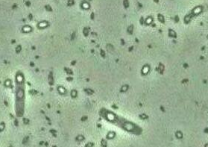
Bacillus thuringiensis

Slide 9
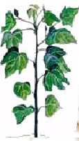
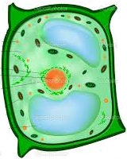

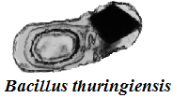
Development of Bt cotton
Bt gene
Cotton plant cell
Bt Cotton

Slide 10
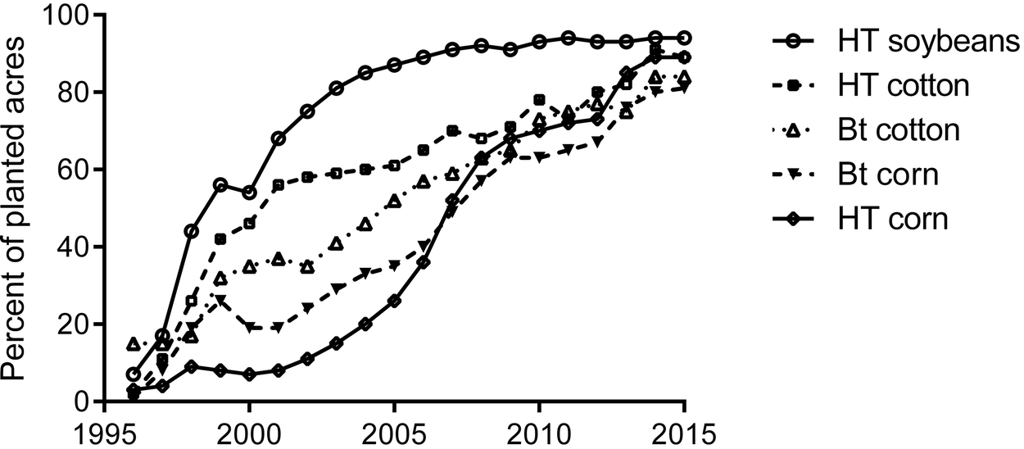
Rapid Adoption of GM Cotton

Slide 11
Bollgard Bollgard-II

Slide 12
Insecticides Kg/ha
Bollgard Bollgard-II

Slide 13
Impact of Bt hybrids
 | Area in lakh ha |  | Yield | Hybrids | Insecticide use Mt
Year | BG | BG-II | Kg/ha | No. | Sucking Pests | Bollworms
2001 |  |  |  |  | 3312 | 9410
2002 | 0.3 |  | 302 | 3 | 2110 | 4470
2003 | 0.9 |  | 399 | 3 | 2909 | 6599
2004 | 5 |  | 470 | 4 | 2735 | 6454
2005 | 10 |  | 472 | 20 | 2688 | 2923
2006 | 36 | 1 | 521 | 62 | 2374 | 1874
2007 | 59 | 5 | 554 | 138 | 3805 | 1201
2008 | 55 | 20 | 524 | 283 | 3877 | 652
2009 | 36 | 48 | 503 | 564 | 5816 | 500
2010 | 37 | 64 | 517 | 809 | 7270 | 249
2011 | 26 | 85 | 496 | 1128 | 6372 | 222
2012 | 19 | 93 | 477 | 1128 | 6872 | 178

Slide 14
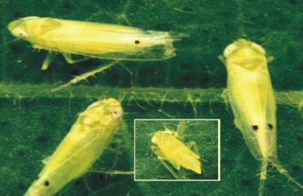
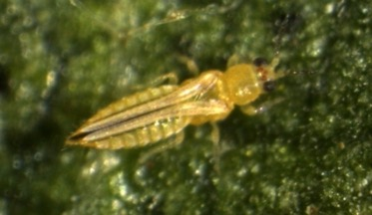
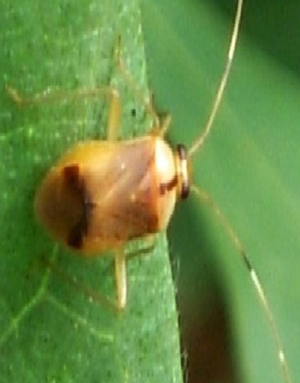
Minor Pests Became Major Pests

Slide 15
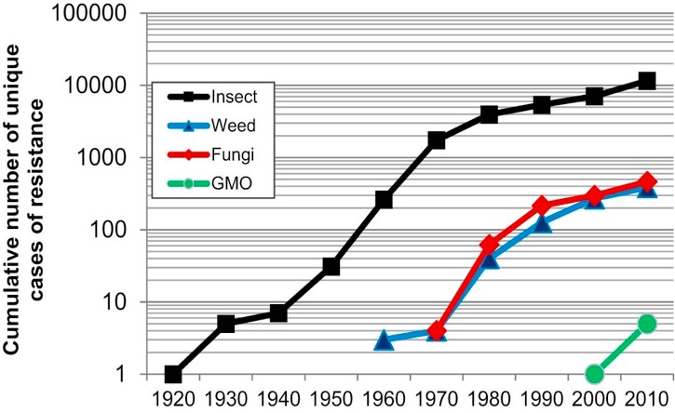
Cases of Insect, Weed & Fungal Resistance to Pesticides and GM crops

Slide 16

Resistance to Bt Crops
Bt transgenic crops
Fall armyworm, Spodoptera frugiperda | Bt Cry 1F corn | Puerto Rico | 2010
Pink bollworm, Pectinophora gossypiella | Bt Cry 1Ac cotton | India | 2011
 | Bt Cry1Ac+ Cry2Ab cotton | India | 2018
African stem borer Busseola fusca | Bt Cry 1 Ab corn | South Africa | 2011
Western corn rootworm, Diabrotica virgifera | Bt Cry 3 Bb 1 corn | USA | 2011
Cotton Bollworm Helicoverpa zea | Bt Cry 1 Ac cotton | USA | 2010

Slide 17
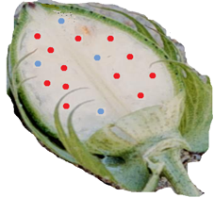
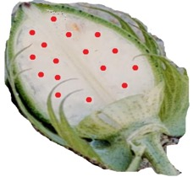
Bolls of Bt-cotton
25% developing seeds in BG & 6.25% in BG-II do not have Bt
Only India cultivates hybrids
BG: 75% seeds have Cry1Ac in bolls on F-1 hybrid plants. 25% are non-Bt
BG-II: 93.75% seeds have Bt
56.25% seeds have Cry1Ac+Cry2Ab;
18.75% seeds have Cry1Ac;
18.75% seeds have Cry2Ab and
6.25% are non-Bt
All other countries have Bt varieties
100% seeds have both Cry toxins in bolls

Slide 18
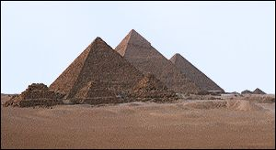
Pyramiding genes for resistance management
CryIAc +
Cry2Ab+
Vip3A
CryIAc +
Cry2Ab
CryIAc +
Cry1F
VIP3A
Cry1F
CryIAc
Cry2Ab

Slide 19
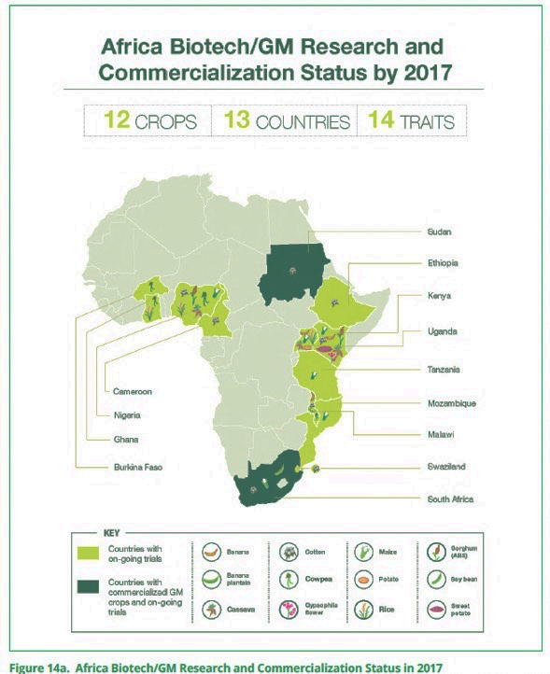
Source: ISAAA, 2017

Slide 20
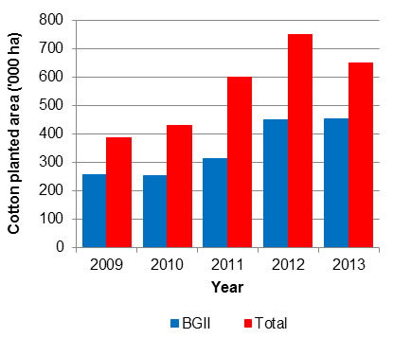
Bt-cotton Area in Burkina Faso
Vitale et al., 2016. AgBioForum

Slide 21
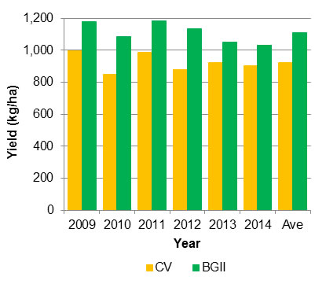
Bt-cotton Yields in Burkina Faso
Insecticide Sprays
Conventional 5
Bt-cotton 1.5
Vitale et al., 2016. AgBioForum

Slide 22
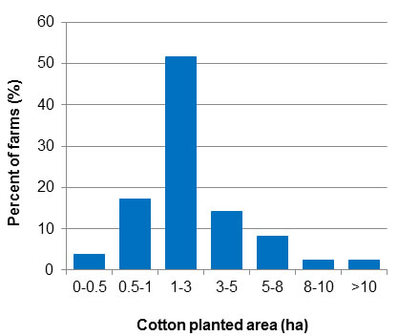
Bt-cotton holdings in Burkina Faso
Vitale et al., 2016. AgBioForum

Slide 23
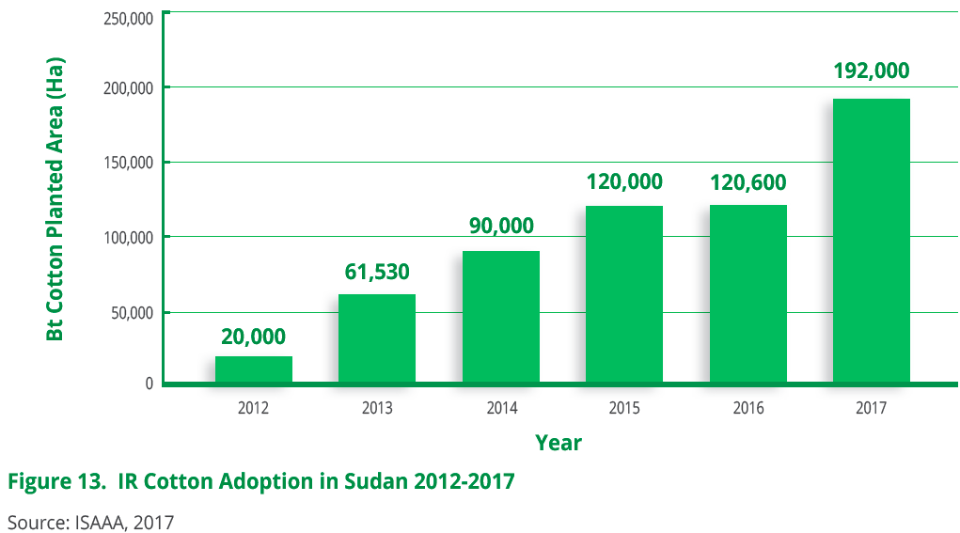

Slide 24
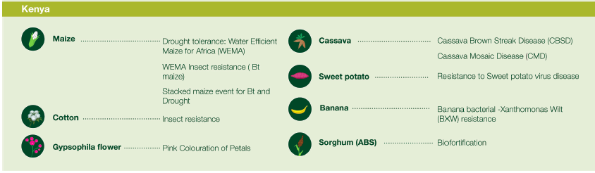

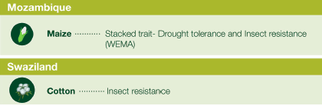
Kenya, Ethiopia, Mozambique, Swaziland & Sudan
Cotton, Maize, Gypsophila, Cassava, Sorghum, Banana & Sweet Potato
Source: ISAAA, 2017

Slide 25
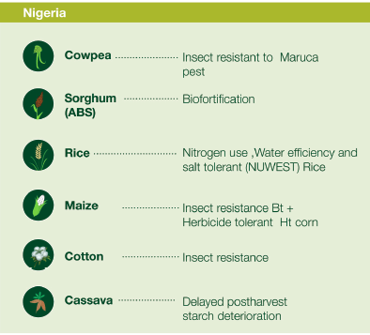

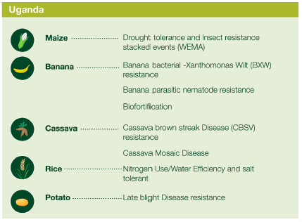
Nigeria, Tanzania & Uganda
Cotton, Cassava, Sorghum, Maize, Rice, Banana, Potato & Cowpea
Source: ISAAA, 2017

Slide 26
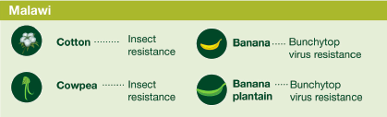
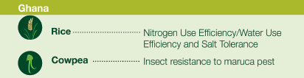
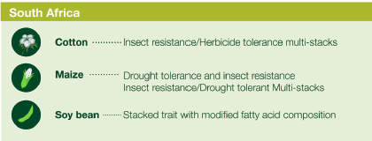
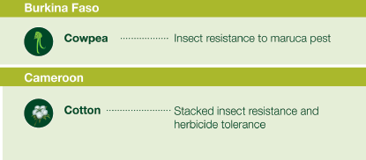
Malawi, Ghana, South Africa, Burkina Faso & Cameroon
Cotton, Maize, Soybean, Rice & Cowpea
Source: ISAAA, 2017

Slide 27
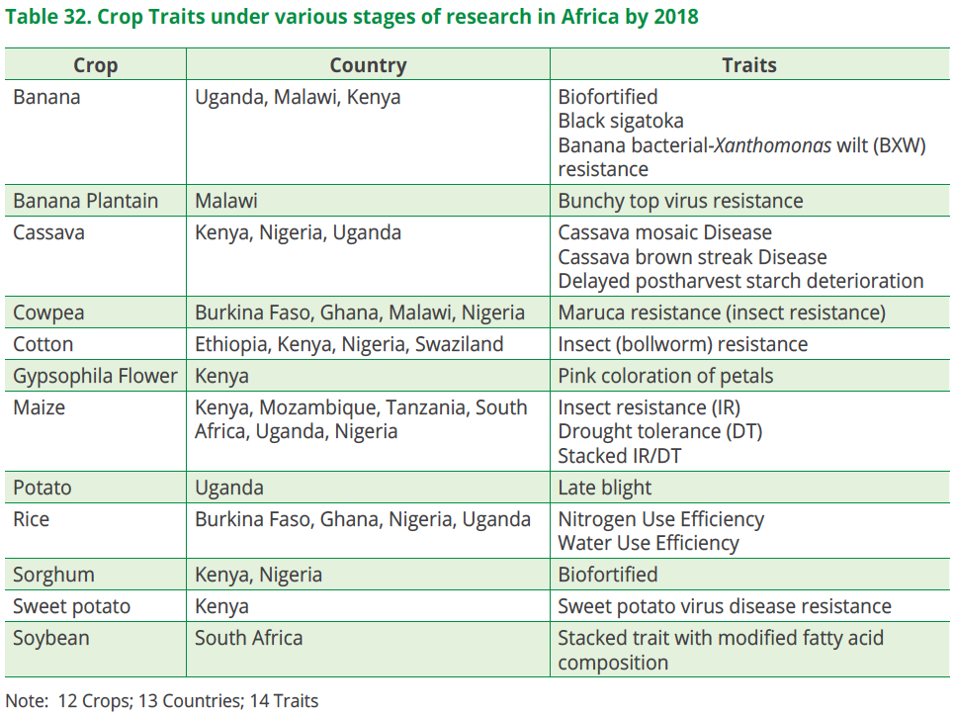
Source: ISAAA, 2017

Slide 28
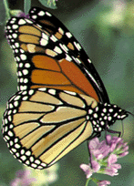

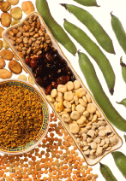
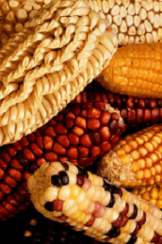
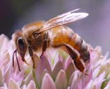
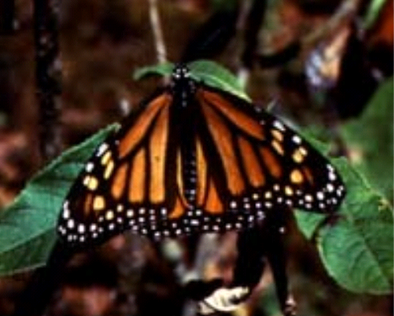
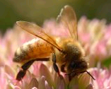
Biotech -Alarms
The case of Monarch Butterfly
Now proven to be false alarm
Horizontal gene flow to non-target and humans from GM crops: Resistance to antibiotics?
Although the probability of transfer is low, the use of technology without antibiotic resistance genes has been encouraged by a recent FAO/WHO expert panel
Allergies
GM Soybean with Brazil nut protein and STARLINK Cry9C Maize were withdrawn -suspected -unsubstantiated allergy possibilities

Slide 29

CORNGATE
SCANDAL
Imported corn seeds from US were reported to have GM
NEWZEALAND
2002

Slide 30
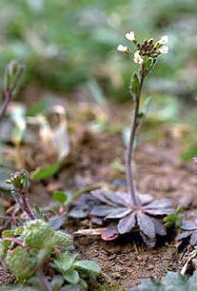
Gene flow from biotech crops
Does it threaten biodiversity?

Slide 31

Árpád Pusztai
“feeding on GM potatoes with snowdrop lectin genes caused damage to intestines and immune system of rats”.
1998: "If I had the choice I would certainly not eat it,"

Slide 32
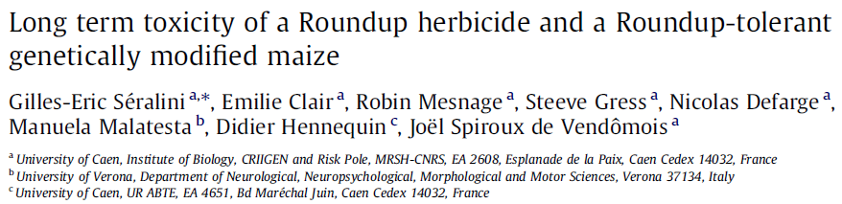
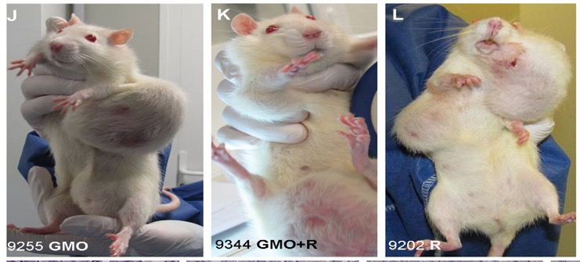
Food & Chemical Toxicology, 19th September 2012

Slide 33
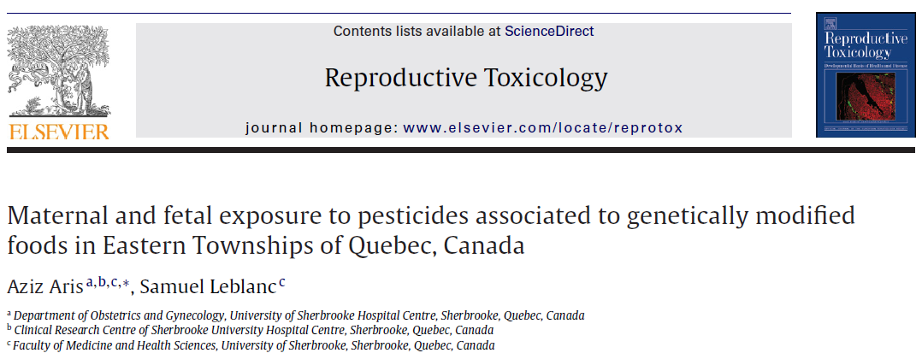
Blood of thirty pregnant women (PW) and thirty-nine nonpregnant women (NPW) were studied. Serum GLYP and GLUF were detected in NPW and not detected in PW. Serum 3-MPPA and
CryAb1 toxin were detected in PW, their fetuses and NPW

Slide 34
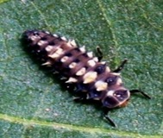


Parliament –Ag Standing Committee, India
BIOSAFETY
Goat & Sheep death in South India
30% more alkaloids in Bt Brinjal
Liver & testicle weights increased in lambs fed on Bt cotton seed
GM crops should be free of antibiotic resistance markers
ARE GM CROPS SUSTAINABLE?
Pink bollworm has developed resistance

Slide 35

No such similar instances from any other part of India or any part of the world during the past 10-18 years of Bt cotton cultivation.
Cotton seed cake is being fed to animals in the US, Australia and China over the past 17-18 years and in India over the past 10 years, without any reported adverse effects.
Thus the reports lack scientific credence

Slide 36

Key et al (2008) reviewed GM food biosafety and state that
“Foods derived from GM crops have been consumed by hundreds of millions of people across the world for more than 15 years, with no reported ill effects (or legal cases related to human health) despite many of the consumers coming from that most litigious of countries, the USA. There is little documented evidence that GM crops are potentially toxic”

Slide 37


Bt Cotton has an Excellent Bio-safety Profile
Oil was tested to be free of Bt genes and Bt proteins
Seed cake is being fed to animals in India for 10 years
No adverse effects on soil microbes/health
No adverse effects on beneficial insects or organisms
Yields have become sustainable

Slide 38

GM Labeling made mandatory
>40 Countries (European Union, Australia, China, India, Japan and Russia) adopted labeling of GM products

Slide 39



Slide 40


Gossypol Reduction in seeds
Dr Kirthi Rathore, Texas 2006

Slide 41

Thank You

