Slide 1

Secrets of High Yields
Keshav R. Kranthi
International Cotton Advisory Committee
Washington DC

Slide 2
YIELD (Kg/ha) 2017
www.icac.org

Slide 3
Potential Yield (Aus) = 3,500 Kg lint/ha
Theoretical Yield = 5,034 Kg lint/ha
Reported Yield (China) = 5,005 Kg lint/ha
-Ref, www.nzweek.com (2013)
Uptake, distribution and redistribution of NPK is crucial
Constable and Bange, 2015
www.icac.org

Slide 4
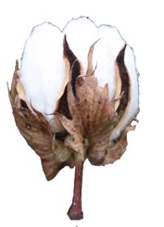
Yields/ha
Bolls/plant x
plants/ha x
boll wt x
ginning%

Slide 5
The Six Main Secrets
Breeding
Compact Architecture
High ginning%
High harvest index
Management
High density + Canopy Management
Precision Management
Short critical window

Slide 6
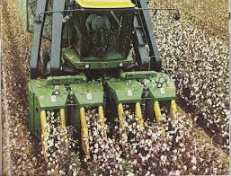
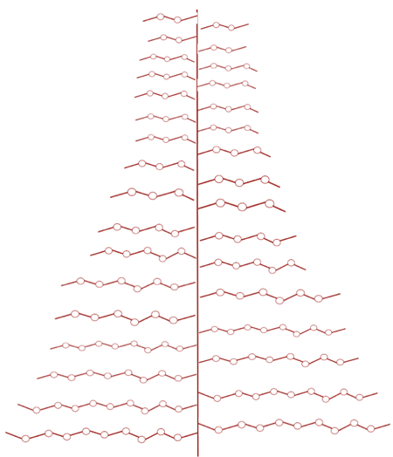
Breeding
Plant type was unsuitable for pickers

Slide 7
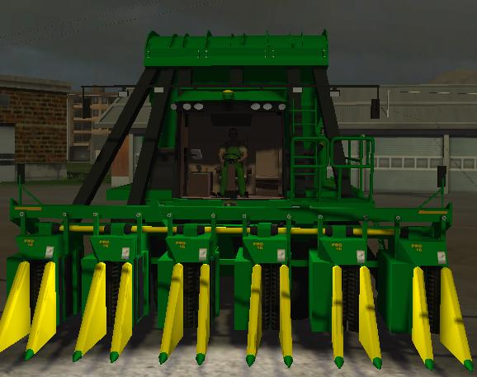
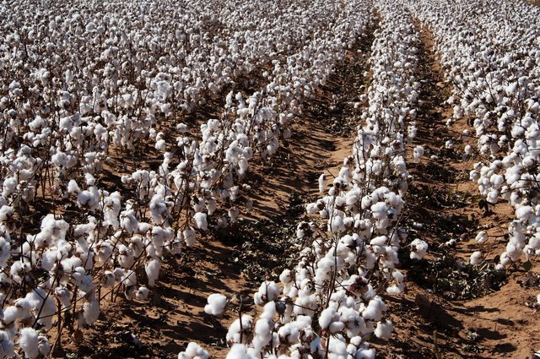
Objective: Breeding plants for the Picker
100 cm tall
70 cm wide
One-time picking

Slide 8
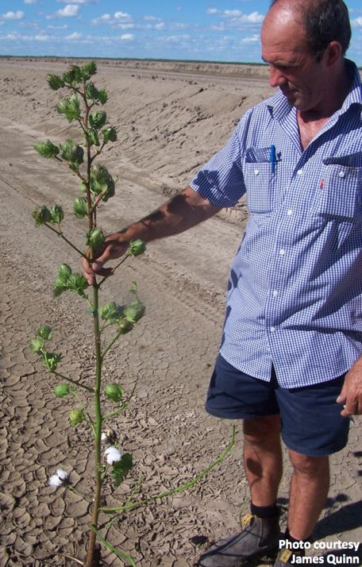
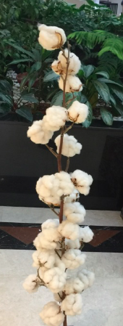
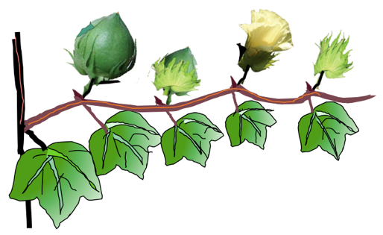
30%
10%
60%
Fruiting Branch
Photo: James Quinn

Slide 9
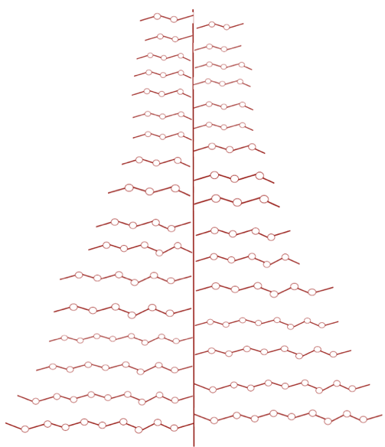
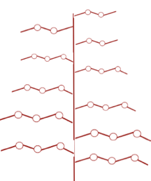
Secret-1 Compact architecture
Breeding
Tall plants
Wide branches
Compact plants
Narrow branches
Inefficient
Efficient

Slide 10
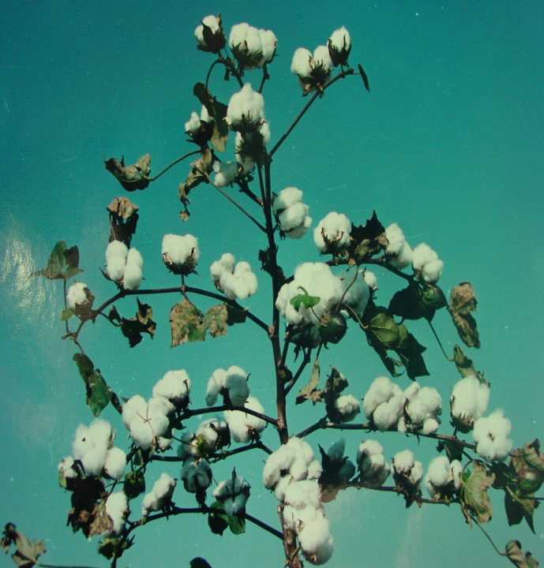
Photo: Mubvekeri, Zimbabwe

Slide 11
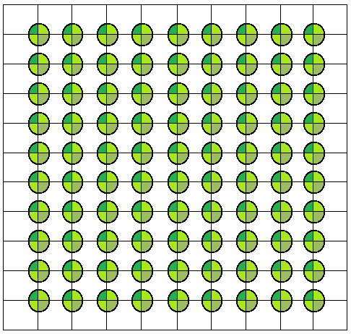

Secret-1a High Density
Spacing 90 x 90 = 11,111 plants /ha = 80 bolls/plant = 40 Q/ha
Spacing 90 x 60 = 18,500 plants /ha = 54 bolls/plant = 40 Q/ha
Spacing 60 x 10 = 166,667 plants /ha = 6 bolls/plant = 40 Q/ha
Spacing 40 x 10 = 250,000 plants /ha = 4 bolls/plant = 40 Q/ha

Slide 12
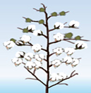

Low density
High Density
High Yields +
Good Quality
90 x 30 cm (India & Africa)
76.5 x 8 cm (Australia)
More plants /ha
Few Bolls per plant
Short duration
Only 40 days critical window
Good fibre quality
High ginning %
High harvest index
High density

Slide 13
High Density
Yield Growth in High Density Countries
Australia
Brazil
China
Mexico
Israel
Turkey
USA

Slide 14
Message
Compact plant architecture +
High Density +
Canopy Management +
Short (40 Days) critical window
give high yields plus good quality
‘Picker-breeding’ catalyzed the big change !!

Slide 15
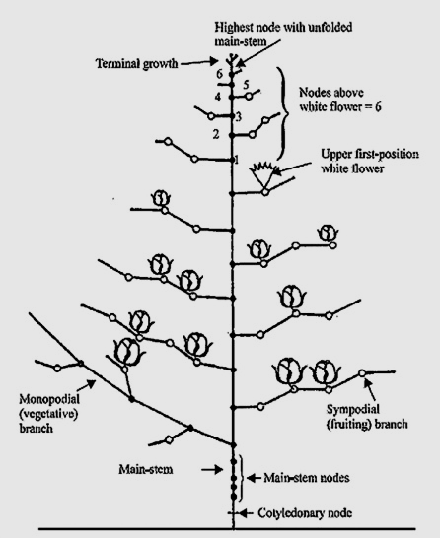
The Cotton Plant
Secret-2 Canopy Management
Nodes above the first flower
Cut-out
www.icac.org

Slide 16
Canopy management
Plant training practices are done for canopy management and also to facilitate nutrients to be redirected to fruiting parts.
Restricting plant height:
Aeration and ventilation in the high density crop is ensured by controlling the plant height to 65-70 cm. 100% compliance
Topping: 100% compliance
Removal of vegetative branches:
Compliance in 50-70% of the farms
Removal of unproductive plant parts:
100% compliance
Removal of early fruiting branches:
100% compliance
Bt-cotton in local varieties:
Bt-cotton technology is introduced into the locally adapted varieties for effective bollworm protection.

Slide 17
Canopy Best practices
India & Africa
>110,000 to 220,000 plants/ha
10-15 bolls/plant
CROP DURATION: 140-160 days 40 veg + 70 fruiting + 40 maturation
Short critical window
Efficient management of insect pests, nutrients, water and light
High yields
11,000 to 40,000 plants/ha
45-60 bolls per plant
CROP DURATION: 180-240 days 50 veg + 120 fruiting + 40 maturation
Long critical window
Complicated management
Low yields
www.icac.org

Slide 18
Secret-3 High ginning%
Australia 43%
Africa 43%
USA 42%
Turkey 42%
China 42%
Brazil 41%
India 35%

Slide 19
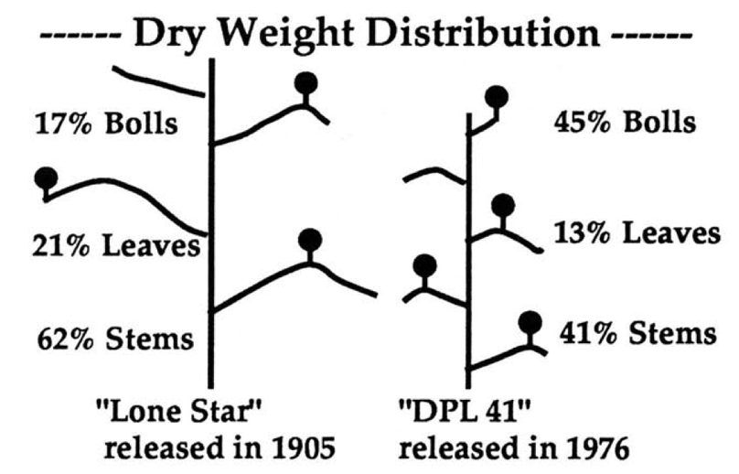
Secret-4 Harvest Index

Slide 20
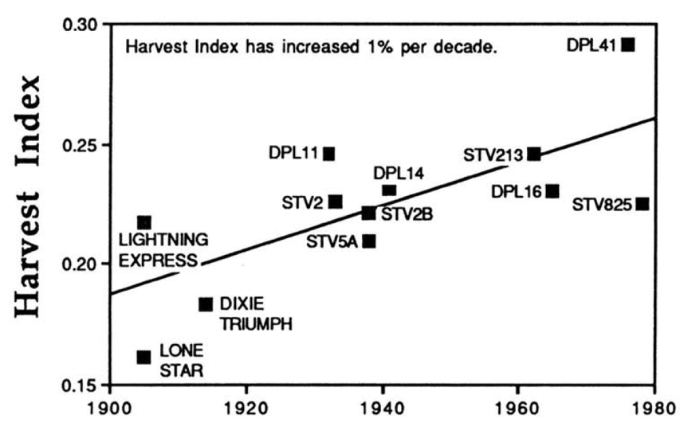
40% INCREASE IN HARVEST INDEX IN 80 YRS
Harvest index: Africa 0.2 compared to 0.45 of the top 5 countries

Slide 21
Secret-5 Precision Management
Crop Management: Soil, Water & Nutrients
Australia: MyBMP
USA: COTMAN
China: Canopy Trimming
Turkey: Balanced Diet
Brazil: Zero Tillage
India: Hybrids

Slide 22
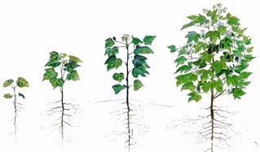
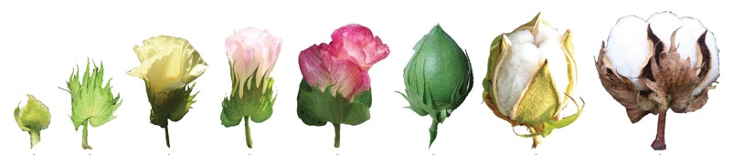
Cotton plants need
80% of water and nutrient requirement
During fruit formation (critical window)
Early season
Mid season
Late season
20 30 40 50 55 60 65 70 90 140
Days after planting

Slide 23
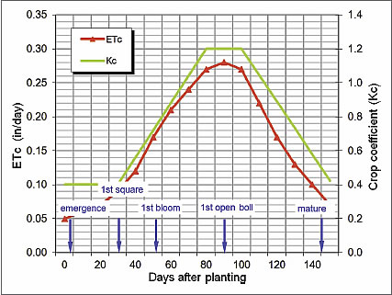



Critical Stages: Flowering + Green boll stage
Water stress at critical stage causes 30-70% yield loss
http://www.cottoninc.com/fiber/agriculturaldisciplines/engineering/irrigation-management/cotton-water-requirements/

Slide 24
Secret-6 Short critical window
for efficient crop management & good uniform fibre quality
THE CRITICAL WINDOW ATTRACTS BOLLWORMS
India and Africa have a longer 80-90 days critical window
Management is a nightmare
Water & nutrients usage is indiscriminate and soil degradation is high
www.icac.org

Slide 25
Intelligent Pest Management
1, Natural Control is Nature’s gift: Conserve it
2. Your intervention can cause Insect pests (varieties, insecticides, fertilizers, cropping systems)
3. All insects pests are not harmful. Some minor pests are useful insects
4. Effective Passive Pest Management
5. Insecticide for ‘eco-window’ and not for pest

Slide 26
Insecticide Misuse & Resurgence
Pyrethroids: Cause Helicoverpa and whitelfly resurgence
Fipronil: Causes whitefly resurgence
Pyrethroid+OP: Hormoligosis and outbreaks
Spinosad: Causes Mealybug resurgence
Organophosphates: Switching off towards vegetation, resurgence of some sucking pests
Methomyl & Thiodicarb: Cause leaf reddening

Slide 27
THE FOUR VARIETAL TRAITS
Compact architecture & high harvest index
Short duration (140-160 days)
Resistance to sucking pests
High ginning%
THE FOUR STEPS IN PLANTING
Stale seed-bed
Seed treatment
Precision planting (row orientation and 10cm spacing)
Planting on ridges
THE FOUR MANAGEMENT INTERVENTIONS
Canopy management
Square & boll retention management
Ecological engineering for stress management
Timely termination and crop residue management
THE FOUR PRODUCTION PRACTICES
Legume cover-crop/ inter-crop / crop-rotation
Mulching & minimum tillage
Water harvesting & precision irrigation
Precision nutrient management

Slide 28
Thank You

