Slide 1

New Mahyco Cotton Hybrids for Zimbabwe & Africa
Plant Breeding – Cotton Hybrids
4 July 2018

Slide 2
Cotton Hybrids – A new frontier for improved productivity
Hybrid – F1 (1st generation) progeny between 2 pure line parents
Exploits “Heterosis” or hybrid vigor: improved or increased capacity in any biological quality in a hybrid
Results in higher yields than varieties ● better and wider adaptability to environmental changes
Better in tolerance to abiotic and biotic stresses ● increased earliness
The story of impact of maize hybrids is known the world over (Zimbabwe maize crop is mainly hybrids)
Mahyco cotton hybrids registered for commercial production in Zimbabwe & Malawi (2017) and Zambia (2018).
7 other African countries currently in process of registration of hybrids.
Hybrids have potential to transform cotton production in Zimbabwe through;
Improved farmer viability
Increase in national area under cotton
Increased national cotton output

Slide 3
Terminology
TSC : Total seed cotton yield (kg/ha) – farmers yield
LINT: Lint yield (kg/ha) – lint produced per hectare (export product)
BWT : Boll weight (g) – standardised by sampling 50 undamaged bolls.
SWT: Seed weight (g) – important trait for commercial ginning esp. lint contamination.
Earliness Index (%) – combined yield of boll sample & 1st pick expressed as a % of the total crop yield.
Fiber/Staple length (mm) – Length of a fibre
Fiber strength (g/tex) – Fibre tenacity
Elongation (El) – the distance that the fibers extend before they break.
Uniformity Index (UI) – an indication of fiber length distribution within the fibrogram.
Micronaire (MIC) – Fibre fineness
Fibre Maturity (Mat) – the degree of cell wall thickness within a cotton sample.
Reflectance (Rd) – the whiteness of the light that is reflected by the cotton fiber.
Yellowness (+b) – the cotton fiber’s reflectance to yellowness.
PHT: Plant Height – height of the cotton plant at physiological maturity

Slide 4
Mahyco Cotton Hybrids Testing Details
Eight cotton hybrids (Gossypium hirsutum L.) from MAHYCO, two seasons 2015/16 and 2016/17
Genotype | Status | Growth Habit | Maturity | Source
MAHYCO C 567 | Hybrid | Semi-determinate | Medium | Mahyco, India
MAHYCO C 569 | Hybrid | Semi-determinate | Medium | Mahyco, India
MAHYCO C 571 | Hybrid | Determinate | Early | Mahyco, India
MAHYCO C 577 | Hybrid | Determinate | Early | Mahyco, India
MAHYCO C 579 | Hybrid | Indeterminate | Late | Mahyco, India
MAHYCO C 608 | Hybrid | Semi-determinate | Medium | Mahyco, India
CHECK 1 | OPV | Determinate | Medium | Zimbabwe
CHECK 2 | OPV | Indeterminate | Late | Zimbabwe

Slide 5
HYBRID TRIALS_2015/16 and 2016/17 details:
Experimental design:
Randomized Complete Block Design with three replications.
Treatments: Ten
Eight Mahyco hybrids : C 567, C569, C 570, C 571, C 577, C 579, C 608, C 609
Two check varieties : 2 OPV CHECK VARIETIES
Plot size: 4 rows x 4.2 m
Spacing: 100 x 30 cm
Locations: Six
(Bindura, Kadoma, Patchway, Chinhoyi, Gokwe, Sanyati)

Slide 6
Seed Cotton Yield superiority of hybrids
Pooled data of 8 and 9 locations each for two years 2015/16 and 2016/17,
respectively.
Variety | 2015/16 Seed Cotton Yield (kg per ha) | Per cent increase | 2016/17 Seed Cotton Yield (kg per ha) | Per cent increase | POOLED Seed Cotton Yield (kg per ha) | Average per cent increase
C 567 | 2522 | 39 | 2597 | 41 | 2562 | 40
C571 | 2329 | 29 | 2630 | 43 | 2488 | 36
C608 |  |  | 2576 | 40
CHECK 2 | 1811 |  | 1843 |  | 1828
Trial Pooled Mean | 1883 |  | 2292 |  | 2088

Slide 7
Lint Yield superiority of hybrids
Pooled data of 8 and 9 locations each for two years 2015/16 and 2016/17, respectively.
Variety | 2015/16 Lint Yield (kg per ha) | Per cent increase | 2016/17 Lint Yield (kg per ha) | Per cent increase | POOLED Lint Yield (kg per ha) | Average per cent increase
C 567 | 988 | 5 | 939 | 23 | 962 | 13
C571 | 997 | 6 | 925 | 21 | 954 | 12
C608 |  |  | 900 | 18
CHECK 2 | 938 |  | 762 |  | 845
Trial Pooled Mean | 937 |  | 865 |  | 901

Slide 8
Yield Potential of hybrids
Table 2.1: Seed Cotton Yield (kg/ha) Results, Mahyco Hybrid Trial, Across site Summary (8 Sites), 2015-16
Entry | Anfield | Bindura | Chinhoyi | Gokwe 1 | Gokwe 2 | Sanyati 1 | Sanyati 2 | Seedco | MEANS
C 567 | 2768ª | 1436ª | 2496ª | 2430ª | 1369ª | 1832ª | 2309ª | 5536ª | 2522
C 571 | 1995^{ab} | 1237^{b} | 2011^{ab} | 2713ª | 1668^{b} | 1380^{b} | 2122ª | 5506ª | 2329
CHECK 2 | 1548^{b} | 1171^{b} | 1747^{b} | 1407^{b} | 1052^{c} | 1402^{b} | 1908^{b} | 4256^{b} | 1811
SITE MEANS | 1883 | 1294 | 2270 | 2251 | 1480 | 1439 | 1994 | 4717 | 2166
SE OF MEANS | 494 | 52 | 214 | 232 | 137 | 152 | 108 | 230 | -
LSD (5%) | 883 | 101 | 394 | 407 | 263 | 293 | 208 | 444 | -
P values | 0.036 | 0.001 | 0.034 | 0.044 | 0.001 | 0.042 | 0.038 | 0.001 | -

Slide 9
Yield Potential of hybrids
Table 2.2: Seed Cotton Yield (kg/ha) Results, Mahyco Hybrid Trial, Across Sites Summary (9 Sites), 2016-17
ENTRY | Anfield | Bindura 1 | Chinhoyi 1 | Chinhoyi 2 | Gokwe 1 | Gokwe 2 | Sanyathi 1 | Sanyathi 2 | Seedco | TRT Mean
C 567 | 1529^{ab} | 2297 | 1675 | 1591 | 3046ª | 3926ª | 2959^{ab} | 2582ª | 3769ª | 2597
C 571 | 1599^{ab} | 2360 | 1884 | 1818 | 2816ª | 3791ª | 3544^{b} | 2163^{ab} | 3694ª | 2630
C 608 | 2104^{b} | 2621 | 2061 | 2154 | 3006ª | 2600ª | 3198^{b} | 1649^{b} | 3789ª | 2576
CHECK 2 | 1114ª | 1737 | 1702 | 1715 | 1521^{b} | 2273^{b} | 2454ª | 1668^{b} | 2407^{b} | 1843
SITE MEANS | 1444 | 2416 | 1824 | 1849 | 2282 | 3024 | 2836 | 1867 | 3089 | 2292
SE OF MEANS | 196.4 | 210.2 | 182.6 | 261 | 199 | 493.2 | 245.1 | 192.6 | 314.6 | .
LSD (5%) | 577.6 | 616.5 | 535.4 | 765.5 | 583.5 | 1447 | 719 | 564.8 | 925.1 | .
P values | 0.008 | 0.152 | 0.659 | 0.387 | 0.000 | 0.000 | 0.035 | 0.073 | 0.015 | -

Slide 10
Stability Analysis: C567
Medium Maturity
Apex genotype.
Moderate stability.
Performed well in the main mega-environment: Sanyati, Anfield, Gokwe 1, and Kadoma

Slide 11
Field Performance of hybrids
YEAR | VARIETY | TSC (kg/ha) | LINT (kg/ha) | BWT (g) | SWT (g) | PHT (cm) | EARLINESS (%)
2015-16 8 SITES | C 567 | 2522 | 988 | 6.0 | 10.2 | 110 | 60
 | C571 | 2329 | 987 | 6.2 | 11.3 | 98 | 66
 | CHECK 2 | 1811 | 938 | 6.2 | 11.6 | 119 | 50
2016-17 9 SITES | C 567 | 2597 | 939 | 6.3 | 10.8 | 119 | 67
 | C571 | 2630 | 925 | 6.3 | 11.8 | 113 | 70
 | C608 | 2576 | 900 | 6.1 | 11.6 | 122 | 61
 | CHECK 2 | 1843 | 762 | 6.2 | 11.6 | 129 | 53
MEANS ACROSS YEARS
 | C 567 | 2562 | 962 | 6.2 | 10.5 | 115 | 64
 | C571 | 2488 | 954 | 6.3 | 11.6 | 106 | 68
 | C608 | 2576 | 900 | 6.1 | 11.6 | 122 | 61

Slide 12
GGE Biplot for Earliness Index: C571 & C577
Early Maturity
Apex genotype.
Very good stability.
Performed well in the main mega-environment

Slide 13
Fiber Performance of hybrids
Table 3.1: Fibre Quality Analysis Results, Mahyco Hybrid Trial, Across Sites (5) Summary, 2015-16
ENTRY | LENGTH (mm) | STRENGTH (g/tex) | ELONGATION (%) | UNIFOMITY (%) | SHORT FIBRE (%) | MICRONAIRE | MATURITY |  | RD |  | B+
C 567 | 32.7 | 27.6 | 6.4 | 87 | 3.5 | 4.6 | 0.87 |  | 82 |  | 10.4
C571 | 32.3 | 28.0 | 6.6 | 86 | 3.9 | 4.7 | 0.87 |  | 81.2 |  | 10.5
C608 | 32.6 | 29.5 | 6.2 | 87 | 3.3 | 4.5 | 0.87 |  | 81.0 |  | 10.4
CHECK 2 | 31.8 | 29.5 | 6.6 | 86 | 4.6 | 4.7 | 0.87 |  | 81 |  | 10.2
Table 3.2: Fibre Quality Analysis Results, Mahyco Hybrid Trial, Across Sites (5) Summary, 2016-17
ENTRY | LENGTH (mm) | STRENGTH (g/tex) | MICRONAIRE | MATURITY | UNIFOMITY (%) | ELONGATION (%) |  | SHORT FIBRE (%) |  | RD | B+
C567 | 31.2 | 29.7 | 4.4 | 0.86 | 86 | 7.0 |  | 4.8 |  | 84 | 8.1
C571 | 31.4 | 32.2 | 4.4 | 0.86 | 86 | 7.0 |  | 5.5 |  | 84 | 8.1
C608 | 31.0 | 32.5 | 4.5 | 0.86 | 86 | 6.9 |  | 4.1 |  | 84 | 8.1
CHECK 2 | 30.2 | 32.1 | 4.3 | 0.86 | 86 | 7.0 |  | 4.7 |  | 84 | 8.1

Slide 14
Key features of Hybrid C 567
Superior yield potential than check; wider adaptability
(5 500 kg/ha dryland production)
Early in maturity (Earliness index 64 % ; CHECK = 52 %)
Large bolls (6.2 g), high boll retention
Shorter internodes and interboll distance
Superior tolerance to Jassids (hairy on dorsal side of leaf)
Smaller leaf size and open canopy
Very high oil content (22.24% ; Checks 20%)
Very high protein content (23% ; Check 21%)
Very good fibre quality parameters at par with checks

Slide 15
Key features of Hybrid C 571
Superior yield potential than check; wider adaptability
(5 500 kg/ha dryland production)
Very early maturity (Earliness index 68 % ; CHECK = 52 %)
Large bolls (6.3 g), high boll retention
Superior fibre quality parameters than checks
Short stature with open canopy
Good tolerance to Jassids
Very high oil content (23% ; Checks 20%)
High protein content (22% ; Check 21%)

Slide 16
Key features of Hybrid C 608
Superior yield potential than check ; wider adaptability
(3 700 kg/ha dryland production)
Medium maturity (Earliness index 62 % ; CHECK 2 = 52 %)
Large bolls (6.0 g) , high boll retention, good boll visibility
It is a multiple stress tolerant hybrid (Jassids, Aphids and Drought)
Stay green trait – imparts tolerance to drought stress
Leathery leaves imparts tolerance to both Jassids and aphids
Superior fibre quality parameters than checks
Very high oil content (22% ; Checks 20%)
Very high protein content (23% ; Check 21%)

Slide 17
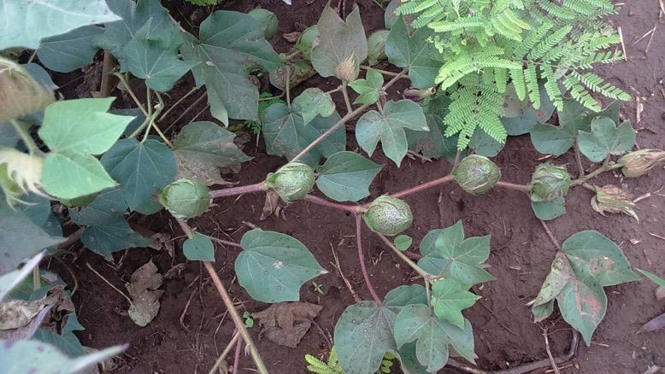
High Boll retention in C 567

Slide 18
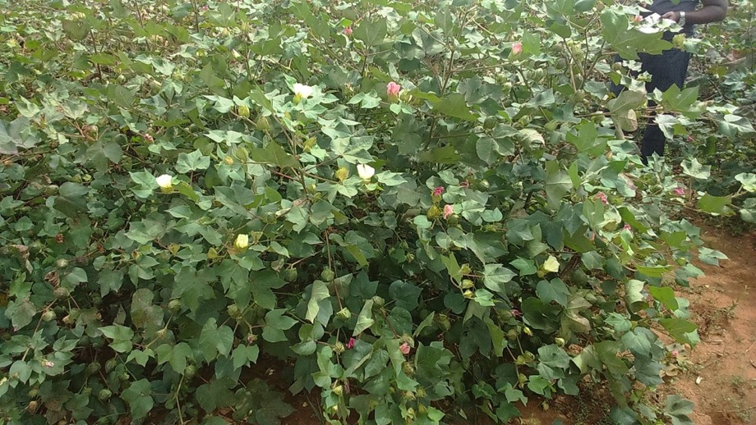
Hybrid C 571
Short internodes
Short interboll distance
Good boll retention
Jassids tolerance

Slide 19

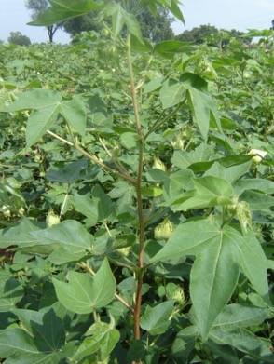
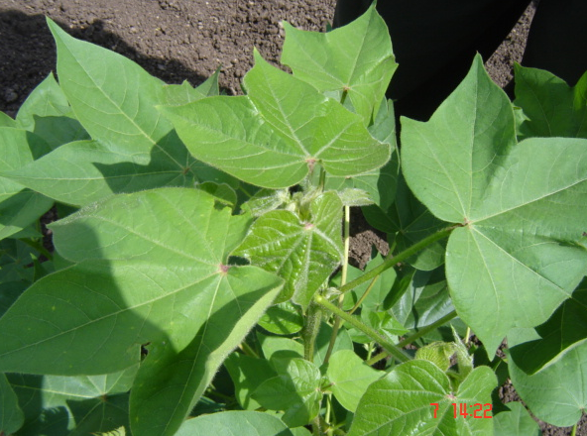
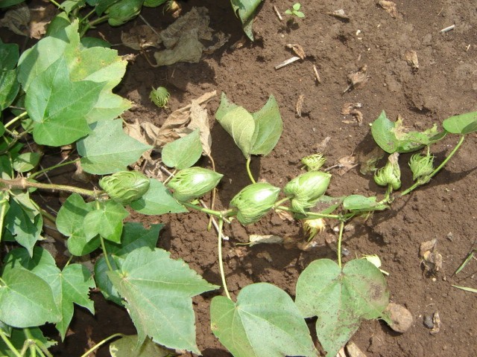
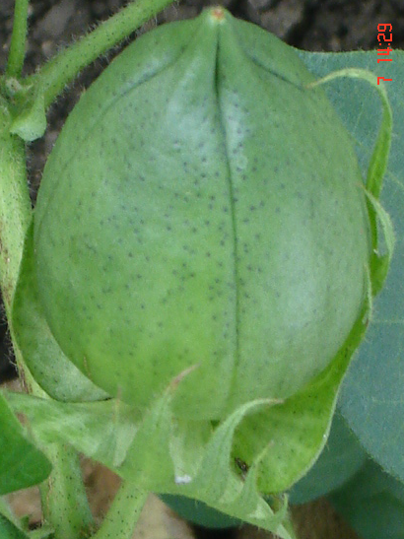
C 608: Morphological Uniqueness
Introgression from a wild species
which imparts
Stay greenness
Drought tolerance
Sucking pest tolerance
Higher fibre strength

Slide 20
Summary of Mahyco Hybrid proposals
Hybrid | Maturity Group | % SC Yield adv over best check | Fibre length (mm) | Fibre strength (g/ tex) | Oil % | Crude Protein % | Special attributes
C 567 | Medium | 24 | 31.9 | 28.7 | 22 (Check 20) | 23 (Check 21) | Wider adaptability, high boll retention, Superior SP tolerance, small size leaves, open canopy
C 608 | Medium | 22 | 31.8 | 31.1 | 22 | 23 | Excellent SP tolerance, stay greener, Very Long fibre with high strength, , small size leaves, open canopy
C 569 | Early | 20 | 31.6 | 29.0 | 23 | 22 | Large bolls, good boll retention, SP tolerance, , small size leaves, open canopy
C 577 | Very early | 15 | 28.3 | 31.2 | 22 | 23 | Better SP tolerance – Jassids, GOT – 39% with medium staple length, , small size leaves, open canopy
C 571 | Very early | 20 | 31.8 | 30.2 | 23 | 22 | Large bolls, SP tolerance, high boll retention, Very Long fibre with high strength , smaller size leaves, open canopy, boll visibility
C 579 | Medium to Late | 12 | 29.9 | 30.0 | 21 | 22 | High GOT – 40 %, Better SP tolerance, Good rejuvenation (mid-season drought suit), large bolls

Slide 21
THANK YOU!!!

