Slide 1


20 Years of GM varieties use
Lessons learnt
13th Meeting of the Inter-regional Cooperative researche network on cotton for the Mediterranean and Middle East regions
Luxor, Egypt, February 2-6, 2018
Michel FOK
michel.fok@cirad.fr

Slide 2
Presentation plan
The use of GM varieties sounds good
Negative impacts observed too
Lessons to retain

Slide 3
The use of GM varieties sounds good
At the world level
  Information extracted from ISAAA
    International Service for the Acquisition of Agri-Biotech Applications
    Report freely available at http://www.isaaa.org

Slide 4
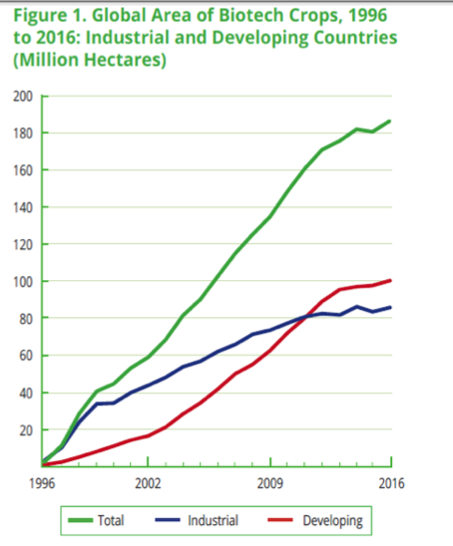
Acreage is continuously increasing

Slide 5
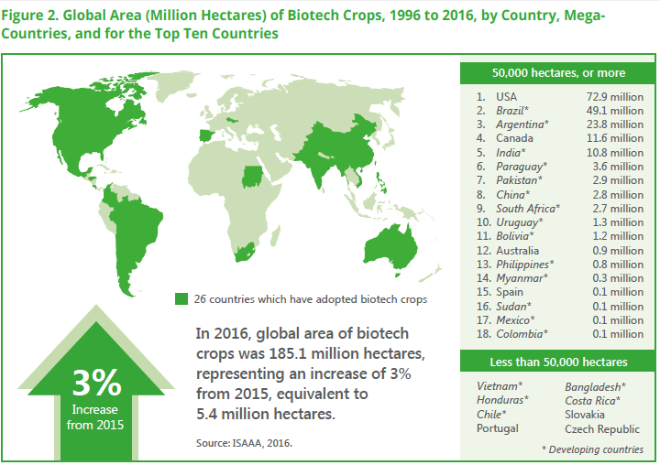
Use is encountered in all continents… with 5 major countries

Slide 6
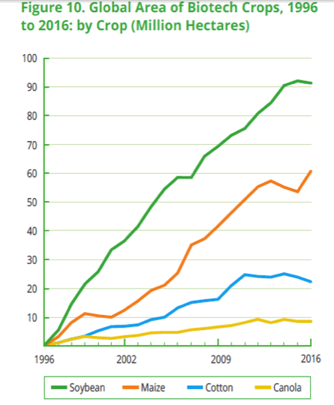
Four major GM crops in the world
Soybean
Corn
Cotton
Canola

Slide 7
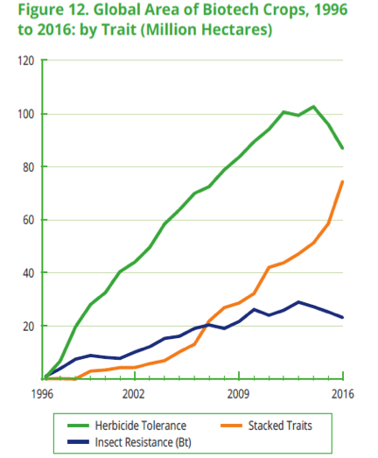
Herbicide tolerance accounts much more than insect resistance in commercial use
Almost exclusively 2 types of GM varieties
Herbicide tolerance
Insect resistance

Slide 8
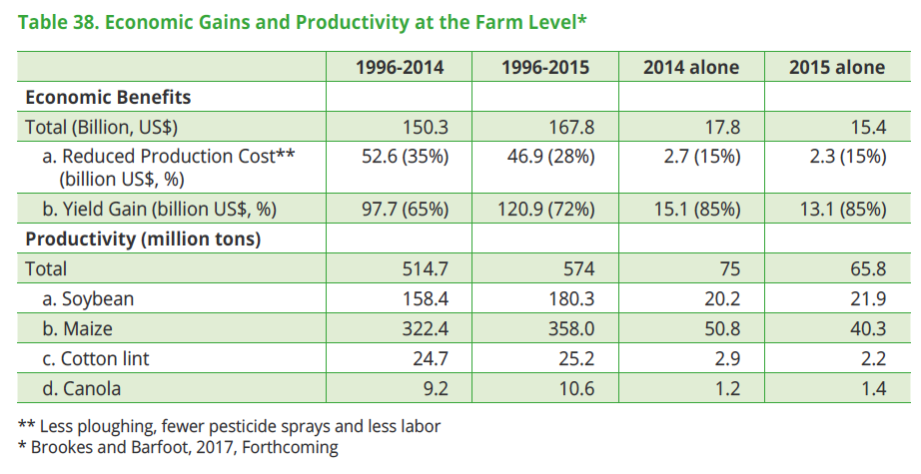
Very high economic impacts are claimed
↑ Productivity
↓ Production cost

Slide 9
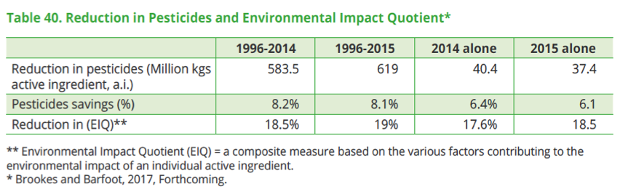
Positive environment impacts by the reduction of pesticide use

Slide 10
The use of GM varieties sounds good
At the level of a specific country
  Australia: A clear but particular case
    Information extracted from the presentation of Mr. Michael Murray, Cotton Australia, in Tashkent, October, 2017

Slide 11
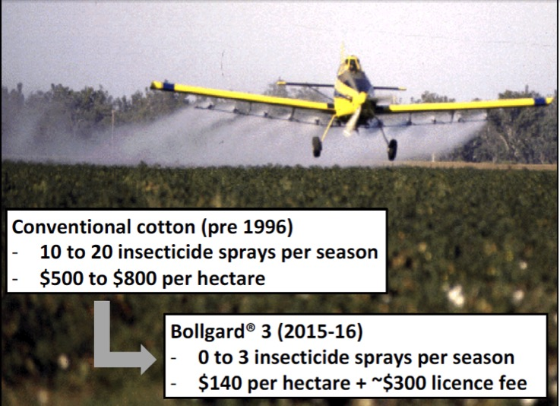
Dramatic decrease of insecticide use and of the cost to control pests, Australia

Slide 12
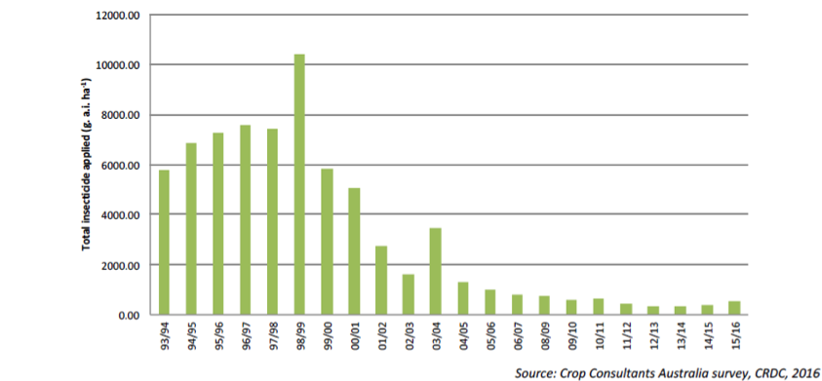
Huge reduction of the amount of insecticide active ingredients per ha, Australia
…but the insecticide active ingredients have also evolved a lot, being effective at a much lower amount

Slide 13
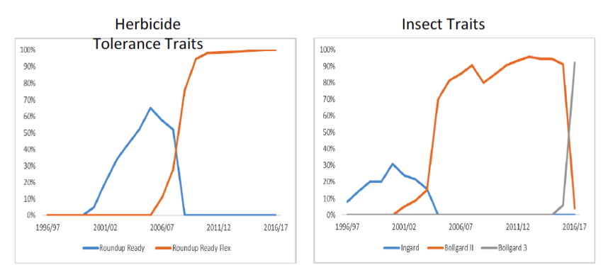
Sequence of genes used for herbicide tolerance and insect resistance, Australia

Slide 14
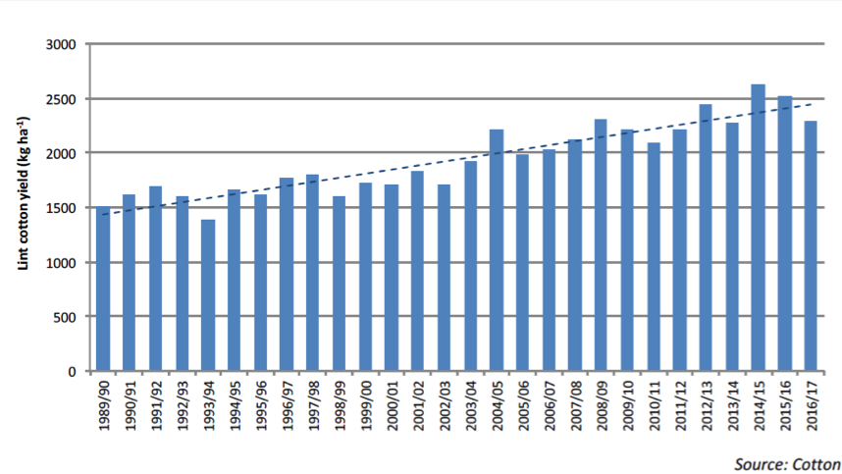
Australia: Continuously ranking 1st in yield

Slide 15
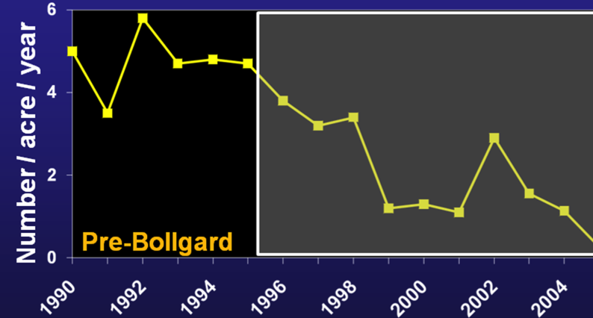
Great decrease of insecticide sprays vs Bt targeted pests in USA
Heliothine sprays
Leonard, 2010 (Cotton Beltwide conferences, New Orleans)
Notes:
The same decrease of insecticide sprays has been observed in the USA with regard to Bt targted pests

Slide 16
Decrease of chemical controls in China
Number of insecticide sprays for CBW (grey points) and all insect pests (black points) on cotton
1990 1994 1998 2002 2006 2010
Lu, Y., Wu, K.et al. (2012). Widespread adoption of Bt cotton and insecticide decrease promotes biocontrol services. Nature, 487, 362–366.
Notes:
The same research team in China has claimed in 2012, in Nature, the use of insecticides has decreased to control cotton pests and has induced biocontrol services. This graphic does show that the number of insecticides to control bollworms has decreased while the total number of chemical controls has decreased then stagnated.
The authors have totally overlooked that in the last years, the number of sprays against non-target pests has increased.

Slide 17
Impacts on yield is variable between countries
No direct yield impact from herbicide tolerance
Yield impact from insect resistance is variable
  According to countries
    Yield increase is higher in developing countries where chemical control was not optimal
  According to the period considered
    Yield might increase in the short term, but could decrease in the mid-term

Slide 18
Pressure reduction in all countries
⇐ Bt effectiveness
Bt targeted pest pressure ➢
  Documented in all countries using Bt varieties
  ⇐ No (not yet?) or rare case of pest resistance to Bt toxins
    Exception = India (single Bt gene for a while)
Notes:
The decrease of the infestation level of Bt target pests is well documented in many countries while the emergence of resistant pests to Bt toxins is still to come or not yet absolute

Slide 19
Negative impacts observed
Negative trend: need for more chemical controls
  ⇐ pests not targted by Bt toxins
  ⇐ weeds resistant to glyphosate

Slide 20

New ennemies have emerged in several major cotton countries
Well documented: USA, China, India
Notes:
The emergence of so called new pests is well documented in several countries like in China, India and USA. The pests are not new, they have become more visible and more damageable because of the change in the pest complex

Slide 21
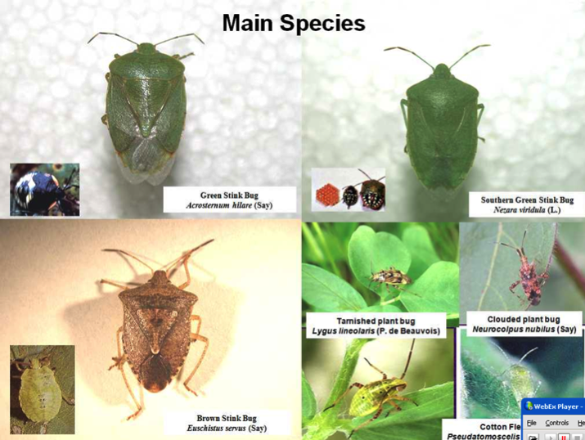
A bug in using GM:
Bugs, new threat in US cotton fields
…but also aphids, jassids…
Notes:
Here are the new nightmare of US cotton growers : various species of bugs.
Bugs differ with worms because they fly, and this makes their control more difficult by going away when you come to spray them.

Slide 22
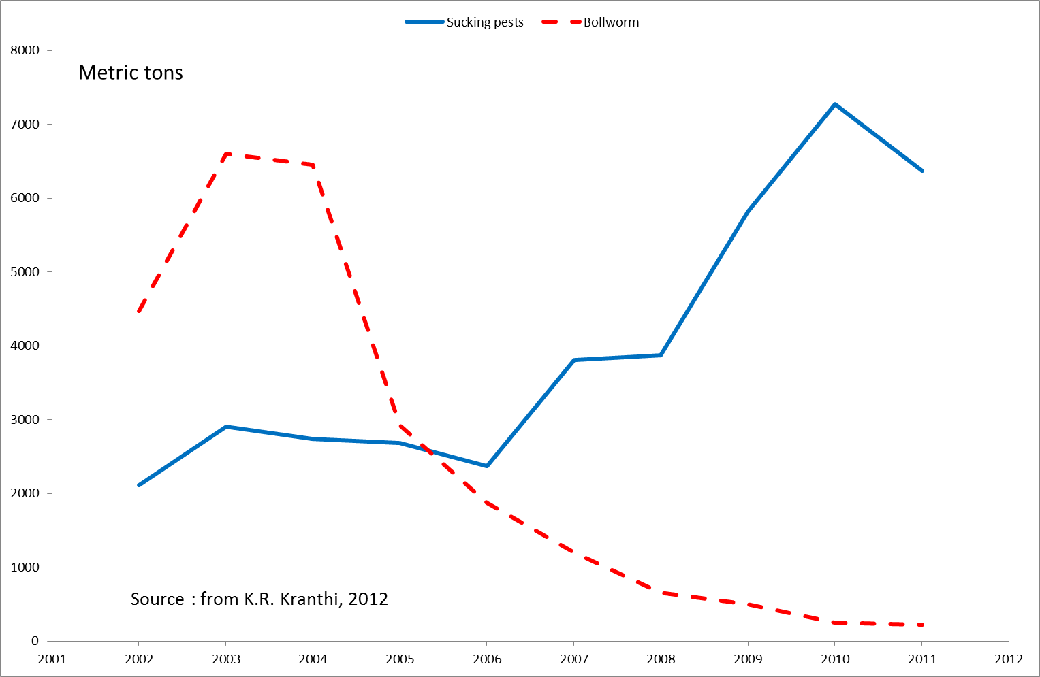
India

Slide 23
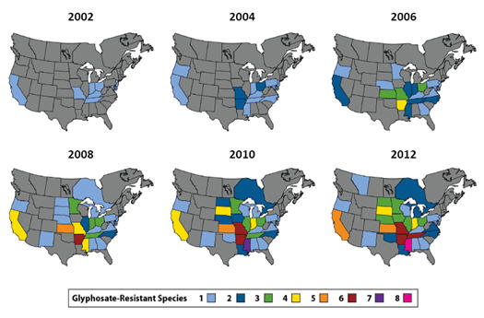
Evolution of the number of glyphosate-resistant species of weeds in th USA

Slide 24
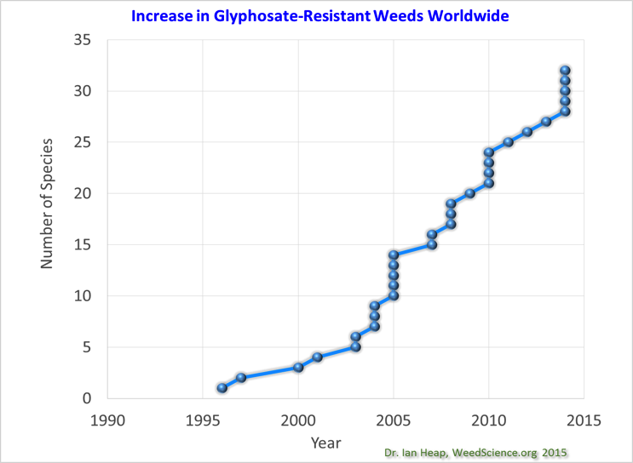
The increase of weed resistance to glyphosate is impressive worldwide
In 2016:
out of 40 resistant species recorded,
17 are found in the USA

Slide 25
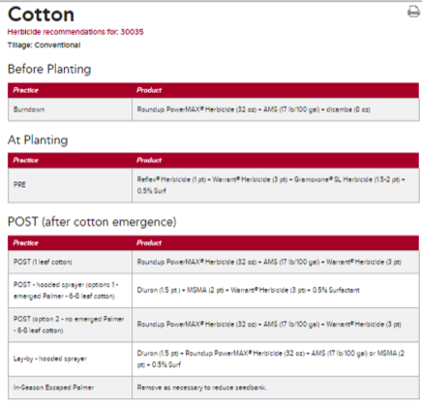
Ironically more herbicides are being used
⇐ resistant weeds management
RoundUp Ready Plus (resistant weed management program of Monsanto)
Recommendations for a location in Georgia State
RoundUp + 2 others
3 others + surfactant
RoundUp + 2 others
3 others + surfactant
RoundUp + 2 others
3 others + surfactant
RoundUp + 6 distinct other herbicides
Notes:
The use of Roundup Ready cotton is no longer based on the unique use of glyphosate herbicide. The weed control program has become quite complex, local specific, and on the recourse to 6 distinct additional herbicides in Georgia.

Slide 26
Special focus on China
Number of insecticide sprays for CBW (grey points) and all insect pests (black points) on cotton
1990 1994 1998 2002 2006 2010
Lu, Y., Wu, K.et al. (2012). Widespread adoption of Bt cotton and insecticide decrease promotes biocontrol services. Nature, 487, 362–366.
Notes:
The same research team in China has claimed in 2012, in Nature, the use of insecticides has decreased to control cotton pests and has induced biocontrol services. This graphic does show that the number of insecticides to control bollworms has decreased while the total number of chemical controls has decreased then stagnated.
The authors have totally overlooked that in the last years, the number of sprays against non-target pests has increased.

Slide 27

Farmers perceived an increased infestation of pests not targeted by Bt-cotton
Annual urveys conducted in Hebei
Answers to the question about the evolution of pest infestations over the 5 last years

Slide 28
Chinese farmers no longer happy with Bt cotton
Among 262 farmers surveyed
Wang & Fok
Hebei province, China. Survey in 2011.
Notes:
In China more than half of the farmers are not happy with the effectiveness of Bt cotton and 3 quarters of them are not happy with its profitability.

Slide 29
Effect against pests not so much lasting
Hebei province, Yellow River Valley, survey in 2011

Slide 30
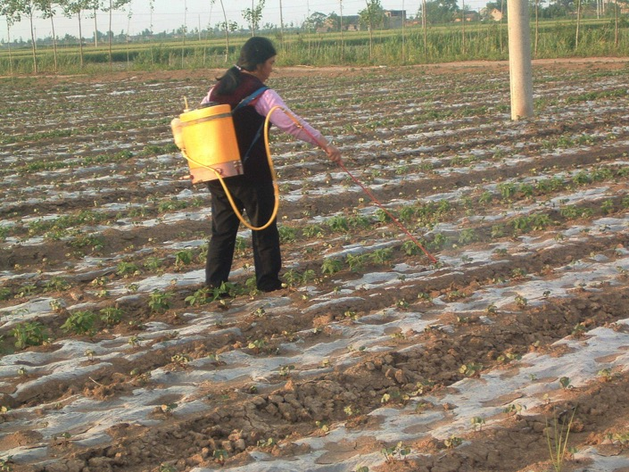
Effect against pests not so much lasting
Early spray against aphids
Hebei Province, 2006

Slide 31
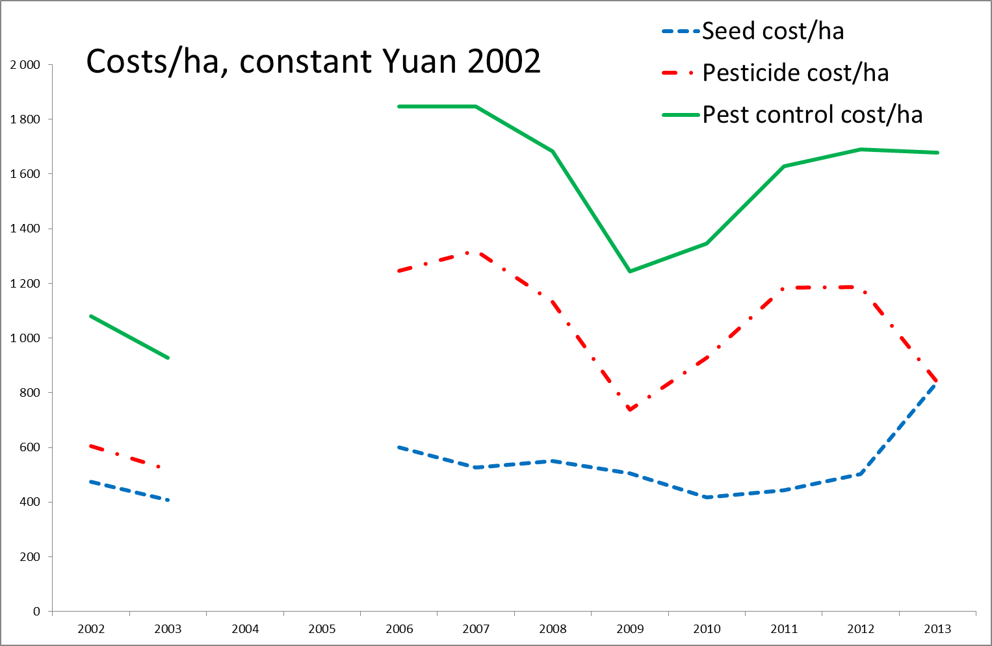
Increased costs to control pests

Slide 32
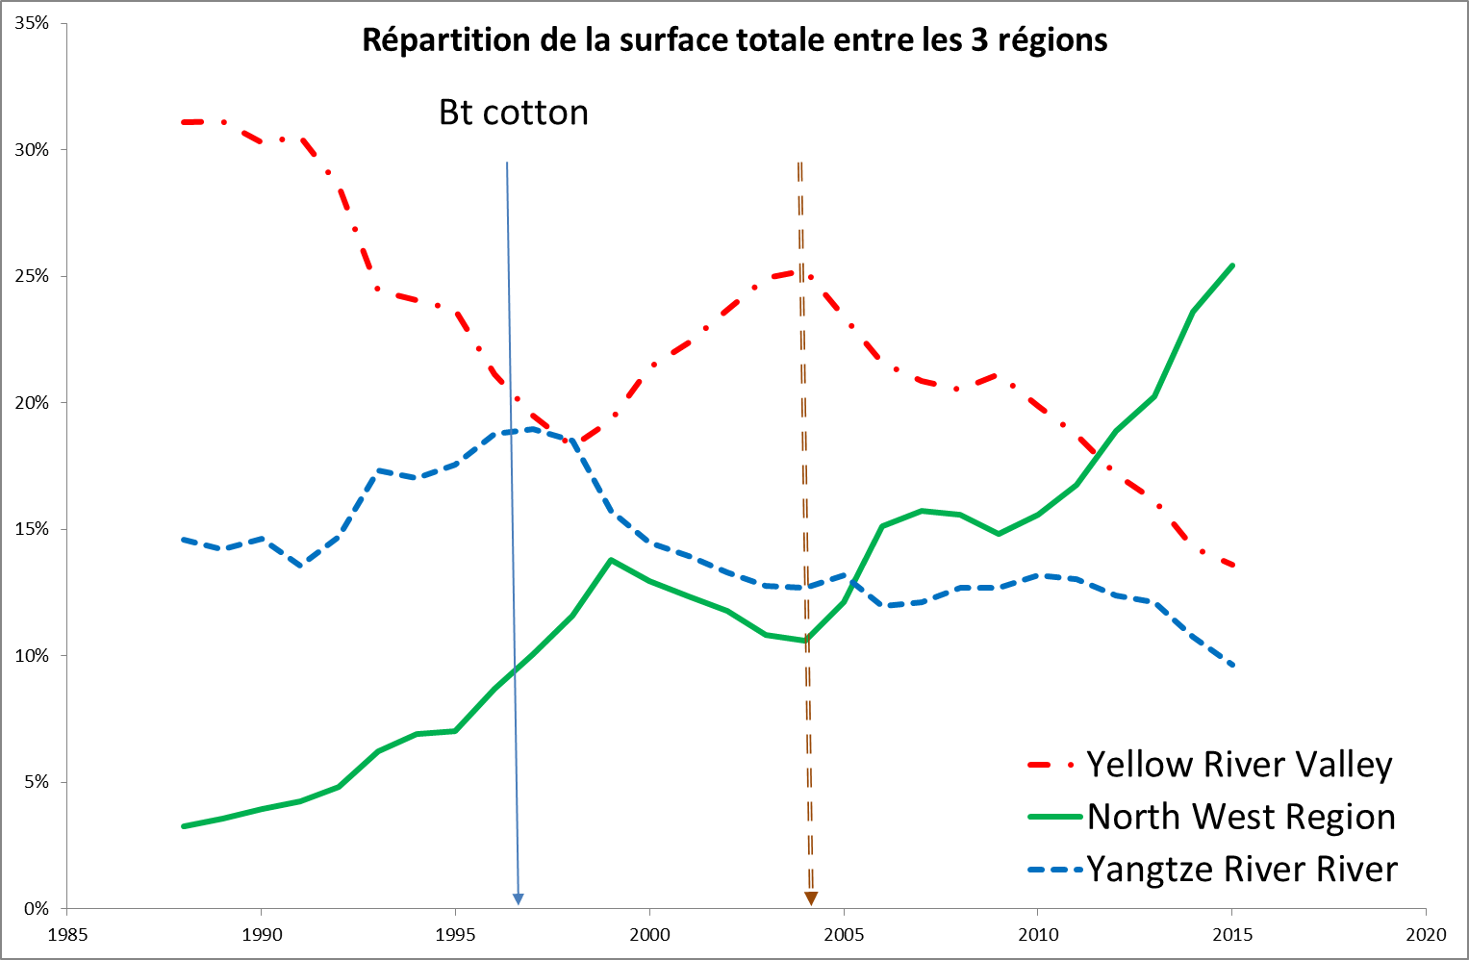
Effect geographically localized
Cotton area share in 3 cotton production regions

Slide 33
Lessons to retain
1. Effectiveness must be debated by considering short term and mid-term effects
  Valid both for pest resistance and herbicide tolerance
  Short term: Good
  Mid term: much less good if not bad

Slide 34
2. Global and a-phased assessments are misguiding
Assessment of GM use must be context specific
  According to country
  Depending on time
…but not the case for most of the available assessments

Slide 35
3. The use of GM must anticipate reaction from the cropping eco-system
GM use is an action on an eco-system
Action implies reaction
  Stronger is the action, stronger is the reaction
The effect reversal observed in mid-term is indicative of the reaction of the eco-system
  Resulting from a generalized and continuous use of GM
The use of GM must anticipate possible reaction by eco-system

Slide 36
4. Best use of GM is reasoned partial use
Option opposed to general and continuous use
Partial use ?
  Combine the use of GM with non-GM: co-existence
  The balance of the combination could/should fluctuate over time

Slide 37
Thank you for your attention

