Slide 1
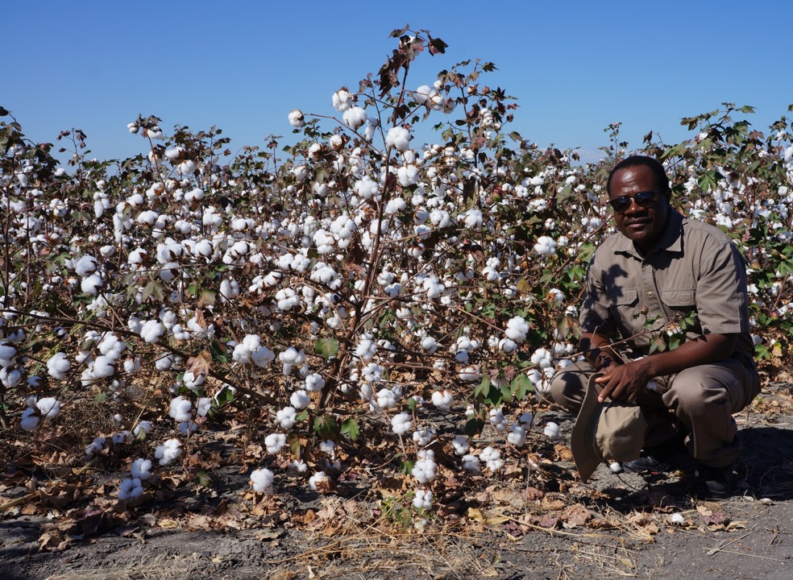
BEST PRACTICES FOR COTTON YIELD ENHANCEMENT IN AFRICA

Slide 2
Research
To a greater extend research in cotton must address the concerns of the cotton value chain in a “patriotic manner”.

Slide 3
Research generates new technology and the following characteristics of good technology are necessary to consider.

Slide 4
Morality of Technology
Technology that would have been relegated in some continents is presented as the “saviour” in Africa.

Slide 5
b. Ripeness of Technology
Why all that rush? Take time.
Develop a high level of personal/institutional confidence with the technology.
NOT FAITH

Slide 6
Therefore test the technology again
and again
and again
and again

Slide 7
Take time to work to make the technology to ensure that it is:
Affordable,
Viable,
Sustainable
Easy to use

Slide 8
c. Quietness of Technology
Deal with controversies
Technology should not be forced down the throat of the user.

Slide 9
THE RESEARCHER NEEDS TO ENSURE THAT GOOD TECHNOLOGY REACHES THE END USER

Slide 10
Training of Trainers (TOT):
“A Conduit for Empowerment”
Technology, Knowledge and Information generated by research should reach the grower in a practical manner.

Slide 11
Unfortunately movement of research outputs tends to end with training of trainers.
Research needs to link with all stakeholders.
Research Extension Grower

Slide 12
However decades of agricultural research produced strategies that leave Africa with very few excuses for failing to raise cotton productivity
Much of Africa has very good cotton varieties.

Slide 13
Focus on Zimbabwe
Has a range of good soils.
Rainfall not very bad
Rivers are many – Need more damming
Cotton varieties are competitive.
Cotton production technologies are quite sound.

Slide 14
BUT WE ARE RANKED LOW
800 KG/HA – NOT A VIABLE YIELD LEVEL

Slide 15
EMPHASIS
1. Growing certified seed of adaptable cotton varieties.
Zimbabwe has a strong seed certifying institution.

Slide 16
2. Planting early in the season.
3. Ensuring that recommended plant populations for particular cotton varieties are achieved maintained throughout the growing season.

Slide 17
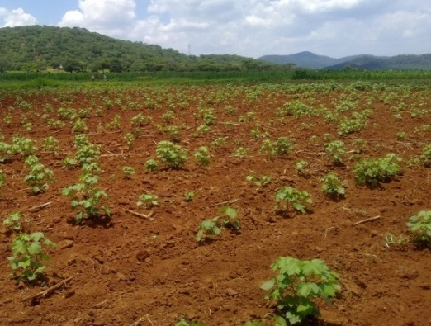

Slide 18
4. Sustaining an effective and efficient weed management regime.
5. Determination of fertilizer rates through testing,
Adequate nutrition promotes
boll formation,
boll retention, and
boll weights

Slide 19
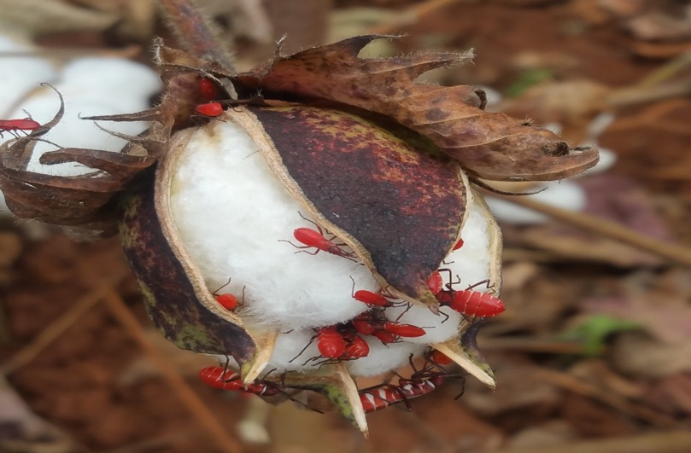
6. Implementing Integrated Pest Management strategies.

Slide 20
7. Pick/Harvest ripe bolls early enough to preserve colour and avoid unnecessary boll loss and boll weight loss.
8. Rid the seed cotton of contaminants during harvesting and storage.
Thank you

