Slide 1
Measuring tolerance levels of pre-released Gossypium hirsutum L. Genotypes to Verticillium dahliae Kleb.
Fredy Musiniwa
Washington Mubvekeri
Cotton Research Institute
P. Bag 765
Kadoma

Slide 2
Introduction
Verticillium wilt is one of the most important diseases of cotton which affects yield and fibre quality in cotton worldwide (Karademir et al., 2010).
The disease is caused by a soil borne fungus called Verticillium dahliae Kleb
Once verticillium wilt is introduced into the field, eradicating it is difficult because of its saprophytic ability

Slide 3
…Introduction
there is no effective chemical control for the disease.
the use of tolerant cultivars is of great importance in controlling the disease.
Measuring V. wilt tolerance levels in new cotton genotypes is one of the major breeding goals at Cotton Research institute

Slide 4
Objective
To determine tolerance levels of new cotton genotypes to verticillium wilt.

Slide 5
Materials and Methods
Study site
Cotton Research Institute
2 Experiments from MSHV breeding programs
Treatments- 12 cotton genotypes
Experimental Design- RCBD with 3 Reps
Plot size- single row of 5.4m
Measurements- %incidence, severity and seed cotton yield

Slide 6
Materials and Methods
Infected plants were tagged with knitting wool of different colours from the period of February up to May.
Percentage incidence was calculated per every plot at the end of the season
Table 1. Scoring system for percentage incidence
% Incidence | Disease Rating | Symbol
0% - 9% | Highly Resistant | HR
10% - 19% | Resistant | R
20% - 29% | Tolerant | T
>30% | Susceptible | S

Slide 7
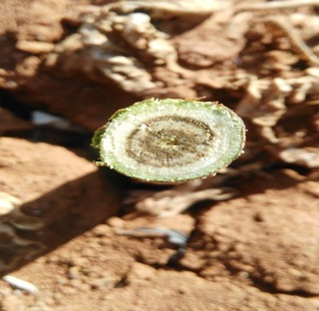
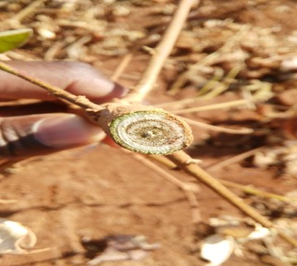
Materials and Methods
Vascular browning was determined by cutting each plant cross sectionally after harvesting.
Yield was measured per plot at the end of the season.

Slide 8
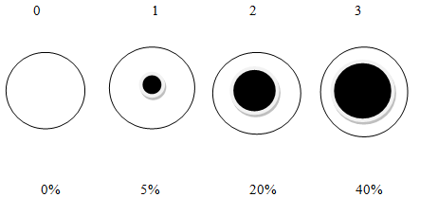
Materials and methods
Fig 1: Vascular browning index for assessing disease severity
0 = no discolouration
1 = discolouration restricted to small spots or an area less than 5% of the stem cross section
2 = discolouration of between 5% and 20% of the stem cross section
3 = discolouration of between 20% and 40% of the stem cross section
4 = greater than 40% vascular discolouration of the stem cross section
Source – (Australian Cotton CRC. 2008.)

Slide 9
Materials and Methods
Data analysis
Data on Incidence and severity was transformed using Arcsine and square root transformations respectively.
Anova was conducted using Genstat 14th edition
Mean separation was done using the Duncan Multiple Range Test at 5% level

Slide 10
Results and Discussions

Slide 11
Table 2: Verticillium wilt incidence, in MSHV1 trial conducted at CRI during 2015-16 seasons.

Slide 12
Table 3: Verticillium wilt severity and yield in MSHV1 trial conducted at CRI during 2015-16 seasons.
Season | 2015 | 2016 | 2015-16
Genotype | Disease severity index | Disease severity index | Yield Kg/ha
K602 | 1.132b | 0.300ab | 2131
97-05-1 | 1.527c | 0.800bc | 2075
SZ9314 | 1.311bc | 0.200a | 1467
BC853 | 1.125b | 0.333ab | 1570
651-01-1 | 1.262bc | 0.533ab | 1041
562-00-9 | 0.812a | 0.567ab | 1609
566-99-23 | 1.190b | 1.100c | 1401
CRI-MS-1 | 1.191b | 0.767bc | 1645
931-05-9 | 1.435bc | 0.533ab | 1279
665-01-3 | 1.398bc | 0.733abc | 1739
QM301 | 1.168b | 0.333ab | 2052
816-01-1 | 1.188b | 0.400ab | 1094
Grand mean | 0.778 | 0.6 | 1592
P value | 0.008 | 0.029 | 0.212
CV | 14.2 | 31 | 29

Slide 13
Medium Staple Middle Veld Varieties
MSHV4

Slide 14
Table 3: Verticillium wilt incidence, severity and yield in MSHV4 trial conducted at CRI during 2015-16 seasons.

Slide 15
Table 3: Verticillium wilt severity and yield in MSHV4 trial conducted at CRI during 2015-16 seasons.
Season | 2015 | 2016 | 2015 | 2016
Genotype | Disease severity index | Disease severity index | Yield Kg/ha | Yield Kg/ha
K602 | 1.00ab | 0.700 | 3880c | 1142abc
BC853 | 1.733bcd | 1.000 | 1028ab | 846ab
917-05-7 | 1.900cd | 0.900 | 1654ab | 988ab
932-00-3 | 0.567a | 0.900 | 2386bc | 1679c
GN96(b)-05-8 | 1.167abc | 0.400 | 2438bc | 1228bc
648-01-4 | 1.033ab | 0.400 | 3687b | 1377bc
912-05-1 | 2.233d | 0.600 | 213a | 633a
280-94-10 | 1.800bcd | 0.400 | 1160ab | 886ab
TN96-05-9 | 1.967cd | 0.400 | 1718ab | 1392bc
CRI-MS-1 | 1.233abc | 1.100 | 1790ab | 1269bc
QM301 | 1.267abc | 1.000 | 1247ab | 1358bc
938-05-3 | 2.167d | 0.500 | 117a | 957ab
Grand mean | 1.506 | 0.700 | 1609 | 1146
P value | 0.002 | 0.099 | 0.002 | 0.018
CV | 29.2 | 31 | 33 | 26.4

Slide 16
Conclusion
Verticillium wilt screening indicated that varieties had different tolerant levels to the disease.
Most genotypes which were tolerant to the disease produced high yields.
MSHV1-562-00-9
MSHV6-932-00-3, GN96(b)-05-8 and 648-01-4

Slide 17
Recommendations
Genotypes GN96(b)-05-8,932-00-3, 648-01-4 and 562-00-9 are recommended for further breeding advancement.
Further research to determine the mode of tolerance

Slide 18
The end
Thank You!!!

