Slide 1
The cotton and spinning sectors of Egypt
Dr. ahmed Mostafa¹ dr. mohamed negm²
1 Chairman of CTIHC
2 Vice Chairman of ICRA

Slide 2
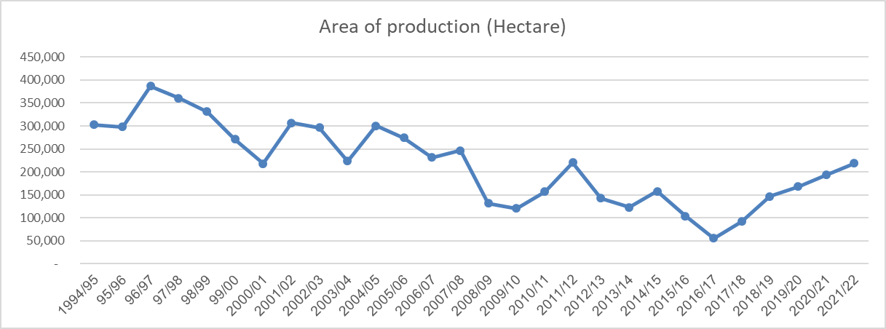

Slide 3
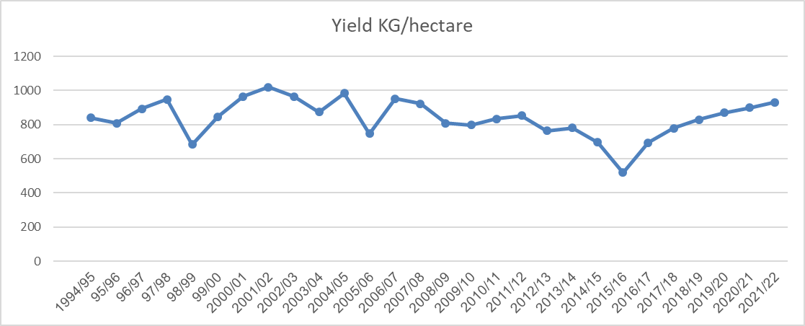

Slide 5
CURRENT VARIETIES

Slide 6
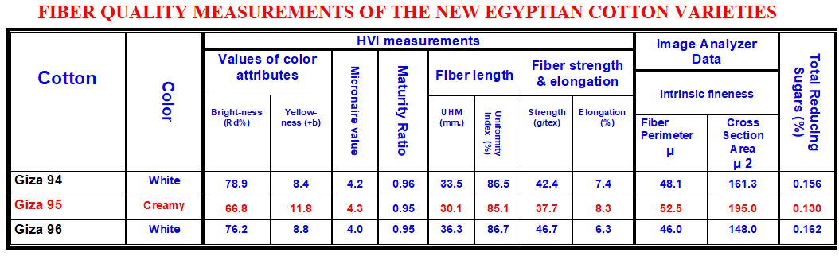
NEW VARIETIES

Slide 7
Cotton Ginning Sector
The new capacity will be set up to operate to efficient lint conversion rates and to the highest quality standards.
Those standards are critically important and refer to:
Control of fiber damage
Elimination of contamination
Minimizing residual trash,
HVI bale certification and traceability systems from field to bale

Slide 8
Cotton Ginning Sector
The field to bale cotton traceable system will have identifying barcode with the following fibre quality and bale data:
Cotton variety
Name of cotton ginnery and location
Lot number
Numbers of bales
Bale number
CATGO lot number
Cotton grade “GATGO”
Date of gin
HVI data results; UHML, UI, Strength, Elongation, Micronaire, SFI, and Color attribute

Slide 9
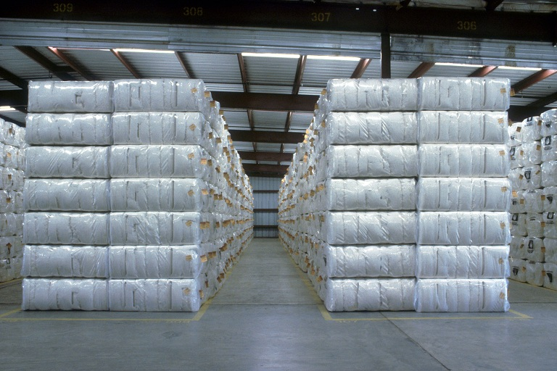
Cotton Ginning Sector

Slide 10
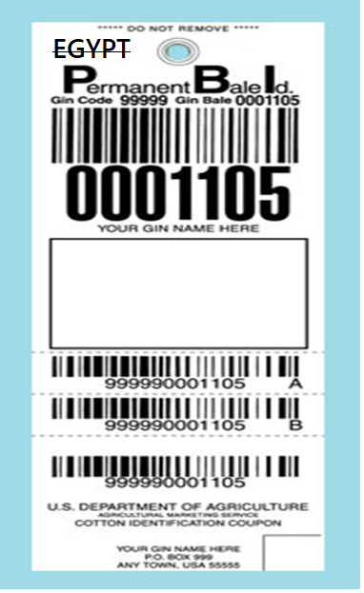

Slide 11
Egyptian textile industries
The Egyptian textile industry was established in new era at least 120 years ago under Private Investment Institutions with the strategic objective of manufacturing the World renowned Egyptian Cotton fiber to end products. The aim of the objective was based on
Securing a local demand for Egyptian Cotton Fiber beside International Textile Industry demand.
Fulfilment of local demand of home textile and clothing products which
will be a substitution of imported products.

Slide 12
Accordingly, the Local and Foreign have invested in creating knitting, weaving and sewing factories as well as Retail Chain Stores spread in Egypt's major cities. The interaction between the entire Supply Chain from the farmer to the consumer in Egypt or Worldwide was a Market Oriented Supply Chain with strong interlinking between the upstream and downstream activities in the textile supply chain.

Slide 15
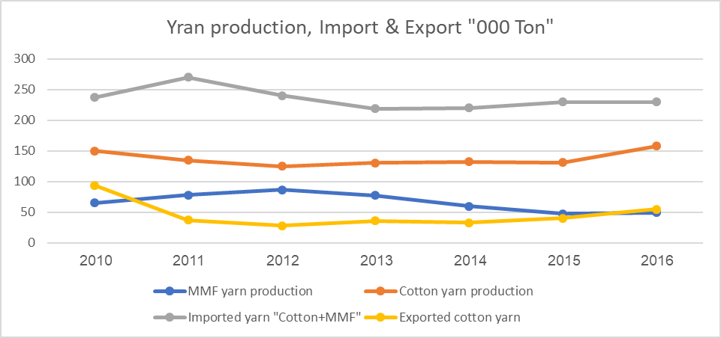

Slide 16
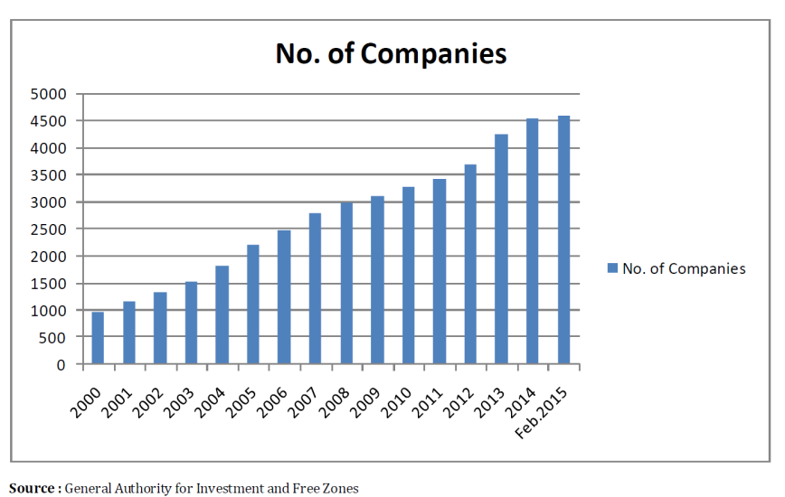

Slide 17
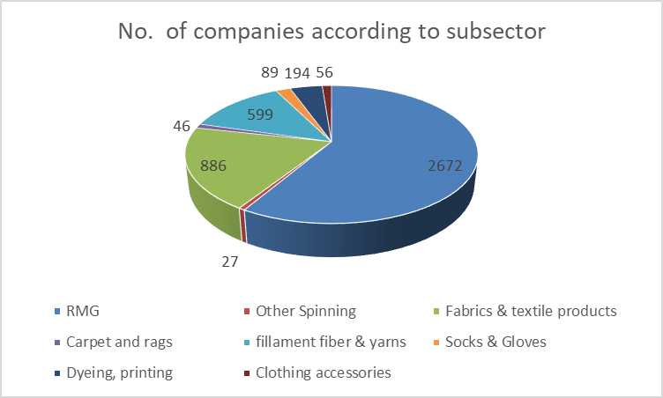

Slide 19
COMPETITIVE POSITION
COST AND AVAILABILITY OF KEY INPUTS

Slide 21
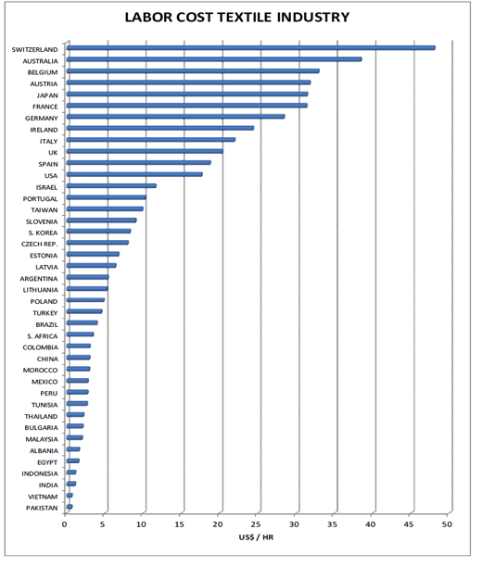

Slide 24
Thank you

