Slide 1

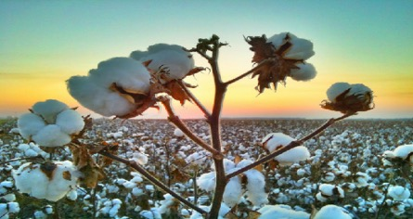
Development of Value Added Products from Cotton Stalk By Products
_________________________________
Nkosilathi Zinti Nkomo
Department of Fibre and Polymer Materials Engineering
National University of Science and Technology
14th SYMPOSIUM AND TRAINING WORLSHOP OF THE SEACF

Slide 2
OUTLINE
Introduction
Aim and Objectives
Literature Review
Methodology
Discussion (Fibreboards, Paper and pulp, Microcrystalline cellulose)
Conclusion & Recommendations
References
Outline
1

Slide 3

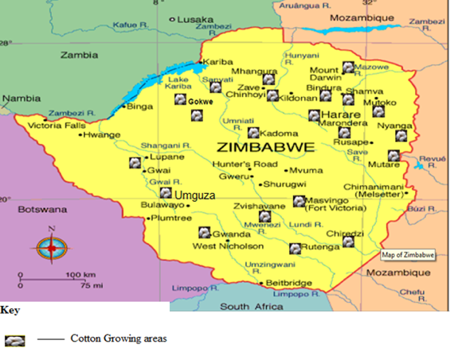
Introduction
2-3 tonnes of cotton stalk is generated per hectare of land [R.M.Gurgar, 2007]. Available is 350,000 hectares farmed.
Cotton stalk is a great raw material for manufacturing bio-composite products [Tao Lin, 2011].
Use of cotton stalks will help in achieving SDG 15.
Zimbabwe’s forest and woodland resources are under increasing threat. The current systems do not encourage investments in forest and woodlands.
Deforestation rate is pegged at 326,000 hectares of forest per year [FAO FORESTRY PAPER 163 ,2010].
Fig 1 – Cotton Farming areas in Zimbabwe [W. Mubvekeri,2014]
Introduction
2
Notes:
40.4 forest cover
1990-2010 lost 29.5% forest cover
1103 species amphibians, birds, mammals and reptiles of which 0.9% are endemic
350000hectares farmed available million tonnes of cotton stalk
2014 – 250000bales of cotton

Slide 4

Aim and Objectives
Aim: To study value added products that can be obtained from cotton stalk by product
Specific Objectives
To study the use of cotton stalks in preparation of microcrystalline cellulose
To study the use of cotton stalk in production of edible mushrooms
Development of fibreboards from cotton stalks
Development of paper and pulp from cotton stalks
Objectives
3

Slide 5
Cotton In Zimbabwe
Literature Review
In 2012 AMA set price of 0.36 to 0.45 cents. Yet farmers expected 0.45 cents minimum. Gvt intervened and gazetted statutory instrument 106A of 2012 making it controlled product.
As price of cotton started to decline, most farmers abandoned the crop for more lucrative crops such as tobacco.
Literature Review
4
Notes:
National output of cotton declined from 250 000 tonnes in 2012/13 to 143 000 tonnes in 2013/2014 season, a decrease of 42% (Nyamwanza Tonderai, 2014).
As price of cotton started to decline, most farmers abandoned the crop for more lucrative crops such as tobacco.
set prices of 0.36 to 0.45 cents. Yet farmers expected 0.45 cents minimum. After deadlock gvt intervened and gazette statutory instrument 106A of 2012 making it controlled product with minister having power to fix cotton prices.

Slide 6
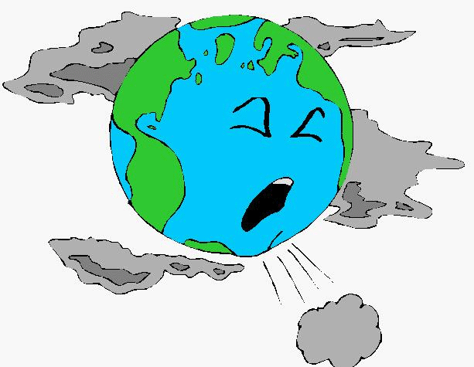
Pollution levels due to burning of cotton stalks
Green House Gas | Emission Factor (g.kg⁻¹) | Total Emission (Mn MT) | Total Emission (Mn Mt Co₂e)
NO_{x} | 2.68 | 0.00265 | 0.7898
CH₄ | 2.7 | 0.0027 | 0.0675
Table 2 – Emission of greenhouse gas per million tonnes of cotton stalks burned in field [Mseva, 2011]
Literature Review
5
Notes:
0.85 million metric tonnes of CO₂ released per million metric tonne of cotton stalks burnt.
0.85Deg rise btwn 1880-2012
Nox forms acid rains which affects monuments, cars, lakes and streams

Slide 7
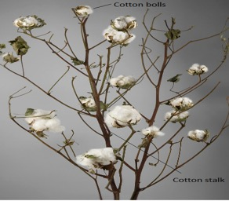
Cotton Stalk
Table 1 – Properties of cotton stalks compared to hardwood [Solution for Making Good Cotton Stalk Pellets, 2012]
Cotton stalks consist of a fibrous outer bark which is 20% by weight and an inner pith [Narendra R,July 2009].
Property | Cotton Stalk | Hardwoods
Hemicellulose (%) | 30.00 - 31.50 | 19.0 - 30.6
Cellulose (%) | 45.00 - 47.80 | 40.0 – 50.0
Lignin (%) | 20.00 - 21.20 | 30.0 -35.0
Literature Review
6
Notes:
Cellulose is the building block of the fibrils in the cell walls. Hemicellulose and lignin are the matrix materials in the secondary cell wall layer and lignin is the primary component of the middle lamella cementing the wooden cells together.
Cellulose which is a major constituent of all natural plant life

Slide 8
Extraction of of Cotton Stalks
Methodology
Transportation
Retting
Cotton stalks were collected from Umguza regions in Zimbabwe after harvest and transported in polypropylene sacks. Then left in the sun for a number of days for shedding of leaves.
Water retting was carried out for 3 weeks.
The water used had an initial pH of 7.40, conductivity of 204 µS(micro Siemens) and Total Dissolved Solids (TDS) of 102ppm
Fibreboards
7

Slide 9
Extraction and segmentation of fibres
Decortication
Shive
Segmentation
Fibres were collected from three sections of the cotton stalk the top section, middle section and root section of the stalk [N.Nkomo et al 2016].
Only stalks exceeding 1 metre were used and divided into 3 equal sections.
Scutching separating fibres from the shive.
Heckling pulling the fibres through several different sized combs.
Fibreboards
8

Slide 10
Preparation of microcrystalline cellulose
Microcrystalline cellulose (MCC) has been widely used especially in food, cosmetics and medical industries as a water retainer, a suspension stabilizer, a flow characteristics controller in the systems used for final products, and as a reinforcing agent for final products such as medical tablets.
MCC is normally obtained at an industrial scale through hydrolysis of wood. MCC has been prepared from coconut shells , sugar cane bagasse, ramie, wheat and rice straws, jute, flax fibres and flax straw and soya bean husk.
Microcrystallie Cellulose

Slide 11
Production of Edible Mushrooms
Results and Discussion
Mushrooms are the fleshy sporophotrd of fungi known to grow in nature on decaying cellulosic materials, dead wood, soil and manure pits.
Mushrooms, a macro fungi with a distinctive fruiting body, is a unique biota which assembles its food by secreting degrading enzymes. It decomposes the complex organic material on which it grows to generate simpler compounds for its nutrition.
Cultivation of oyster mushrooms on various crop residues is well known and it has been shown that pleurotus spp can be successfully grown on rice straw, wheat straw, cotton stalks and other cellulosic materials [Z.Bano 1962]
Mushrooms
9

Slide 12
Procedure for preparing cotton stalk substrate for mushroom production
Chipping of the cotton stalks
Overnight soaking and boiling of the cotton stalks
Cooling of the stalks after boiling
Mushroom spawn is introduced into the cotton stalk polypropylene bags
Holes are punched into the bag and it is hanged on the wall.
Mushrooms
10

Slide 13
Stages of mushroom growth
Mushrooms produced from cotton stalk substrate take approximately 25 days to mature and be ready for harvesting.
Temp must be maintained at 25-30Deg Celsius with relative humidity of 55-80%.
Stage | Time (Days)
Spawn layer | 1
Mycelium growth | 15-20
Pin heads | 20-24
Fruiting bodies | 24
Harvesting stage | 25 - 30
Mushrooms
11

Slide 14
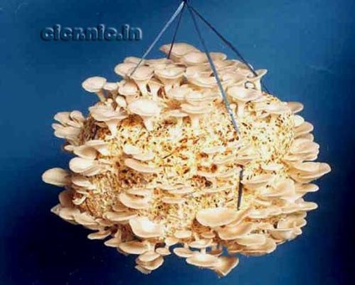
Mushroom Yield
Mushrooms yields up to 600g per kg and on supplementation with Bengal flour @ 3%, as much as 1000g of fleshy fruiting bodies can be harvested per kg of cotton stalks.
Mushrooms
12

Slide 15
Development of paper and Pulp
Forests are shrinking day by day and contrary to this the demand for raw materials for paper production is increasing.
Pulps produced from cotton stalks could be an alternative rea material for the paper and pulp industry [M.Akgul, 2009].
The cotton stalks are put into a rotary digester and temperature raised. The cooking material can then be refined in a disc refiner in two passes, and then thoroughly washed in mechanical washers and beaten in a valley beater to obtain pulp of desired freeness.
Screening is then don to remove uncooked cotton stalk chips and fibre bundles [A.J.Shaikh, 2003].
Paper and Pulp
13

Slide 16
Conclusion
Value addition to the cotton farming process.
Study can reduce pollution from burning these cotton stalks as waste
Cotton stalks can be used for growing edible mushrooms adding value to the cotton farming process.
Potential end uses for composite boards for furniture applications. More research into natural resins with cotton stalk fibres.
Use of Cotton stalks in the paper and pulp industry
Conclusion
14

Slide 17
References
FAO FORESTRY PAPER 163. (2010) Global Forest Resources Assessment 2010 Main report, http://www.fao.org/docrep/013/i1757e/i1757e.pdf.
Ministry of Industry and Commerce, (2014), Zimbabwe Cotton to Clothing strategy 2014-2019.
Mseva, (2011), Eastern African Cotton, Textile & Apparel value Chain conference, General Agronomy and Extension Practices for Cotton Production; Case Study of Zimbabwe.
Narendra R, Y. Y. (2009, July). Properties and potential applications of natural cellulose fibres from the bark of cotton stalks. Bioresource Technology, 100(14), 3563-3569. Retrieved from http://www.sciencedirect.com/science/article/pii/S0960852409002168
Nkomo, N.Z, L.C Nkiwane, D.Njuguna, E.N.Oyondi (2016). Extraction and characterisation of the mechanical properties of cotton stalk bast fibres (pp. 10-16). Nairobi: Proceedings of the 2016 Annual Conference on Sustainable Research and Innovation: JKUAT.
R.M.Gurgar, A.J Shaikh, R.H.Balasubramanya and S.Srenivasan, (December 22, 2007), Composite boards from cotton stalks, Central Institute for Research on Cotton Research, Regional Station Coimbatore
Tao Lin, Z. W. (2011, November). Cotton Fiber-Reinforced Polypropylene Composites. Retrieved from http://www.scientific.net/AMM.138-139.581
Literature Review
16

Slide 18

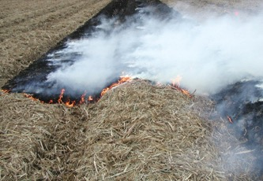
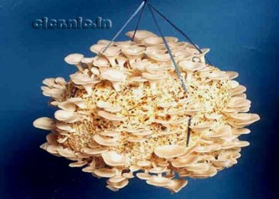
“Why destroy when you can create?”
Thank you….
End ……….

