Slide 1

Genetic variation for fibre properties in breeding lines of cotton (G. hirsutum L.)
13th Meeting of the Inter-regional Cooperative Research Network on Cotton for the Mediterranean and Middle East Regions, Luxor, Egypt February 4, 2018
S. M. Palve
Principal Scientist, Division of Crop Improvement,
ICAR – Central Institute for Cotton Research,
Nagpur – 440010,
India

Slide 3
Figure : Zonal Map of India showing distribution and zones
Source: CICR, nagpur

Slide 4
Introduction
Cotton is grown in a wide range of ecosystems under varying temperatures and water regimes
Of the four cultivated species, G. hirsutum occupies largest area under cultivation.
India is the leading country in terms of area under cotton cultivation and raw cotton production in the world.
Cotton is grown on 105 lakh hectares with the production of 351 lakh bales of 170 kg with a productivity of 568 kg lint/ha during 2016-17.
Cotton production in rainfed areas – erratic rain distribution, water stress is common, impacting on productivity and fibre quality

Slide 6
Background
Cotton breeders faces the task of developing varieties/hybrids that perform well in the farmer’s field, at the gin and in the textile processing
Evaluation of fibre quality parameters of cotton genotypes with strong support from ICAR-Central Institute for Research on Cotton Technology(ICAR-CIRCOT), Mumbai
Fiber samples were taken from genotype and were evaluated using HVI classification.
Parameters included micronaire, fiber length, length uniformity index , strength and elongation.

Slide 7
Materials and Methods
Experimental materials statistical design of experiment
Name of the Experiment | Genotypes | Statistical Design
Genetic variation for fibre properties in breeding lines of cotton (G. hirsutum) | 27 | CRBD
Observations on yield attributing traits and fibre properties

Slide 8
In order to improve simultaneously seed cotton yield and fibre quality of G. hirsutum cotton, through conventional breeding, efforts were made for developing improved breeding lines with greater length, strength and uniformity at ICAR – Central Institute for Cotton Research, Nagpur, India.
Twenty five breeding lines along with two check varietiesSuraj and NH 615 were evaluated in randomized block design for fibre properties during 2016-17.
Fibre properties were evaluated (Ginning Training Centre, ICAR-CIRCOT, Nagpur) using High Volume Instrument (HVI).

Slide 9
Results and Discussion
ANOVA showed that genotypes differed significantly from each other for plant height, boll weight, UHML, UI, BS and Elongation percentage
Plant height ranged from 91 cm (CNH 09-52) to 116 cm (CNH 09-70).
Number of sympodial branches varied from 1855 (CNH 09-54) to 24.1 (CNH 09-78).
Heighest boll weight of 4.9 g was recorded by CNH 09-51 and CNH 09-69.

Slide 10
Table 1. Mean values of seed cotton yield and yield attributing traits
Genotype | Plant Height(cm) | No. of Mono. | No. of Symp. | Boll No. | Boll wt. (g) | SCY/ha (kg)
CNH09-21 | 100.8 | 1.5 | 20.7 | 25.4 | 4.4 | 2192
CNH09-33 | 92.0 | 1.3 | 20.4 | 28.2 | 3.7 | 2167
CNH09-45 | 100.6 | 1.2 | 18.7 | 22.8 | 4.3 | 1504
CNH09-51 | 96.0 | 1.3 | 20.8 | 22.1 | 4.9 | 1338
CNH09-52 | 91.1 | 2.5 | 20.6 | 22.3 | 4.2 | 1604
CNH09-54 | 93.4 | 0.9 | 18.5 | 19.9 | 3.8 | 1705
CNH09-55 | 91.3 | 2.2 | 22.2 | 23.6 | 3.8 | 1681
CNH09-56 | 96.8 | 1.8 | 20.7 | 21.4 | 3.9 | 1070
CNH09-57 | 97.2 | 1.6 | 19.4 | 19.8 | 4.4 | 899
CNH09-58 | 95.7 | 1.0 | 19.5 | 24.2 | 4.7 | 1855
CNH09-59 | 99.3 | 1.3 | 21.6 | 25.0 | 3.8 | 2006
CNH09-67 | 103.5 | 1.5 | 21.1 | 118.5 | 4.5 | 2400
CNH09-69 | 103.1 | 1.6 | 22.8 | 25.6 | 4.9 | 2508
CNH09-70 | 116.1 | 1.3 | 22.1 | 23.2 | 4.4 | 1446

Slide 11
Genotype | Plant Height(cm) | No. of Mono. | No. of Symp. | Boll No. | Boll wt. (g) | SCY/ha (kg)
CNH09-71 | 104.7 | 1.1 | 22.1 | 25.2 | 4.1 | 2192
CNH09-72 | 105.1 | 1.2 | 22.2 | 22.4 | 4.0 | 1103
CNH09-73 | 115.4 | 0.4 | 22.9 | 23.4 | 4.2 | 3074
CNH09-75 | 98.5 | 1.0 | 19.8 | 21.7 | 3.5 | 1833
CNH09-76 | 105.6 | 1.3 | 21.3 | 19.5 | 4.6 | 2030
CNH09-77 | 102.7 | 1.9 | 21.7 | 24.5 | 4.1 | 1966
CNH09-78 | 108.9 | 0.6 | 24.1 | 21.6 | 4.5 | 2431
CNH09-79 | 85.1 | 0.6 | 19.7 | 19.8 | 3.9 | 2609
CNH09-80 | 95.8 | 1.8 | 22.1 | 26.1 | 4.2 | 2368
SURAJ | 95.0 | 1.3 | 20.8 | 22.9 | 4.6 | 1838
NH 615 | 88.0 | 1.8 | 17.5 | 22.7 | 3.4 | 1558
Mean | 99.3 | 1.4 | 20.9 | 26.9 | 4.2 | 1895
SE | 5.4 | 0.4 | 1.4 | 18.9 | 0.2 | 411.2
LSD 5 % | 15.8 | - | - | - | 0.7 | -

Slide 12
Breeding lines CNH 09-73, CNH 09-78 and CNH 09-79 had lowest monopodial branches amongst breeding lines evaluated
These lines suitable for high density planting system (HDPS) having both yield fibre properties at par with the check variety Suraj

Slide 13
Table 2. Mean values of fibre properties
Genotype | UHML (mm) | UI (%) | Mic. | BS (g/tex) | EL. (%)
CNH09-21 | 29.5 | 82.5 | 3.6 | 30.8 | 5.9
CNH09-33 | 30.9 | 83 | 3.7 | 29.3 | 5.7
CNH09-45 | 30.5 | 83 | 3.6 | 35.8 | 6.1
CNH09-51 | 28.1 | 81.5 | 4.7 | 30.2 | 6
CNH09-52 | 30.4 | 83 | 4.2 | 27.7 | 6.1
CNH09-54 | 28.8 | 81.5 | 4.4 | 29.8 | 6.2
CNH09-55 | 29 | 82 | 3.7 | 30.3 | 5.9
CNH09-56 | 30.1 | 82.5 | 3.6 | 31.4 | 6.5
CNH09-57 | 29.1 | 82 | 3.8 | 30.6 | 6.5
CNH09-58 | 31.2 | 83 | 4 | 33.5 | 6.5
CNH09-59 | 27.7 | 81.5 | 4.4 | 29.6 | 6.0
CNH09-67 | 27.7 | 81 | 3.5 | 31.2 | 6.1
CNH09-69 | 28.6 | 82 | 3.7 | 30.8 | 6.1
CNH09-70 | 27.7 | 81.5 | 3.4 | 31.5 | 6.1

Slide 14
Genotype | UHML (mm) | UI (%) | Mic. | BS (g/tex) | EL. (%)
CNH09-71 | 28.6 | 82 | 3.5 | 32.8 | 6.1
CNH09-72 | 29.4 | 82 | 3.1 | 34.6 | 6.3
CNH09-73 | 28.9 | 82 | 3.7 | 33.4 | 6.4
CNH09-75 | 31.1 | 83 | 3.7 | 33.1 | 6.5
CNH09-76 | 29.4 | 82 | 3.5 | 31.3 | 6.0
CNH09-77 | 30.1 | 82.5 | 3.3 | 34.7 | 6.2
CNH09-78 | 29.1 | 82 | 3.2 | 33.1 | 6.0
CNH09-79 | 30.4 | 82.5 | 3.5 | 32.9 | 6.1
CNH09-80 | 29 | 82 | 3.7 | 32.9 | 6.2
SURAJ | 32.1 | 83.5 | 3.9 | 31.5 | 6.3
NH 615 | 27.0 | 80.5 | 4.2 | 28.5 | 5.6
Mean | 29.4 | 82.2 | 3.7 | 31.6 | 6.1
SE | 0.7 | 0.4 | 0.3 | 1.3 | 0.1
LSD 5 % | 1.9 | 1.2 | - | 3.7 | 0.4

Slide 15
Staple Length Categories of Indian Cottons Based on UHML
Category | Range of UHML
Short | 20 mm and below
Medium | 20.5 – 24.5
Medium Long | 25.0 – 27.0
Long | 27.5 – 32.0
Extra long | 32.5 mm and above
Ratings of Cotton on the basis of Length Uniformity
Category | UI
Poor | Below 76
Fair | 76 to 78
Average | 79 to 83
Good | 83 to 85
Excellent | Above 85

Slide 16
Classification of Cottons According to Micronaire Value
Category | Range of Micronaire Value
Very fine | Below 3.0
Fine | 3.0 to 3.9
Average | 4.0 to 4.9
Coarse | 5.0 to 5.9
Very coarse | 6.0 and above
Ratings of cotton based on tenacity at 3.2 mm gauge length (HVI mode)
Category | Range of Bundle tenacity values in g/tex
Very weak | 20.0 & below
Weak | 20.1 – 25.0
Average | 25.1 – 29.0
Good | 29.1 – 32.5
Very good | Above 32.5

Slide 17
Table 3. Mean seed cotton yield (kg/ha) and fibre properties
Genotype | SCY/ha (kg) | UHML (mm) | UI (%) | Mic. | BS (g/tex) | EL. (%)
CNH09-21 | 2192 | 29.5 | 82.5 | 3.6 | 30.8 | 5.9
CNH09-33 | 2167 | 30.9 | 83 | 3.7 | 29.3 | 5.7
CNH09-45 | 1504 | 30.5 | 83 | 3.6 | 35.8 | 6.1
CNH09-51 | 1338 | 28.1 | 81.5 | 4.7 | 30.2 | 6
CNH09-52 | 1604 | 30.4 | 83 | 4.2 | 27.7 | 6.1
CNH09-54 | 1705 | 28.8 | 81.5 | 4.4 | 29.8 | 6.2
CNH09-55 | 1681 | 29 | 82 | 3.7 | 30.3 | 5.9
CNH09-56 | 1070 | 30.1 | 82.5 | 3.6 | 31.4 | 6.5
CNH09-57 | 899 | 29.05 | 82 | 3.8 | 30.6 | 6.5
CNH09-58 | 1855 | 31.2 | 83 | 4 | 33.5 | 6.5
CNH09-59 | 2006 | 27.7 | 81.5 | 4.4 | 29.6 | 6.0
CNH09-67 | 2400 | 27.7 | 81 | 3.5 | 31.2 | 6.1
CNH09-69 | 2508 | 28.6 | 82 | 3.7 | 30.8 | 6.1

Slide 18
Genotype | SCY/ha (kg) | UHML (mm) | UI (%) | Mic. | BS (g/tex) | EL. (%)
CNH09-70 | 1446 | 27.7 | 81.5 | 3.4 | 31.5 | 6.1
CNH09-71 | 2192 | 28.6 | 82 | 3.5 | 32.8 | 6.1
CNH09-72 | 1103 | 29.4 | 82 | 3.1 | 34.6 | 6.3
CNH09-73 | 3074 | 28.9 | 82 | 3.7 | 33.4 | 6.4
CNH09-75 | 1833 | 31.1 | 83 | 3.7 | 33.1 | 6.5
CNH09-76 | 2030 | 29.4 | 82 | 3.5 | 31.3 | 6.0
CNH09-77 | 1966 | 30.1 | 82.5 | 3.3 | 34.7 | 6.2
CNH09-78 | 2431 | 29.1 | 82 | 3.2 | 33.1 | 6.0
CNH09-79 | 2609 | 30.4 | 82.5 | 3.5 | 32.9 | 6.1
CNH09-80 | 2368 | 29 | 82 | 3.7 | 32.9 | 6.2
SURAJ | 1838 | 32.1 | 83.5 | 3.9 | 31.5 | 6.3
NH 615 | 1558 | 27.0 | 80.5 | 4.2 | 28.5 | 5.6
Mean | 1895.0 | 29.4 | 82.2 | 3.7 | 31.6 | 6.1
SE | 411.2 | 0.7 | 0.4 | 0.3 | 1.3 | 0.1
LSD 5 % | - | 1.9 | 1.2 | - | 3.7 | 0.4

Slide 19
Among the best performing breeding lines, CNH 09-69, CNH 09-73, CNH 09-79, were the top highest in yield
CNH 09-73 had highest seed cotton yield of 3074 kg/ha followed by CNH 09-79 ((2609 kg/ha) and CNH 09-69 (2508 kg/ha).
These lines have advantage of higher yield along with better fibre properties.
The highest yielding breeding line CNH 09-73, had UHML of 28.9 mm with bundle strength of 33.4 g/tex.

Slide 20
Heighest UHML was recorded by quality check Suraj (32.1 mm) followed
by CNH 09-58 (31.2 mm) an CNH 09-75 (31.01 mm)

Slide 21
Breeding line CNH 09-45 recorded highest bundle strength of 35.8 g/tex
followed by CNH 09-77 (34.7 g/tex) and CNH 09-72 (34.6 g/tex)

Slide 22
Amongst breeding lines CNH 09-73 had highest SCY of 3074 kg/ha followed
by CNH 09-79 (2609 kg/ha) and CNH 09-69 (2508 kg/ha)

Slide 23
Quality check variety Suraj recorded bundle strength of 31.5 g/tex with SCY of 1838 kg/ha.
Highest bundle strength of 35.8 g/tex was recorded by CNH 09-45 however, it has very low SCY of 1504 kg/ha.

Slide 24
Table 4. Phenotypic &Genotypic correlations
 | UHML (mm) | UI (%) | Mic. | BS (g/tex) | EL. (%) | SCY/ha (kg)
Boll wt. (g) | 0.071 -0.037 | 0.137 0.039 | 0.095 -0.378 | 0.120 0.239 | 0.104 0.415* | 0.059 0.251
UHML (mm) |  | 0.324 0. 287 | -0.194 -0.183 | 0.328 0.301 | 0.350 0.444* | 0.049 -0.206
UI (%) |  |  | -0.199 -0.164 | 0.353 0.217 | 0.310 0.455* | 0.082 -0.210
Mic. |  |  |  | -0.548** -0.837** | -0.092 -0.190 | -0.247 0.010
BS (g/tex) |  |  |  |  | 0.379 0.629** | 0.233 -0.122
EL (%) |  |  |  |  |  | -0.166 -0.357
*, ** Sinificant at 0.05 and 1 % levels of probibility;
Upper values – phenotypic corre. , Lower- genotypic corre.

Slide 25
Genotypic correlation of boll weight was positive with bundle strength, elongation, and seed cotton yield
UHML had significant positive correlation with elongation
Bundle strength had highly significant genotypic correlation with elongation
Genotypic correlation of UHML and bundle strength was negative with seed cotton yield
Uniformity index had positive association bundle strength and elongation
Association of fibre fineness was negative with fibre strength and elongation both at genotypic and phenotypic levels

Slide 26
Conclusions:
Significant differences were found for upper half mean length (UHML), uniformity index (UI), fibre bundle strength and elongation.
Check variety Suraj had highest UHML of 32.1 mm followed by CNH 09-58 (31.2 mm) followed by CNH 09 -75 (31.1 mm).
Breeding lines CNH 09-75, CNH 09-58, CNH 09-33 and CNH 09-45 had UHML of 31.3 mm, 31.1mm, 30.9 mm and 30.4 mm, respectively. However, the released varieties Suraj and NH 615 had UHML of 32.1 mm and 26.9 mm, respectively.
Amongst breeding lines CNH 09-45 recorded highest fibre strength of 35.8 g/tex followed by CNH 09-77 (34.7 g/tex) and CNH 09-72 (34.6 g/tex).
While released varieties Suraj and NH 615 had fibre bundle strength of 32.1 g/tex and 26.9 g/tex, respectively.
For uniformity index, CNH 09-33, CNH 09-45, CNH 09-52, CNH 09-58 and CNH 09-75 were promising with a value of 83.0 while Suraj had 83.5.

Slide 27
Breeding lines CNH 09-56, NH 09-57 CNH 09-58 and CNH 09-75 had highest fibre elongation of 6.5 followed by CNH 09-73 with a value of 6.4.
Breeding lines CNH 09-45, CNH 09-58, CNH 09-72 CNH 09-75 and CNH 09-77 developed had better fibre properties of fibre UHML and bundle strength.
Genotypic correlation of UHML and bundle strength was negative with seed cotton yield
This research confirms that a negative association between fibre length and strength with seed cotton yield.
These improved breeding lines with better fibre properties and higher seed cotton yield will be useful for testing under coordinated multi-location and State multi location varietal trials (SMVT) for seed cotton yield and fibre properties.

Slide 28
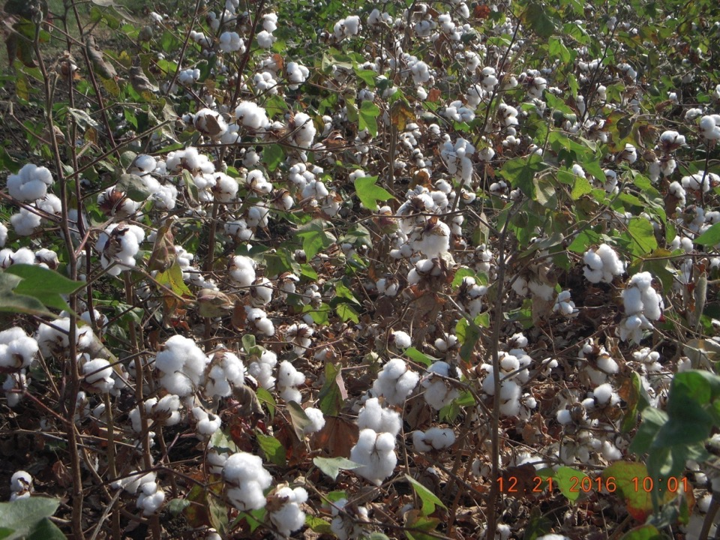
CNH 09-73

Slide 29
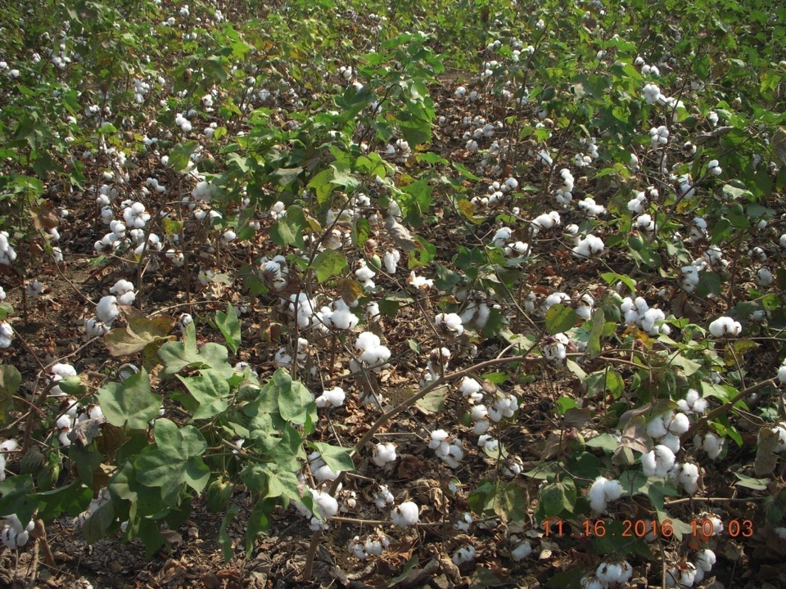
CNH 09-77

Slide 30
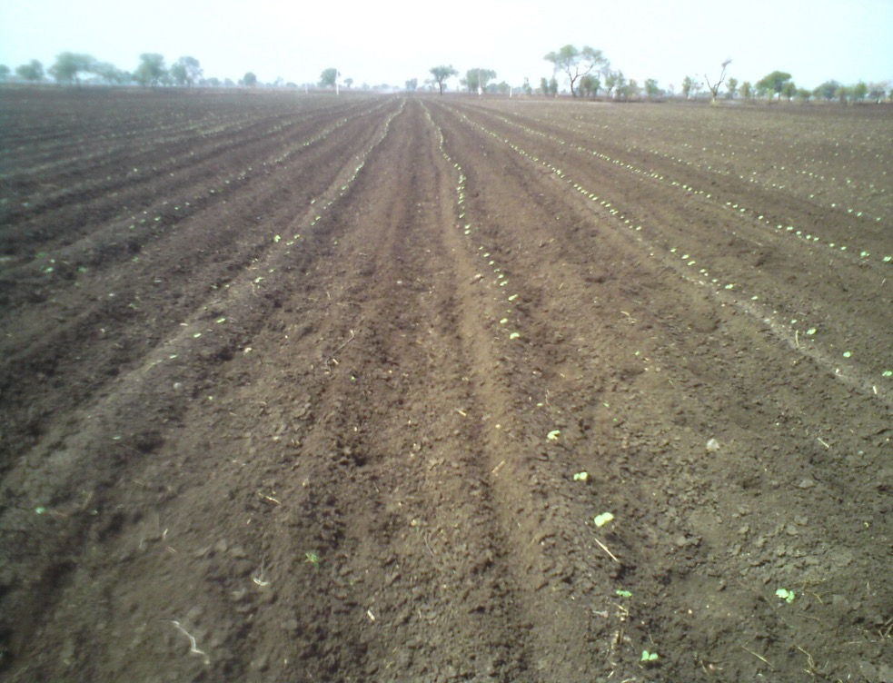

Slide 31
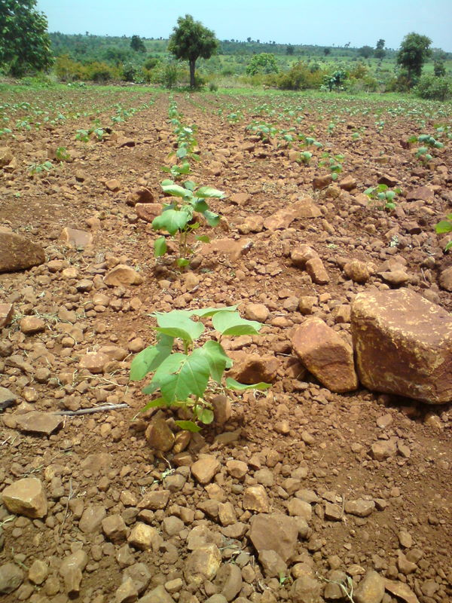

Slide 32
Thank you

Slide 33
Staple Length Categories of Indian Cottons Based on UHML
Category | Range of UHML
Short | 20 mm and below
Medium | 20.5 – 24.5
Medium Long | 25.0 – 27.0
Long | 27.5 – 32.0
Extra long | 32.5 mm and above
Ratings of Cotton on the basis of Length Uniformity
Category | UI
Poor | Below 76
Fair | 76 to 78
Average | 79 to 83
Good | 83 to 85
Excellent | Above 85

Slide 34
Classification of Cottons According to Micronaire Value
Category | Range of Micronaire Value
Very fine | Below 3.0
Fine | 3.0 to 3.9
Average | 4.0 to 4.9
Coarse | 5.0 to 5.9
Very coarse | 6.0 and above
Ratings of cotton based on tenacity at 3.2 mm gauge length (HVI mode)
Category | Range of Bundle tenacity values in g/tex
Very weak | 20.0 & below
Weak | 20.1 – 25.0
Average | 25.1 – 29.0
Good | 29.1 – 32.5
Very good | Above 32.5

Slide 35
Table: The quality of cotton required to produce different counts of Yarn
Count range | Range of UHML (mm) | Minimum Value of UI | Minimum Tenacity (g/t) | Range of Micronaire | Type of cotton
<14s | Below 24 | - | - | Above 5.0 | Short
14s-18s | 24-25 | 81 | 27.5 | 3.9-4.7 | Medium
20s-24s | 25-26 | 82 | 28.0 | 3.8-4.2 | Medium Long
25s-30s | 26-27 | 83 | 29.1 | 3.4-4.2 | Medium Long
31s-40s | 27-29 | 84 | 29.3 | 3.3-4.1 | Long
41s-50s | 29-31 | 84 | 31.3 | 3.3-4.0 | Long
51s-60s | 31-33 | 86 | 33.6 | 3.2-3.9 | Long
61s-80s | 33-34 | 86 | 36.6 | 3.2-3.8 | Extra long
81s-100s | 34-36 | 87 | 38.3 | 3.1-3.4 | Extra long
101s-120s | 36> | 88 | 40.0 | 2.9-3.2 | Extra long

