Slide 1
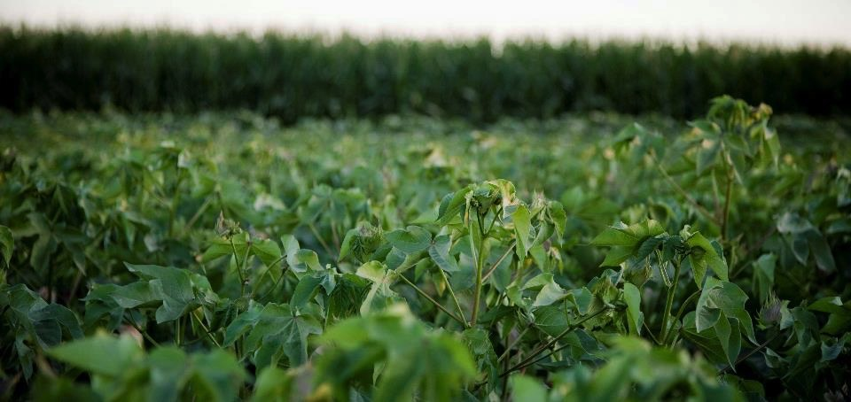
ALKHORAYEF IRRIGATION SOLUATIONS.
The optimum design
less power consumption …
DESIGNED, TESTED AND VERIFIED TO FIT ALL YOUR NEEDS …

Slide 2

Index
System configuration.
All spans 6-5/8’’
One span 8-5/8”
Two spans 8-5/8”
Three spans 8-5/8’’
Four spans 8-5/8”
Five spans 8-5/8”
Fuel consumption.
Operation cost.

Slide 3
SYSTEM CONFIGURATION
Irrigated Area, Ha | 63.6
Flow, GPM | 1500
Maximum Water Consumption mm/day | 12
Average fuel Consumption L/hr./hp | 0.186
Yearly average running hrs. | 5000
Fuel Cost LE / L | 3.75

Slide 4
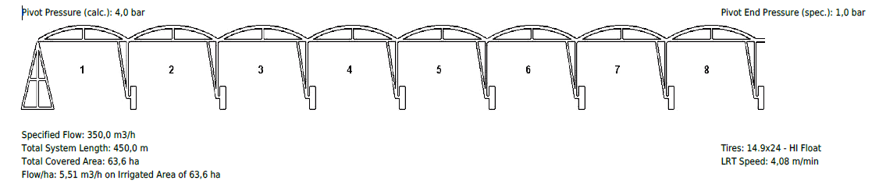
All pivot spans 6 (5/8)’’
Friction Losses, PSI | Pivot Point Pressure | End Pressure, PSI | Area, Ha | Flow, GPM
44 | 59 | 15 | 63.6 | 1500

Slide 5
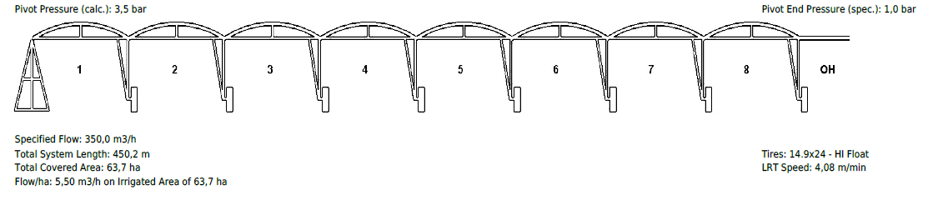
1 Tower 8 (5/8)’’ + 7 Towers 6 (5/8)’’ + OH 6m
Friction Losses, PSI | Pivot Point Pressure | End Pressure, PSI | Area, Ha | Flow, GPM
37 | 52 | 15 | 63.6 | 1500

Slide 6
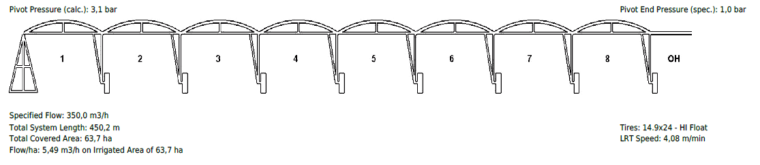
2 Towers 8 (5/8)’’ + 6 Towers 6 (5/8)’’ + OH 12m
Friction Losses, PSI | Pivot Point Pressure | End Pressure, PSI | Area, Ha | Flow, GPM
31 | 46 | 15 | 63.6 | 1500

Slide 7
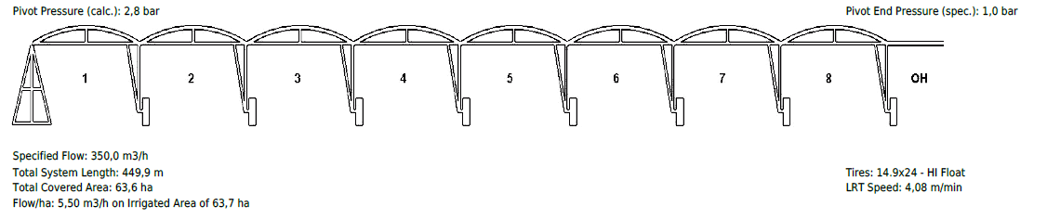
3 Towers 8 (5/8)’’ +4 Towers 6 (5/8)’’ + OH 18m
Friction Losses, PSI | Pivot Point Pressure | End Pressure, PSI | Area, Ha | Flow, GPM
26 | 41 | 15 | 63.6 | 1500

Slide 8
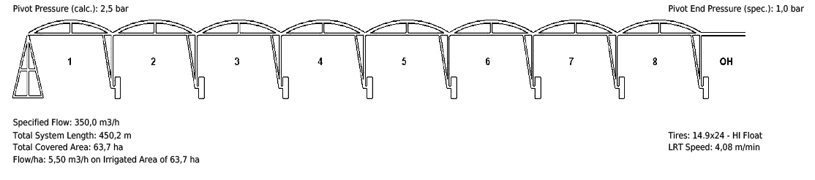
4 Towers 8 (5/8)’’ + 4 Towers 6 (5/8)’’ + OH 22m
Friction Losses, PSI | Pivot Point Pressure | End Pressure, PSI | Area, Ha | Flow, GPM
22 | 37 | 15 | 63.6 | 1500

Slide 9
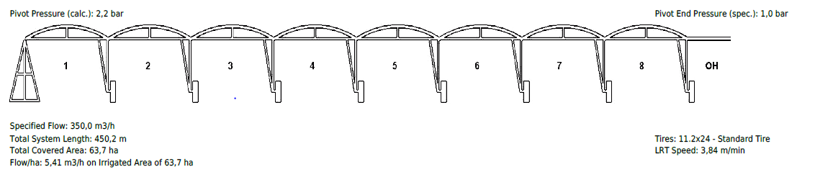
5 Towers 8 (5/8)’’ + 3 Towers 6 (5/8)’’ + OH 24m
Friction Losses, PSI | Pivot Point Pressure | End Pressure, PSI | Area, Ha | Flow, GPM
17 | 32 | 15 | 63.6 | 1500

Slide 10
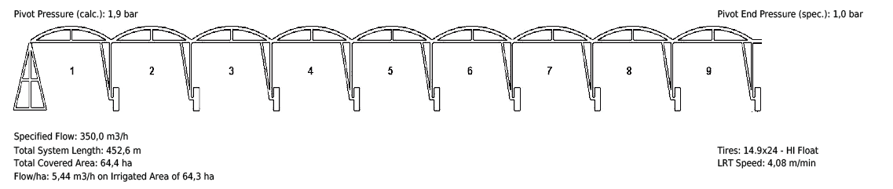
6 Towers 8 (5/8)’’ + 3 Towers 6 (5/8)’’
Friction Losses, PSI | Pivot Point Pressure | End Pressure, PSI | Area, Ha | Flow, GPM
13 | 28 | 15 | 63.6 | 1500

Slide 11
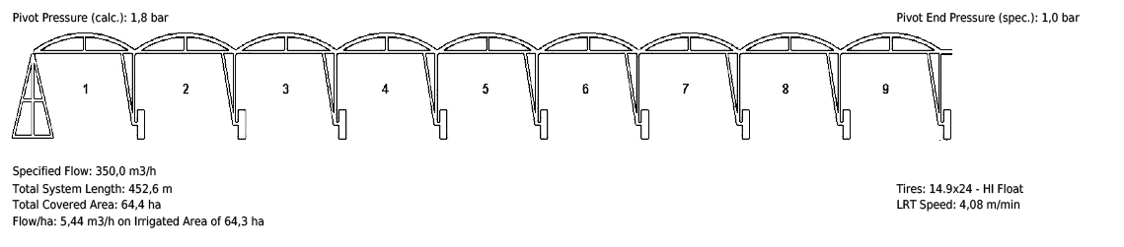
7 Towers 8 (5/8)’’ + 2 Towers 6 (5/8)’’
Friction Losses, PSI | Pivot Point Pressure | End Pressure, PSI | Area, Ha | Flow, GPM
11 | 26 | 15 | 63.6 | 1500

Slide 12
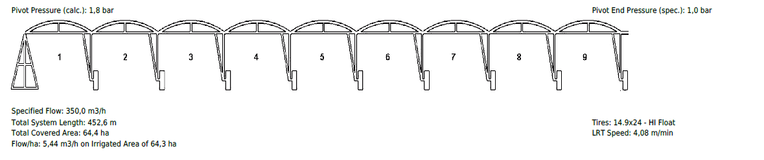
8 Towers 8 (5/8)’’ + 1Tower 6 (5/8)’’
Friction Losses, PSI | Pivot Point Pressure | End Pressure, PSI | Area, Ha | Flow, GPM
11 | 26 | 15 | 63.6 | 1500

Slide 13
From Pipe 6”(5/8) TO Pipe 8”(5/8) with Mainline
Frictions

Slide 14
SYSTEM SPECS | ALL 6-5/8" | ONE TOWER 8 5/8" | TWO TOWER 8 5/8" | THREE TOWER 8 5/8" | FOUR TOWERS 8 5/8" | FIVE TOWERS 8 5/8" | Six TOWERS 8 5/8" | Seven TOWERS 8 5/8" | Eight TOWERS 8 5/8"
PIVOT PRESSURE(psi) | 59 | 52 | 46 | 41 | 37 | 32 | 28 | 26 | 26
MAINLINE 10” (500M) +FRICTION LOSSES(psi) | 38
PUMP REQUIRED PRESSURE (TDH) (psi) | 97 | 90 | 84 | 79 | 75 | 70 | 66 | 64 | 64
REQUIRED HORSE POWER AT PUMP@-75% Eff. | 113.1667 | 105 | 98 | 92.16667 | 87.5 | 81.66667 | 77 | 74.66667 | 74.66667
Aver. Fuel Consumption L/hr (.186) | 21.16217 | 19.635 | 18.326 | 17.23517 | 16.3625 | 15.27167 | 14.399 | 13.96267 | 13.96267
Fuel Consumption Cost in LE/year | 396790.6 | 368156.3 | 343612.5 | 323159.4 | 306796.9 | 286343.8 | 269981.3 | 261800 | 261800
Fuel Consumption Cost Variance |  | 28634.38 | 53178.13 | 73631.25 | 89993.75 | 110446.9 | 126809.4 | 134990.6 | 134990.6
 |  | 7% | 13% | 18% | 22% | 28% | 32% | 33% | 33%

Slide 15


Slide 17


Slide 18
The Difference in price between 6”5/8 and 8”5/8
is L.E 18,000 X5 span=90,000 L.E
That comes from 1st. Year with benefits
35fed(%23)
30.5fed(%20)
26fed(%17)
21fed(%14)
16.5fed(%11)
11.5fed(%7)
7fed.(%4.5)
2.5fed.(%1.5)

Slide 19
From Pipe 6”(5/8) TO Pipe 8”(5/8) without Mainline

Slide 20
SYSTEM SPECS | ALL 6-5/8" | ONE TOWER 8 5/8" | TWO TOWER 8 5/8" | THREE TOWER 8 5/8" | FOUR TOWERS 8 5/8" | FIVE TOWERS 8 5/8" | Six TOWERS 8 5/8" | Seven TOWERS 8 5/8" | Eight TOWERS 8 5/8"
PIVOT PRESSURE(psi) | 59 | 52 | 46 | 41 | 37 | 32 | 28 | 26 | 26
REQUIRED HORSE POWER AT PUMP@-75% Eff. | 68.83 | 60.66 | 53.66 | 47.83 | 43.16 | 37.33 | 32.66 | 30.33 | 30.33
Aver. Fuel Consumption L/hr (.186) | 12.87 | 11.34 | 10.03 | 8.94 | 8.07 | 6.98 | 6.10 | 5.67 | 5.67
Fuel Consumption Cost in LE/year | 241346.9 | 212712.5 | 188168.8 | 167715.6 | 151353.1 | 130900 | 114537.5 | 106356.3 | 106356.3
Fuel Consumption Cost Variance |  | 28634.38 | 53178.13 | 73631.25 | 89993.75 | 110446.9 | 126809.4 | 134990.6 | 134990.6
 |  | 13% | 23% | 30% | 39% | 46% | 54% | 56% | 56%

Slide 21


Slide 22


Slide 23

The extra cost of a larger pipe will be recovered quickly from lower fuel costs

Slide 24
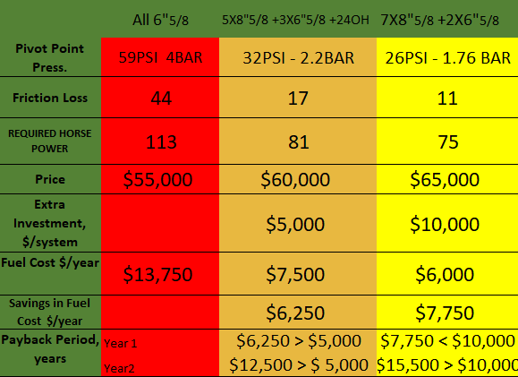
RETURN ON INVESTMENT

Slide 25
THANK YOU

