Slide 1


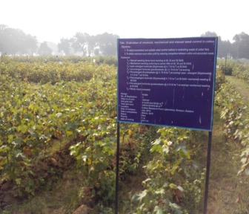
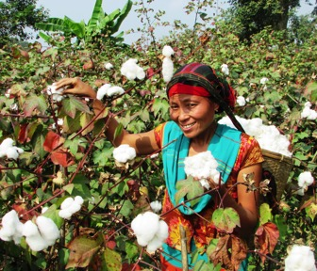
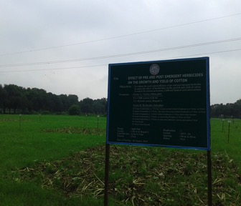

 | 13th Meeting of the ICAC Inter-Regional Cooperative Research Network on Cotton for the Mediterranean and Middle East Regions
EVALUATION OF DIFFERENT WEED CONTROL METHODS IN COTTON FIELD
Md. Fakhre Alam Ibne Tabib, PhD
Deputy Director

Slide 2

BANGLADESH COTTON: CURRENT SCENARIO
INTRODUCTION
2nd largest apparel producer in the world
2nd largest cotton fibre consumer in the world
Highest Raw cotton importer in the world with 6.25 million bales annual requirment-10.30% of world import
Fibre Imports from-India, Uzbekistan, USA, Egypt, CIS and some African countries
31.50 billion US dollar business in 2016 expected creep up to 50 billion dollar in 2021

Slide 3
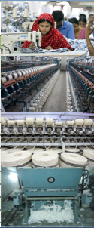
COTTON SECTOR IN BANGLADESH
READYMADE GARMENTS | Garments unit | 5000
 | Total Work Force | 5.5 million
B. TEXTILE | Knit wear industries | 1700
 | Weaving mills | 1343
 | Hand loom | 0.3 million
C. SPINNING | Spinning mill | 407
D. GINNING | Ginning Centres | Private-20, CDB-12
 | Saw ginning | 104
 | Roller ginning | 25
E. OIL EXTRACTION | Crude oil expeller | 15
 | Oil refinery | 01

Slide 4
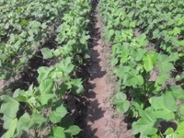
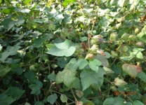
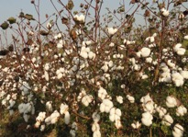
Growing Season of Upland Cotton (Kharif-2)
 | July | Aug. | Sept. | Oct. | Nov. | Dec.
Land Preparation & Sowing
Crop Management
Harvesting

Slide 5



Growing Season of Upland Cotton (Rabi)
 | Nov. | Dec. | Jan. | Feb. | Mar. | Apr. | May.
Land Preparation & Sowing
Crop Management
Harvesting

Slide 6
Major weeds commonly found in the cotton field
Weed species | Common Name | Local Name | Family
Cynodon dactylon | Bermuda grass | Durba | Gramineae
Cyperus rotundus | Nut Sedge | Mutha | Cyperaceae
Eleusine indica | Goose grass | Chapra | Gramineae
Ageratum conyzoides | Goat weed | Chaglagacha | Compositae
Panicum repens | Torpedo grass | Banchina | Gramineae
Digitaria sanguinalis | Scrab grass | Angulighash | Gramineae
Cyanotis axillaris | Kanainala | Kanainala | Commelinaceae
Commelina benghalensis | Spider wort | Kanaibashi | Commelinaceae
Azonopus compressus | Carpet grass | Karpetghash

Slide 7
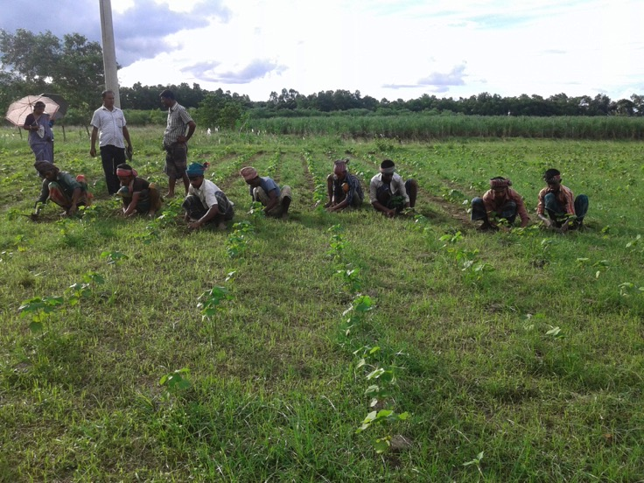
Farmers Practice
- Manual Weed Control
Increase production cost due to high labour price.
Unavailability of agricultural labour force.
Doesn’t perform timely weed control due to unfavourable weather condition.

Slide 8
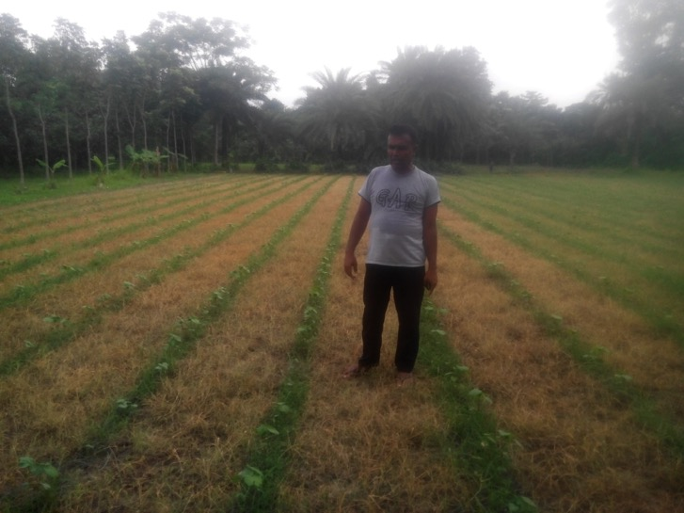
Farmers Practice
- Chemical Weed Control
Glyphosate base weed control.
High crop injury and seedling mortality.
Not feasible during seedling stage of cotton plant.

Slide 9
OBJECTIVES
To select economical and suitable weed control method for controlling weeds in cotton field.
To evaluate the weed control efficiency of different weed control methods.

Slide 10
Efficacy of Different Herbicides Over Manual Weeding in Controlling Cotton Weed
Experiment-1

Slide 11
METHODS AND MATERIALS
Design : RCBD
No. of replication: 3
Treatments:
 | T₁= Weedy control
 | T₂= Hand weeding
 | T₃= Glyphosate @ 3.5 L ha⁻¹ 14 DBS of cotton
 | T₄= Paraquat @ 2.8 L ha⁻¹ 14 DBS of cotton
 | T₅= Glyphosate @ 3.5 L+ Paraquat @ 2.8 L ha⁻¹ 14 DBS of cotton
 | T₆= Orthosulfamuron @ 0.15 g ha⁻¹ 14 DAS of cotton (Protective spray)
 | T₇= Indazifalam @ 0.15 L ha⁻¹ 14 DBS of cotton
 | T₈= Phenoxyprop-P-Ethyle @ 0.75 L ha⁻¹ 14 DAS of cotton (Protective spray)
 | T₉= Cyhalophob-butayl @ 1.0 L ha⁻¹ 14 DAS of cotton (protective spray)
 | T₁₀= Bispyribac sodium@ 0.15 g ha⁻¹ 14 DAS of cotton(protective spray)
Date of sowing: 01 September, 2013
Cotton variety : CB-9

Slide 12
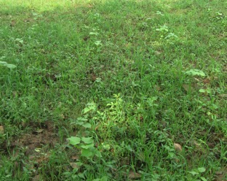
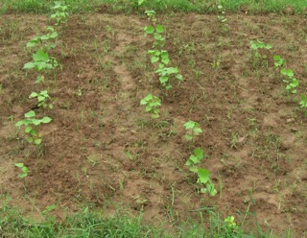
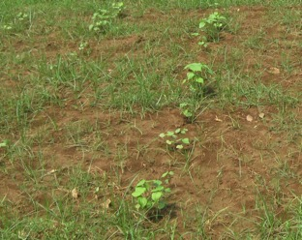
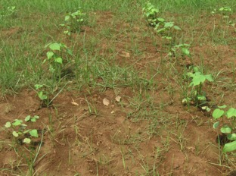
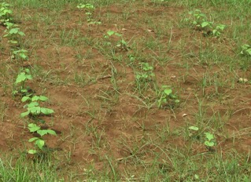
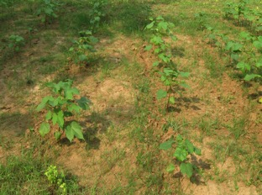
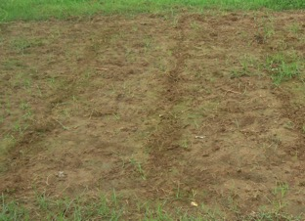
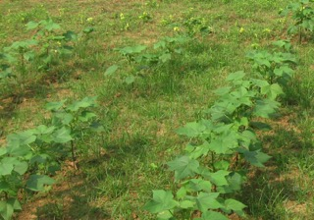
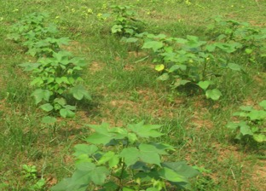
T1
T2
T3
T4
T5
T6
T7
T8
T9

Slide 13
RESULTS
AND
DISCUSSION

Slide 14
Fig 1.1: Weed abundance as influenced by different herbicide
application and manual weed control

Slide 15
Fig. 1.2: Weed control efficiency of different herbicides and
manual weeding

Slide 16
Table 1.1: Plant count and morphological characters of cotton as
influenced by different herbicide application and manual
weeding
Treatment | No. of plant/ha | Sympodial br/ plant | Monopodial br/ plant
T₁ | 22500 | 7.33 | 1.30
T₂ | 24550 | 7.80 | 1.20
T₃ | 23180 | 8.10 | 1.20
T₄ | 23320 | 7.23 | 0.87
T₅ | 24280 | 8.46 | 0.90
T₆ | 19070 | 6.50 | 1.03
T₇ | 3429 | 1.83 | 0.37
T₈ | 21260 | 7.30 | 1.70
T₉ | 17830 | 7.63 | 1.07
T₁₀ | 18110 | 8.90 | 1.10
LSD _{0.05} | 3375 | 1.76 | 0.395
CV% | 9.96 | 14.45 | 21.49

Slide 17
Fig 1.3: Plant height of cotton as influenced by different herbicide
application and manual weed control

Slide 18
Table 1.2: Yield and yield components of cotton as influenced by
different herbicide application and manual weeding
Treatment | Seed Cotton Yield Kg ha⁻¹ | No. of boll plant⁻¹ | Single boll wt (g)
T₁ | 384.1 | 13.60 | 5.30
T₂ | 1289.0 | 17.23 | 5.96
T₃ | 1207.0 | 16.40 | 5.80
T₄ | 1008.0 | 17.00 | 4.53
T₅ | 1211.0 | 19.60 | 6.27
T₆ | 912.2 | 16.30 | 5.60
T₇ | 144.0 | 3.633 | 1.67
T₈ | 761.3 | 16.37 | 6.13
T₉ | 925.9 | 16.50 | 5.87
T₁₀ | 939.6 | 14.30 | 5.77
LSD _{0.05} | 173.00 | 3.85 | 1.63
CV% | 11.48 | 14.86 | 17.91

Slide 19
Table 1.3: Economic return as influenced by different herbicide
application and manual weeding
Treatment | Variable cost (Tk ha⁻¹) | Gross return (Tk ha⁻¹) | Net return (Tk ha⁻¹) | BCR
T₁ | 55575 | 24698 | -30877 | 0.44
T₂ | 68075 | 82207 | 14132 | 1.21
T₃ | 56275 | 76641 | 20366 | 1.36
T₄ | 56135 | 64104 | 7969 | 1.14
T₅ | 56205 | 77043 | 20838 | 1.37
T₆ | 55800 | 57969 | 2169 | 1.04
T₇ | 55875 | 9172 | -46703 | 0.16
T₈ | 55950 | 48537 | -7413 | 0.87
T₉ | 55875 | 58982 | 3107 | 1.06
T₁₀ | 55800 | 59795 | 3995 | 1.07

Slide 20
Evaluation of Chemical, Mechanical and Manual Weed Control in Cotton
Experiment-2

Slide 21
METHODS AND MATERIALS
Design : RCBD
No. of replication: 3
Treatments:
 | T₁ = Manual weeding (three hand weeding at 20, 35 and 50 DAS)
 | T₂ = Mechanical weeding (culturing by power tiller at 20, 35 and 50 DAS)
 | T₃ = Post-emergent herbicide (Glyphosate @ 4.7 lit ha⁻¹) at 20 DAS
 | T₄ = Pre-emergent herbicide (Pendimethalin @) 3.75 lit ha⁻¹) at sowing
 | T₅ = Pre-emergent (Pendimethalin @) 3.75 lit ha⁻¹) at sowing+ Post- emergent (Glyphosate @ 4.7 lit ha⁻¹) at 35 DAS
 | T₆ = Post-emergent herbicide (Glyphosate @ 4.7 lit ha⁻¹) at 20 DAS+ mechanical weeding at 50 DAS
 | T₇ = Pre-emergent herbicide (Pendimethalin @) 3.75 lit ha⁻¹) at sowing+ mechanical weeding at 35 DAS
 | T₈ = Weedy check (untreated)
Date of sowing: 22 July 2014
Cotton variety : CB-12

Slide 22
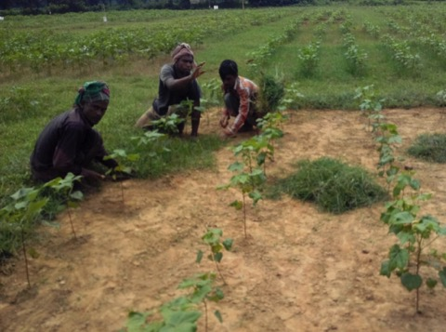
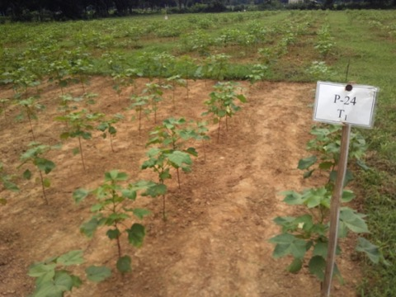
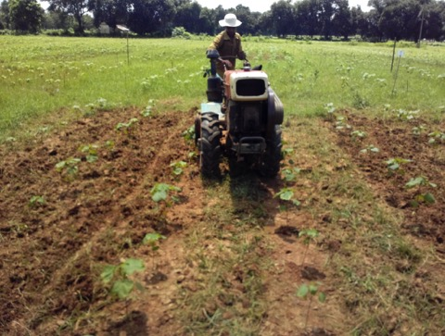
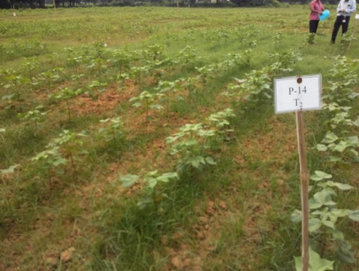
T1
T1
T2
T2

Slide 23
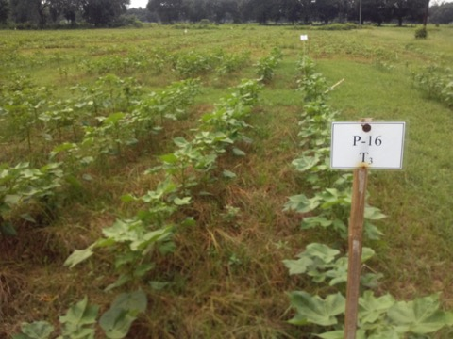
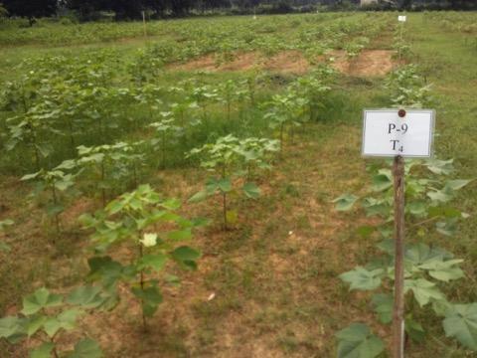
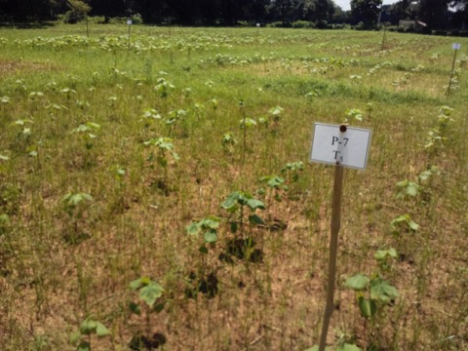
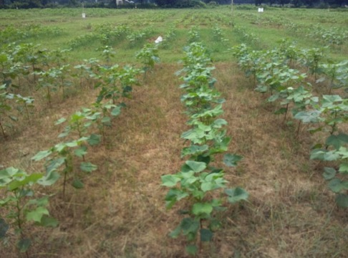
T3
T4
T5
T5

Slide 24
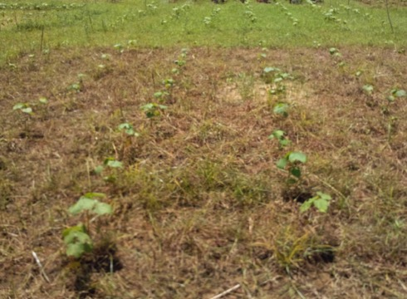
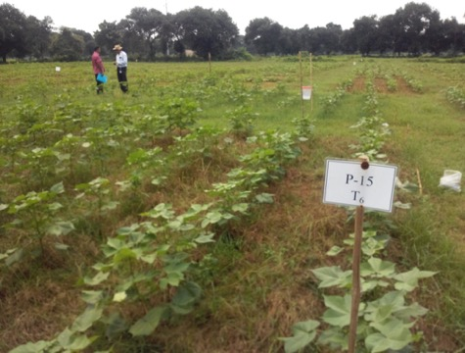
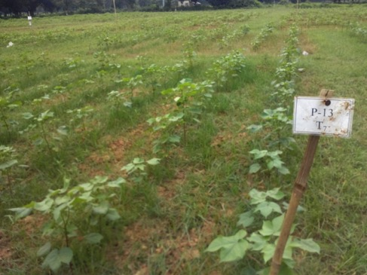
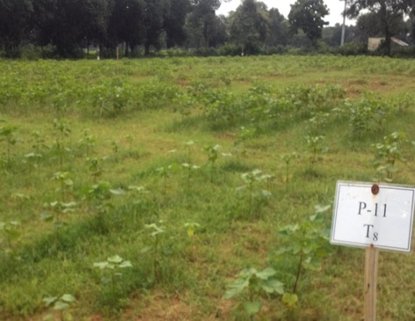
T6
T6
T7
T8

Slide 25
RESULTS
AND
DISCUSSION

Slide 26
Fig. 2.1: Weed abundance and weed weight as influenced
by chemical, mechanical and manual weeding

Slide 27
Fig. 2.2: Weed control efficiency of different chemical, mechanical
and manual weeding

Slide 28
Fig. 2.3: Plant height of cotton as influenced by chemical,
mechanical and manual weeding

Slide 29
Fig. 2.4: Plant number, Sympodial and Monopodial br. as
influenced by chemical, mechanical and manual weeding

Slide 30
Fig. 2.5: Seed cotton yield, boll number and weight as influenced
by chemical, mechanical and manual weeding

Slide 31
Fig. 2. 6: Functional relationship between Seed cotton yield and
weed abundance in different chemical, mechanical and
manual weeding

Slide 32
Table 2.1: Gin properties of cotton as influenced by different chemical,
mechanical and manual weed control method in cotton
Treatment | Lint % (GOT) | Seed % | Lint Index | Seed Index
T₁ | 40.50 | 59.00 | 6.71 | 9.77
T₂ | 40.63 | 58.87 | 6.77 | 9.80
T₃ | 40.93 | 58.57 | 6.69 | 9.57
T₄ | 40.20 | 59.30 | 6.65 | 9.80
T₅ | 40.57 | 58.93 | 6.86 | 9.97
T₆ | 40.57 | 58.93 | 6.77 | 9.83
T₇ | 40.93 | 58.57 | 6.76 | 9.67
T₈ | 40.33 | 59.17 | 6.48 | 9.50
LSD _{0.05} | 1.48 | 1.48 | 0.47 | 0.34
CV% | 2.08 | 1.43 | 4.01 | 1.99

Slide 33
Table 2.2: Economic return as influenced by different chemical,
mechanical and manual weed control method in cotton
Treatment | Variable cost (Tk ha⁻¹) | Gross return (Tk ha⁻¹) | Net return (Tk ha⁻¹) | BCR
T₁ | 94375 | 101070 | 6695 | 1.07
T₂ | 80815 | 106355 | 25540 | 1.32
T₃ | 82300 | 93794 | 11494 | 1.14
T₄ | 82150 | 85344 | 3194 | 1.04
T₅ | 85675 | 119554 | 33879 | 1.40
T₆ | 82980 | 109316 | 26336 | 1.32
T₇ | 82830 | 87579 | 4749 | 1.06
T₈ | 78775 | 51549 | -27226 | 0.65

Slide 34
Efficacy of Different Herbicides Over Manual Weeding in Controlling Cotton Weed
Experiment-3

Slide 35
METHODS AND MATERIALS
Design : Split plot
No. of replication: 3
Treatments:
 | Factor-A: Variety
 | V₁=CDB variety CB-14
 | V₂=Hybrid Variety Rupali-1
 | Factor-B: Weed Control Method
 | WC₁= Panida (Pendimethalin) @) 3.75 lit ha⁻¹ at cotton sowing+ Glyfocel (Glyphosate) @ 4.7 lit ha⁻¹ at 35 DAS
 | WC₂= Panida (Pendimethalin) @ 3.75 lit ha⁻¹ 3 days after cotton sowing + Glyfocel (Glyphosate) @ 4.7 lit ha⁻¹ at 35 DAS
 | WC₃= Panida (Pendimethalin) @) 3.75 lit ha⁻¹+ Glyfocel (Glyphosate) @ 4.7 lit ha⁻¹ before cotton emergence
 | WC₄= Panida (Pendimethalin)@)3.75 lit ha⁻¹ at cotton sowing+ Paraquat @ 4.7 lit ha⁻¹ & Glyfocel (Glyphosate) @ 4.7 lit ha⁻¹ at 35 DAS
 | WC₅= Panida (Pendimethalin) @) 3.75 lit ha⁻¹ at sowing followed by water hyacinth mulch at 15 DAS
 | WC₆= Weed free plot
 | WC₇= Weedy check (untreated)
Date of sowing: 10 August, 2015

Slide 36
RESULTS
AND
DISCUSSION

Slide 37
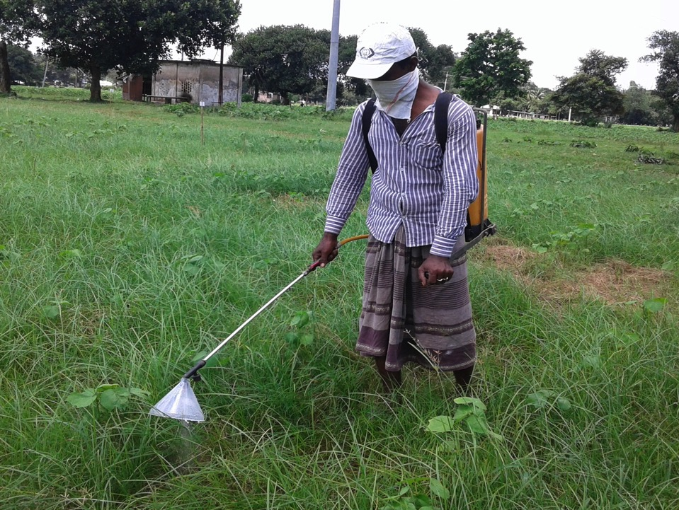
Application of Post Emergent Herbicide
LOCALLY MADE SPRAY SHIELD FOR HERBICIDE APPLICATION

Slide 38
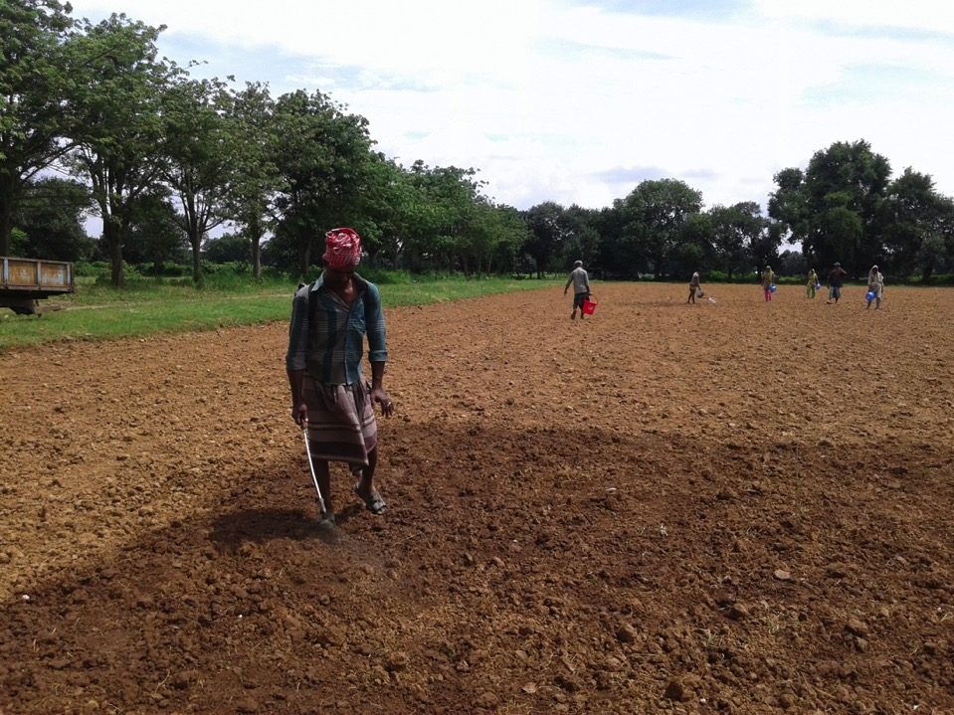
Application of Pre- Emergent Herbicide

Slide 39
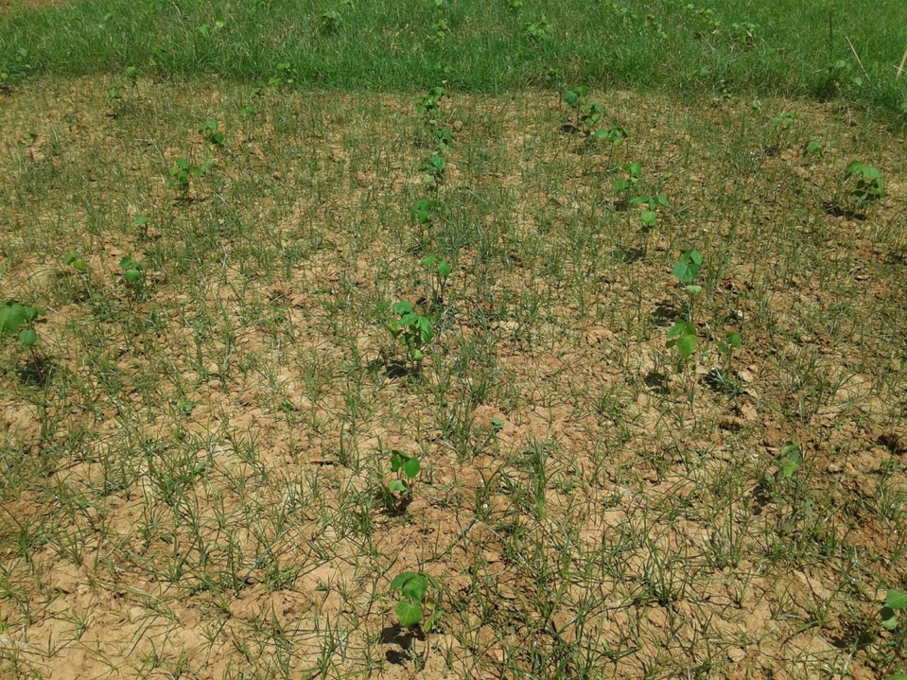
Cotton plant and weed abundance after application of pre emergent herbicide

Slide 40
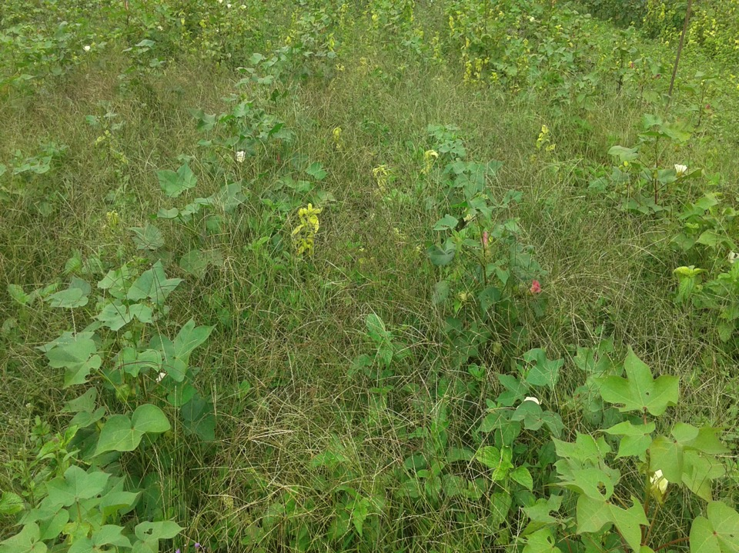
Weedy Checked Plot

Slide 41
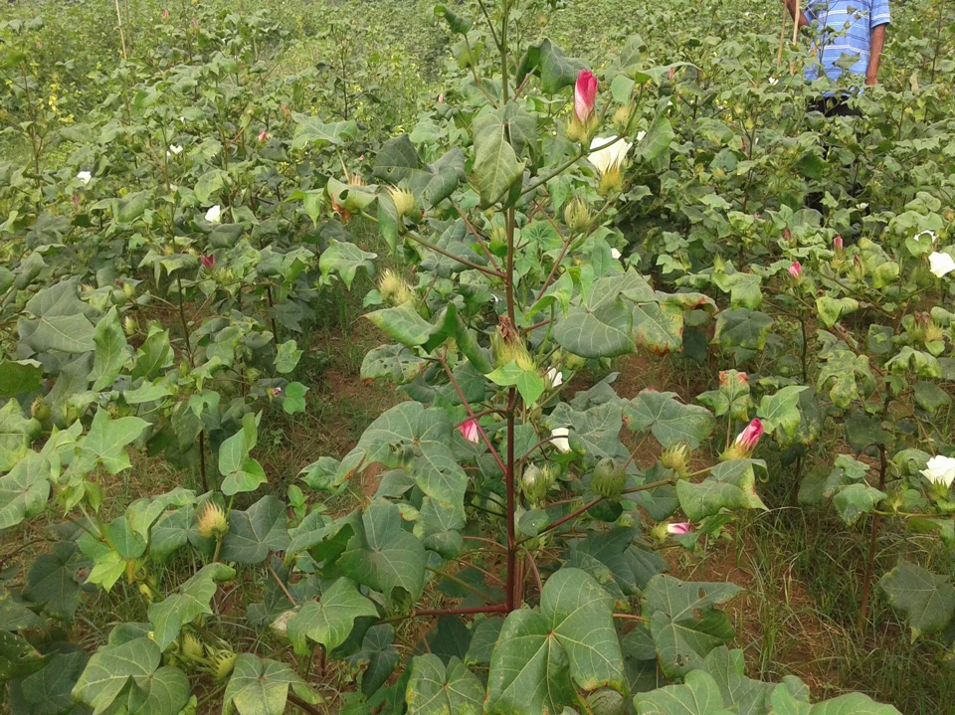
Weed Free Plot

Slide 42
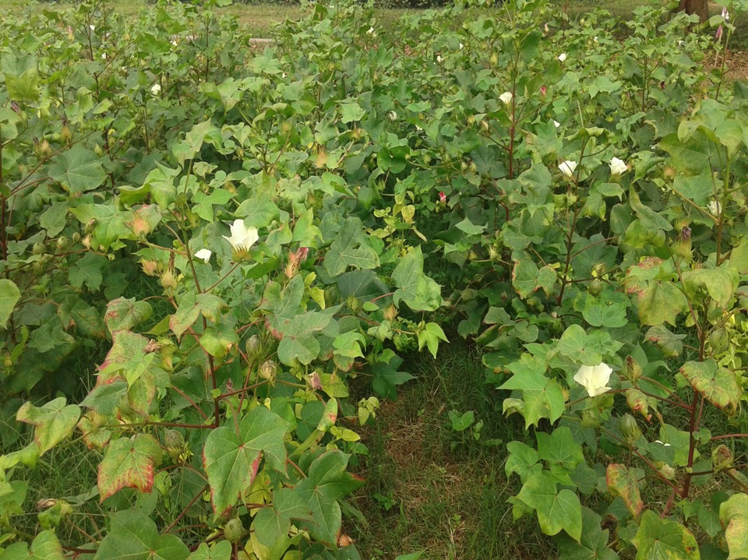
Experimental plot: pre emergent herbicide at sowing and post emergent herbicide at 35 DAS

Slide 43
Fig 3.1: Speed of germination (SPG) and Mean germination time (MGT) as influenced by different weed control methods.

Slide 44
Fig 3.2: Number of plants ha⁻¹ as influenced by variety and weed control methods.

Slide 45
Fig 3.3: Plant height of cotton at different days after sowing as influenced by different weed control methods.

Slide 46
Table 3.1: Yield and yield components of cotton as influenced by different weed control methods.
Weed control methods | No of sympodial br. plant⁻¹ | No of monopodial br. plant⁻¹ | No. of bolls plant⁻¹ | Single boll weight (g) | Seed Cotton Yield (kg ha⁻¹)
WC₁ | 14.40 | 0.35 | 27.32 | 5.64 | 2175.14
WC₂ | 12.08 | 0.30 | 23.12 | 4.44 | 1885.84
WC₃ | 9.080 | 0.23 | 17.98 | 4.20 | 1239.34
WC₄ | 12.08 | 0.60 | 27.16 | 5.12 | 1713.00
WC₅ | 11.32 | 0.62 | 22.12 | 4.58 | 1633.09
WC₆ | 15.18 | 0.47 | 34.14 | 5.84 | 3213.74
WC₇ | 7.800 | 0.30 | 13.00 | 3.58 | 666.58
LSD _{0.05} | 1.66 | 0.16 | 2.06 | 0.50 | 102.05
CV% | 26.22 | 66.01 | 30.53 | 18.91 | 42.71

Slide 47
Fig 3.4: Number of bolls plant⁻¹ as influenced by variety and weed control methods

Slide 48
Fig 3.5: Cotton single boll weight (g) as influenced by variety and weed control methods.

Slide 49
Table 3.2: Economic return as influenced by variety and weed control method in cotton
Weed control methods | Variable cost (Tk ha⁻¹) | Gross return (Tk ha⁻¹) | Net return (Tk ha⁻¹) | BCR
V₁WC₁ | 76880 | 113695 | 36815 | 1.48
V₁WC₂ | 77660 | 92711 | 15051 | 1.19
V₁WC₃ | 78180 | 62497 | -15683 | 0.80
V₁WC₄ | 77920 | 88973 | 11053 | 1.14
V₁WC₅ | 78960 | 87424 | 8464 | 1.11
V₁WC₆ | 81230 | 150469 | 69239 | 1.85
V₁WC₇ | 70830 | 38663 | -32167 | 0.55
V₂WC₁ | 91695 | 117986 | 26291 | 1.29
V₂WC₂ | 92475 | 108278 | 15803 | 1.17
V₂WC₃ | 92995 | 70364 | -22631 | 0.76
V₂WC₄ | 92735 | 93545 | 810 | 1.01
V₂WC₅ | 93775 | 86626 | -7149 | 0.92
V₂WC₆ | 96045 | 190615 | 94569 | 1.98
V₂WC₇ | 85645 | 32798 | -52847 | 0.38

Slide 50
CONCLUSION
Chemical weed control method in combination with pre-emergent herbicide at sowing and post emergent herbicide at 35 DAS effectively control cotton weed.
The result of the experiment can be forwarded to on farm trial and demonstration at different locations in the country to control cotton weed.

Slide 51
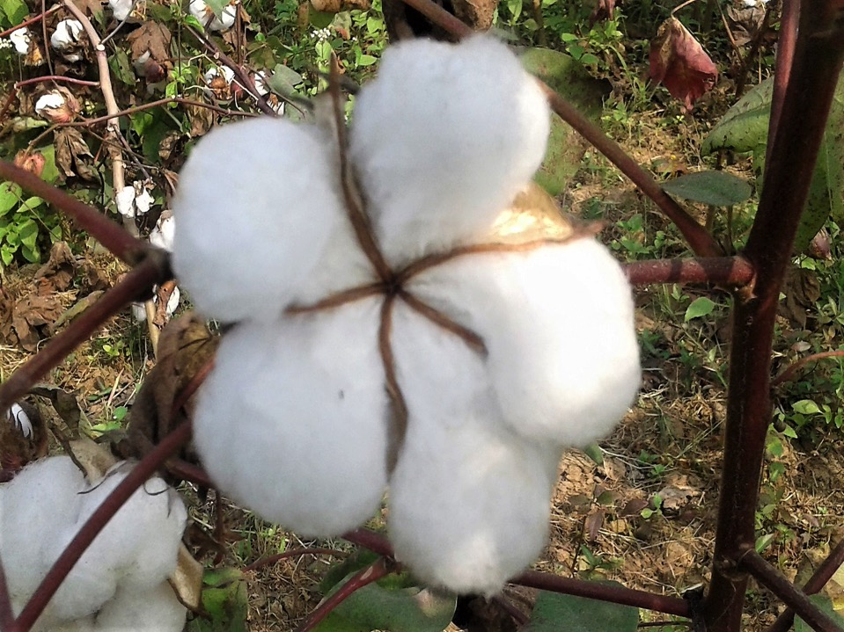
THANK YOU ALL
SPECIAL THANKS TO
DR. KESHAV KRANTI, MR. KAI HUGHES
AND
DR. MICHEL FOK
AND
ALSO THANKS TO PROF. DR. MOHAMED NEGM

