Slide 1

Genetic variation in germplasm of Gossypium hirsutum L. for yield and fiber related traits and CLCuD
Muhammad Tehseen Azhar, PhD
Department of Plant Breeding and Genetics
Univ. of Agriculture, Faisalabad (Pakistan)
Co-Chair of Germplasm and Genetic Stock, ICGI

Slide 2
Cotton is problem plant ……
Non-availability of quality cotton seed
Non-availability of genotypes suitable for mechanical picking
Heat and water stresses---Due to climate change
Under dose of Bt toxin ---One of the reasons of resistance in pink boll worm
Less rate of germination
Occurrence of sucking and chewing pests

Slide 3
7. Infestation of white fly----Managed by integration of multiple technologies
8. Imbalanced use of fertilizers
9. Lack of support price for seed cotton

Slide 4
Way forward…
Development of climate change resilient germplasm
New genotypes suitable for mechanical picking
Provision of quality seed to the farmers
Development of pest resistant genotypes
Farmer training on cotton agronomy through extension/outreach activities
Management of pink boll worm at national level- Resistant genotypes
Breakage of life cycle
Eradication of cotton sticks
7. Govt. should take initiatives to fix support price of cotton like wheat

Slide 5
Mean values of yield and fiber related traits in Gossypium hirsutum L.
Genotypes | CLCuD Score | Plant Height | No. of Bolls | Boll Weight (g) | GOT (%) | Seed Cotton Yield per Plant (g) | Staple Length (mm) | Fiber Strength (g/tex) | Fiber Fineness (µg/inch) | Fiber Unifor- mity (ratio) | Short Fiber Index (%) | Fiber Elongation (%)
FH-182 | 4.37 | 83.67 | 8 | 2.44 | 34.43 | 18.69 | 23.93 | 23.80 | 4.27 | 45.77 | 15.07 | 7.80
FH-181 | 5.00 | 88.33 | 23 | 3.81 | 32.16 | 87.30 | 24.90 | 24.53 | 4.73 | 45.20 | 14.63 | 6.00
FH-162 | 4.70 | 79.33 | 10 | 2.55 | 38.42 | 30.60 | 23.87 | 23.73 | 4.77 | 45.83 | 15.37 | 7.07
FH-308 | 4.47 | 73.67 | 18 | 3.12 | 35.26 | 54.81 | 22.67 | 22.50 | 4.63 | 49.00 | 20.03 | 6.33
FH-163 | 4.20 | 90.67 | 13 | 3.39 | 36.14 | 44.56 | 22.20 | 22.77 | 4.07 | 44.40 | 21.83 | 7.63
IUB-222 | 2.77 | 93.67 | 16 | 3.73 | 35.68 | 62.60 | 22.67 | 22.97 | 4.30 | 47.67 | 18.70 | 7.13
VH-289 | 3.43 | 108.33 | 15 | 3.31 | 37.04 | 49.92 | 24.57 | 24.87 | 4.13 | 47.03 | 10.67 | 7.03
CIM-599 | 3.47 | 76.00 | 12 | 3.53 | 34.42 | 41.13 | 25.57 | 24.17 | 4.23 | 45.20 | 9.70 | 7.70
FH-114 | 4.53 | 63.33 | 9 | 2.58 | 35.80 | 24.03 | 23.50 | 23.63 | 4.07 | 46.00 | 14.40 | 8.07
AA-802 | 4.83 | 49.00 | 8 | 2.69 | 33.72 | 22.95 | 24.70 | 24.13 | 4.57 | 48.93 | 10.57 | 7.13
VH-232 | 3.53 | 67.33 | 11 | 3.10 | 33.05 | 32.45 | 23.90 | 23.93 | 4.73 | 51.87 | 11.77 | 6.03
FH-158 | 4.33 | 62.33 | 8 | 3.01 | 36.53 | 23.68 | 23.60 | 22.07 | 4.23 | 46.17 | 18.77 | 6.17
S-12 | 3.97 | 53.33 | 14 | 2.92 | 31.37 | 39.40 | 22.87 | 22.70 | 4.87 | 49.40 | 18.87 | 6.90
SB-149 | 3.87 | 48.00 | 11 | 3.30 | 34.38 | 36.79 | 25.53 | 24.47 | 4.00 | 47.27 | 10.30 | 7.50
CRS-456 | 3.50 | 69.00 | 15 | 3.67 | 38.27 | 57.20 | 21.80 | 22.47 | 5.43 | 51.00 | 17.90 | 7.40
CRS-2007 | 3.37 | 63.00 | 13 | 3.17 | 36.30 | 41.77 | 25.37 | 24.00 | 4.80 | 47.60 | 10.00 | 5.73
IR-3701 | 3.27 | 73.33 | 13 | 3.43 | 39.21 | 44.47 | 23.57 | 22.47 | 4.93 | 51.60 | 13.00 | 6.63

Slide 6
Range of means for yield and fiber related traits in Gossypium hirsutum L.
Traits | Range of means
CLCuD Score | 2.8-5.0
Plant Height | 48-108
No. of Bolls | 8-23
Boll Weight | 2.43-3.81
GOT (%) | 31.37-39.21
Seed Cotton Yield per Plant | 18.69-87.30
Staple Length | 21.8-25.6
Fiber Strength | 22.1-24.9
Fiber Fineness | 4.0-5.4
Fiber Uniformity | 44.4-51.9
Short Fiber Index | 9.70-21.83
Fiber Elongation | 5.73-8.07

Slide 7
Index scores of yield and fiber related traits in Gossypium hirsutum L.
Genotype | CLCuD Score | Plant Height (cm) | No. of Bolls | Boll Weight (g) | GOT (%) | Seed Cotton Yield per Plant (g) | Staple Length (mm) | Fiber Strength (g/tex) | Fiber Fineness (µg/inch) | Fiber Unifor -mity (ratio) | Short Fiber Index (%) | Fiber Elongat- ion (%) | Total Score
FH-182 | 1 | 3 | 1 | 1 | 2 | 1 | 2 | 2 | 1 | 1 | 2 | 3 | 20
FH-181 | 1 | 3 | 3 | 3 | 1 | 3 | 3 | 3 | 3 | 1 | 2 | 1 | 27
FH-162 | 1 | 2 | 1 | 1 | 3 | 1 | 2 | 2 | 3 | 1 | 2 | 2 | 21
FH-308 | 1 | 2 | 3 | 2 | 2 | 3 | 1 | 1 | 3 | 3 | 1 | 1 | 23
FH-163 | 1 | 3 | 2 | 2 | 2 | 2 | 1 | 1 | 3 | 1 | 1 | 3 | 22
IUB-222 | 3 | 3 | 3 | 3 | 2 | 3 | 1 | 2 | 3 | 2 | 1 | 2 | 28
VH-289 | 2 | 3 | 3 | 2 | 3 | 3 | 2 | 3 | 3 | 2 | 3 | 2 | 31
CIM-599 | 2 | 2 | 2 | 3 | 1 | 2 | 3 | 3 | 3 | 3 | 3 | 3 | 28
FH-114 | 3 | 1 | 1 | 1 | 2 | 1 | 1 | 2 | 3 | 1 | 2 | 3 | 21
AA-802 | 3 | 1 | 1 | 1 | 1 | 1 | 3 | 3 | 2 | 2 | 3 | 2 | 23
VH-232 | 2 | 2 | 1 | 2 | 1 | 1 | 2 | 2 | 3 | 3 | 3 | 1 | 23
FH-158 | 3 | 1 | 1 | 1 | 3 | 1 | 2 | 1 | 3 | 2 | 1 | 1 | 20
S-12 | 1 | 1 | 2 | 1 | 1 | 2 | 1 | 1 | 1 | 3 | 1 | 2 | 17
SB-149 | 2 | 1 | 2 | 2 | 1 | 2 | 3 | 3 | 3 | 2 | 3 | 3 | 29
CRS-456 | 1 | 2 | 3 | 3 | 3 | 3 | 1 | 1 | 1 | 3 | 2 | 2 | 25
CRS- 2007 | 2 | 1 | 2 | 2 | 2 | 2 | 3 | 2 | 1 | 2 | 3 | 1 | 23
IR-3701 | 1 | 2 | 2 | 3 | 3 | 2 | 2 | 1 | 1 | 3 | 3 | 1 | 24

Slide 8
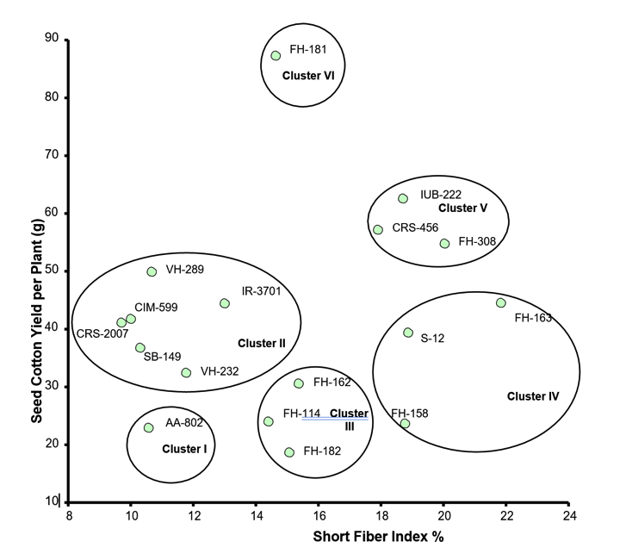
CLCuD susceptible
CLCuD resistance
Metroglyph diagram illustrating distribution of various clusters from various
genotypes of upland cotton

Slide 9
Cluster number, Cluster index scores, and Cotton genotypes included in each cluster
Cluster No. | Genotypes | Cluster Index
I | AA-802 | 23
II | CIM-599, VH-289, VH-232, SB-149, CRS- 2007, IR-3701 | 158
III | FH-182, FH-162, FH-114 | 62
IV | FH-163, FH-158, S-12 | 59
V | FH-308, IUB-222, CRS-456 | 76
VI | FH-181 | 27

Slide 10
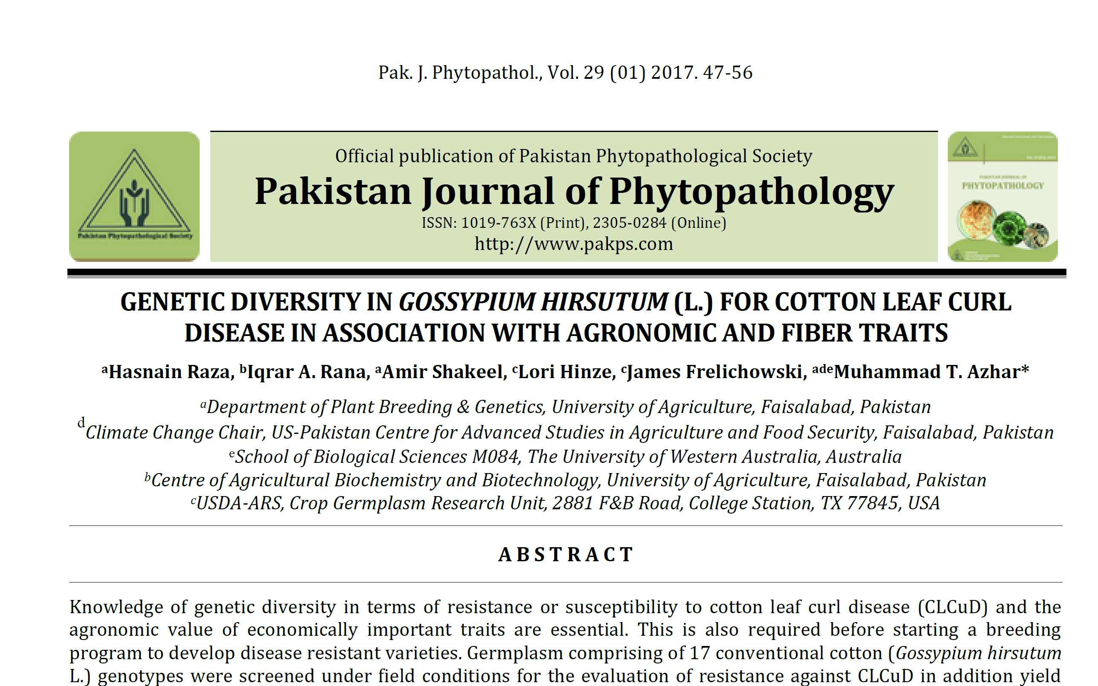

Slide 11
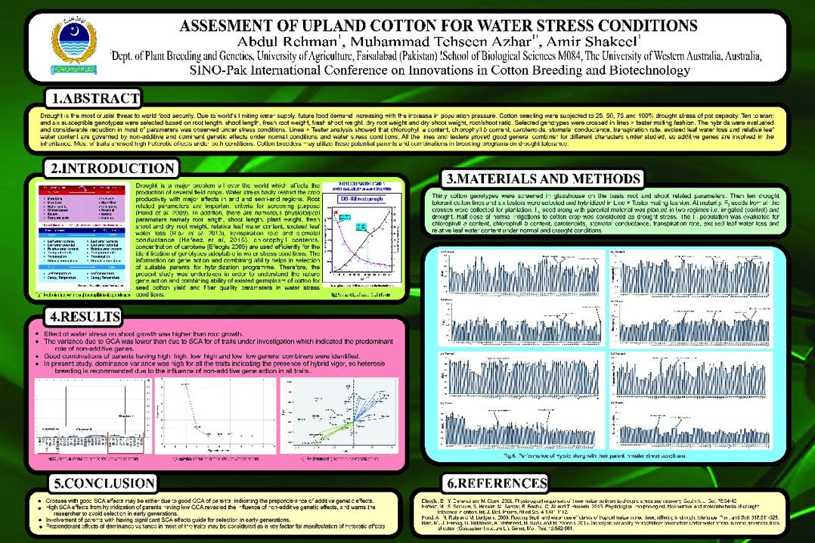

Slide 12
The cotton grown in Pakistan is harvested manually by females and children
Unfortunately, the manual cotton picking is a time consuming and laborious job.
Females face serious health issues due to
Health Risks
About 6 to 7 hours are spent to pick 2.5 acre of cotton by a team of 32-35 laborers
Insect bites
Hand cuts
Working in high ambient temperature
Issue of backbone due to continues load carrying
Bruises
Efficiency of female to perform other jobs
Excessive use of pesticides
Frost
Seed cotton must be picked to avoid
Adverse weather conditions

Slide 13


Adaptation of advance line PB-896 for trash free
cotton through mechanical picking

Slide 14
GOALS/OBJECTIVES
Adaptability of cotton advance line “PB-896” in cotton belt
Adjustability of plant geometry of PB-896 suitable for mechanical pickers in demonstration plots
Field experimentation for evaluation of mechanical picker for various sowing methods of cotton
Indigenization of imported cotton picker employing reverse engineering approach under local cotton varieties and planting geometry
Field demonstration and skill development of stakeholders, manufacturers, students and farmers to enhance cotton harvest mechanization

Slide 15
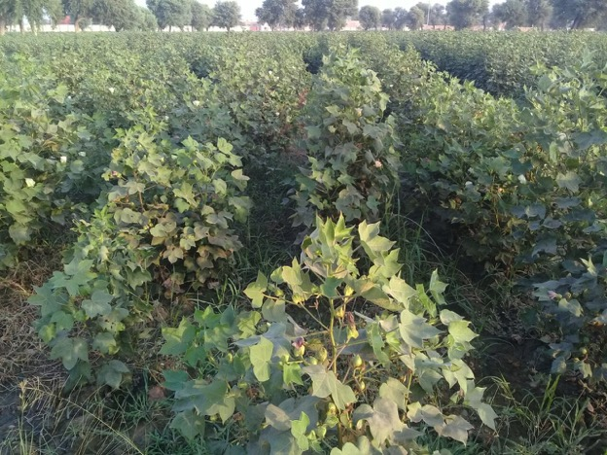
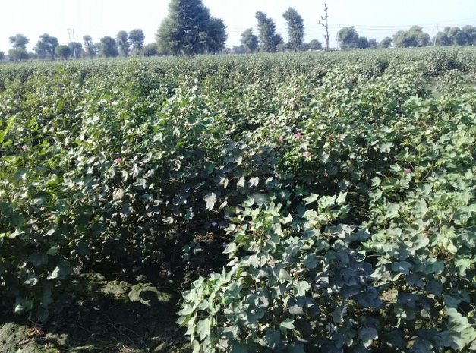
What to do?
Adaptation trials -- by Dept. PBG
Plant geometry -- by Dept. of Agronomy
Reverse engineering of imported mechanical picker -- by Dept. of FMP

Slide 16
Project Output
Availability of cotton seed of PB-896 for general cultivation to the farmers
Opportunity of cotton mechanization in the country.
Improved trash free cotton export due to quality and timely cotton picking using mechanical cotton pickers.
Reduction in labor requirement especially females and children
Health security of females and child labors used in manual cotton picking.

Slide 17




Genotyping and development of heat stress tolerant cotton germplasm having enhanced quality traits
Theme: DEVELOPMENT OF STRESS-TOLERANT GERMPLASM FOR WHEAT AND COTTON
Dr. Muhammad Tehseen Azhar, Lecturer/PI
Dept. of Plant Breeding and Genetics

Slide 18
Cotton is the major fiber crop in Pakistan and contributes 1% in GDP
Temperature exceeds 45 °C in cotton belt. High temperature exerts negative impact on yield through boll shedding.
65-70% of its fruiting points are not productive due to;
heat induced sterility in pollen grains
bollworm attack, and
increased humidity during monsoon
_________________________________________
A genotype resisting to highlighted syndromes will contribute to exponential increase in yield.

Slide 19
Adverse effects of heat stress
Shedding of squares, buds and flowers
Movement of water, ions, and inorganic solutes across the plant membrane, which interferes with photosynthesis and respiration
Protein metabolism, including degradation of proteins, inhibition of protein accumulation, and induction of certain proteins
_____________________________________________
Developing short duration and compact varieties of cotton
Notes:
has been the solution to avoid adverse effects of stress on cotton

Slide 20
Way forward …..
Due to the unavailability of the cotton genome sequence earlier, identification of candidate genes for various traits had not been possible.
GBS approach -----allows sequencing, discovery and genotyping of thousands of SNPs in a single step.
GBS ----- simple and short library preparation protocol
Used in apple, barley, maize, rice, wheat and soybean.
However, in cotton ----has a narrow genetic base, GBS needs to be exploited for high density linkage map construction and powerful mapping of important traits.
_____________________________________________________
It is need of the hour to complement conventional breeding with molecular approaches

Slide 21
Objectives
Long term
Development of climate resilient and good quality cotton varieties
Short term
Identification of heat tolerant germplasm of cotton
Genotyping by sequencing of identified germplasm
Exploitation of biochemical and SNPs markers linked with heat tolerance and quality traits

Slide 22
Expected Outcomes
Based on phenotypic data, heat tolerant lines having good quality like fiber traits will be available for breeding programs for the development of potential genetic material against heat stress
SNPs markers linked parameters associated with heat tolerance, yield related traits, and fiber quality will be available for genomic assisted breeding
Advance strains developed at the department (having potential to cope with heat stress without compromising yield) will be sent for evaluation in national trials

Slide 23
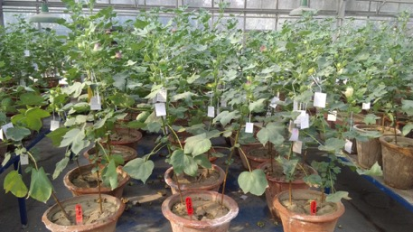
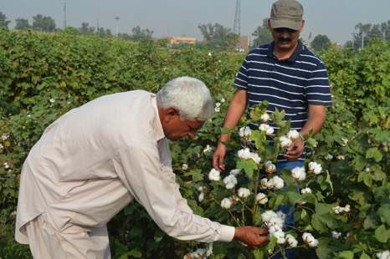
Other Activities of Cotton Research Group
Crossing block of seventy genotypes of cotton were grown on October 29, 2016
F₁ ---- 239 crosses by 24 Master students
F₂ ---- 38 families
F₃ ---- 38
F₄ ---- 60
F₅ ---- 42
F ₆ ---- 27
F₇ ---- 7
Total germplasm ------ 330 genotypes
Advance bulks -------- 13
Demonstration trial of PB-896 and PB-76

Slide 24
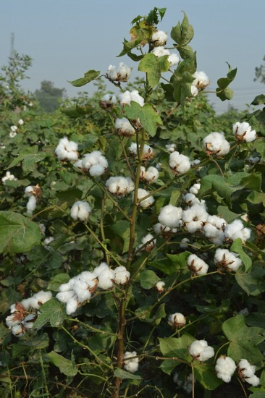
THANK You

