Slide 1


Front Line Demonstration in Cotton - As a Good Transfer of Technology Practice Advocated for Africa from the Experiences of India
ICAC - 14th meeting of Southern and Eastern African Cotton Forum (SEACF)
04 – 06, July 2018 at Harare, Zimbabwe
Dr (Mrs) Usha Rani Joshua & Dr. A. H. Prakash
Principal Scientist (Agrl. Extension)
Central Institute for Cotton Research (CICR), ICAR,
Regional Station, Coimbatore - 641 003
Tamil Nadu, India
+91 98432 98422 (mobile) ushajoshua@rediffmail.com

Slide 2

Introduction
History of Demonstrations
What is Front Line Demonstration
Origin of Front Line Demonstration in India
Objectives of Front Line Demonstration
Methodology Adopted in Front Line Demonstration
Special feature of FLD
Impact created so far in Indian cotton scenario
Challenges faced
Future prospects
Concluding Suggestions for African countries

Slide 3
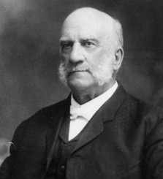
"What a man hears, he may doubt;
what he sees, he may also doubt;
but what he does, he cannot doubt"
Seaman A. Knapp (1903)
Agriculture Extension Pioneer
who first recognized the need for demonstrations
Source : https://en.wikipedia.org/wiki/Seaman_A._Knapp

Slide 4
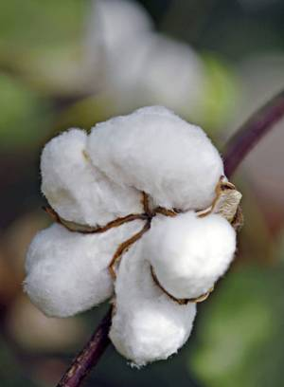
Introduction
The performance of cotton sector in India is quite impressive in terms of its achievements in area and production over the years.
This is due to introduction of promising genotypes, potential production and protection technologies, policies which are full of promise, effective Transfer of Technology practices and efficient toil of Indian cotton growers.
Among these, the properly defined and streamlined technology dissemination arrangements played a major role.
Attempts on farmer to farmer technology dissemination, empowerment and capacity building of farmers, gender mainstreaming, Public Private Partnership and promoting Information and Communication Technology in technology transfer are those streamlined TOT activities behind the country’s success.
Among them, “Front Line Demonstrations in Cotton” is one of the longest running best farmer friendly TOT program with great impact about which is this paper.

Slide 5
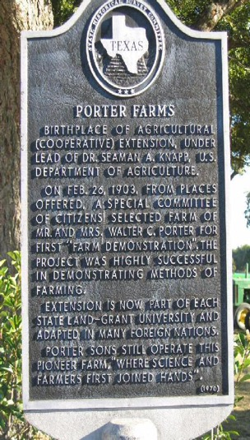
History of Demonstrations in Cotton
“Show me how?” is the mantra for demonstration concept
It started during the birth of Cooperative Extension (1896-1905) of Land Grant Commission of United States of America.
The Land Grant Commission recognized the public’s right to know the activities carried out in the research stations and hence carefully documented the research output and disseminated the information to farms, homes and ranches through extension programs.
The father of demonstration Seaman A. Knapp, the special agent with the United States Department of Agriculture, established the first demonstration farm in 1903 at Walter C. Porter farm, near Terrell, in Kaufman County, Texas
It is surprising that the first demonstration included multi crops viz., 25 acres of cotton, 24 acres of corn, three acres of peas and sorghum, one acre of sweet potatoes and one acre of grain sorghum and milo maize.
Source: https:// www.fold3.com/page/641421058-seaman-asahel-knapp/stories

Slide 6
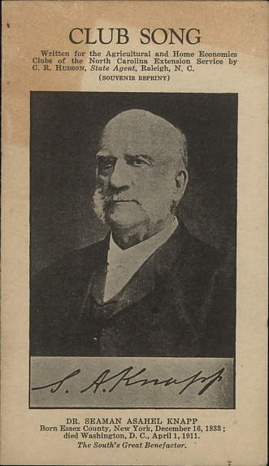
In the first demonstration farm, Walter C. Porter followed the Department of Agriculture’s recommendations
At the end of the year, Porter estimated that his income was at least USD 700 more than his regular income and decided to continue to follow the recommendation of the Scientist Knapp to manage his crops.
In later years, the first demonstrator Porter facilitated the other farmers in the area to operate on a demonstration farm model and history says that his farm has become a laboratory for teaching progressive farm techniques and an incubator for the establishment of the agricultural extension service.
Then Seaman demonstrated on a broad scale in the weevil-infested areas of Texas and two adjoining states. Knapp demonstrated improved cotton growing methods. With a $40,000 budget, he directed more than 20 federal agents who worked with some 7,000 farmers to establish demonstration plots.
Based on his experiences in demonstrations, he stated the famous quote that “What a man hears, he may doubt; what he sees, he may also doubt; but what he does, he cannot doubt” and became the father of Demonstration.
Source: https://www.fold3.com/page/641421058-seaman-asahel-knapp/stories

Slide 7
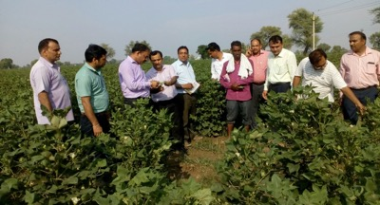
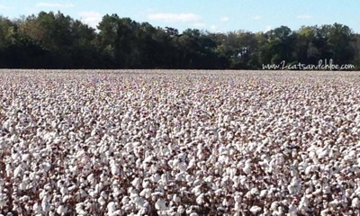
Demonstration in Indian context
The field demonstration conducted under the close supervision of scientists of the National Agriculture Research System in India including the Scientists from ICAR, State Agricultural Universities, Krishi Vigyan Kendra (Farmers Science Centre) is called Front Line Demonstration (FLD).
“Seeing is believing” is the principle of Front Line Demonstration, “Learning by doing” is its methodology and “Yield Enhancement” is its motive.
It provides an effective learning situation as farmers “See the crops themselves”, “interact with the scientists and extension workers on the fields”, and “get doubts clarified then and there itself”.
It is one of the major First Line Extension Programs of ICAR.
Seeing is believing is the principle
Yield enhancement is the motive

Slide 8
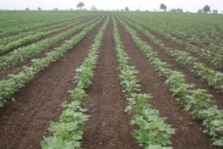
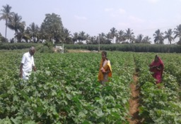
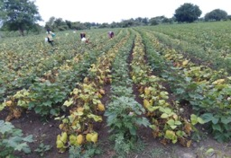
FLD in Cotton
The Indian Council of Agricultural Research introduced the Lab to Land program in the golden jubilee year 1979 for efficient transfer of technology.
The idea behind the program was that the viable technologies developed by the researchers should have an on farm field testing and the farmers should be convinced about the technologies for wider adoption in short span of time.
This program was expanded to cotton crop also, implemented in a big way and gained much popularity in early eighties among cotton growers.

Slide 9

Objectives
To demonstrate the usefulness of the latest improved crop production and protection technologies to the farmers as well as extension workers with a view to reduce the time gap between technology generation and its adoption.
To enable scientists to obtain direct feedback from cotton farmers and suitably reorient their research programs and develop appropriate technology packages.
To create effective linkage among scientists, extension personnel and farmers.

Slide 10

Implementing Agencies and Fund Flow Mechanism
This novel program was implemented in 1996-97 through All India Coordinated Research Project (AICRP) on cotton and its net working centres and CICR and its regional stations
Department of Agriculture and Cooperation (DAC), Ministry of Agriculture and Farmers Welfare, Government of India is the sponsoring agency
Until 2013, these demonstrations were conducted on Production Technology, Integrated Pest Management and on Farm implements under Technology Mission on Cotton, Mini Mission II.
For the past five years, under the National Food Security Mission (NFSM), these demonstrations are being conducted on ICM, Desi/ELS /Seed production and intercropping

Slide 11
Methodology Adopted
Women and tribal
reservation
low productivity areas / problematic areas
A list of beneficiaries and their plot numbers were notified with the help of local village Officials
Impact analysis
information on the crops
cropping system of the area
Bench mark survey
inter cropping
average yields of cotton
FLDs on ICM in cotton
local practices adopted
FLDs on Desi/ELS/ELS cotton seed production
cost of cultivation
FLDs on Intercropping in cotton
Provision for supply of critical inputs
Conduct of demonstrations by the Scientists on the selected farmers’ fields
One acre – FLD and One acre – local practice

Slide 12
Number of demonstrations conducted year wise and the budgetary outlay (1996-97 to 2016-17)
A total of 3581 acres of demonstrations were conducted with the budget total outlay of Rs.105 lakh under Intensive Cotton Development Programme of Ministry of Agriculture, Government of India from 1995-96 to 1999 2000
A total of 4134 hectares of demonstrations were conducted with the budget total outlay of Rs.225.00 lakh under Technology Mission on Cotton – Mini mission II from 2000-01 to 2004-05
From 2005-06 onwards, FLDs were conducted in three different components. A total of 9359 acres of demonstration on cotton production technology, 139 unit demonstration on cotton IPM and 112 unit demonstration on cotton farm implements were conducted from 2005-06 to 2012-13 with a budget outlay of Rs. 461.54 lakh.
From 2014-15, the FLD in cotton were sponsored by National Food Security Mission on Cotton – Commercial Crops, Ministry of Agriculture and Farmers welfare, Government of India. A total of 1157 demonstrations on cotton FLD on ICM in cotton, 702 demonstrations on Desi / ELS / Seed Production and 459 FLD on intercropping in cotton were conducted during 2014-15 and 2017-18 with a total budget outlay of Rs.187.45 lakh

Slide 13
Average yield obtained in FLDs conducted Nationwide from 1997-98 to 2017-18 (SCY kg/ha)
(Source: FLD Annual Report published by PC (Cotton Improvement) ICAR-AICRP (Cotton) (from 1997-98 to 2017-18))

Slide 14
Average Seed Cotton Yield of FLD and Farmers’ practices
(Source: FLD Annual Report published by PC (Cotton Improvement) ICAR-AICRP (Cotton) (from 1997-98 to 2017-18))
Average FLD yield = 1686
Average FP yield = 1433

Slide 15
Gap between Average FLD yield and Average Farmers’ practice yield
(Source: FLD Annual Report published by PC (Cotton Improvement) ICAR-AICRP (Cotton) (from 1997-98 to 2017-18))

Slide 16
Possibility of Increasing average seed cotton yield of Farmers ’by proper TOT intervention viz., FLD
S. No | Year | SCY - FLD Kg/ha | SCY- FP Kg/ha | Increase of FLD SCY over FP %
1 | 1997-98 | 1326 | 965 | 37.4
2 | 1998-99 | 1219 | 932 | 30.79
3 | 1999-2000 | 1605 | 1283 | 25.09
4 | 2000-01 | 1386 | 1134 | 22.22
5 | 2001-02 | 1166 | 938 | 24.3
6 | 2002-03 | 1315 | 1111 | 18.36
7 | 2003-04 | 1431 | 1205 | 18.75
8 | 2004-05 | 1572 | 1364 | 15.24
9 | 2005-06 | 1630 | 1382 | 17.94
10 | 2006-07 | 1965 | 1699 | 15.65
11 | 2007-08 | 1971 | 1712 | 15.18
12 | 2008-09 | 1906 | 1639 | 16.29
13 | 2009-10 | 2166 | 1899 | 14.06
14 | 2010-11 | 1764 | 1452 | 21.48
15 | 2011-12 | 2060 | 1832 | 12.44
16 | 2012-13 | 1608 | 1435 | 12.05
17 | 2014-15 | 1946 | 1646 | 18.22
18 | 2015-16 | 1547 | 1352 | 14.42
19 | 2016-17 | 2122 | 1867 | 13.65
20 | 2017-18 | 2024 | 1808 | 11.94
 | Average | 1686.45 | 1432.75 | 17.73

Slide 17

Special features of this TOT program
The program was successful in dissemination of good cultivation practices in cotton
The successful beneficiary farmers facilitate the other fellow farmers to adopt the new technologies and hence a farmer to farmers’ technology dissemination
Analysis on yield parameter over twenty years revealed that an average of 18.00 % increase in yield was obtained in FLDs as compared to farmers’ regular practices
There was reasonable reduction in cost of cultivation in FLDs as compared to farmers’ regular practices
Mandatorily includes women and downtrodden farmers as beneficiaries as per the GOI’s norms and hence there is inclusive development
Enabled the scientists to obtain direct feedback from cotton farmers and suitably reorient their research programs

Slide 18

Challenges faced in Conduct of FLDs
pros and cons in Scientist conducting the demonstrations in the sense that the visits made by Scientists to the fields were not sufficient many times and in some times during crucial period the Scientists might not visit the FLD due to pressing other research commitments.
Meager inclusion of modern Information and Communication Technology (ICT) tools in this approach, the advisory on crop protection aspects was insufficient to meet out the needs of farmers.

Slide 19

FLD – a Good TOT Practice to be advocated for Africa
Africa is an important cotton producer and having a significant role in the value chain of cotton. Cotton is one of the most widely cultivated cash crops by small and marginal farmers in Africa.
Despite its economic potential, the cotton sector in Africa is subject to many risks with respect to weather conditions, price fluctuations and pest attacks which threaten the sustainability of cotton production in Africa.
A reform to sustain and foster cotton production in Africa is imperative since millions of smallholder farmers depend on cotton for their livelihood.
Considering the profile of African cotton growers and experiences had in India, conducting FLD is suggested for improving the socio economic status of cotton growers in Africa.
Replicating the success of this proven cotton TOT model in Africa will certainly pave way for profitable and sustainable cotton farming in the coming years.

Slide 20
Other Suggestions to enhance the cotton production in Africa
Seven Sayings to enhance the cotton production and value of byproducts in Africa
Diagnose constraints in cotton cultivation and need of cotton stakeholders using world renowned data / information collection tools at micro and macro levels in Africa.
Devise a nationwide mission mode approach – “African Cotton Mission” with technological, extension, capacity building, policy and regulatory interventions to solve the constraints and meet out the need in production of cotton and value addition of its byproducts
Develop the Best Integrated Crop Management Package of Practice for African cotton with good technological interventions considering the global best cultivation practices in cotton
Disseminate the developed Best Integrated Crop Management Practice in farmers’ fields combined with conventional and contemporary good extension practices reflecting on the global best extension practices in cotton
Drive a country wide massive capacity building program at all levels from top policy makers to Para extension workers at field level including foreign visits and local field visits.
Decide supportive policies to include farm women and attract rural youth in cotton cultivation and value addition of cotton by products including smart credit, micro financing and price policies.
Determine to double the cotton yield and triple the cotton farmers’ income by overcoming all impending obstacles while executing the mission with right regulatory interventions.

Slide 21

Acknowledgment
Our Sincere thanks to
Dr. Kai Hughes, Executive Director, ICAC and
Dr. K. R. Kranthi, Head Technical Section, ICAC
The Organizing committee of 14th SEACF Meeting Dr. Lawrence Malinga and LOC
The ICAR and the Director, ICAR-CICR, Nagpur
The Project Coordinator and Head, ICAR-CICR, Coimbatore
The participating FLD centers and cooperating FLD farmers

Slide 22
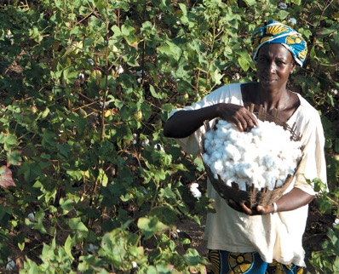
Learning expands great souls
– Namibian Proverb
………..let us demonstrate the novel Cotton technologies until we bring satisfying smile in the faces of every African cotton grower ………..
Photo source: https://inhabitat.com/ecouterre/u-s-eu-cotton-subsidies-cost-africa-250-million-a-year-says-new-report/

Slide 23


