Slide 1


The World Cotton Market: Structure and Outlook
Rebecca Pandolph
Statistician
International Cotton Advisory Committee
ACSA Cotton Institute-University of Memphis
Memphis, TN
8 June 2015

Slide 2

Overview
ICAC
Current Market Situation
  2014/15 and Country Market Shares
  Market Fundamentals
Past Trends
  Supply & demand
  Prices
  Government interventions
Outlook
  2015/16
  Long-term

Slide 3
INTERNATIONAL COTTON ADVISORY COMMITTEE
40 Governments
Formed in 1939
$1.8 million
9 employees, 8 countries
Washington, DC

Slide 4
ICAC
MISSION
Assist governments in fostering a healthy world cotton economy, by
  Providing transparency
  Clearinghouse for technical information on cotton production
  Forum for discussion of cotton issues of international significance

Slide 5
ICAC
FOUR PRIMARY FUNCTIONS
Statistics
Technical Information
Forum for Discussion and Cooperation
Liaison with International Community

Slide 6

ICAC’s Statistics on Cotton
Supply & Use
Who uses ICAC data?
How many countries are involved in the cotton sector?
Data collected for each country:
  Beginning stocks
  Production (area, yield)
  Imports
  Consumption
  Exports
  Ending stocks
= Total Supply
= Total Distribution
Notes:
Users: member governments, private sector, academia, international organizations, general public
> 60 producing countries, > 90 consuming countries, > 120 importing and/or exporting countries

Slide 7
ICAC SOURCES
Coordinating Agencies
National Organizations
World Bank, FAO, UN
Trade Publications
Government Reports
Business Contacts
Researchers

Slide 8
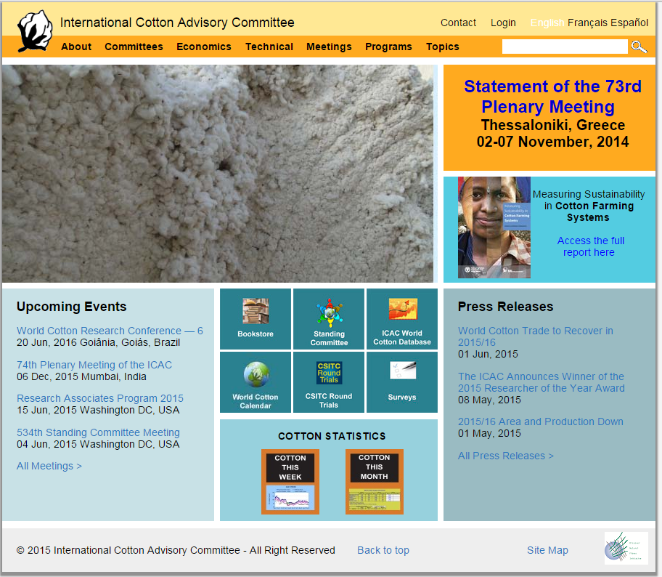
www.icac.org

Slide 9
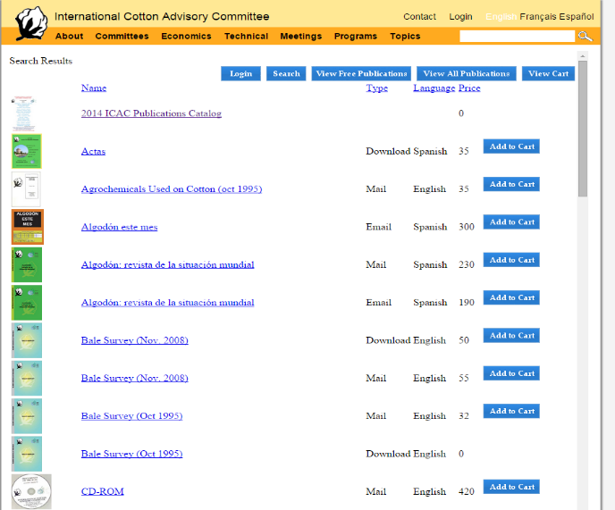
ICAC Publications

Slide 10
ICAC Publications
Quarterly:
  The Recorder
Annually:
  Cotton: World Statistics
  The Outlook for Cotton Supply
  World Cotton Trade
  World Textile Demand
  Production and Trade Policies Affecting the Cotton Industry
  Structure of World Cotton Trade

Slide 11
ICAC Publications
Quarterly:
  The Recorder
Annually:
  Cotton: World Statistics
  The Outlook for Cotton Supply
  World Cotton Trade
  World Textile Demand
  Production and Trade Policies Affecting the Cotton Industry
  Structure of World Cotton Trade

Slide 12
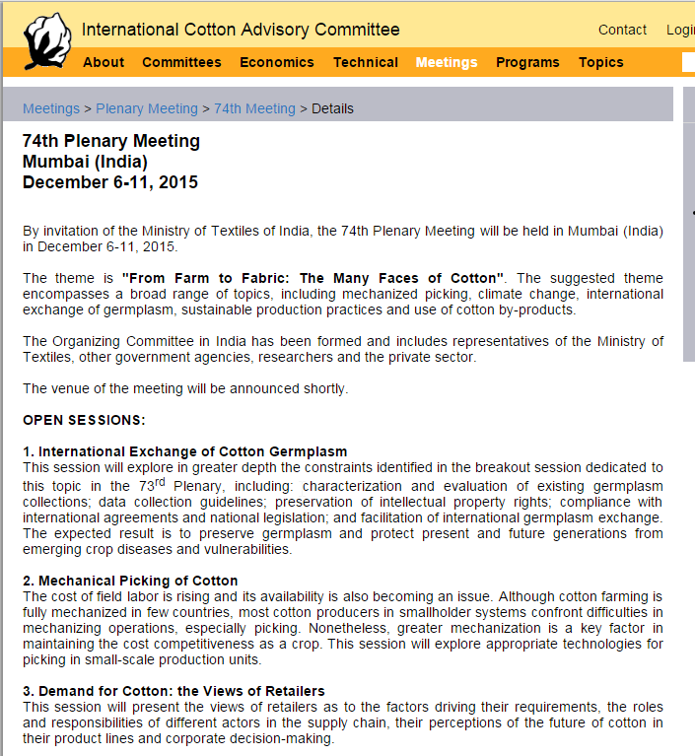
Invitation to 74th Plenary Meeting
December 6-11th 2015
https://www.icac.org/mtgs/Plenary/74th-Meeting

Slide 13
Current Market Situation
2014/15 Market and Country Market Shares

Slide 14
Cotlook A Index in 2014/15
U.S. cents/lb

Slide 15
World Cotton Area and Yield
Million hectares
Kg/ha

Slide 16
World Cotton Fundamentals 2014/15
Million tons

Slide 17
Cotton Production by Country
26.1 Million tons
Notes:
China: 6.9
India: 6.6
US: 2.8
Pakistan 2 million
Brazil 1.7
Others are just under 1 million

Slide 18
Cotton Production
Million Tons

Slide 19
Cotton Mill Use by Country
24.3 Million tons
Notes:
China 7.5
India 5.1
Pakistan 2.3
Turkey 1.4
Rest of individual countries 600-900,000

Slide 20
Cotton Consumption
Million Tons

Slide 21
Cotton Imports by Country
7.5 Million tons
Notes:
China 3 million
Bangladesh 990
Turkey 970

Slide 22
Cotton Imports
Million tons

Slide 23
Cotton Exports by Country
7.5 Million tons
Notes:
US 2.3
India 1.9
Australia 990

Slide 24
Cotton Exports
Million tons

Slide 25
Current Market Situation
Market Fundamentals

Slide 26
Statistics and Price Forecasting
ICAC
Cotton Outlook Ltd.
United Nation’s Food and Agriculture Organization/Organization of Economic and Cooperative Development
U.S. Department of Agriculture
Food and Agricultural Policy Research Institute

Slide 27
ICAC Price Model
ln(A_{t}/A_{t-1})=a*ln(X_{t}/X_{t-1})+b*ln(X_{t-1}/X_{t-2})+m_{t}*c*ln(Y_{t-1}/Y_{t-2})+(1-m_{t})*d*ln(Z_{t}/Z_{t-1})
+e*D07+f*D09+g*D10
Stock to use ratio for World Less China (X_{t})
Stock to use ratio for China (Y_{t-1})
China’s net imports (Z_{t})
https://www.icac.org/cotton-economics-and-cotton-statistics/Price-Model

Slide 28
World Supply =
Beginning Stocks + Production
World Demand =
Mill Use + Ending Stocks
World Supply = World Demand

Slide 29
World Cotton Fundamentals 2014/15
Million tons
46.2
Beginning
Stocks
Ending
Stocks
Production
Mill Use

Slide 30
World 2014/15
(million metric tons)
Beginning Stocks = 20
Production = 26.2
Supply = 46.2
Mill Use = 24.4
Ending Stocks = 21.8
Demand = 46.2
46.2 * US$1.56 per kg = $72.1 billion

Slide 31
Supply = Demand higher/lower production
= higher/lower Ending Stocks

Slide 32
Supply = Demand higher/lower mill use
= lower/higher Ending Stocks

Slide 33
Country Supply =
Beginning Stocks + Production + Imports
Country Demand =
Mill Use + Ending Stocks + Exports
Country Supply = Country Demand

Slide 34
Cotton Fundamentals 2014/15
China
Million tons
20.2
Exports
<
Imports
Beginning
Stocks
Ending
Stocks
Production
Mill Use

Slide 35
Cotton Fundamentals 2014/15
India
Million tons
8.5
Imports
Exports
Beginning
Stocks
Ending Stocks
Production
Mill Use

Slide 36
Cotton Fundamentals 2014/15
USA
Million tons
4.1
Imports
Beginning
Stocks
Exports
Production
Ending
Stocks
Mill Use

Slide 37
Important Concepts
World Ending Stocks =
Beginning Stocks + Production – Mill Use
World Stocks to Use Ratio =
Ending Stocks / Mill Use
World Ending Stocks 2014/15 = 21.8
World Mill Use 2014/15 = 24.4
World Stocks to Use Ratio 2014/15 = 21.8 / 24.4 = 0.89

Slide 38
Important Concepts
Country Ending Stocks =
Beg. Stocks + Prod. + Imports – Exports – Mill Use
Country Stocks to Mill Use Ratio =
Ending Stocks / Mill Use
Country Stocks to Use Ratio =
Ending Stocks / ( Mill Use + Exports )
INDIA:
Ending Stocks 2014/15 = 2.2
Stocks to Mill Use Ratio 14/15 = 2.2 / 5.3= 0.42
Stocks to Use Ratio 14/15 = 2.2/ (5.3 + 1 ) = 0.35

Slide 39
Cotton Consumption
↑ population, ↑ cotton consumption
↑ income, cotton consumption per capita ↑↓

Slide 40
Cotton Consumption
Low income countries:
↑ income, ↓ market share of cotton
High income countries:
↑ income, market share of cotton stable at around 40%
Outlook:
↑ cotton consumption
↓ market share of cotton

Slide 41
Past Trends
Supply and Demand

Slide 42
World Cotton Production & Mill Use
Million tons
Production
Mill Use

Slide 43
World Cotton Production & Mill Use
Million tons
2004/05 – 2006/07:
Cumulative Gap: 4.2 mill tons
A Index: -24% in 04/05
3 years to recover
Production
Mill Use

Slide 44
Growth in World Cotton Mill Use
Notes:
Rescession 08/09 Volatile prices 2010-2011

Slide 45
World Consumption of Textile Fibers
Notes:
Natural and MMF

Slide 46
World Consumption of Textile Fibers and Population
Billions People

Slide 47
World Consumption of Textile Fibers
Notes:
Cellulosic excludes filter tow
Non-Cellulosic excludes olefin.

Slide 48
Share of Cotton in World Textile Fiber Consumption
%
Average 1960-1989

Slide 49
Cotton Consumption per Capita vs. GDP per Capita 1992

Slide 50
Cotton Consumption per Capita vs. GDP per Capita 1992

Slide 51
Cotton Consumption per Capita vs. GDP per Capita 2008

Slide 52
Cotton Consumption per Capita vs. GDP per Capita 2008

Slide 53
Cotton Consumption per Capita vs. GDP per Capita 1992, 2000, 2008

Slide 54
Market Share of Cotton vs. GDP per Capita 1992, 2000, 2008

Slide 55
World Ending Stocks
Million tons

Slide 56
Past Trends
Prices

Slide 57
A Index and Stock-to-Mill Use Ratio in World Less-China
% change in Cotlook A Index
% change in SMU in World-less-China
From 1981/82 to 2013/14

Slide 58
A Index and Nearby NY Futures Prices
US cents / lb
Notes:
Updated 7/30/14

Slide 59
Season-Average A Index
(source: Cotton Outlook Ltd.)
US cents / lb
Notes:
Nominal

Slide 60
Factors Affecting Cotton Prices in 2010/11
A Index, US cents/lb

Slide 61
Price Volatility by Season:
Daily Cotlook A Index
Difference with respect to season average
Season highest value
Season lowest value
2013/14: August-September 2013
Notes:
But not only relative prices have an impact on cotton consumption. Price volatility is a major factor too. Price volatility measures the dispersion of prices, or the fluctuation of prices over a certain period of time. This slide shows the dispersion of the highest and the lowest value of the A Index during each season with respect to the season average. In 2010/11 volatility peaked and has retrenched since to average levels. But the impact of that record season made cotton a riskier business (and therefore more difficult to finance).
In 2012/13, volatility was below the long term average, and so far we have seen little changes in prices in 2013/14, but history shows that higher volatility will return at some point in the future.

Slide 62
Relative Price of Cotton to Polyester (Annual)
Ratio

Slide 63
Cotton and Chinese
Polyester Prices
US cents/lb
*Weekly quotes (Source: Cotton Outlook Ltd.)

Slide 64
Cotton Lint and
Cotton Yarn Indexes*
Weekly Index*
Cotlook A Index
Yarn Index
* Average 2005 = 100 ; Source: Cotton Outlook

Slide 65
Past Trends
Government Interventions

Slide 66
Cotlook A Index
U.S. cents/lb
2014/15

Slide 67
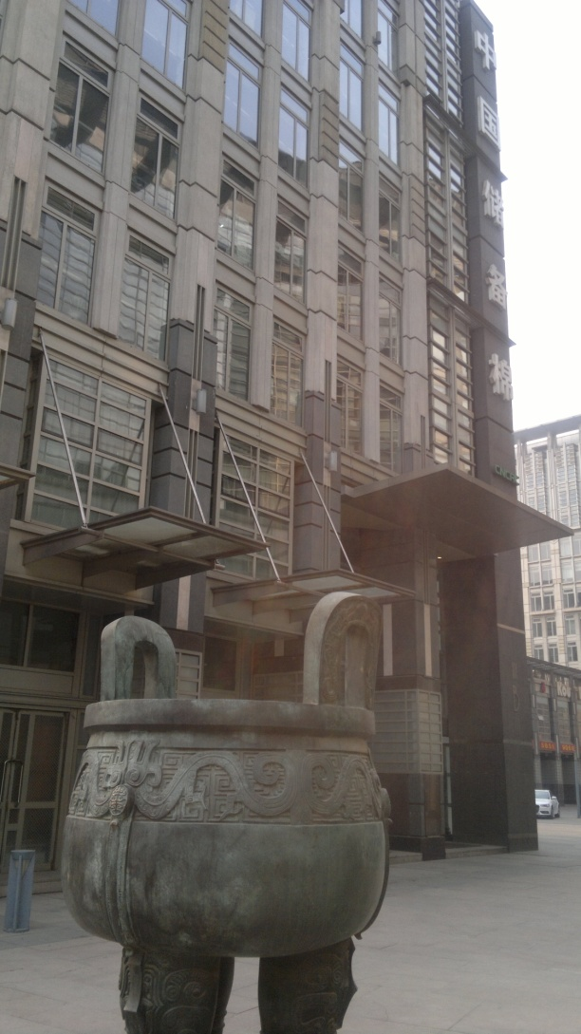
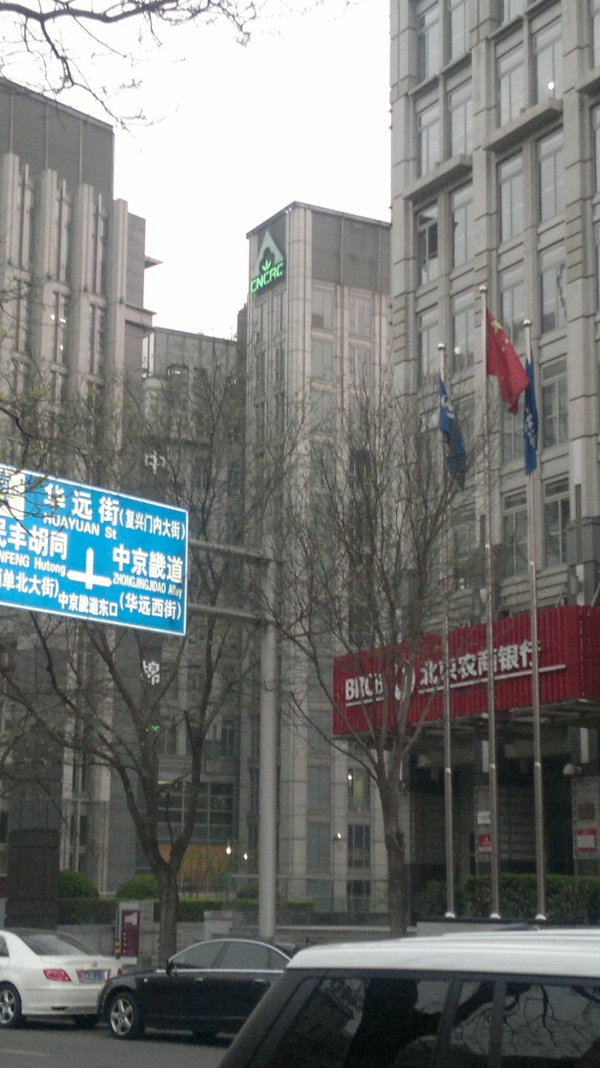
Why not lower?
China National Cotton Reserve Corporation (CNCRC)

Slide 68
Government Interventions that sustained cotton prices
Chinese National Reserve Corporation:
11 million tons in 2011/12 to 2013/14
India: export ban March – May 2012. Exports August - March 2012: 1.6 million tons.

Slide 69
Purchases of Cotton by the Chinese National Reserve
Thousand tons
Million tons

Slide 70
Estimated Size of China National Reserve
Million tons

Slide 71
World Ending Stocks
Million Tons
Stock to Use Ratio

Slide 72
Direct Assistance to Cotton Production
Direct support to production
Border protection
Crop insurance subsidies
Minimum support price mechanisms
Input subsidies
Transportation subsidies

Slide 73
DIRECT ASSISTANCE TO COTTON
Billion US$

Slide 74
DIRECT ASSISTANCE TO COTTON
AND PRICES
Billion US$
A Index (US$/lb)

Slide 75
WORLD PRODUCTION UNDER DIRECT ASSISTANCE
Million Tons
Average With Assistance: 55%

Slide 76
DIRECT ASSISTANCE TO COTTON

Slide 77
2015/16 Outlook

Slide 78
Price of cotton vs. competing crops at planting time
Ratio
Notes:
Planting time: February-March for all crops except wheat (sept-oct average of the previous fall).

Slide 79
2010 = 100
Crude Oil Prices
(World Bank Pink Sheet Monthly Prices)
Fertilizer Prices
(World Bank Fertilizer Index)
2010 = 100
Notes:
79

Slide 80
World Cotton Area and Prices
US cents / lb
Million Hectares

Slide 81
World Average Yield
(rainfed + irrigated)
Kg/ha
Notes:
Updated on 1 2012

Slide 82
World Cotton Production & Mill Use
Million tons
Production
Mill Use

Slide 83
World Supply =
Beg. Stocks + Production
Million tons
Prod. S. Hem.
Prod. N. Hem.
Beginning Stocks
46

Slide 84
World Begging Stocks
Million tons
22

Slide 85
World Production
Million tons
Southern Hem.
Northern Hem
24

Slide 86
Major Cotton Producing Countries in the Northern Hemisphere
Million Tons

Slide 87
Cotton Production
Million Tons

Slide 88
Cotton Exports
Million tons

Slide 89
World Demand =
Ending Stocks + Mill Use
Million tons
Mill Use
Ending Stocks
46

Slide 90
Growth in World Cotton Mill Use
Growth in World GDP
Notes:
Our short term projections depend heavily on prices and growth in world GDP.

Slide 91
Cotton Consumption
Million Tons

Slide 92
Cotton Imports
Million tons

Slide 93
Cotton Imports
Million tons

Slide 94
World Ending Stocks
Million tons
Stocks-to-Use Ratio

Slide 95
Ending Stocks
Million tons

Slide 96
Cotlook A Index
Season-average (US cents/lb)

Slide 97
Prices in 2015/16
Dependent on effects of Chinese policy
Production vs. Consumption
Recovery of World Economy

Slide 98
Futures Prices
(Dec-14 & Jul-15 contracts)
US cents / lb

Slide 99
Settlement Prices for Cotton Futures Contracts as of July 30
Cents/lb

Slide 100
Cotlook A Index
Season-average (US cents/lb)

Slide 101
Long Term Outlook

Slide 102
World Cotton Area
Million Hectares
Notes:
Updated to September 1

Slide 103
Biotec cotton area
(percentage of world total)
Notes:
Updated as of September 2010

Slide 104
Average World Yield
Kg/ha
Notes:
Updated 6/8/11

Slide 105
Technological Changes in Agriculture
Mechanization
Synthetic fertilizers
Insecticides
Herbicides
Biotechnology
?

Slide 106
World Cotton Production
Million Tons

Slide 107
Season-Average Cotlook A Index
ICAC forecast
Cents/lb
Notes:
As of July 15, 2009

Slide 108
World Consumption of
Textile Fibers
Million tons

Slide 109
Notes:
So our long term projections foresee that while total cotton consumption will continue to grow, the market share of cotton among all textile fibers will continue to decline, possible to 25% by 2025.

Slide 110
Outlook for Merchants
Fewer and bigger ( ↑ concentration )
More multi-commodity merchants
Fewer cotton-only merchants

Slide 111
Increasing Capital Requirements
2007: $6 loan per $1 equity
2010 & 2012: $3 loan per $1 equity
Notes:
trend in cotton's share of world fiber use

Slide 112
Bigger merchants command bigger sales
Average Sales Volume,
Thousand tons

Slide 113
The World Cotton Market: Structure and Outlook
Rebecca Pandolph
Statistician
International Cotton Advisory Committee
ACSA Cotton Institute-University of Memphis
Memphis, TN
8 June 2015

